Slide 1

D-19, Harthala Industrial Estate, Kanth Road, Moradabad – 244001 - INDIA. Tel:+91-591-2451288 / Mobile: +91- 9837045600,
E-mail : amit@poojaint.net

Slide 2
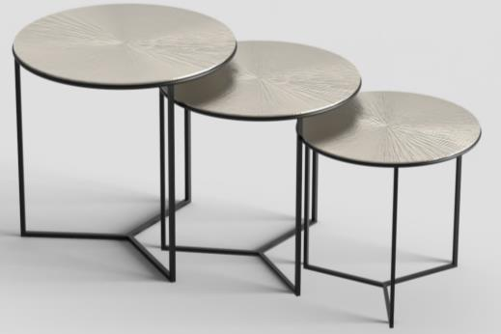
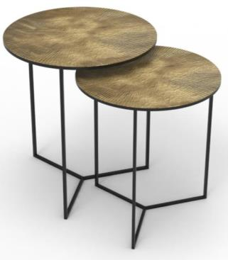
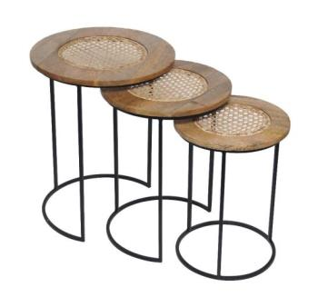
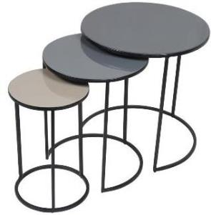
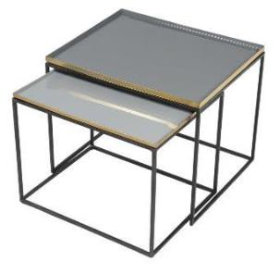
NESTING
TABLES

Slide 3
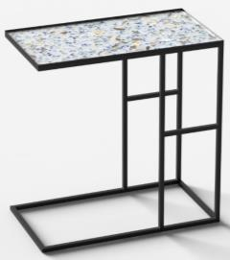
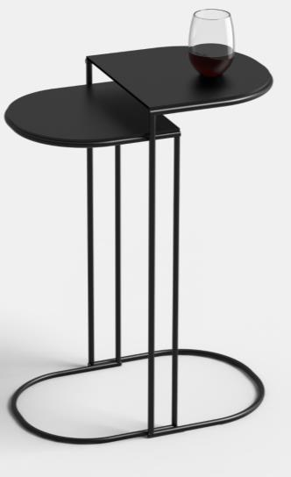
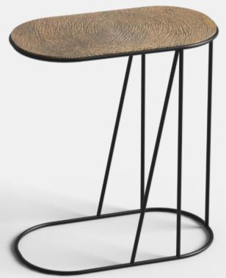
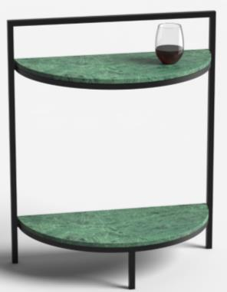
C-TABLES

Slide 4
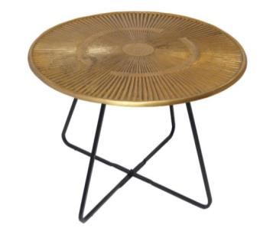
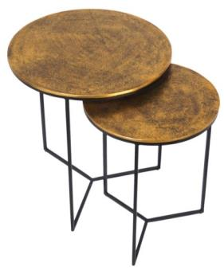
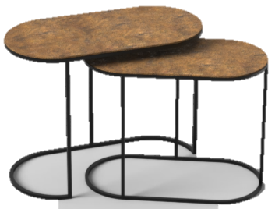
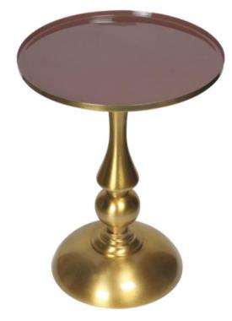
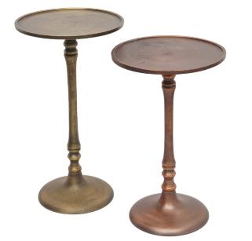
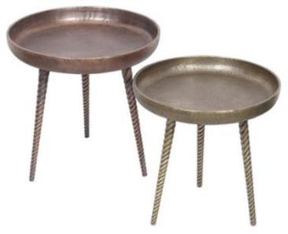
ACCENT
TABLES

Slide 5
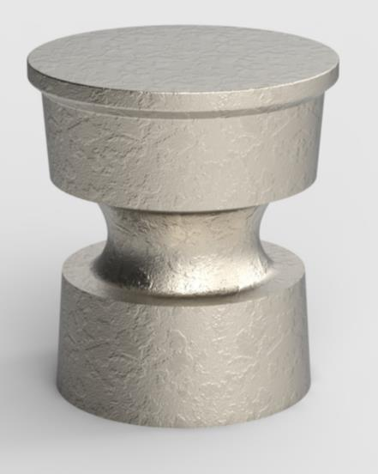
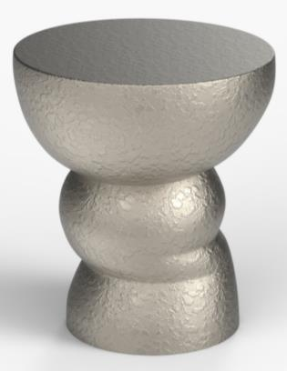
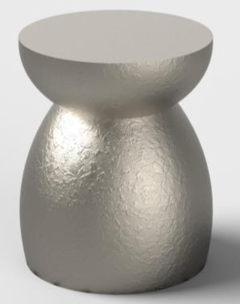
ACCENT
TABLES

Slide 6
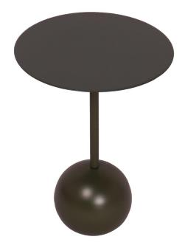
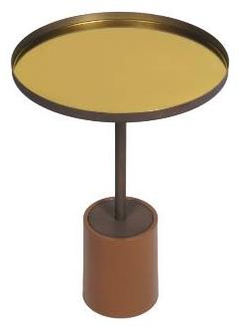
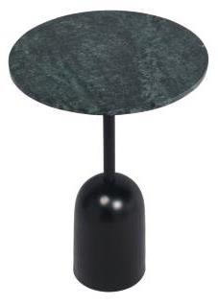
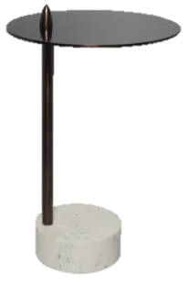
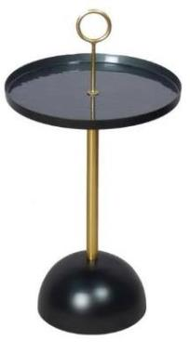
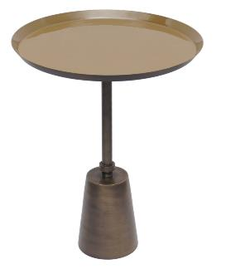
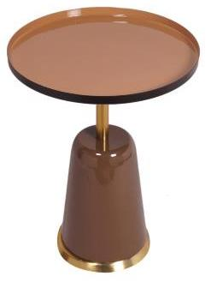
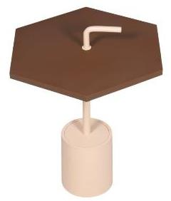
ACCENT
TABLES

Slide 7
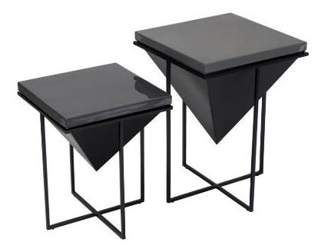
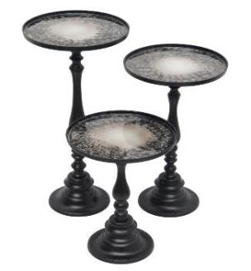
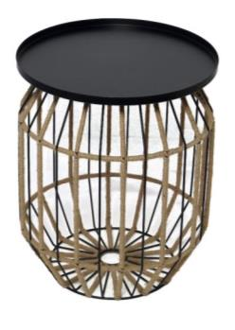
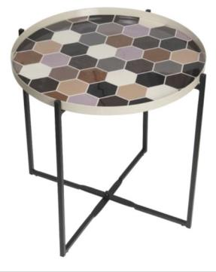
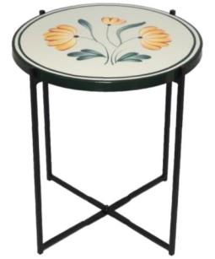
ACCENT
TABLES

Slide 8
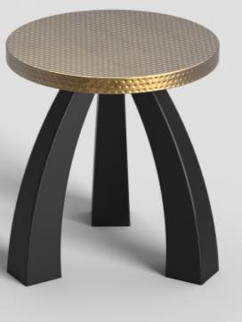
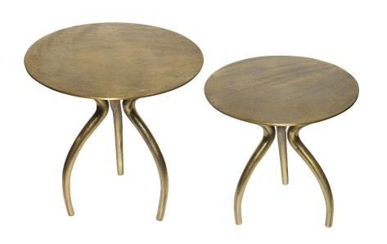
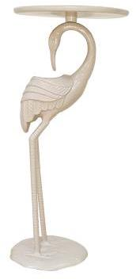
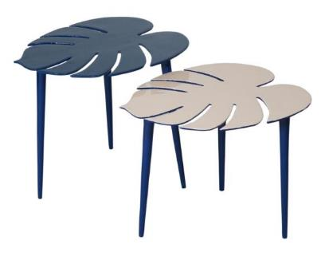
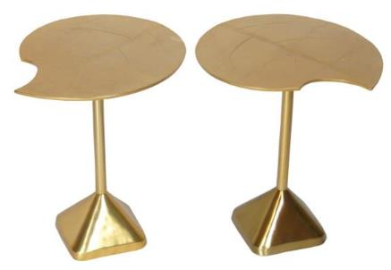
ACCENT
TABLES

Slide 9
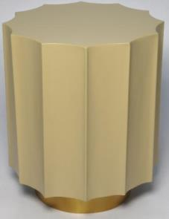
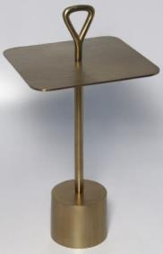
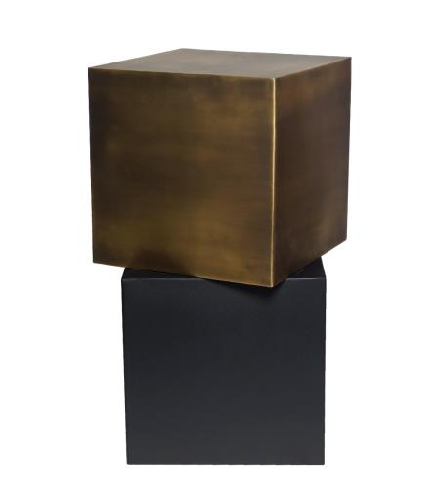
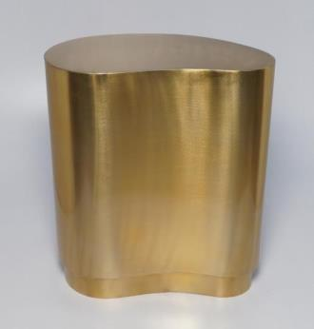
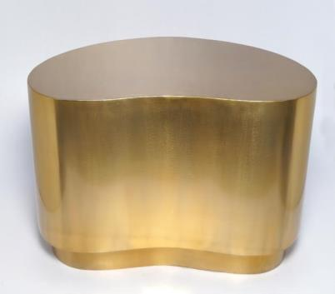
ACCENT
TABLES

Slide 10
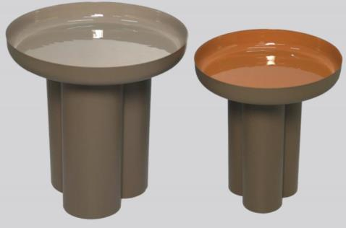
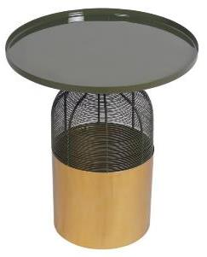
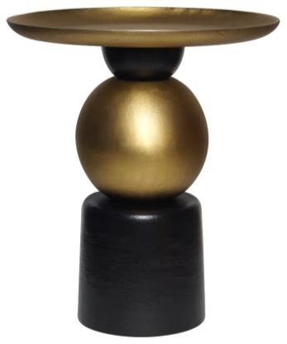
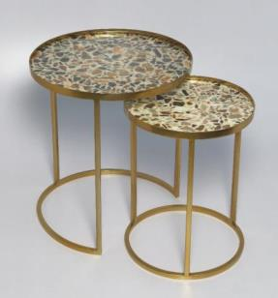
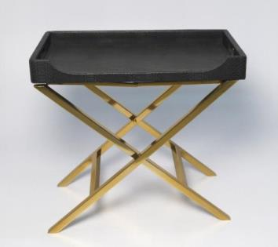
ACCENT
TABLES

Slide 11
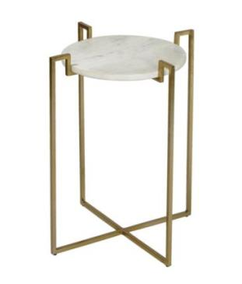
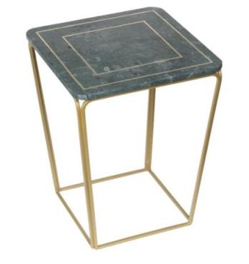
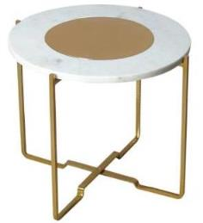
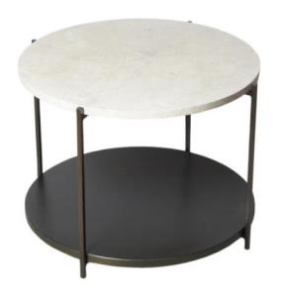



MARBLE & METAL
TABLES

Slide 12






MARBLE & METAL
TABLES

Slide 13





MARBLE & METAL
TABLES

Slide 14




CENTER
TABLES

Slide 15






GLASS/METAL
TABLES

Slide 16



MIRROR
TABLES

Slide 17





CAST GLASS &
METAL TABLES

Slide 18






TABLE
COLLECTION

Slide 19






SIDE TABLE
COLLECTION-TERRAZZO FINISH

Slide 20






SIDE TABLE
COLLECTION-TERRAZZO FINISH

Slide 21






BARCART

Slide 22



COAT
RACK

Slide 23





RACKS

Slide 24







LANTERN
COLLECTION

Slide 25







LANTERN
COLLECTION

Slide 26




VASES

Slide 27







VASES

Slide 28







VASES

Slide 29







VASES

Slide 30






STORAGE
BOX

Slide 31






BOWLS

Slide 32





BOWLS

Slide 33






HAMMERED COLLECTION

Slide 34





STORAGE
BOWLS

Slide 35





TRAYS

Slide 36






TRAYS

Slide 37







CANDLE
HOLDER

Slide 38






CANDLE
HOLDER

Slide 39





CANDLE
HOLDER

Slide 40





WAX
VOTIVE

Slide 41





WAX
VOTIVES

Slide 42



HANGING
PLANTER

Slide 43








FLOOR
PLANTER

Slide 44




WALL
SHELF

Slide 45




WALL
SHELF

Slide 46




WALL
SHELF

Slide 47






WALL
MIRROR

Slide 48




CHOPPING
BOARD

Slide 49






CHOPPING
BOARD

Slide 50







MARBLE
COLLECTION

Slide 51






COASTER

Slide 52




CUTLERY

Slide 53







DECOR

Slide 54



GLOBE

Slide 55



PHOTO
FRAME

Slide 56





POUF
& BENCH

Slide 57





NATURAL
COLLECTION

Slide 58






GLASS/METAL
COLLECTION

Slide 59




ORANGE
COLLECTION

Slide 60





GOLD
COLLECTION

Slide 61




GREEN EMBOSSED
COLLECTION

Slide 62





WOOD & METAL
WIRE COLLECTION

Slide 63




WOODEN/DECAL
COLLECTION

Slide 64




RUST
COLLECTION

Slide 65





BLACK & GOLD
COLLECTION

Slide 66





GREY TEXTURE
COLLECTION

Slide 67





WATER CANE
COLLECTION

Slide 68






WALL
MIRROR

Slide 69





GLASS
WITH NATURAL

Slide 70




HANGING
LAMPS

Slide 71






NATURAL
COLLECTION

Slide 72






NATURAL
COLLECTION

Slide 73




NATURAL
COLLECTION

Slide 74




BOOK ENDS
COLLECTION

Slide 75



UMBRELLA
HOLDERS

Slide 76





CHRISTMAS
COLLECTION

Slide 77



BAR ACCESSORIES

Slide 78



METAL
COLLECTION

Slide 79




WIRE
BASKETS

Slide 80




BATH SET

Slide 81

THANK YOU
D-19, Harthala Industrial Estate, Kanth Road, Moradabad – 244001 - INDIA. Tel:+91-591-2451288 / Mobile: +91- 9837045600,
E-mail : amit@poojaint.net

