Slide 1

INDIAN TEXTILE INNOVATION
BEDDING COLLECTIONS
DUVETS + PILLOW CASE

Slide 2
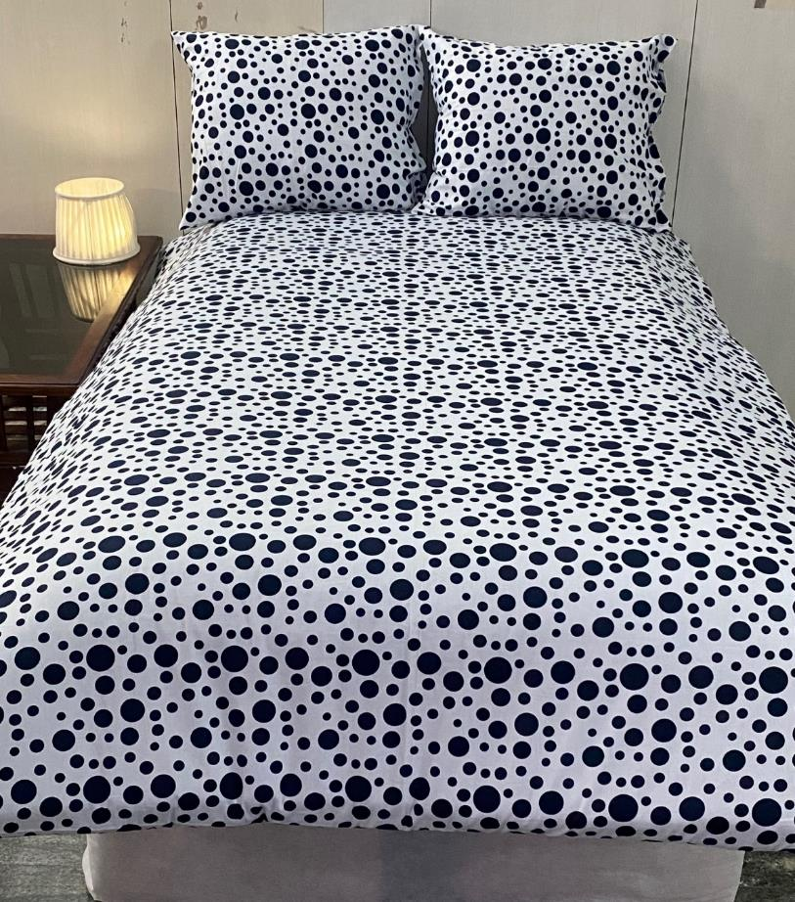
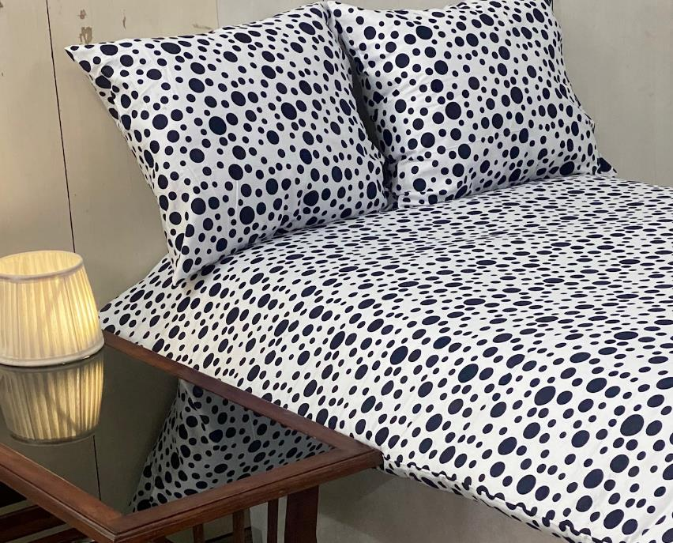
INDIAN TEXTILE INNOVATION
ITI BS - 101 / DOTS PRINTS
White / Black

Slide 3
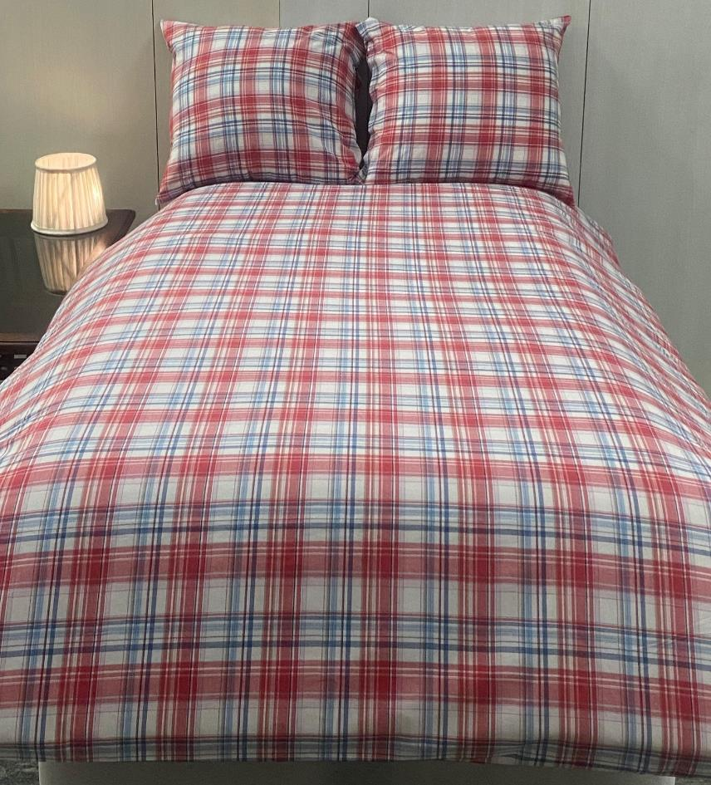
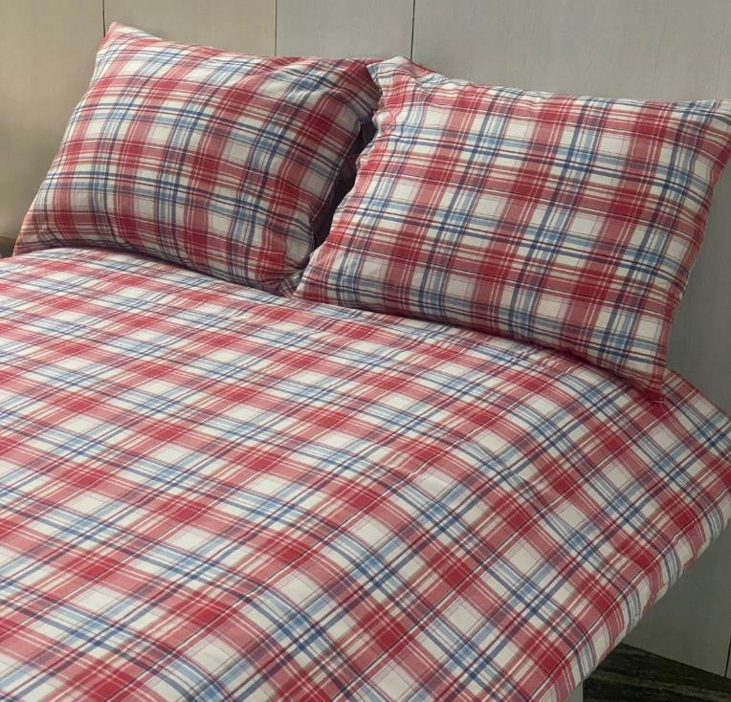
INDIAN TEXTILE INNOVATION
ITI BS - 102 / CHECK DESIGN
White / Rust / Blue

Slide 4
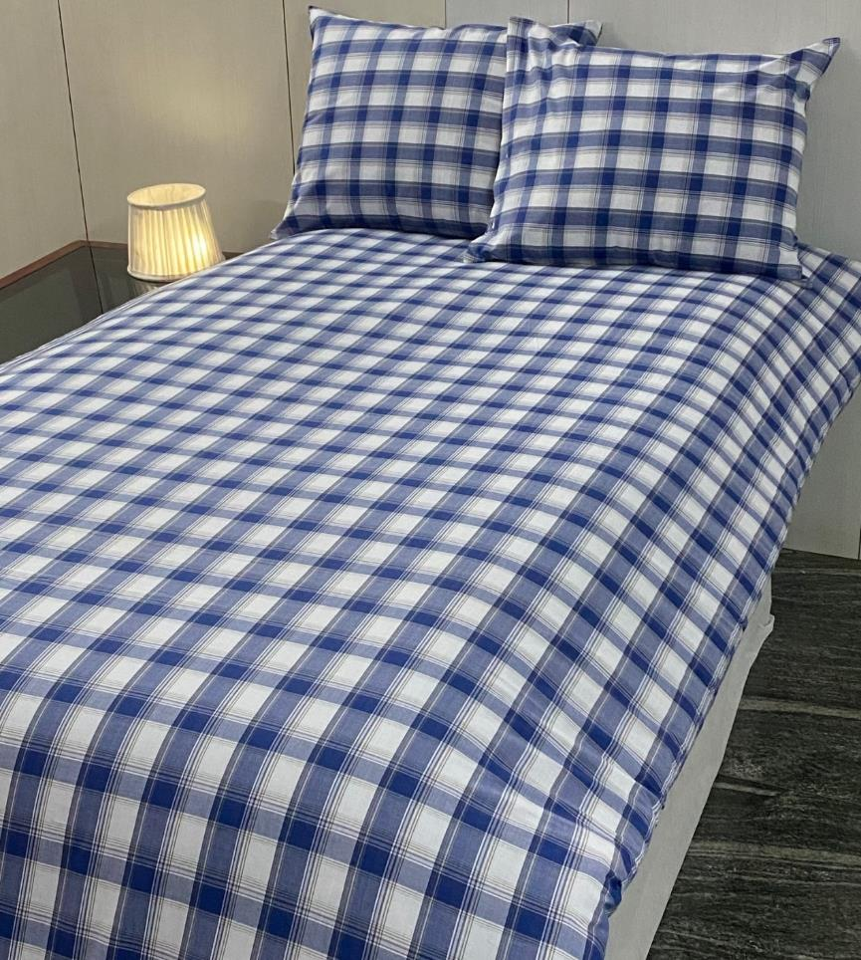
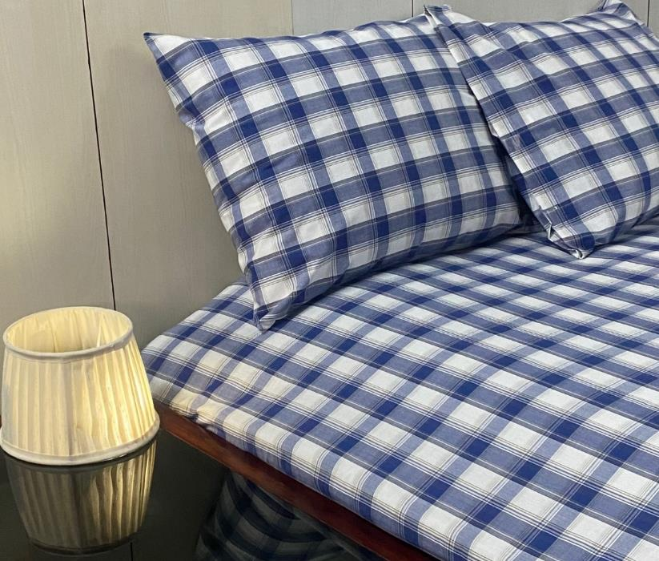
INDIAN TEXTILE INNOVATION
ITI BS - 103 / CHECK DESIGN
Blue / White

Slide 5
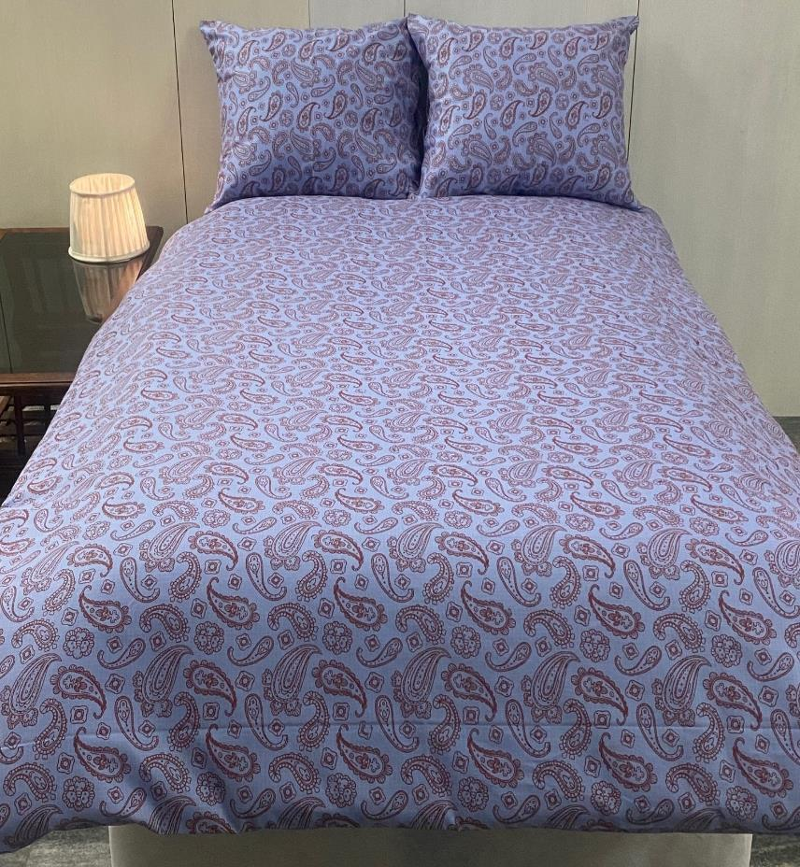
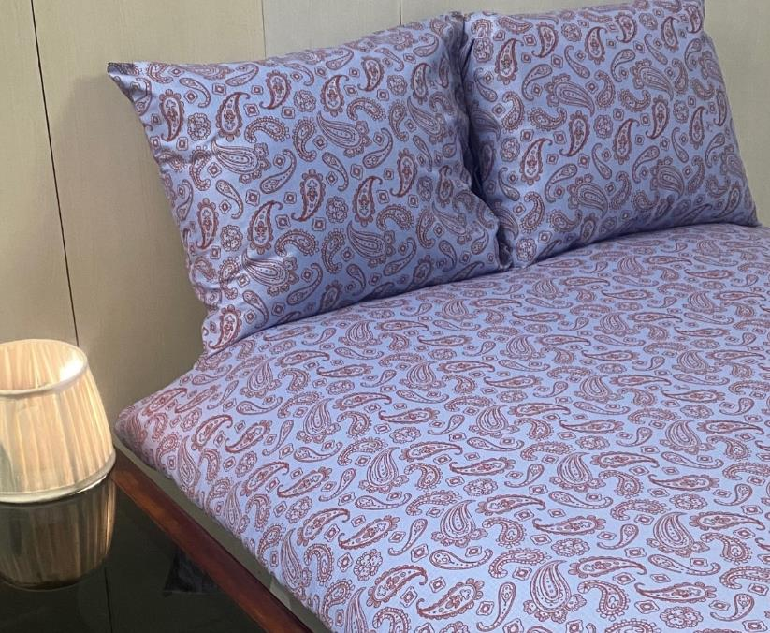
INDIAN TEXTILE INNOVATION
ITI BS - 104 / PAISLEY PRINTS
Purple / Brown

Slide 6
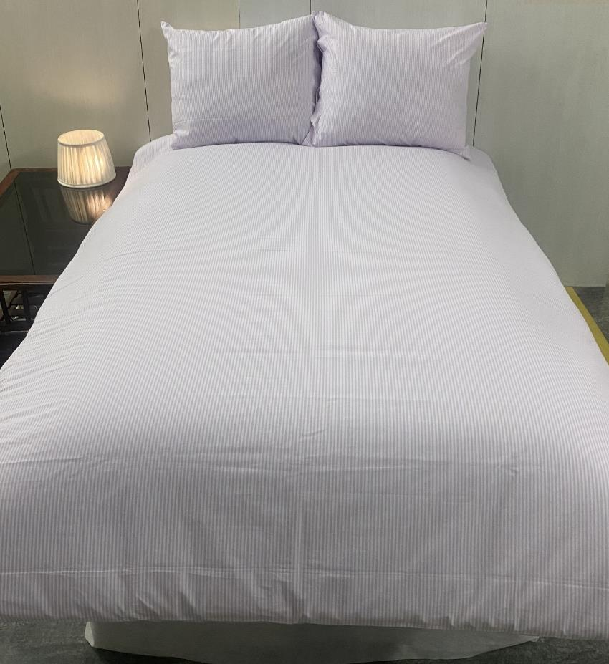
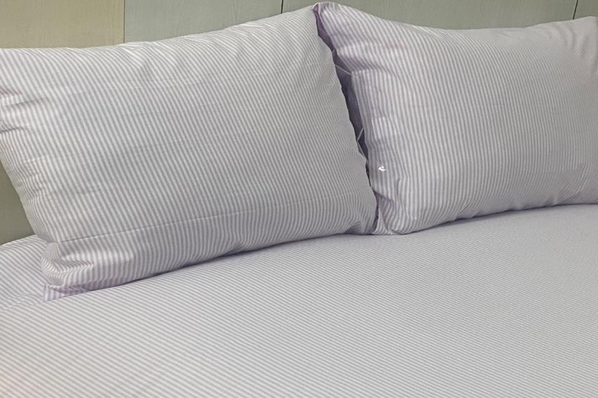
INDIAN TEXTILE INNOVATION
ITI BS - 105 / PIN STRIPES
White / Pink

Slide 7
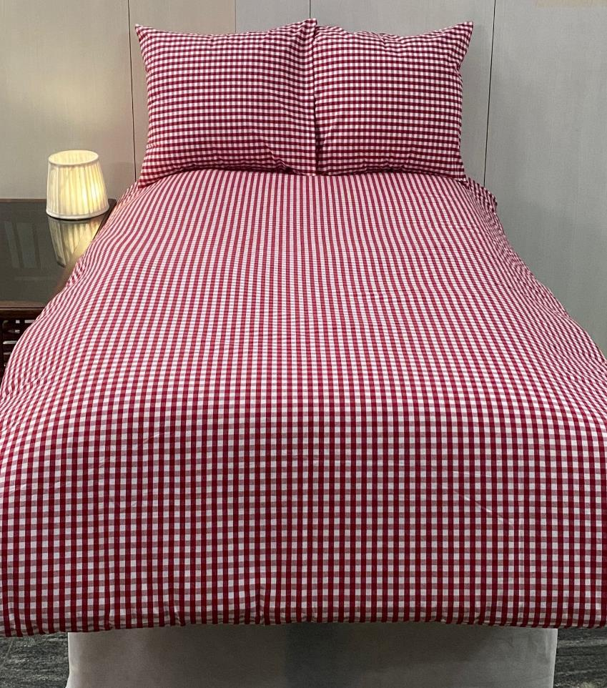
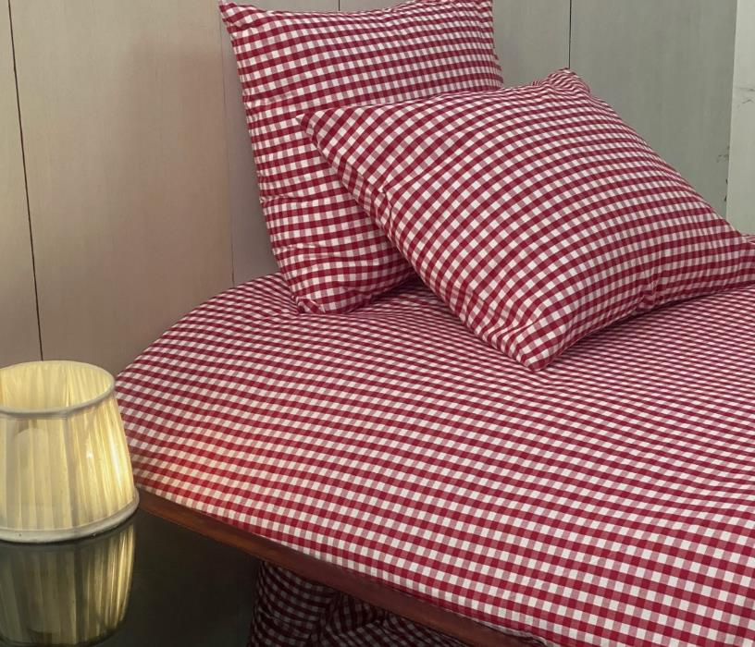
INDIAN TEXTILE INNOVATION
ITI BS - 106 / GINGAM CHECK DESIGN
Red / White

Slide 8
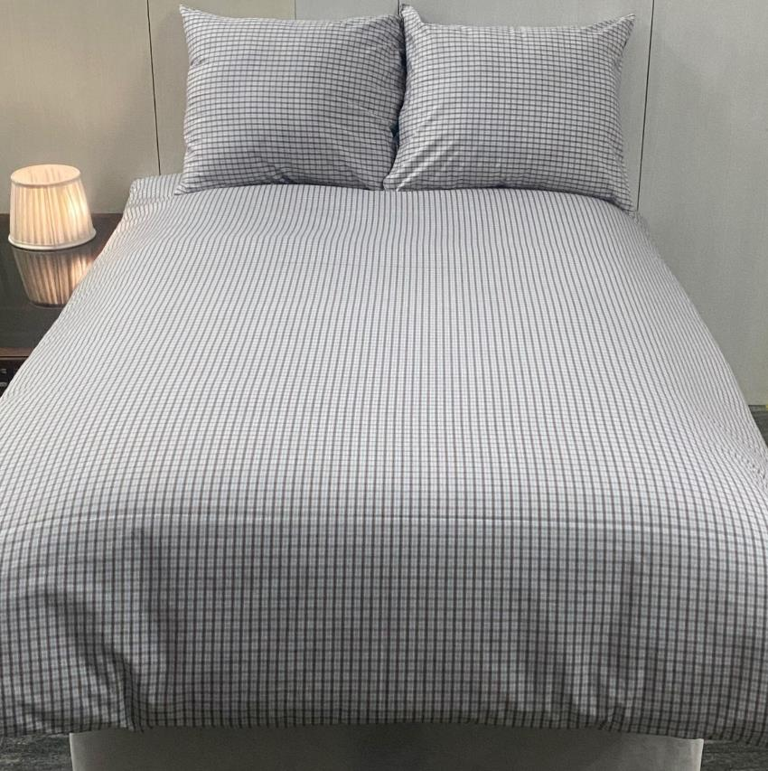
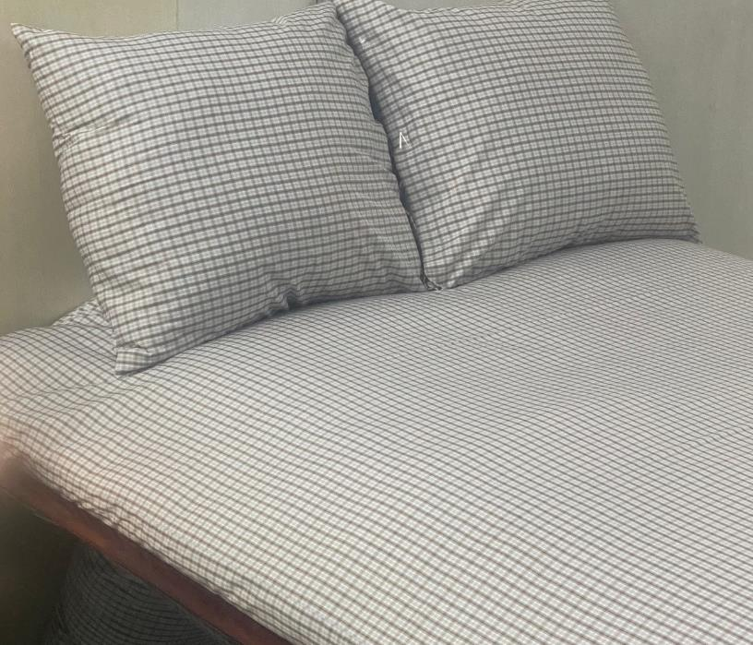
INDIAN TEXTILE INNOVATION
ITI BS - 107 / CHECK DESIGN
White / Brown

Slide 9
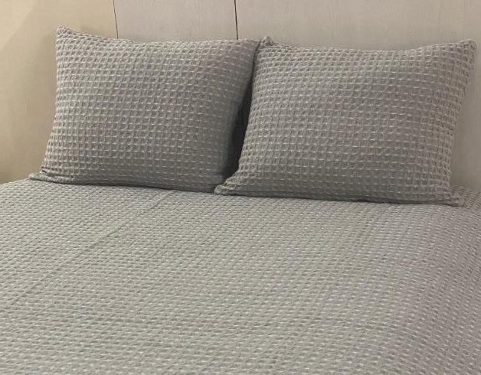
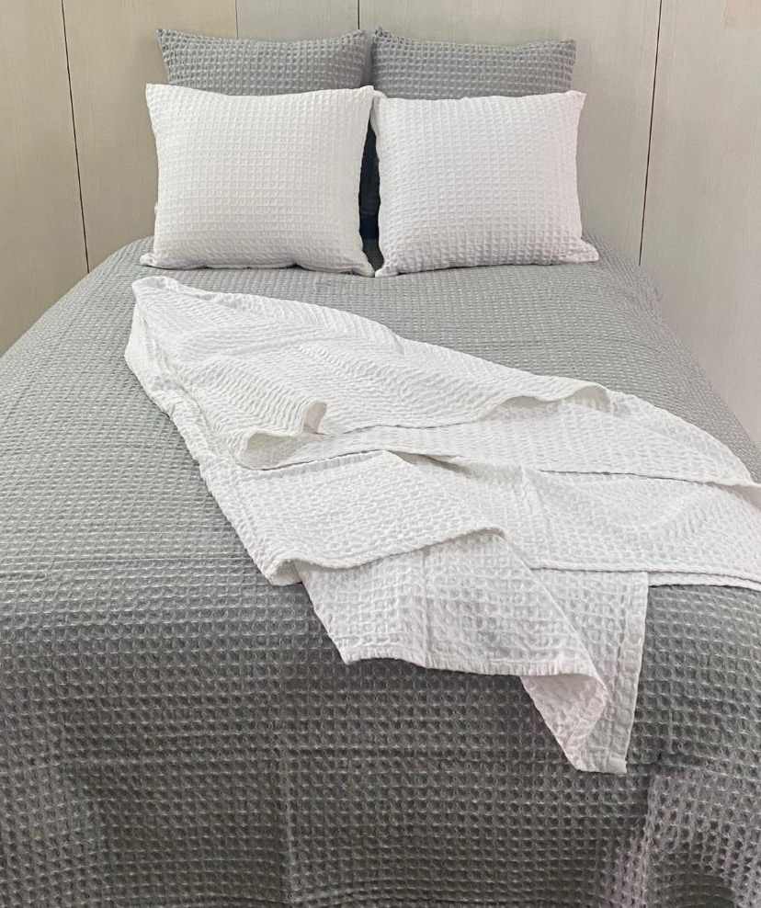
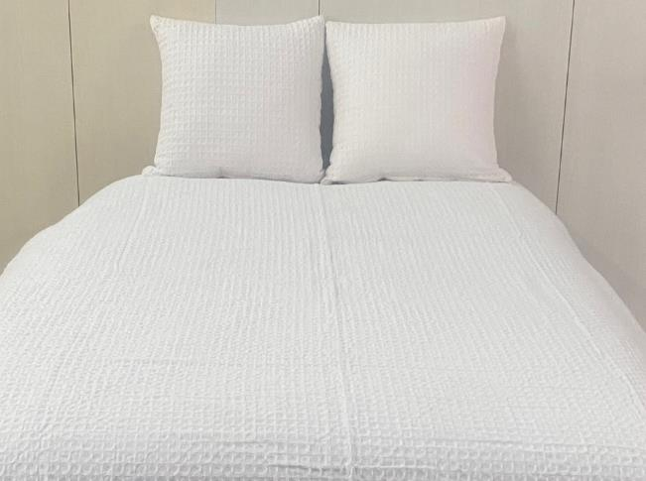
INDIAN TEXTILE INNOVATION
ITI BS - 108 / White Waffle & ITI BS - 109 / Grey Waffle

Slide 10
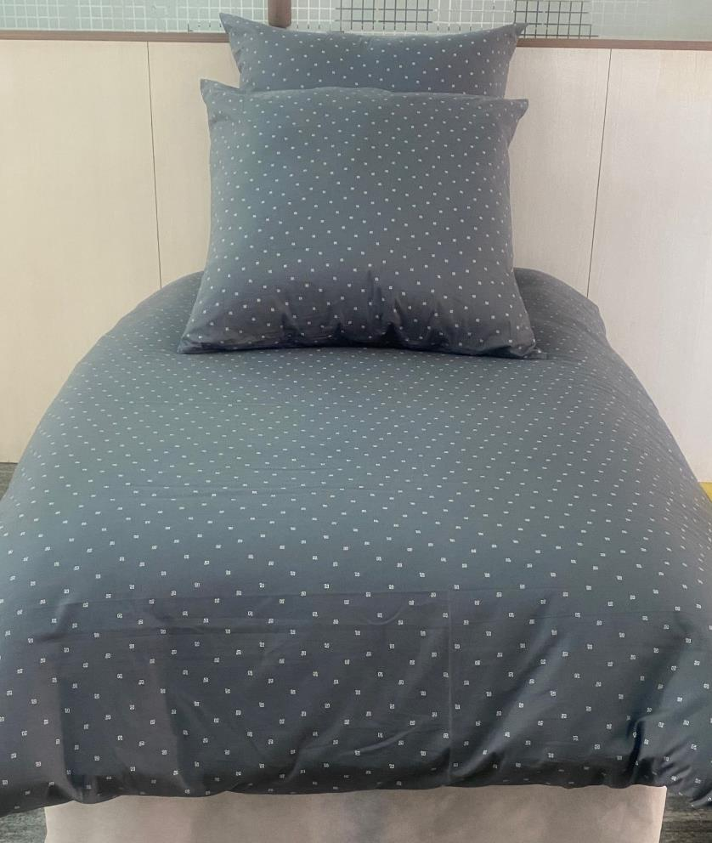
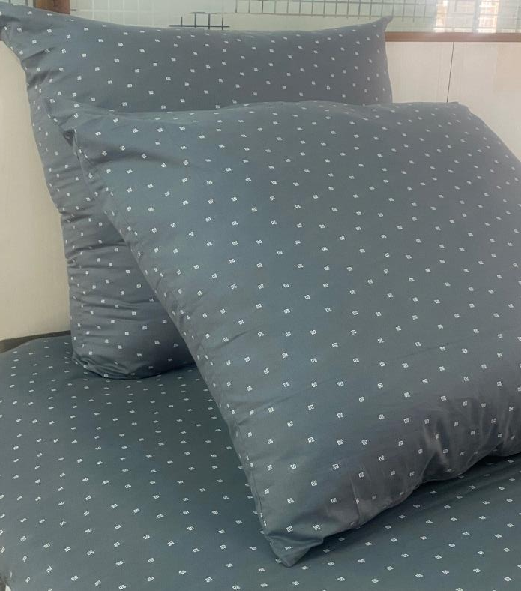
INDIAN TEXTILE INNOVATION
ITI BS - 110 / DOTS PRINTS
Dark Blue / White

Slide 11
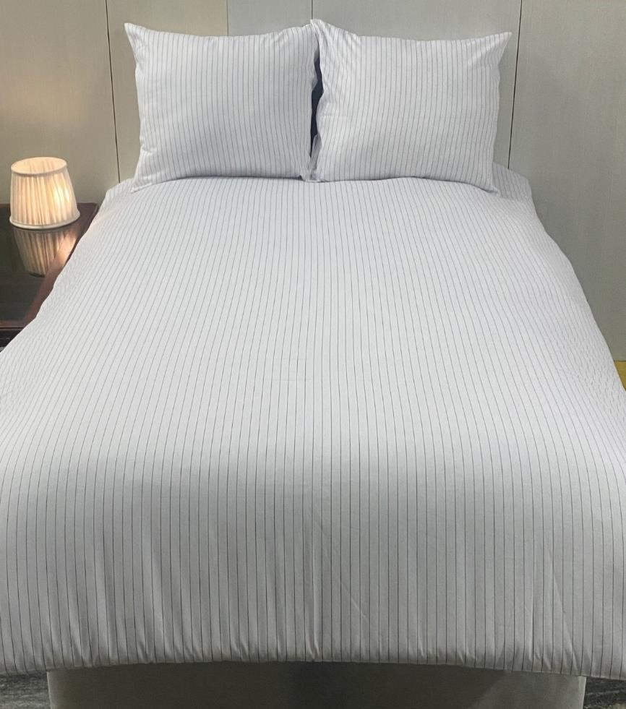
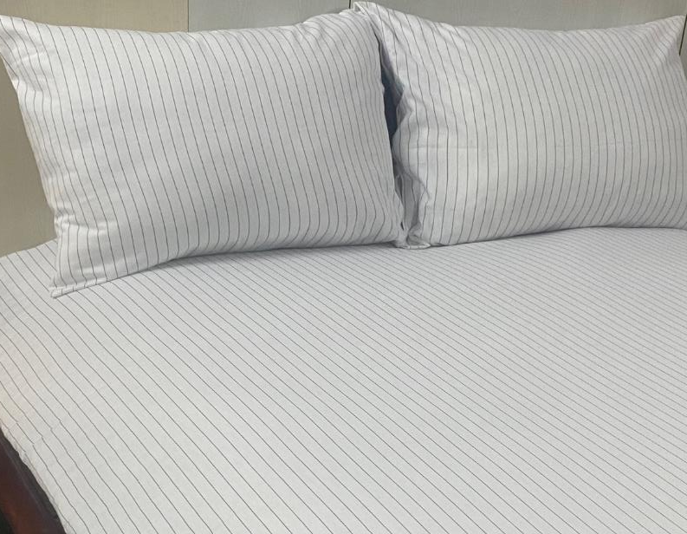
INDIAN TEXTILE INNOVATION
ITI BS - 111 / STRIPES
White / Grey

Slide 12
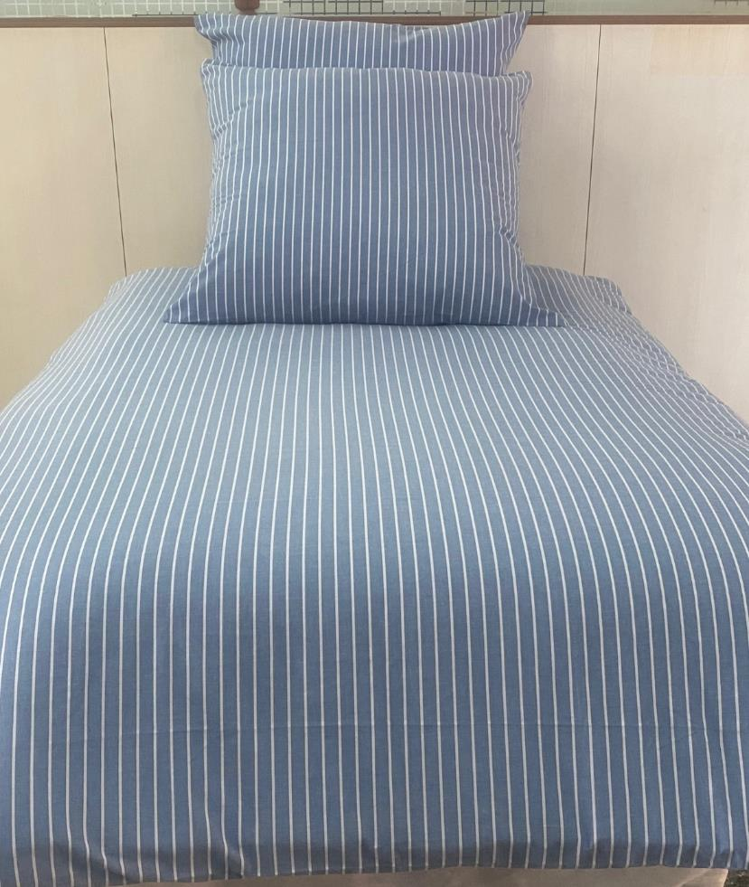
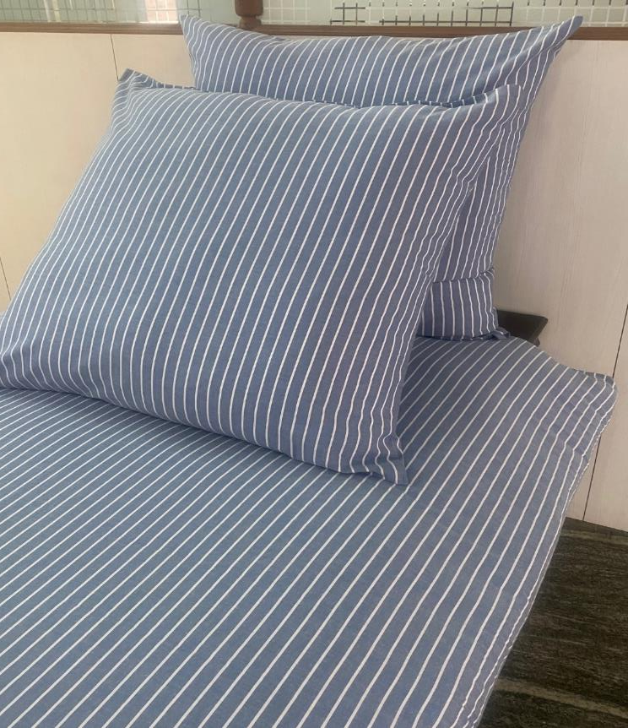
INDIAN TEXTILE INNOVATION
ITI BS - 112 / STRIPES
Dark Blue / White

