Slide 1

HOMME TEXTILE
A GOVT. OF INDIA RECOGNISED STAR EXPORT HOUSE
https://hommetextile.com/

Slide 2
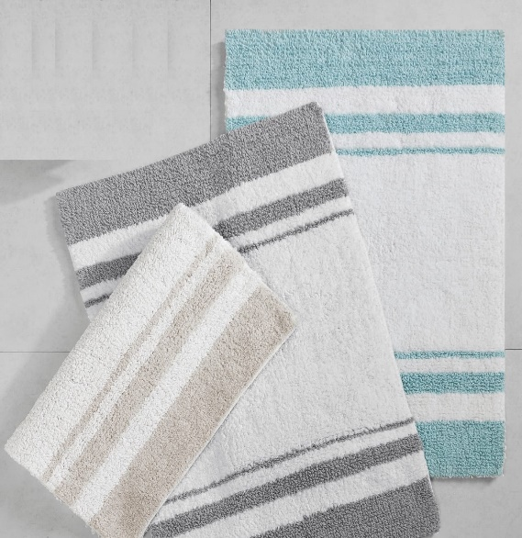
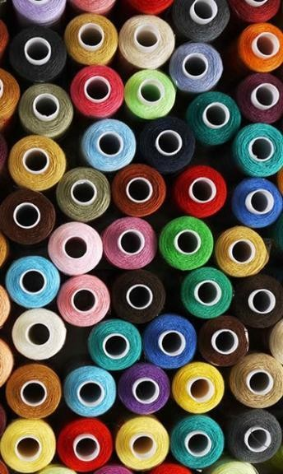

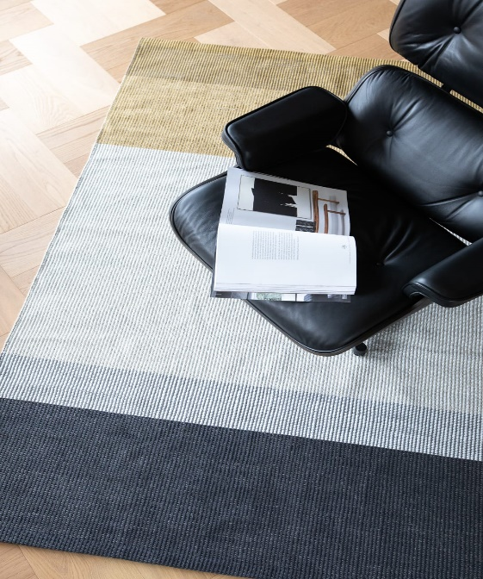
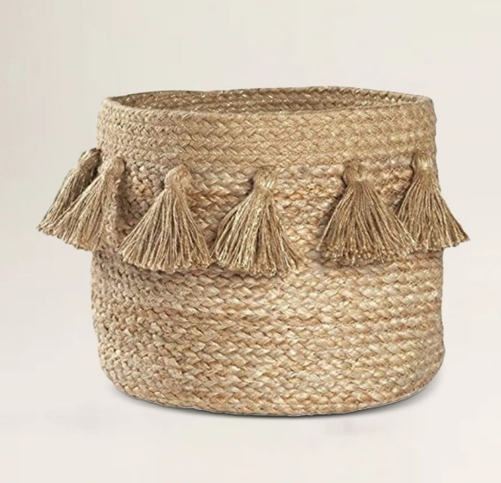
At HOMME TEXTILE, we create complete home decor solutions from outdoor to indoor. Including Cushions, Rugs, Carpets & Bathmats.
Our collection features an exclusive design to enhance the beauty of your dream home. Each product is made to give an extra visual to attract eyes. Our products fuses diligent craftsmanship with modern style.
They are created with classic hand weaving techniques and modern artful accents to recite a tale that is both timeless and personal.
Fibers we used - Cotton, PET, Wool, Micro polyester, Jute.

Slide 3
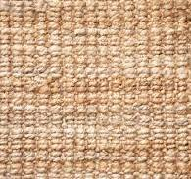
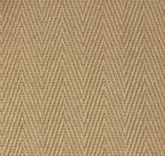
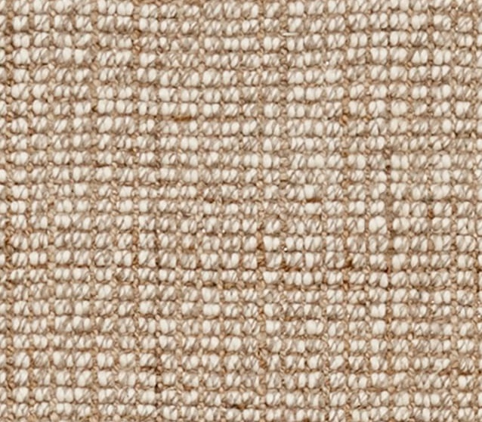
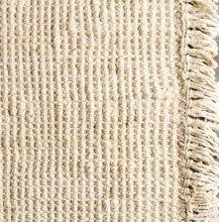
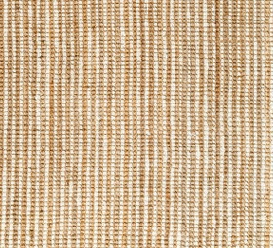
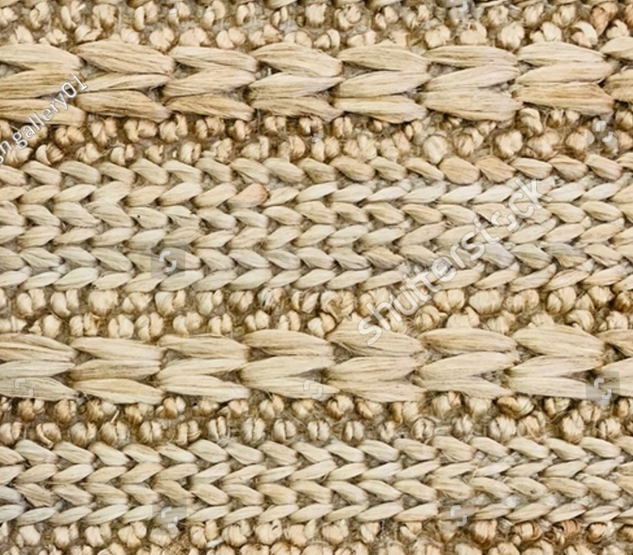
JUTE RUGS TEXTURED

Slide 4
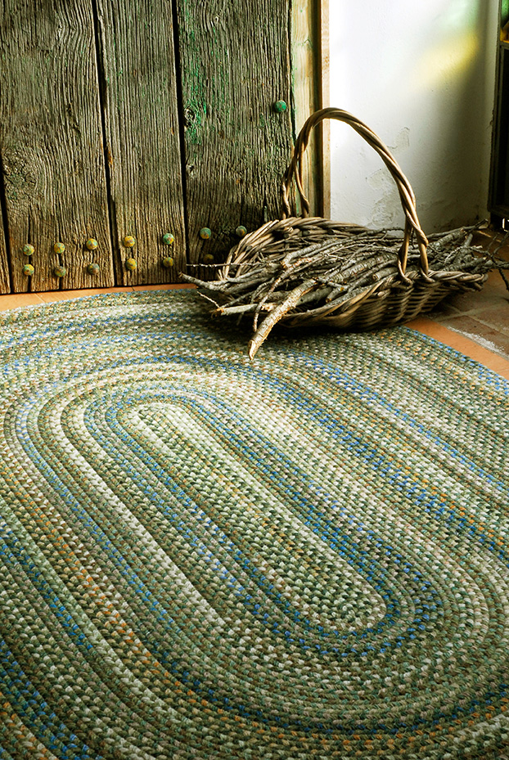
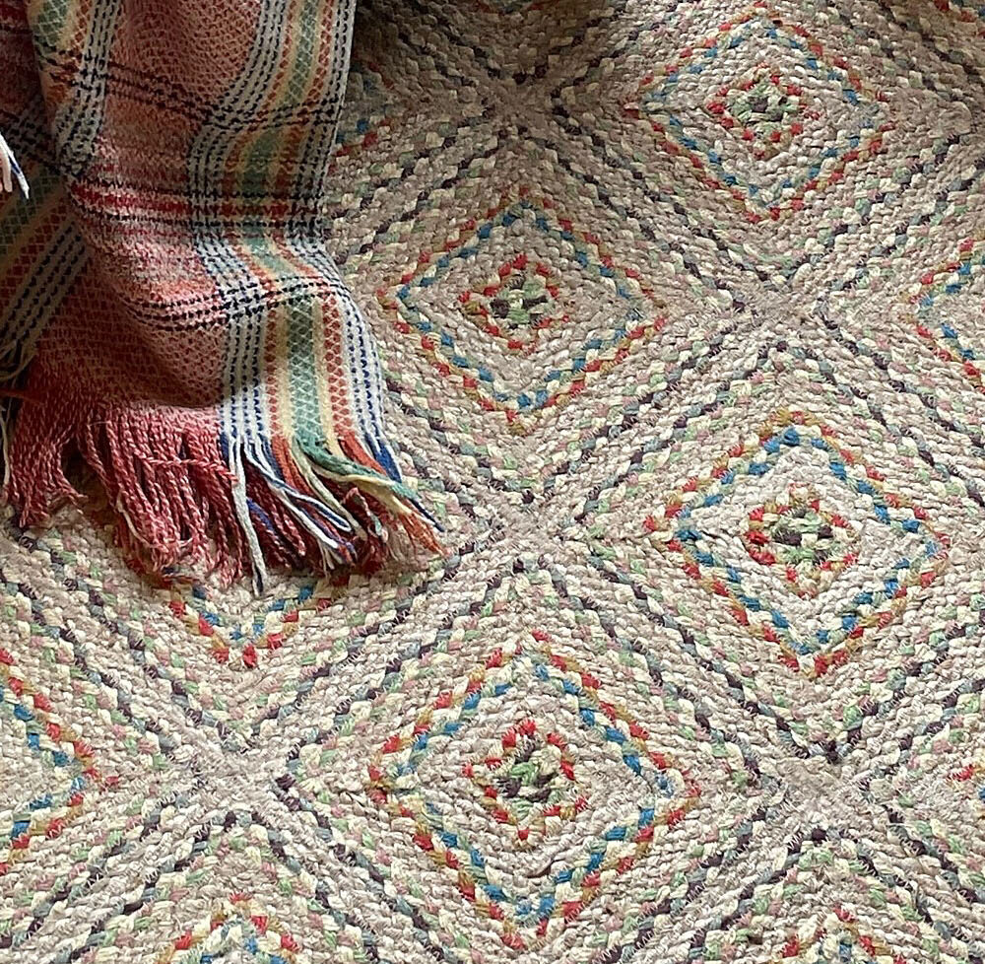
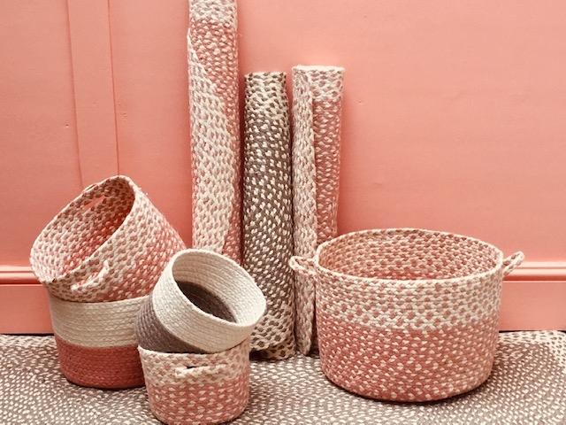
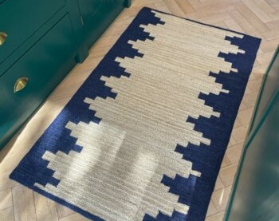
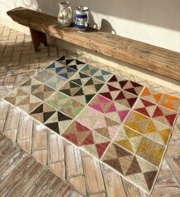
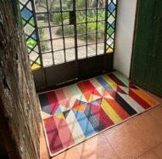
BRAIDED RUGS & BASKET

Slide 5
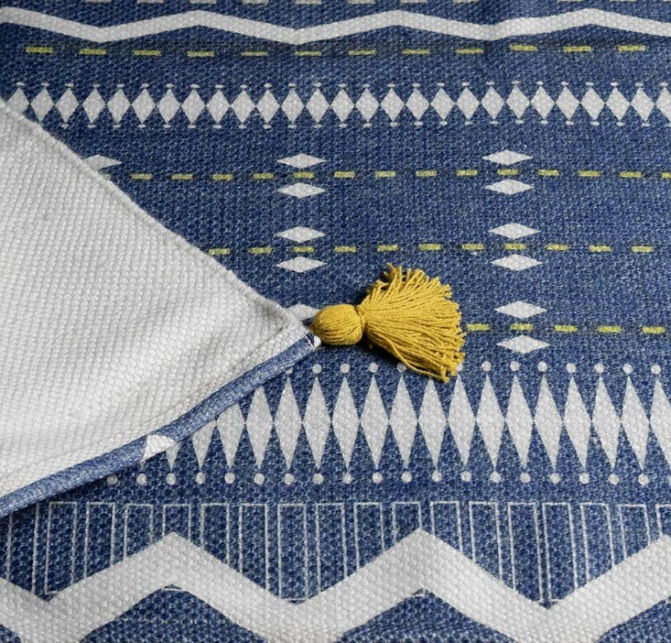
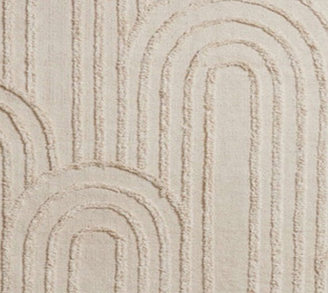
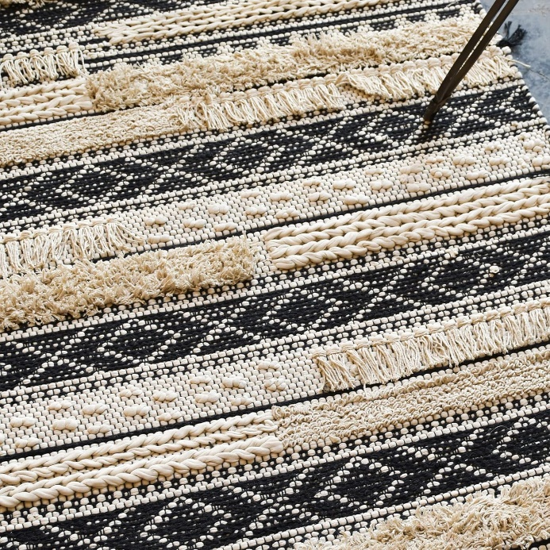
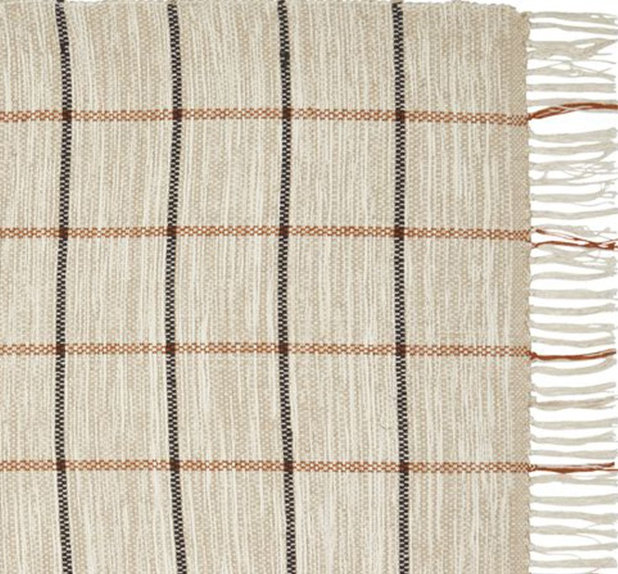
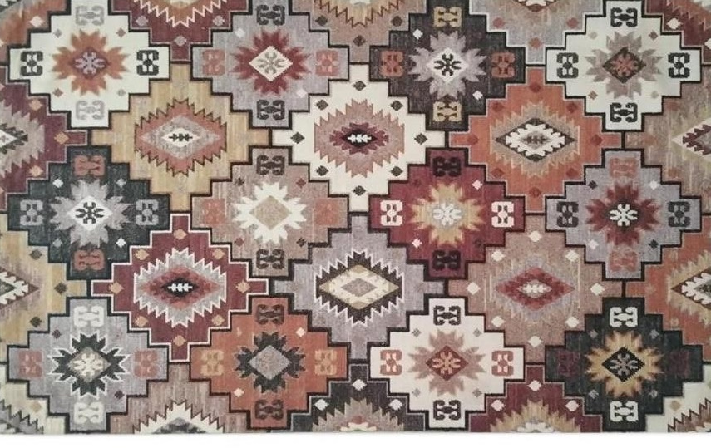
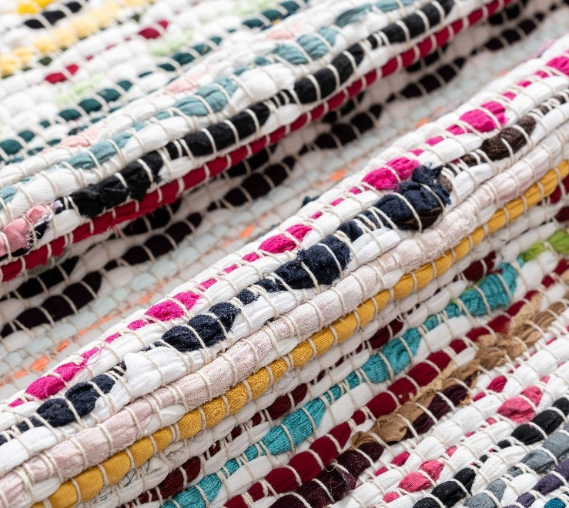
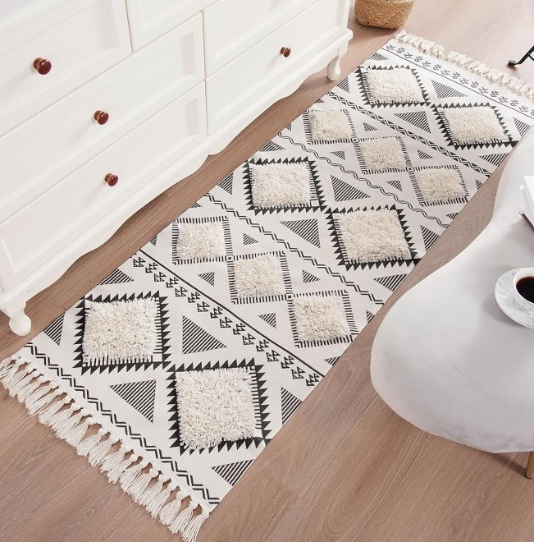
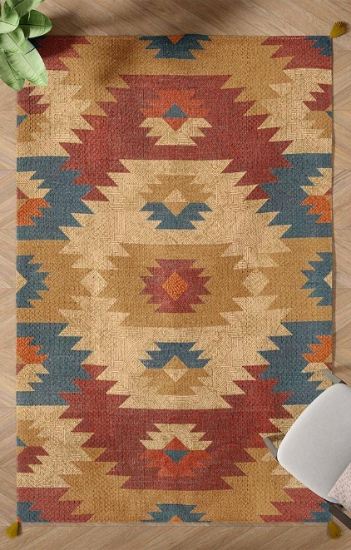
WOVEN TEXTURED RUGS

Slide 6
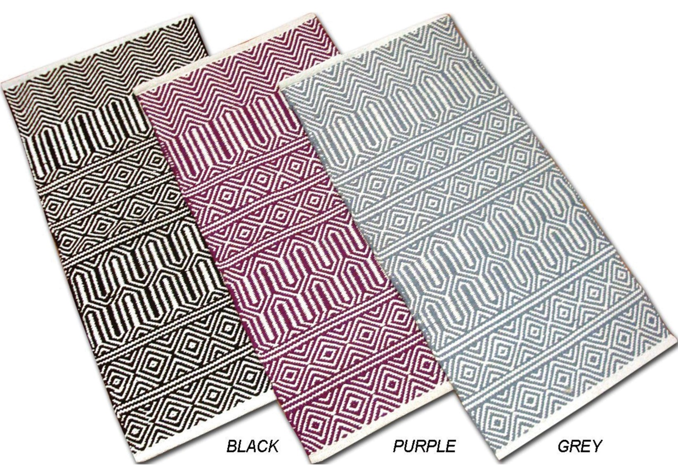
HTW-0105

Slide 7
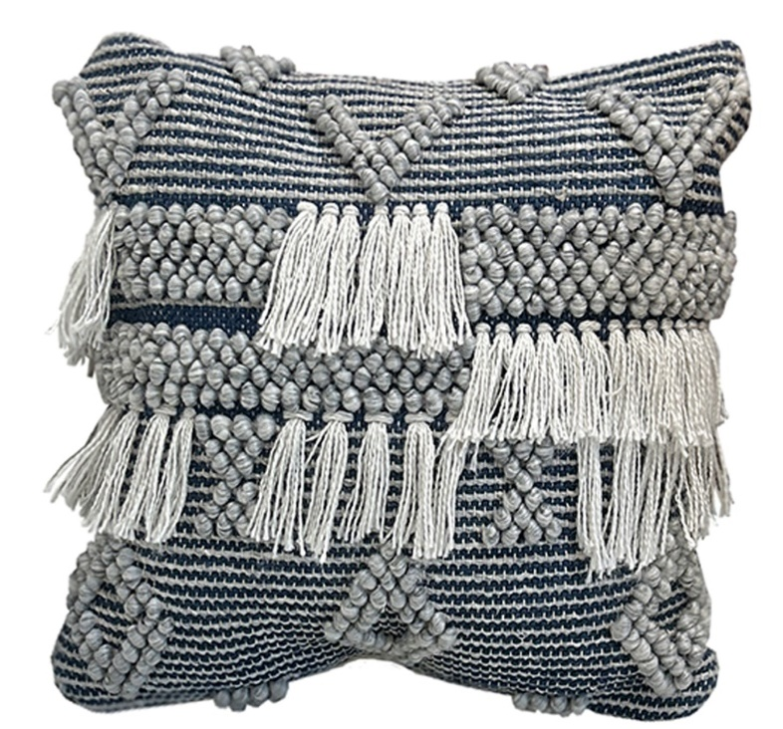
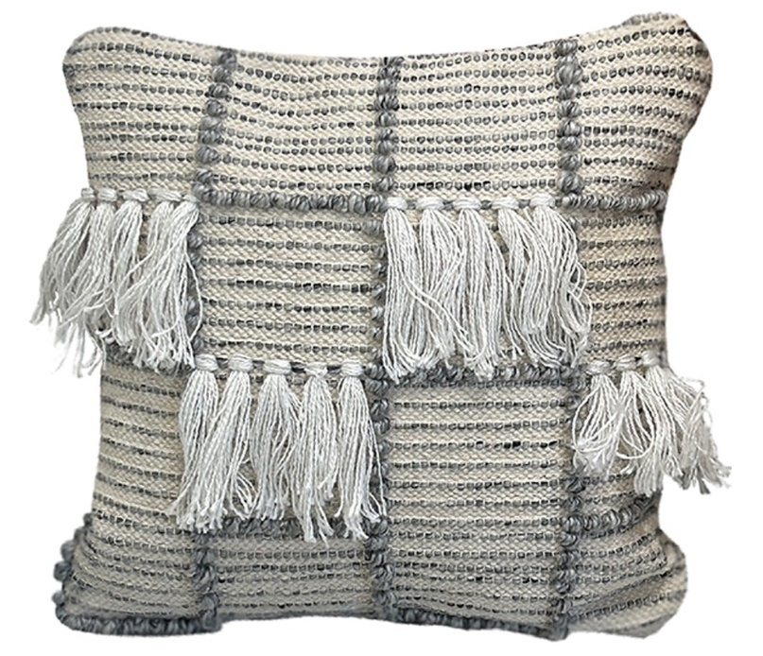
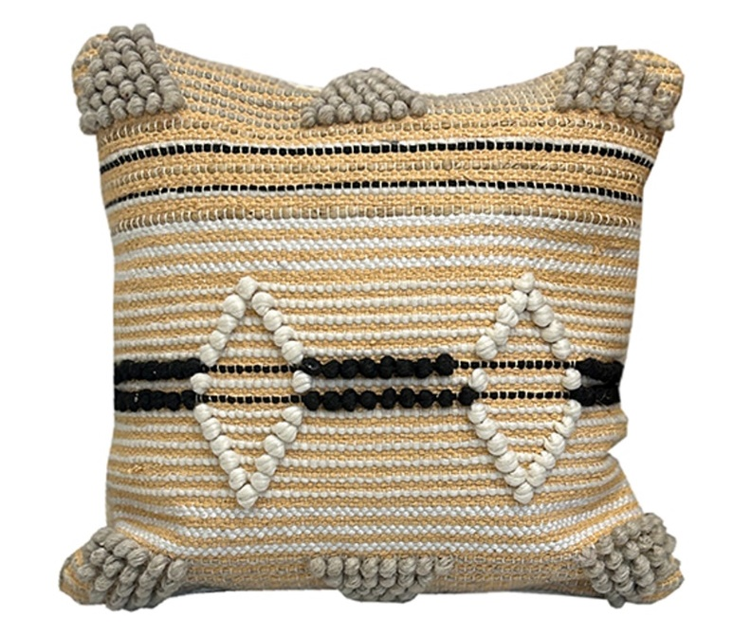
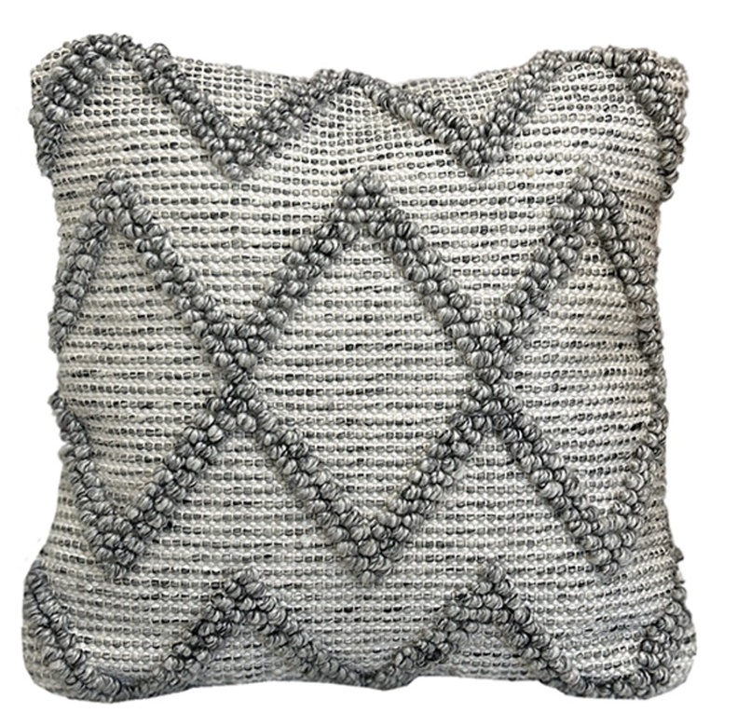
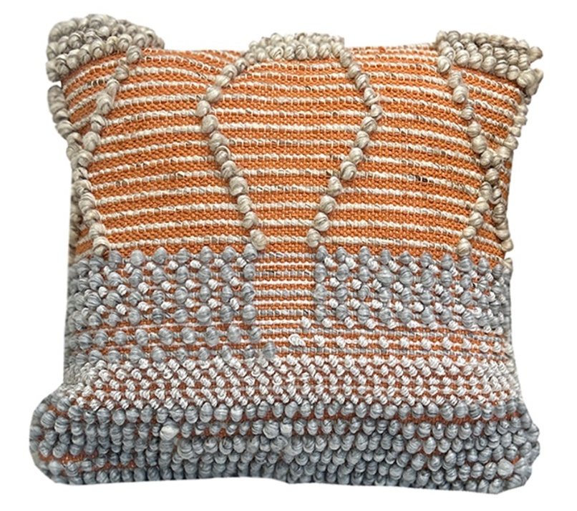
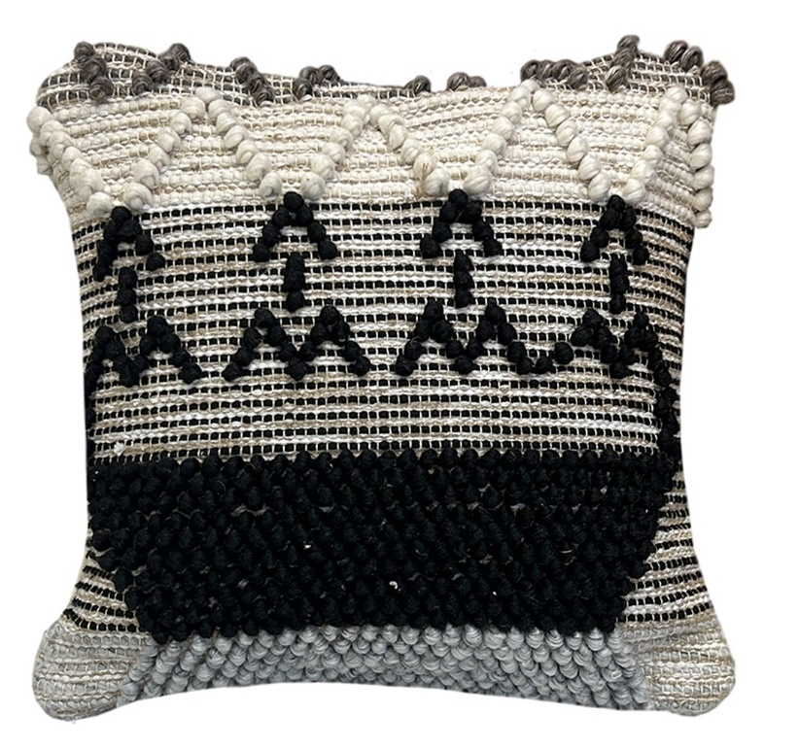
HTC-0109
HTC-0111
HTC-0108
HTC-0110
HTC-0114
HTC-0112

Slide 8
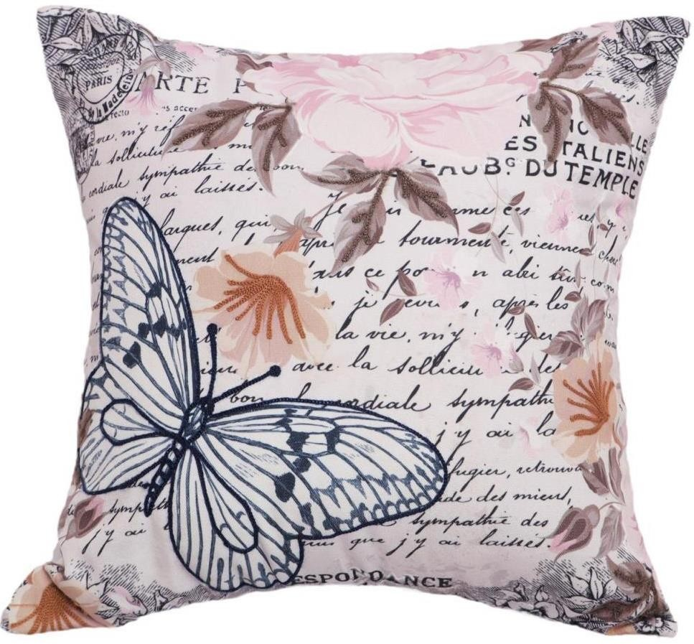
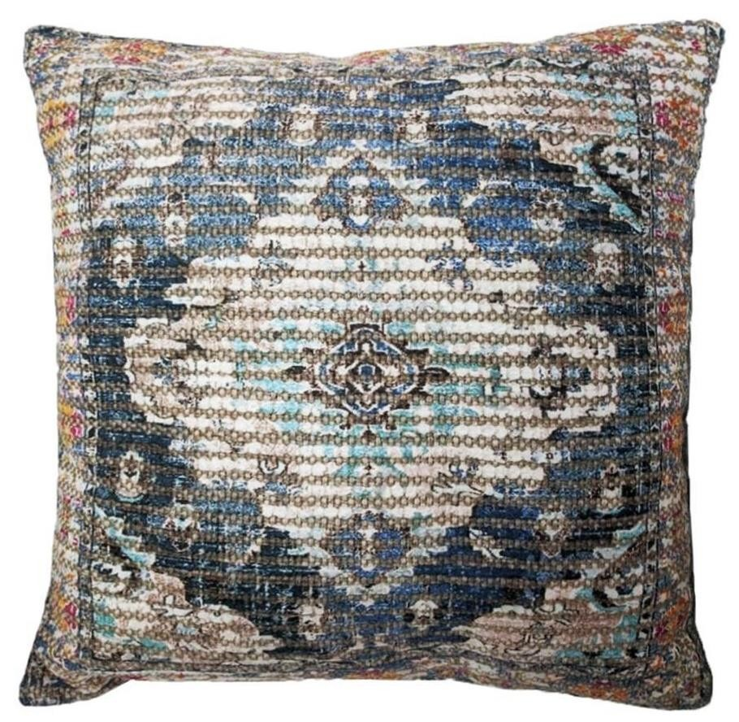

Slide 9

Contact Us
Mr. ANSHU SINGLA (DIRECTOR)
INDIA MOB : +91-8685999989
Email: info@hommetextile.com
homme@hommetextile.com
Mr. PANKAJ SINGLA
INDIA MOB : +91 8059114803
Email : info@hommetextile.com
homme@hommetextile.com
HOMME TEXTILE
A GOVT. OF INDIA RECOGNISED ONE STAR EXPORT HOUSE
ADDRESS : STREET NO 1, SHIV NAGAR,
PANIPAT- 132103 (HR)
INDIA.
https://hommetextile.com/

