Slide 1
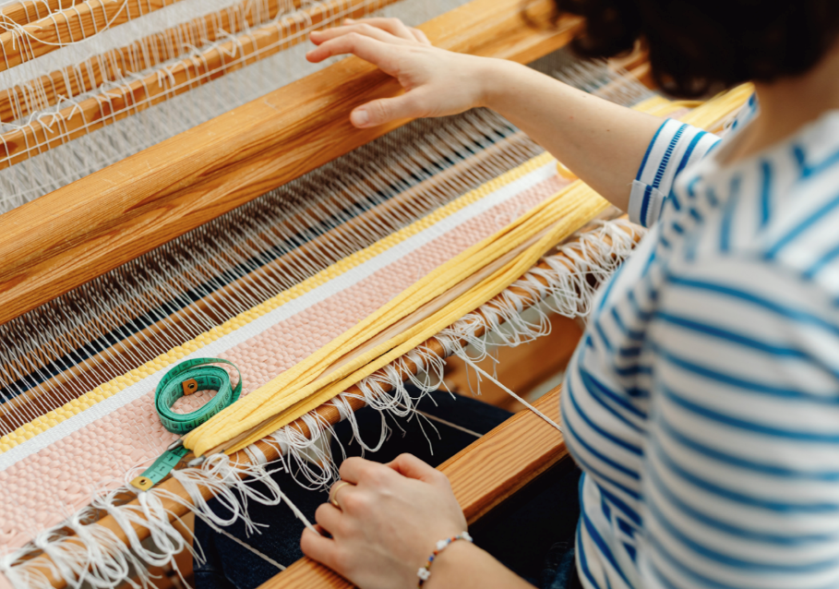

https://hommetextile.com/

Slide 2
INTRODUCTION
Homme Textile is a textile company that are manufacturers and exporters of high quality Home Furnishing products in Soft Floor Coverings (Bath Rugs, Accent Rugs, Area Rugs & Cushion Cover) .

Slide 3
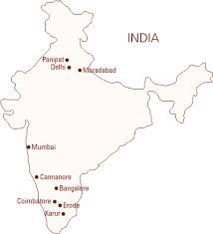
PLANT LOCATION
The factory Area is located in Panipat City which is around 90 km from New Delhi.
Nearest Airport is New Delhi International Airport and it is 2 hrs. drive from Airport to the factory and also can be accessed through train.

Slide 4
CATEGORY DIVISION
Cushion covers
Rugs & Carpet
Tufted Bath Rugs
Total Turnover : USD 4 Million

Slide 5
COMPANY’S GOAL
Full Customer satisfaction is our primary goal. We realize that we are working in an era of global competition and we need to be ahead of others in terms of Price, Quality and Innovation.
We believe in continuous improvement in our Designs, Product range & Quality with the dynamically changing trends.

Slide 6
ENVIRONMENT & SUSTAINABILITY
Our Company has a responsibility to protect the environment. We use eco friendly dyes and recycled packaging materials.

Slide 7
OUR VISION
Our vision is to continuously provide quality products and service to our customers with the use of upgraded technology, Product innovation and constant cost control.

Slide 8
WHY Homme Textile….
Cost Competitiveness advantage in terms of both Direct Import and Domestic.
Latest Set-up for making Rugs and Bathmats.
Strong Design and Product Development capabilities.
Independent quality team for control quality.
Notes:
p

Slide 9
Thank you….

