Slide 1

Stock Presentation

Slide 2


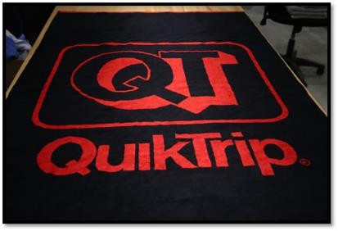
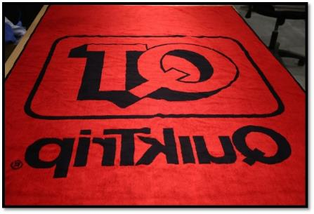
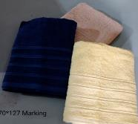
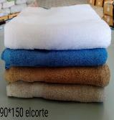
Bath Sheet
Size: 40 x 70 inch – 102 x 178 cm
Weight : 26.30 Lbs/dz – 994 gm/pc
GSM: 550
Yarn : 20/d
Total Pcs: 7000
Total Kg: 6958
PP#16307

Slide 3
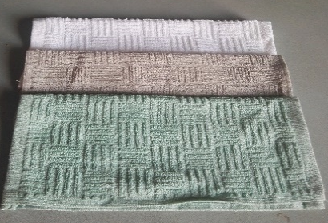
Wash Cloth
Size: 12x12”
Lbs : 1.1
Gm/pc:
Gsm: 447
Yarn : 20/2
Total Pcs: 50749
Total Kg: 2110
PP#18871
WQ

Slide 4
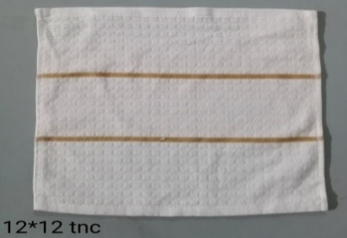
Wash Cloth
Size: 12x12”
Lbs : 1.1
Gm/pc:
Gsm: 447
Yarn : 20/2 Rs
Total Pcs: 25103
Total Kg: 948
PP#12138
WQ

Slide 5
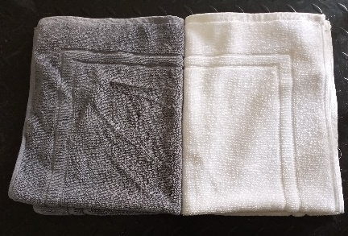
BATH MAT
Size: 50x70 cm
Lbs : 6.30 – 680 GSM
Yarn: 12/2 R.S
Total Pcs: 482
Total Kg:114.8
PP#16339
WQ

Slide 6
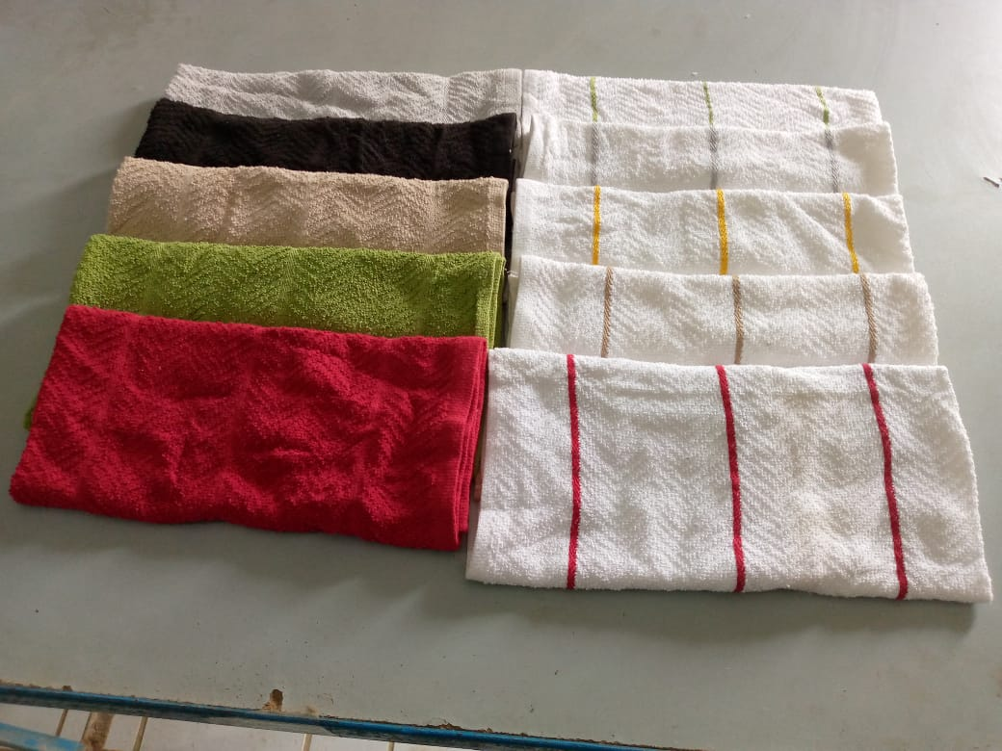
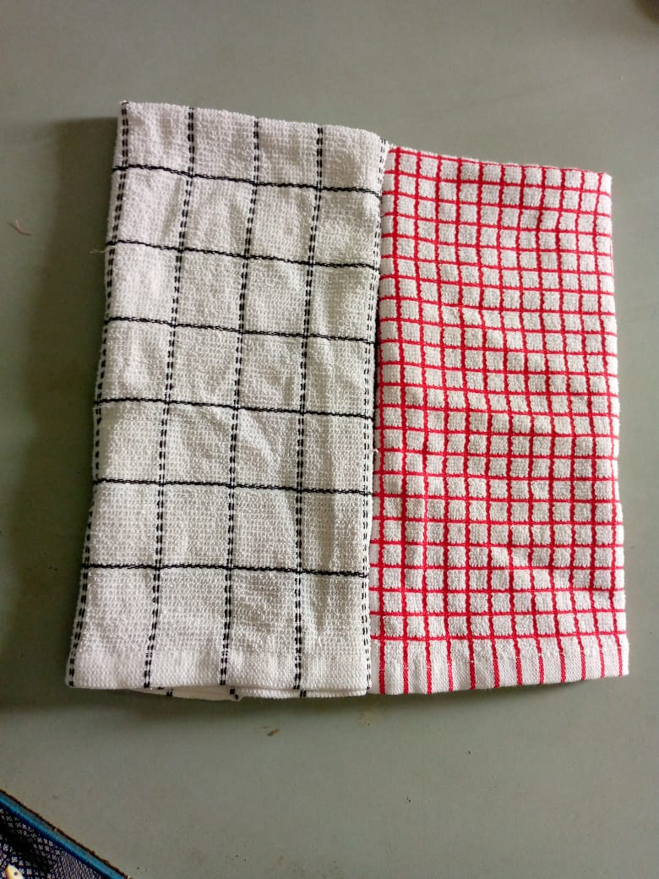
Kitchen Towel
Size: 42 x 62 cm
Lbs : 1.93
Yarn : 18/2 O.E
Total Pcs: 207654
Total Kg: 15149
PP#19320/20826

Slide 7
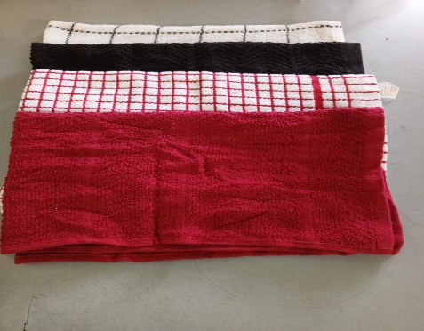
Kitchen Towel
Size: 42 x 62 cm
Lbs : 2.06
Yarn :
Total Pcs: 26020
Total Kg: 2026.1
PP#32532

Slide 8
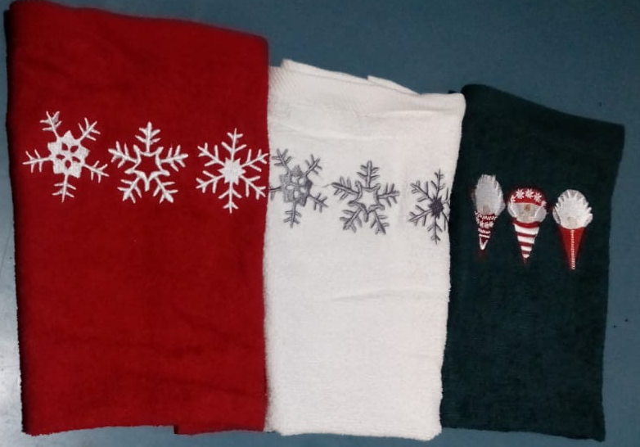
Kitchen Towel
Size: 30x50 cm
Lbs : 1.587
Yarn :
Total Pcs: 14280
Total Kg: 856.6
PP#26166

Slide 9
Kitchen Towel
Size: 45 x 65 cm
Lbs : 2.16/2.38
Yarn : 20/2 / 12/s Soft
Total Pcs: 128365
Total Kg: 10977.6
PP#10121/10353/19076/18644/18042/17101

Slide 10
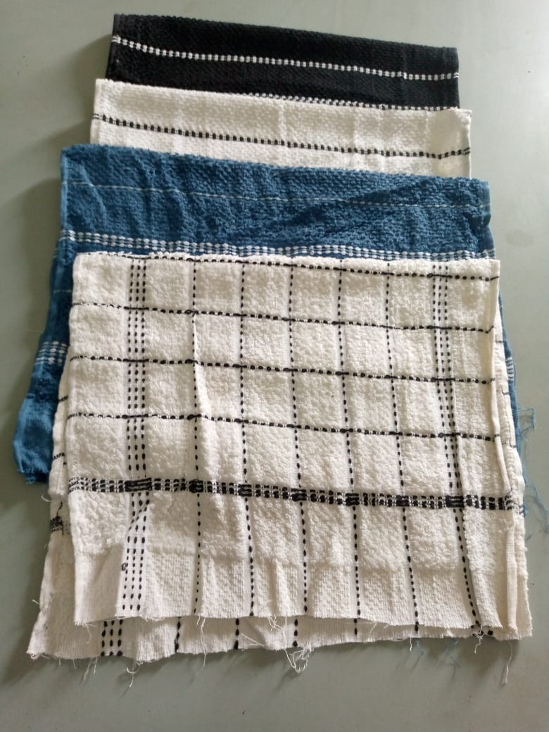
Kitchen Towel
Size: 40 x 60 cm
Lbs : 2.25
Yarn : 20/2
Total Pcs: 13376
Total Kg: 1137.6
PP#7413
UnStich

Slide 11
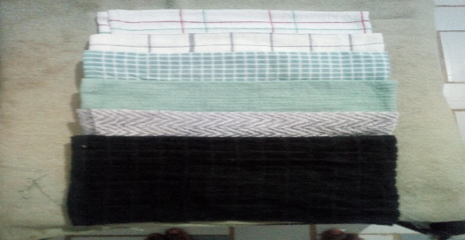
Kitchen Towel
Size: 45X65 CM
Lbs : 2.01 LBS
Yarn : 20/2 R.S
Total Pcs: 76800
Total Kg: 5835.1
PP#10723/10724 – MARKING

Slide 12
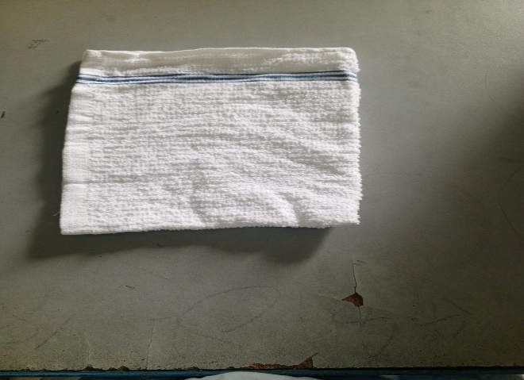
Barmop
Size: 16x19 “
Lbs : 1.75
Yarn :
Total Pcs: 25610
Total Kg: 1694.1
PP#34463

Slide 13
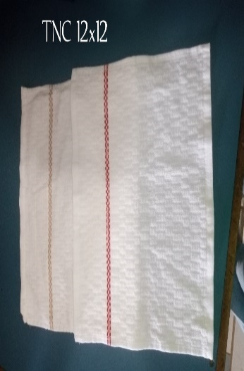
Wash Cloth
Size: 12X12 INCH
Lbs : 1LBS
Yarn : 20/2
Total Pcs: 33943
Total Kg: 1283
PP# 26568 / 26728

Slide 14
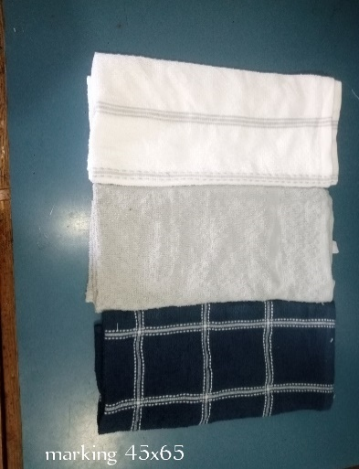
Kitchen Towel
Size: 45X65 CM
Lbs : 2.17
Yarn : 12/1 SOFT
Total Pcs: 23053
Total Kg: 1894.5
PP# 25438 / 25439

Slide 15
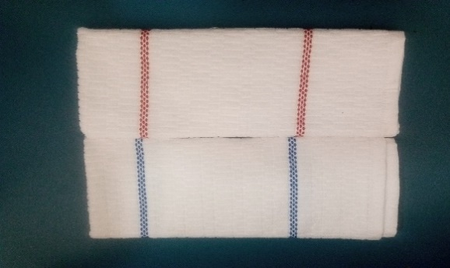
Kitchen Towel
Size: 16X28 INCH
Lbs : 3.2
Yarn : 20/2 R.S
Total Pcs: 4002/24630
Total Kg: 484.1/2979.2
PP# 26544 / 26548

Slide 16
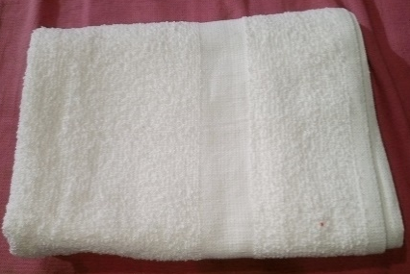
Bath Towel
Size: 22X44 “
Lbs : 6
Yarn : 14/1 OE
Total Pcs: 2412
Total Kg: 547
PP# 27026

Slide 17
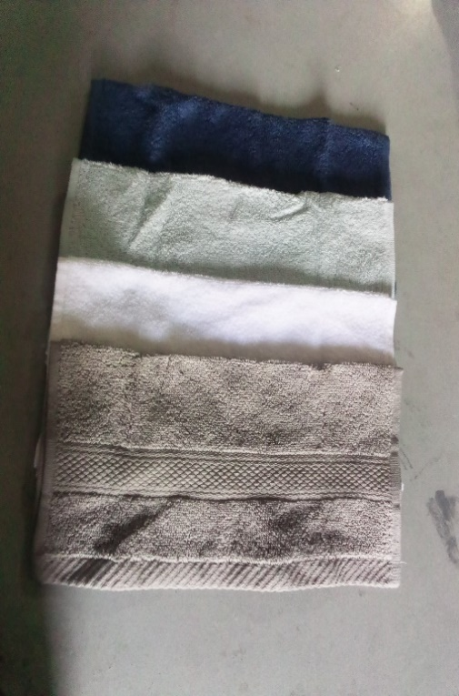
Wash Cloth
Size: 12x12 “
Lbs : 1.3/1.4
Yarn : 12/s Z.T
Total Pcs: 9228
Total Kg: 463
PP# 23023/22271

Slide 18
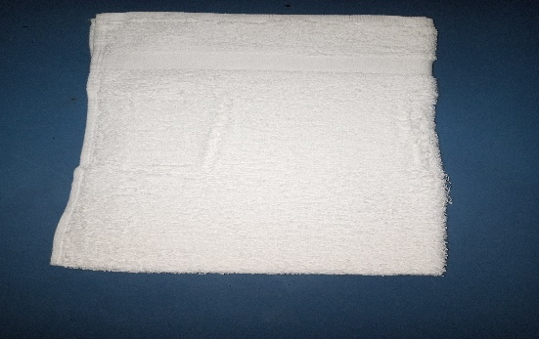
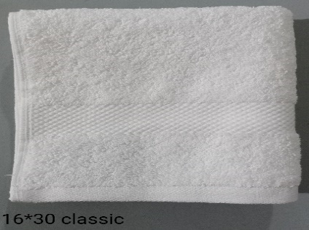
Kitchen Towel
Size: 16x27/16x30”
Lbs :3 /4.5
Yarn : 12/S COMED
Total Pcs: 2040/897
Total Kg: 231.3/152.6
PP# 14258/11492

Slide 19
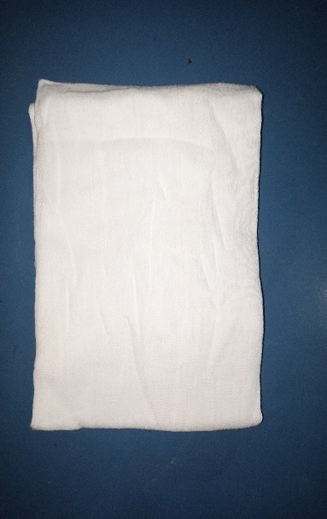
Flour Sack
Size: 30x38”
Lbs : 2.04
Yarn :
Total Pcs: 14160
Total Kg: 1091.9
PP# 24971

Slide 20
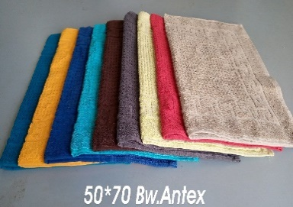
Bath Mat
Size: 50x70cm
GSM : 750
Lbs : 6.94
Yarn : 10/s Soft
Total Pcs: 456
Total Kg: 119.6
PP# 15713/11588/18835

Slide 21
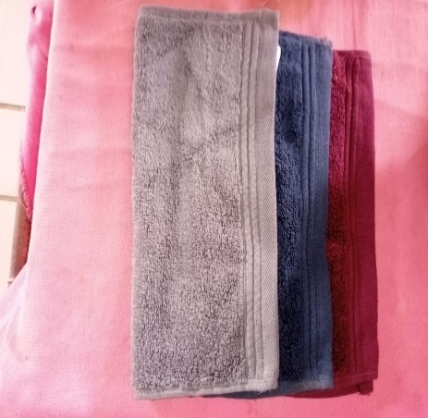
Wash Cloth
Size: 30x30cm
Lbs : 1.38
GSM : 580
Yarn : 12/s Z.T
Total Pcs: 19809
Total Kg: 1033.3
PP# 2167720542/15394

Slide 22
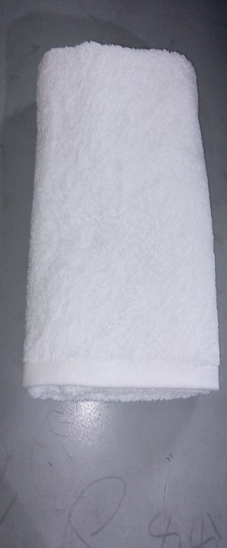
Bath Towel & Bath Sheet
Size:70x140/80x160/80x180cm
Lbs : 12.44/15.23/17.14
Yarn: 16/s
Total Pcs: 1130/888/522
Total Kg: 531/511/338
PP# 27208/27209/27207

Slide 23
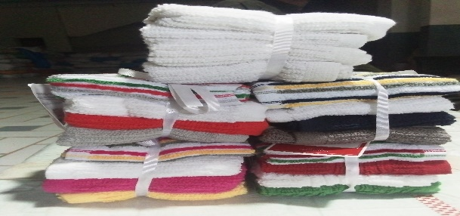
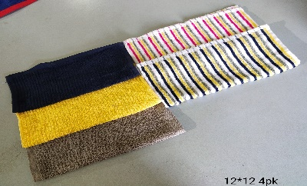
Wash Cloth
Size:12x12”
Lbs : 1.1
Yarn:20/2
Total Pcs: 168117
Total Kg: 6990.3
PP# 14897/13922/13086

Slide 24
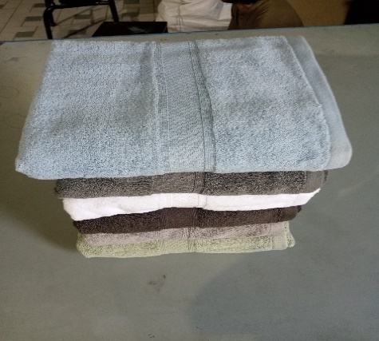
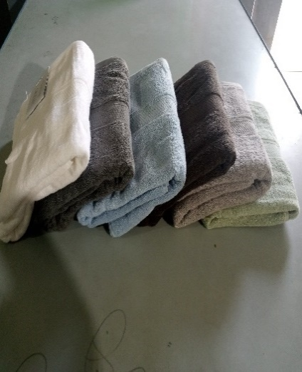
Bath Towel
Size:30x54”
Lbs : 13.82
Yarn: 12/S Z.T
Total Pcs: 2712
Total Kg: 1389.1
PP#14138

Slide 25
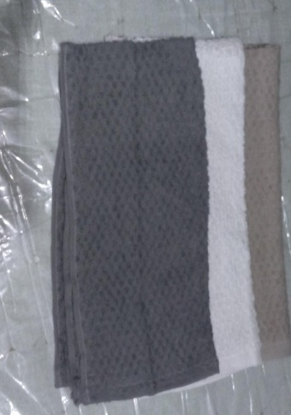
Bath Towel
Size:25.5x47.5”
Lbs : 7.44
Yarn:12/s Soft
Total Pcs: 3939
Total Kg: 1107.8
PP#30280

Slide 26
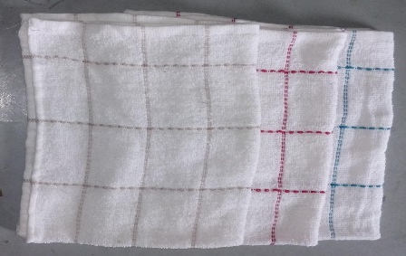
Kitchen Towel
Size:42x62cm
Lbs : 1.93
Yarn: 18/2 O.E
Total Pcs: 35850
Total Kg: 2615.4
PP#30816

Slide 27
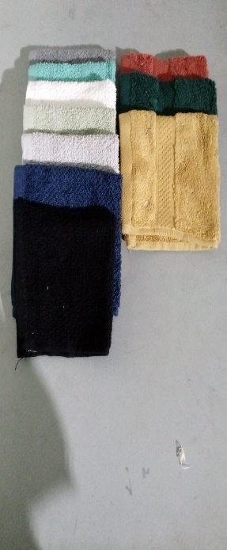
Wash Cloth
Size:12x12”
Lbs : 1.4
Yarn: 12/s Z.T
Total Pcs: 24933
Total Kg: 1319.5
PP#29796

Slide 28
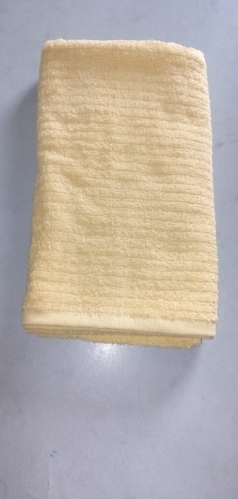
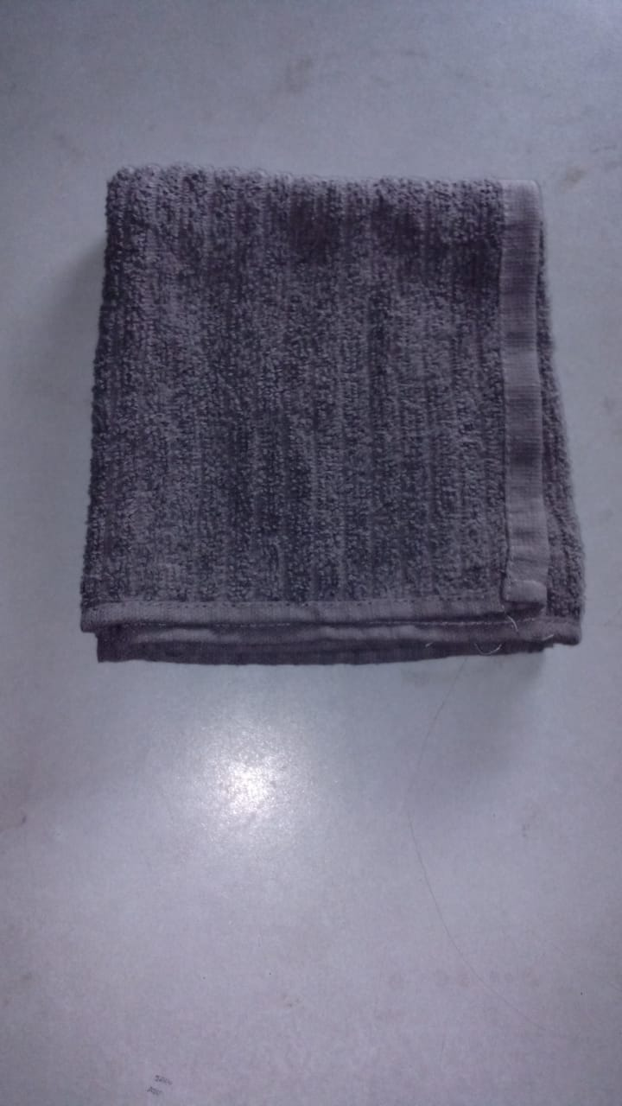
Bath & Hand Towel
Size:50x94/65x135cm
Lbs : 5/9.389
Yarn:10/S Soft
Total Pcs: 4239/4467
Total Kg: 547.2/757
PP#28006

Slide 29
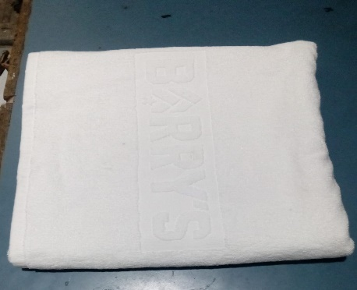
Bath Towel
Size:73x138cm
Lbs : 15.19
Yarn: 20/2 RS
Total Pcs: 2683
Total Kg: 1517.6
PP#30597

Slide 30
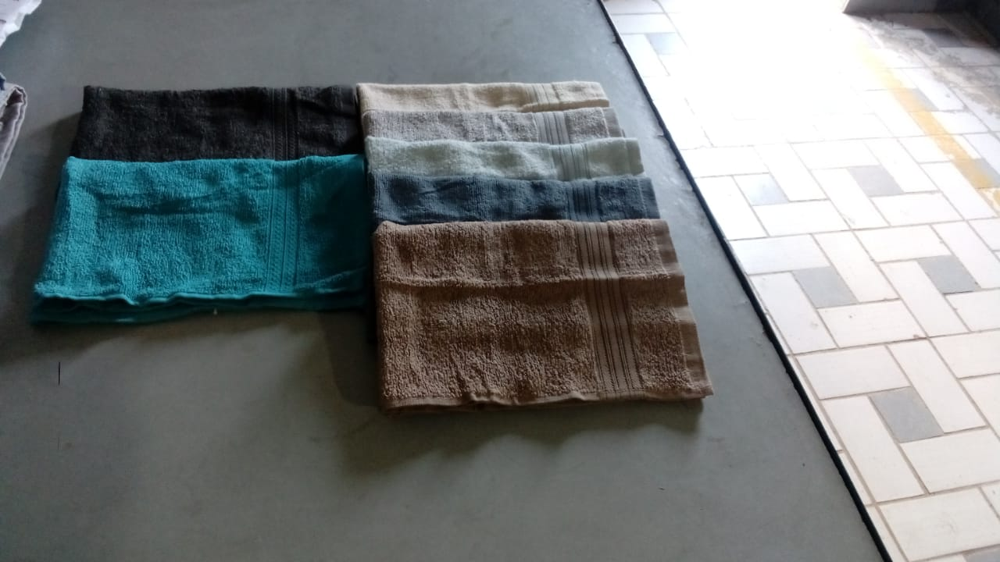
Kitchen Towel/Wash Cloth
Size:16x26/12x12”
Lbs : 2.75/.9
12/s Ring Spun
Total Pcs: 24996/25200
Total Kg: 2598.3/857.3
PP#20520/24119

Slide 31
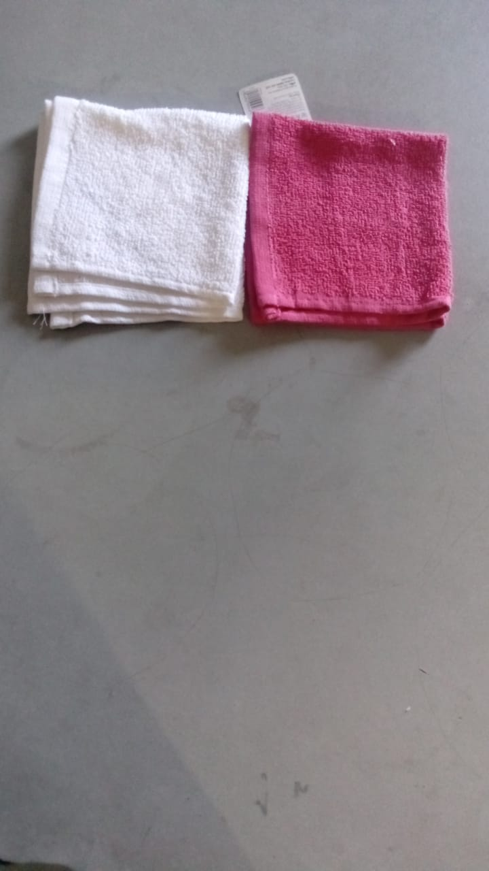
Wash Cloth
Size:30x30cm
Lbs : .95
Yarn: 12/s Soft
Total Pcs: 140900
Total Kg: 5059.7
PP#30838/30944
Unstich 37956Pcs

Slide 32
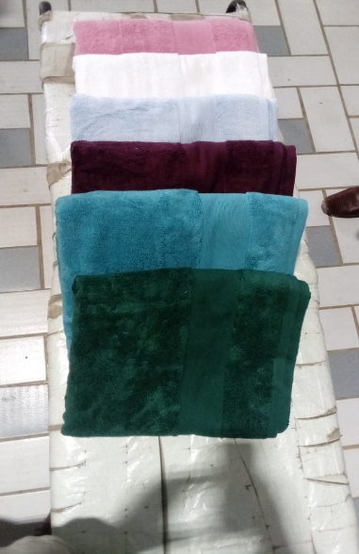
Bath Towel Hand Towel
Size:70x127cm
Lbs : 13.64
Yarn: 12/1 ZT SUS
Total Pcs: 2274
Total Kg:1172.4
PP#20540/31492

Slide 33
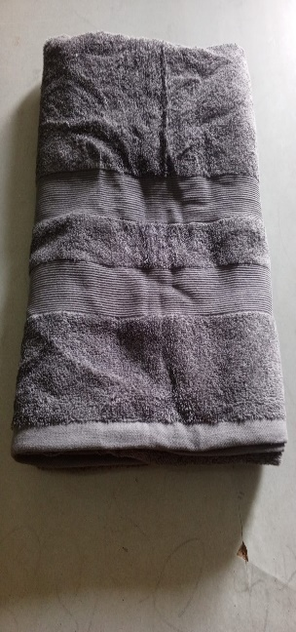
Bath Sheet
Size:100x150cm
Lbs : 17.86
Yarn: 16/1 Comb SUS
Total Pcs: 2978
Total Kg: 2010.5
PP#31508

Slide 34
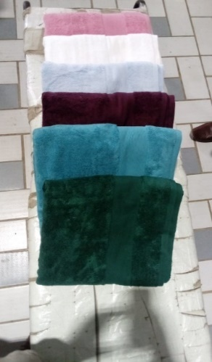
Bath Sheet
Size:100x150cm
Lbs : 23.01
Yarn: 12/1 Z.T
Total Pcs: 1914
Total Kg: 1664.7
PP#20540

Slide 35
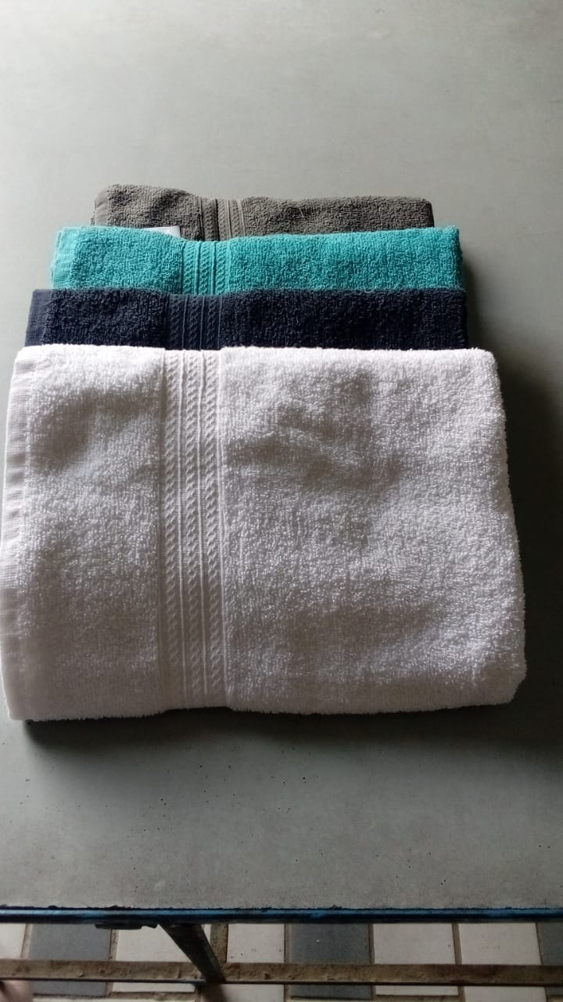
Bath Towel
Size:27x54”
Lbs : 10/10.25
Yarn:
Total Pcs: 7083/1674
Total Kg: 2677.4/648.4
PP#24119

Slide 36
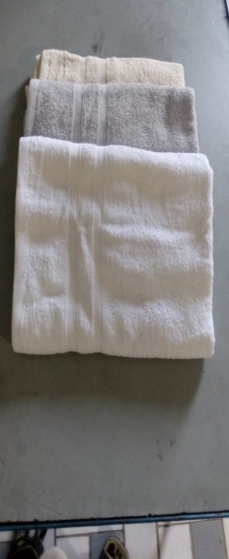
Bath Towel
Size:27x54”
Lbs : 10/10.25
Yarn:
Total Pcs: 2588
Total Kg: 1162.2
PP#24719

Slide 37
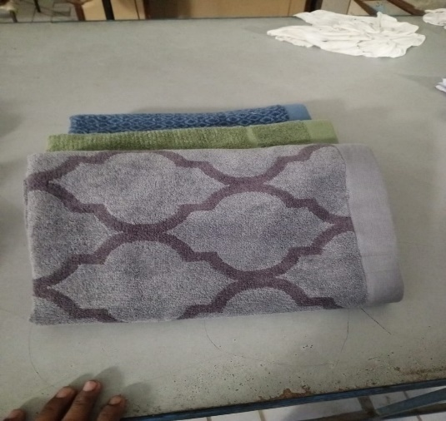
Bath Towel/Hand Towel
Size:70x140/51x103cm
Lbs : 14.37/7.71
Yarn:
Total Pcs: 1840/5005
Total Kg: 999.5/1458.6
PP#32774/32979/32972

Slide 38
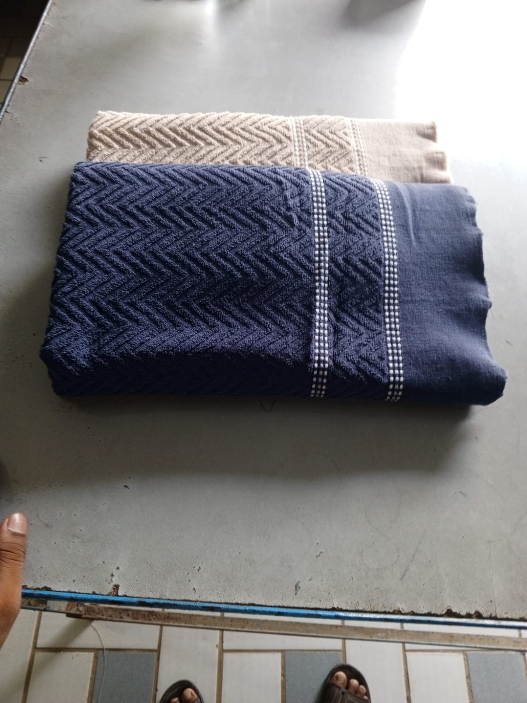
Bath Towel
Size:70x140cm
Lbs : 11.66/9.074
Yarn:
Total Pcs: 3641/7789
Total Kg: 1604.8/2671.6
PP#20005/19997

Slide 39
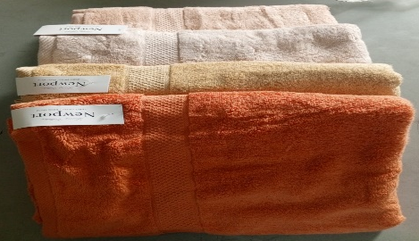
Bath Towel
Size:27x54”
Lbs : 14.18
Yarn:
Total Pcs: 2736
Total Kg: 1466.5
PP#30558

Slide 40
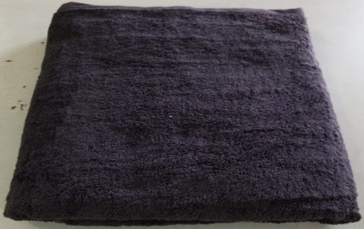
Bath Sheet
Size:100x180cm
Lbs : 34.28
Yarn:
Total Pcs: 751
Total Kg: 973.1
PP#28983

Slide 41
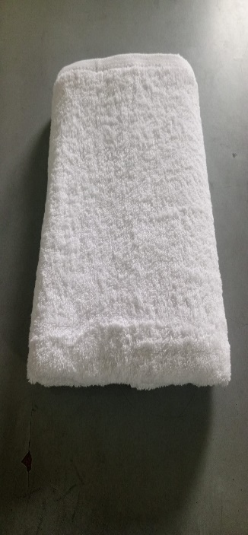
Bath Sheet
Size:80x150cm
Lbs : 17.46
Yarn:
Total Pcs: 818
Total Kg: 539.9
PP#27205

Slide 42
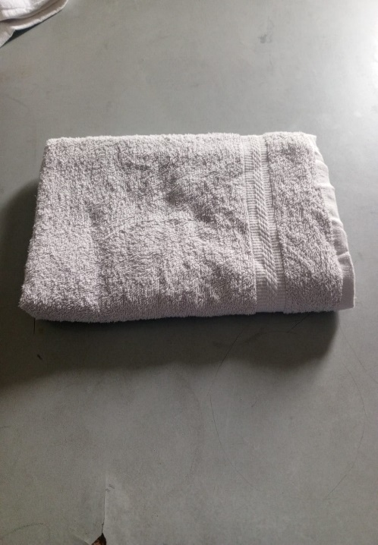
Bath Towel
Size:70x140cm
Lbs : 9.33
Yarn:
Total Pcs: 1502
Total Kg: 529.7
PP#31877

Slide 43
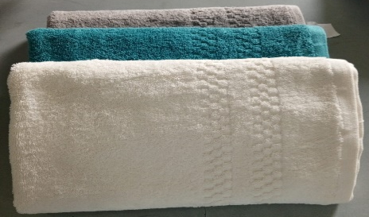
Bath Towel
Size:71x143cm
Lbs : 13.97
Yarn:
Total Pcs: 2724
Total Kg: 1438.4
PP#33619

Slide 44
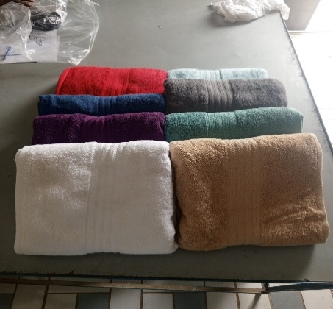
Bath Towel/ Bath Sheet
Size:24x48/35x70/24x50 “
Lbs : 8.26/24.25/8.6
Yarn:
Total Pcs: 3675/1404/4140
Total Kg: 1147.4/1287/1345.8
PP#32139/26330

Slide 45

Hand Towel/ Bath Towel/Bath Sheet
Size:50x90/70x127/100x150 cm
Lbs : 5.77/11.41/19.25
Yarn:
Total Pcs: 10167/3943/8945
Total Kg: 2217.5/1700.6/6508.8
PP#20364/26780/

Slide 46

Wash Cloth
Size:11x11”
Lbs : 1
Yarn: 10/S Soft
Total Pcs: 17206
Total Kg: 650.4
PP#30746

Slide 47



Hand Towel
Size: 50X80 CM
Lbs : 4.76
Yarn : 12/1 SOFT
Total Pcs: 861
Total Kg: 154.9
PP# 20001/02/03/05

