Slide 1
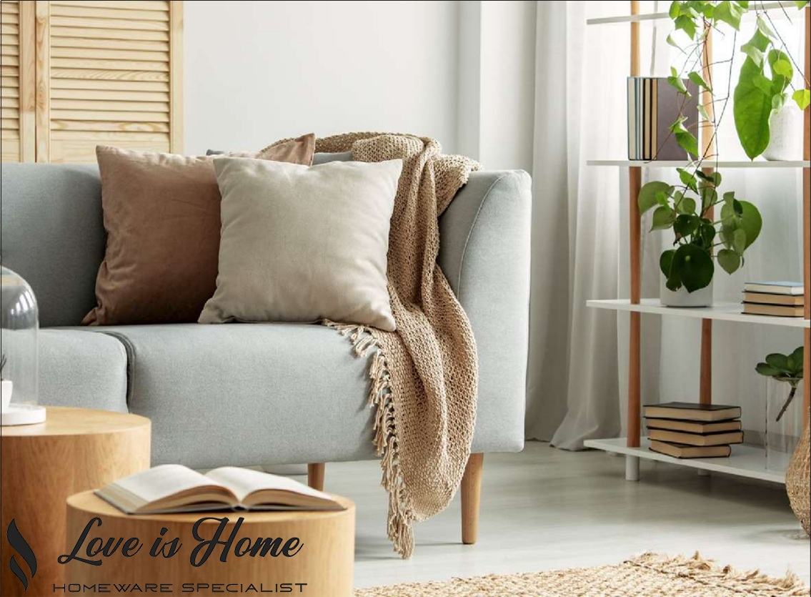

Slide 2
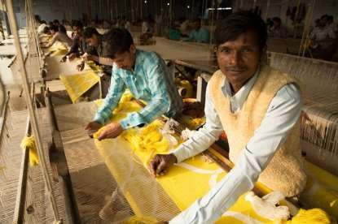
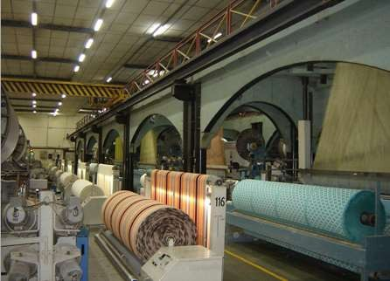

ABOUT US
The exclusive tradition of quality and refined work is the world of LOVE IS HOME.
We are a distinguished manufacturer and exporter of outstanding range of home furnishing & lifestyle products with a strengthened hold on Carpets, Rugs, Bathmats, Cushions, Poufs, Throws, Towels, Decorative Items, Stools, Pet Beds & many more home essential goods. Set up in 2006 with its manufacturing base in ‘City of Weavers” Panipat (Haryana), we have exclusive products catering to a discerning export market. Superior quality and innovative designs is our benchmark we follow for customer contentment.
VISION: Our vision is to provide our customers the most creative, most effective
& highest valued products.
MISSION: To combine constant innovation using craftsmanship & technology
OUR LEGACY
LOVE IS HOME came into existence in 2007 in Panipat (Haryana) as a manufacturing and trading unit of floor covering on a tiny scale and then started supplying to domestic exporters. Now LOVE IS HOME has elevated to a bigger level with its exports to many countries across the globe.
Our journey is based on our belief in prerequisite principles of trust, credibility, superior quality, product innovation, respect for each other and the environment, community service, timely delivery, constant & consistent learning. We are focused skilled and the dedicated towards pairing the traditional values of remarkable craftsmanship & technology.

Slide 3
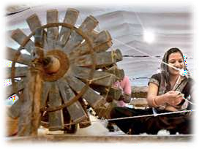
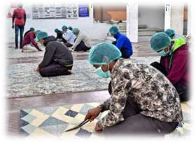
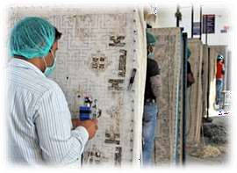
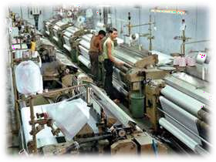
THE TEAM
LOVE IS HOME is a team of experienced professionals. Incorporated with a mission to be the connoisseur manufacturer of home furnishing products, we have always been dedicated towards the same. Today this vision is well on its way of already being realized. We are one of the primer manufacturer & exporter of Carpets, Rugs, Bathmats, Cushions, Poufs, Throws, Towels, Decorative Items, Stools & Pet Beds.
We have a professional team of experienced people who develop new and innovative concepts for the market with their sharp acumen and skills. Our products blend with the fine hand- weaving techniques of master craftsmen with modern tastes and styles.
INFRASTRUCTURE
Modernization and constant up gradation is the key to survive in this dynamic industry. So as to keep up with this scenario and for self development, we assure highest standards through our infrastructure.
200 Pit Looms
50 Handlooms
90 Hand Tufting Frames
10 Knitting Machines
4 Jacquard Looms
70 Tufting Machines
20 Braided Machines
70 Stitching Machines

Slide 4


OUR QUALITY STANDARDS
We have strict policies adhering to quality control. Quality is what we sell. We believe in the concept of “DO IT RIGHT THE FIRST TIME”. We constantly strive for extreme quality products and on time delivery schedules to maximize customer satisfaction.
We have moved towards Total Quality Management by incessant training of our employees with an attitude directed towards improvement.
optimum price
best quality
OUR
✓ Following the adage of 'Client First'
✓ Offering competitivepricesto buyers
✓ Incessanteffort for timely deliverywith high quality standards
✓ Providing a healthy working environment to employees that can improve their productivity
VALUES
Our culture permeates togetherness and we are working on our aims to achieve what we desire-
“To combine constant innovation using craftsmanship & technology with best quality products to delight consumer every time.”
LOVE IS HOME
Amit Kumar
Mobil: +91 829 558 5550
amit@loveishome.co.in
info@loveishome.co.in
www.loveishome.co.in

