Slide 1
New Products
Zed Eco Sourcing
India Sourcing Expert

Slide 2



Table Decor

Slide 3


Table Top

Slide 4

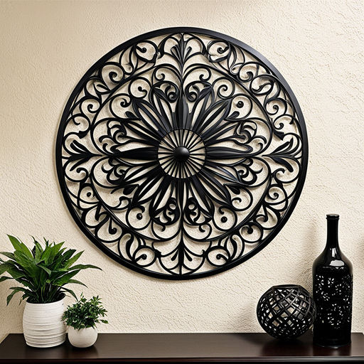
Wall Decor

Slide 5



Candle Holder

Slide 6
Source With Us
Exclusive Products Sourcing Service
FREE Supplier Search
No HIDDEN CHARGES
100% QUALITY ASSURANCE
90 DAYS CREDIT PAYMENT OPTION
For More Information visit our website www.zedecosourcing.com
Contact
Email : info@zedecosourcing.com
WhatsApp : +919458621944

