Slide 1

Shree Radhey Overseas
Shree Radhey Overseas is one of the leading Manufacturers and Exporters of textile home furnishing products in India. With a history of more than 20 years, we settled ourselves as the reputed supplier amongst our client with 0% rejection through which we have gained the confidence to supply our products to overseas customer directly

Slide 2
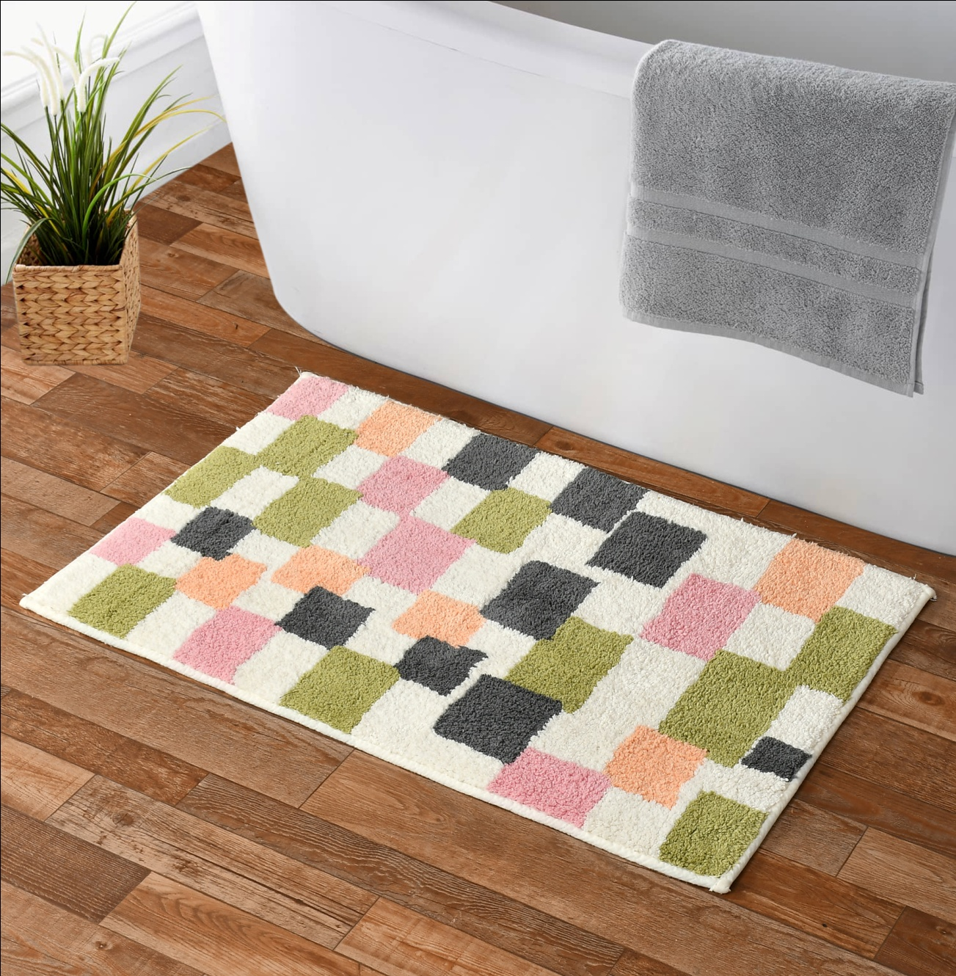
Cotton Tuffted Bathmat
Size-50x80 Cm
Quality- 1800gsm
Price- 2.30 $
Code – sro-521

Slide 3
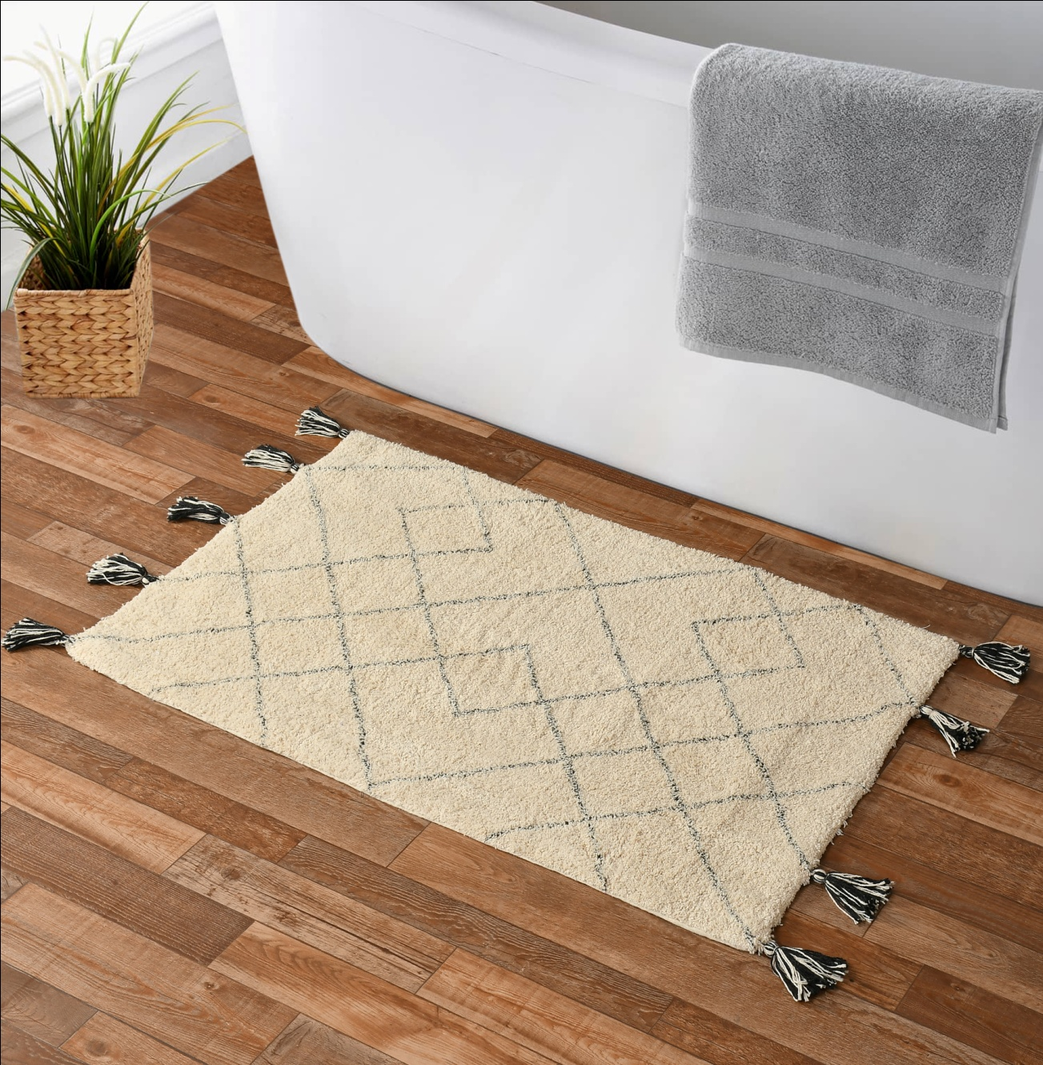
Cotton Tuffted Bathmat
Size-50x80 Cm
Quality- 1700gsm
Price- 2.70 $
Code – sro-522

Slide 4
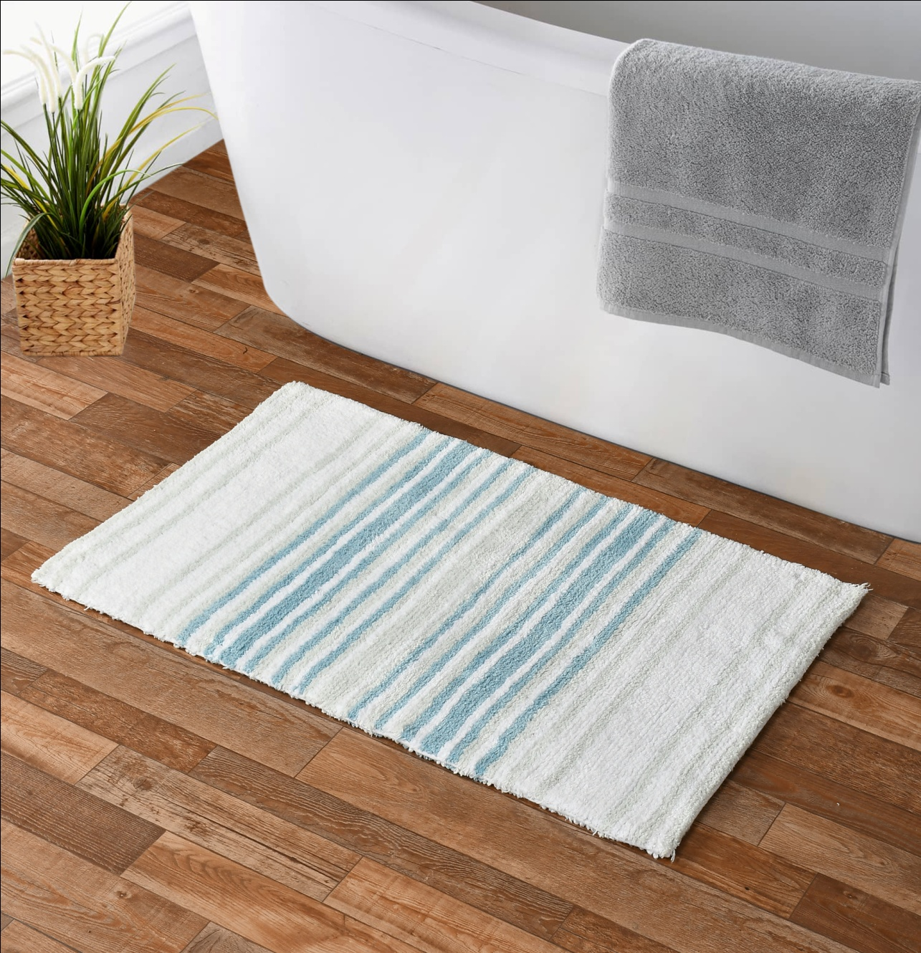
Cotton Tuffted Bathmat
Size-50x80 Cm
Quality- 2100gsm
Price- 2.90 $
Code – sro-523

Slide 5
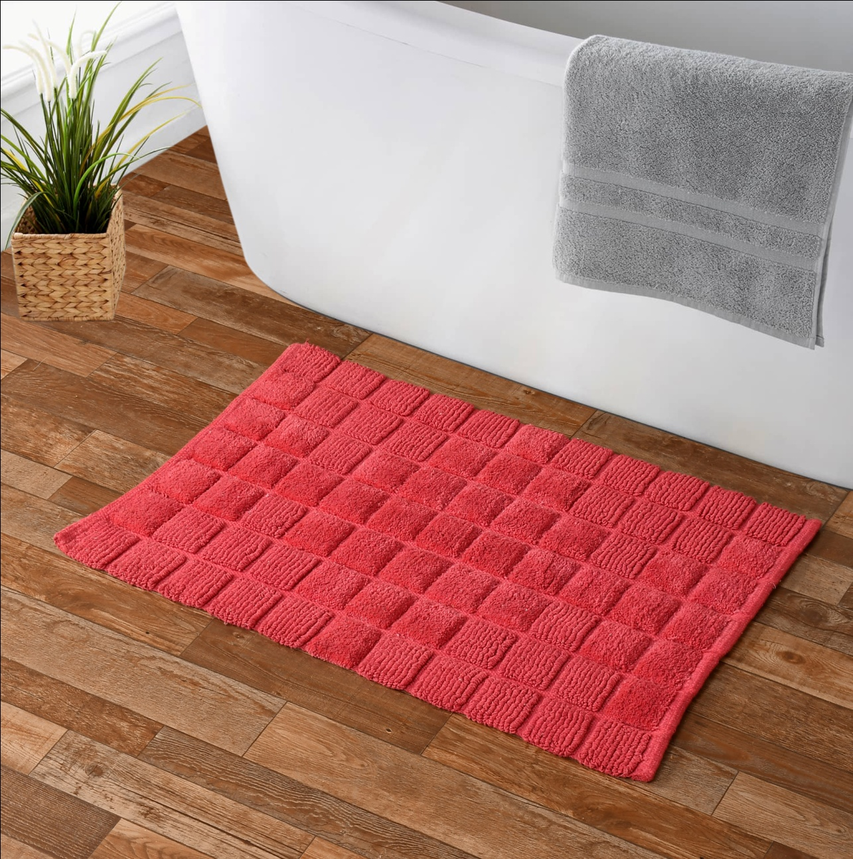
Cotton Tuffted Bathmat
Size-40x60 Cm
Quality- 1400gsm
Price- 1.35 $
Code – sro-524

Slide 6
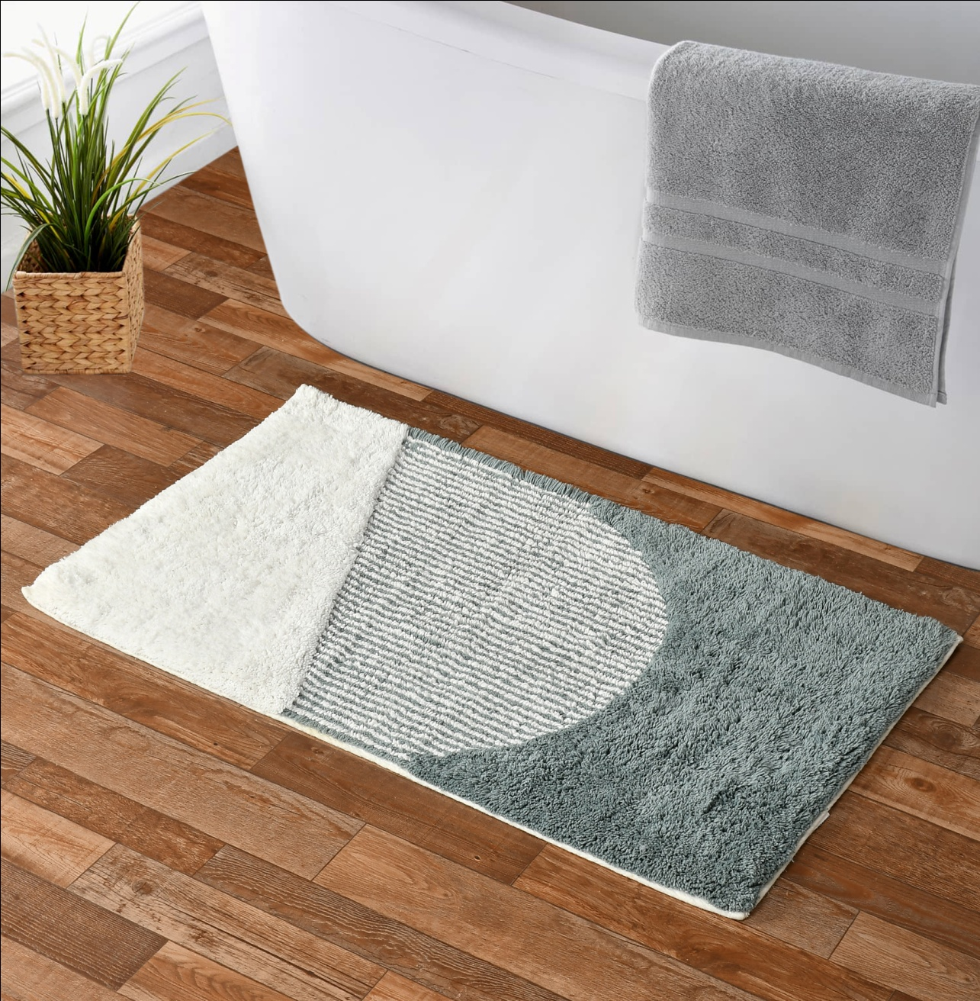
Cotton Tuffted Bathmat
Size-50x80 Cm
Quality- 1900gsm
Price- 2.70 $
Code – sro-525

Slide 7
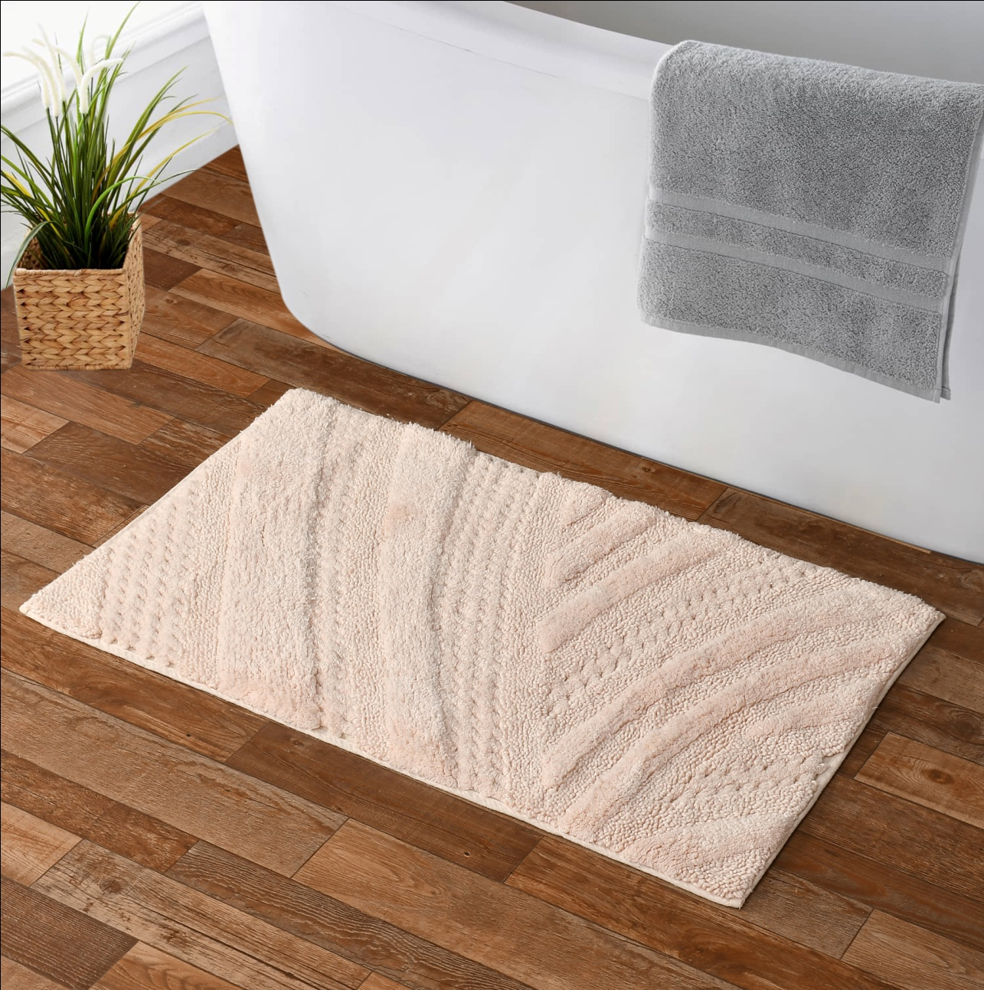
Cotton Tuffted Bathmat
Size-50x80 Cm
Quality- 1600gsm
Price- 2.40 $ Code – sro-526

Slide 8
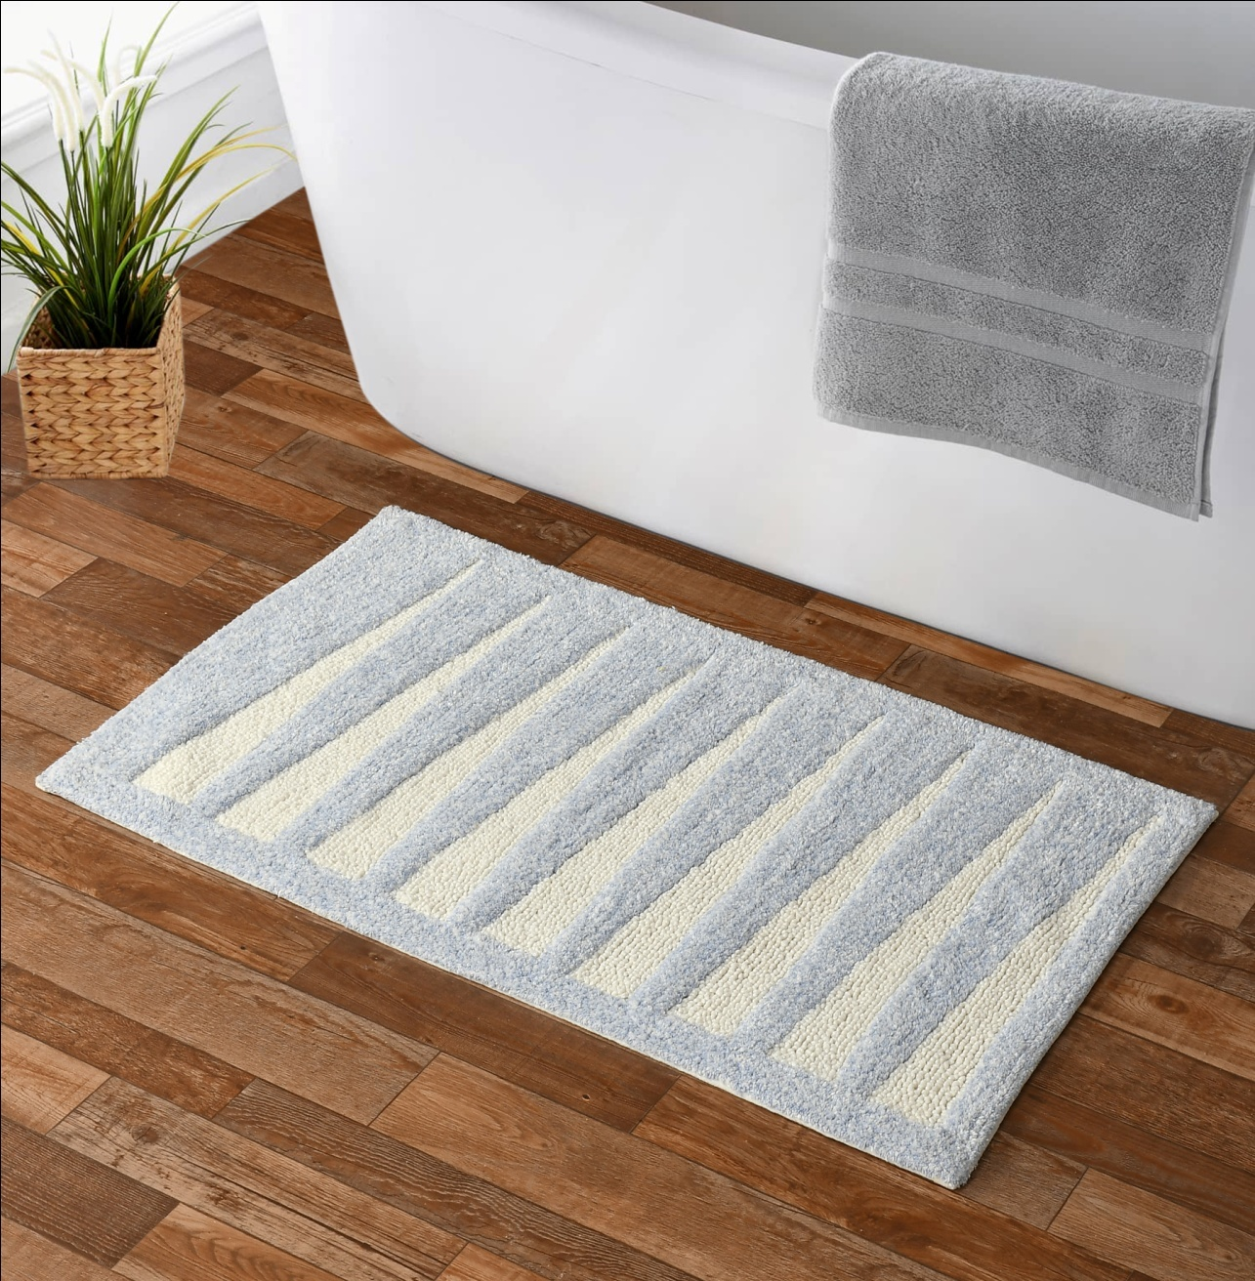
Cotton Tuffted Bathmat
Size-50x80 Cm
Quality- 1650gsm
Price- 2.50 $
Code – sro-527

Slide 9
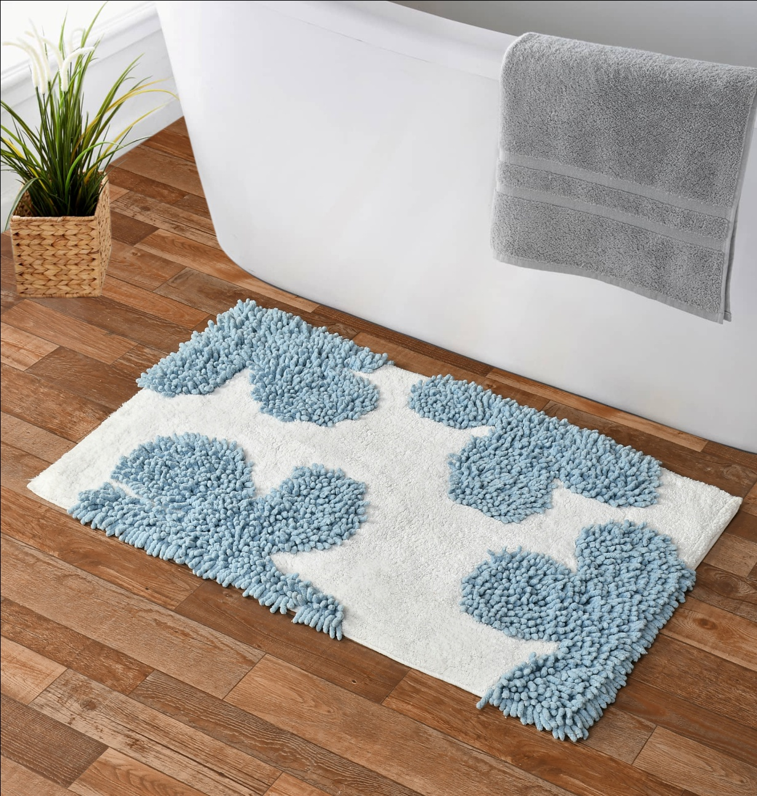
Cotton Tuffted Bathmat
Size- 50x80 Cm
Quality- 2300gsm
Price- 2.85 $
Code – sro-528

Slide 10
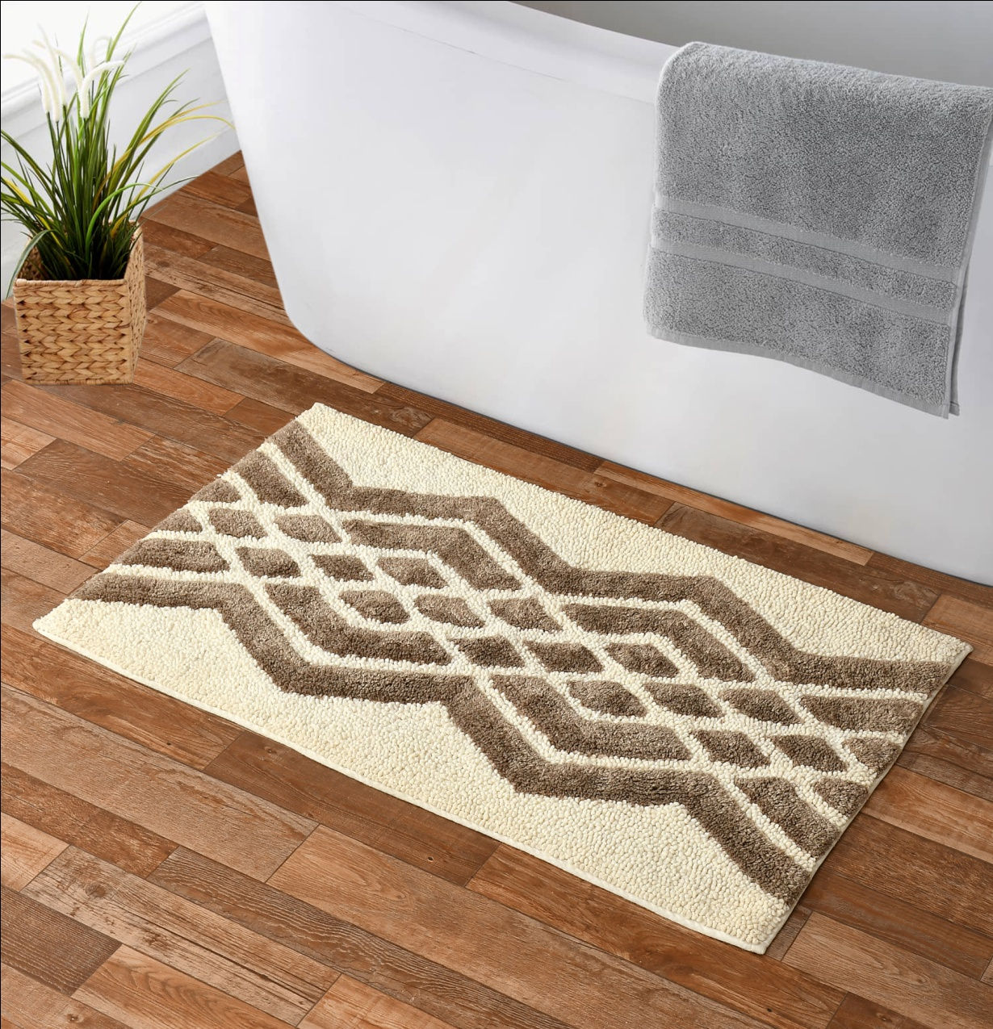
Cotton Tuffted Bathmat
Size- 50x80Cm
Quality- 2000gsm
Price- 2.70 $
Code - sro-529

Slide 11
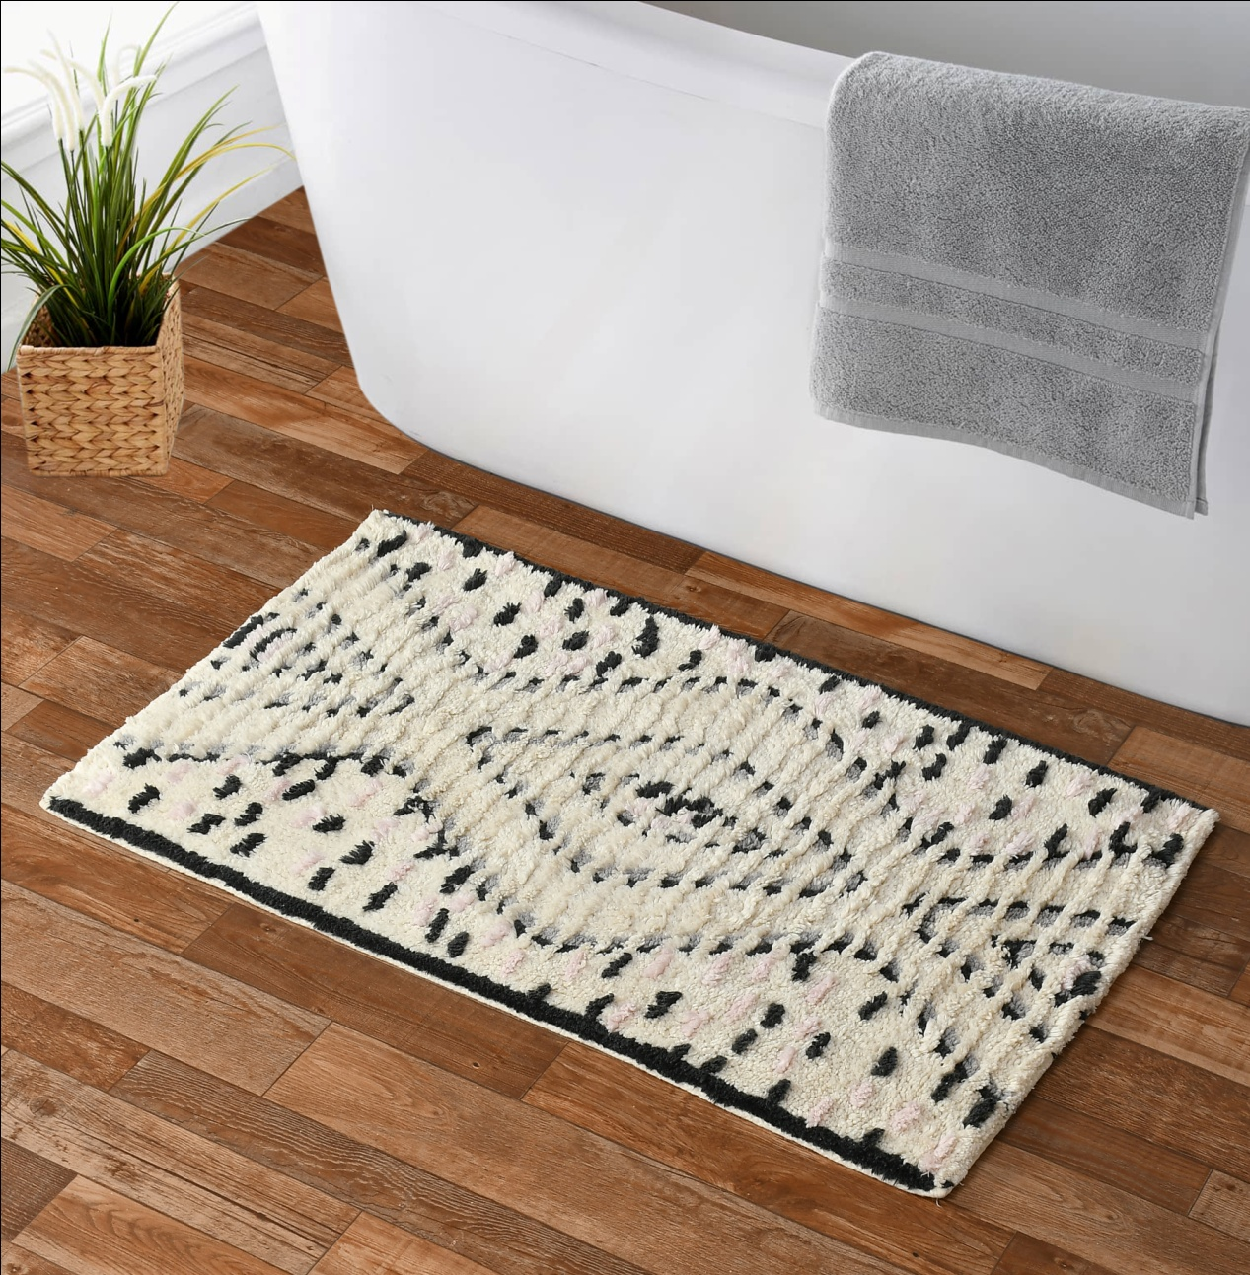
Cotton Tuffted Bathmat
Size-50x80 Cm
Quality- 2000gsm
Price- 2.70 $
Code – sro-530

Slide 12
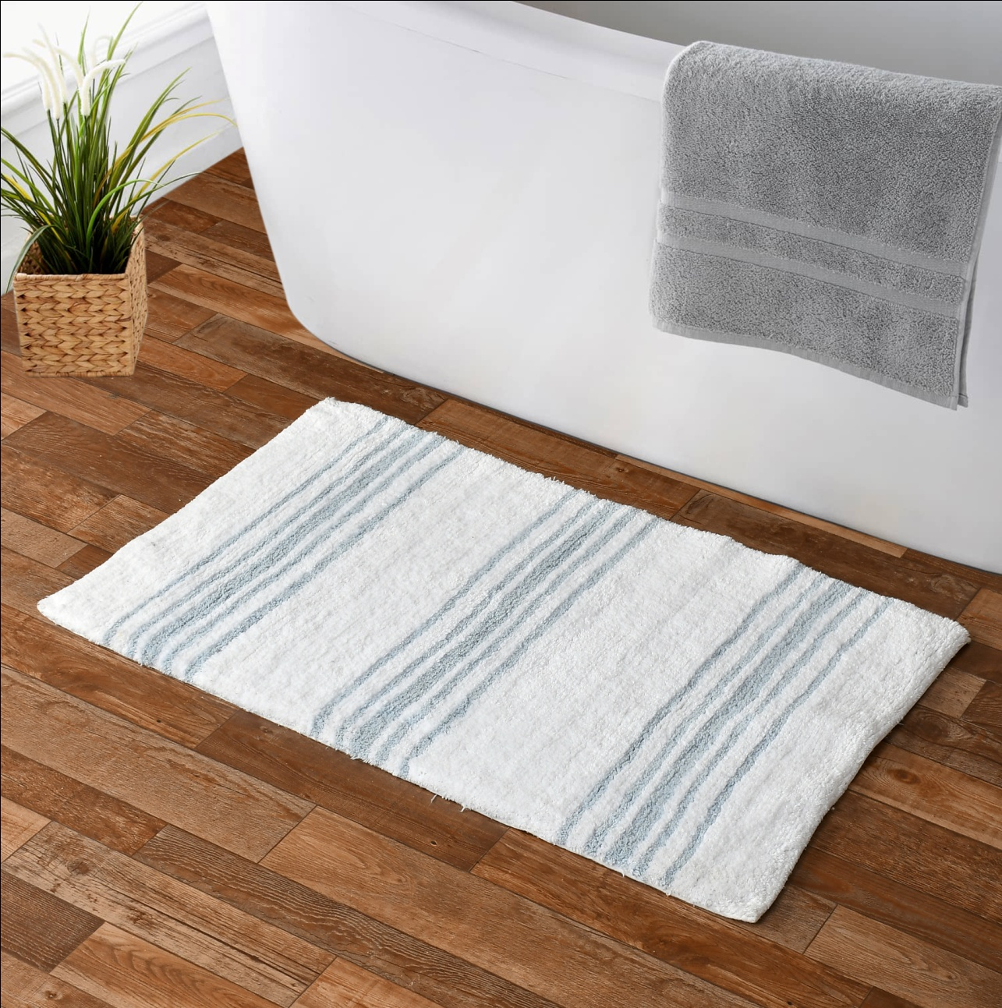
Cotton Tuffted Bathmat
Size-50x80 Cm
Quality- 2100gsm
Price- 2.90 $
Code - sro-531

Slide 13
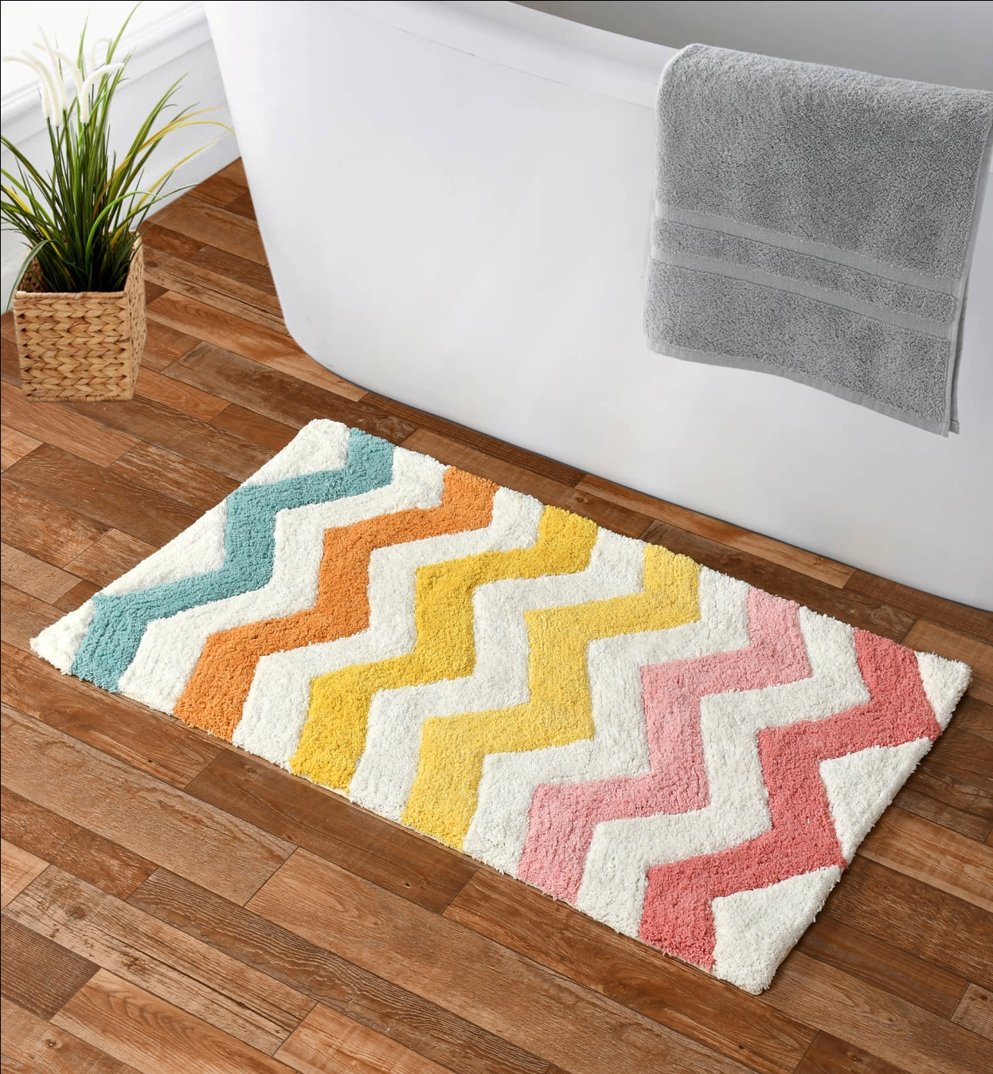
Cotton Tuffted Bathmat
Size-50x80 Cm
Quality- 1900gsm
Price- 2.60 $
Code – sro-532

Slide 14
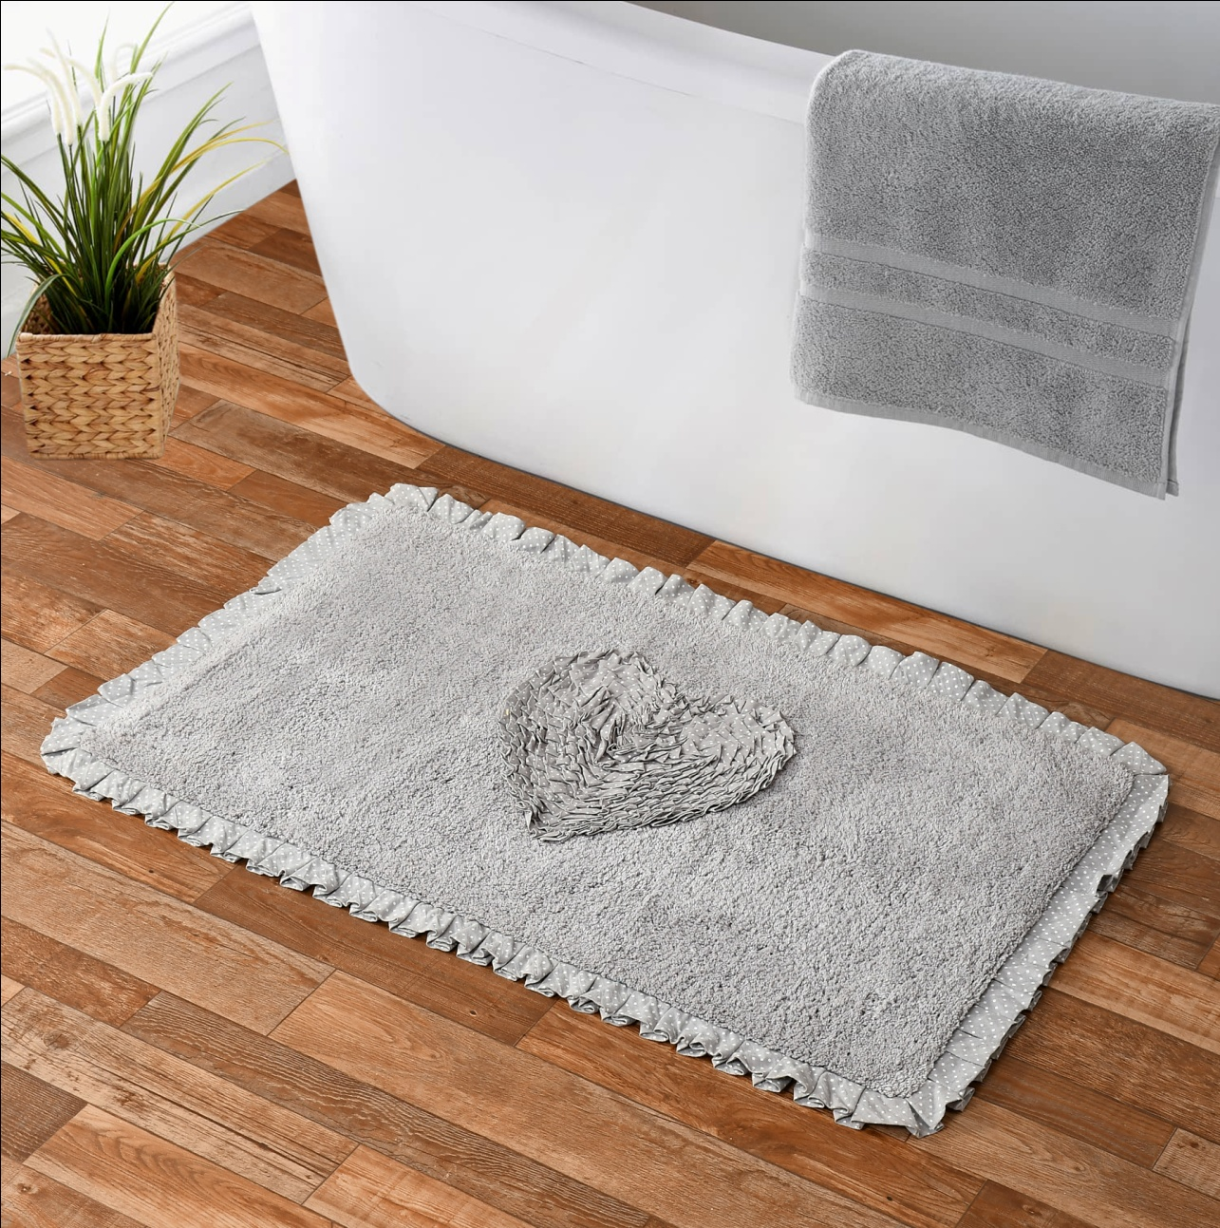
Cotton Tuffted Bathmat
Size-50x80 Cm
Quality- 1850gsm
Price- 2.70 $
Code – sro-533

Slide 15
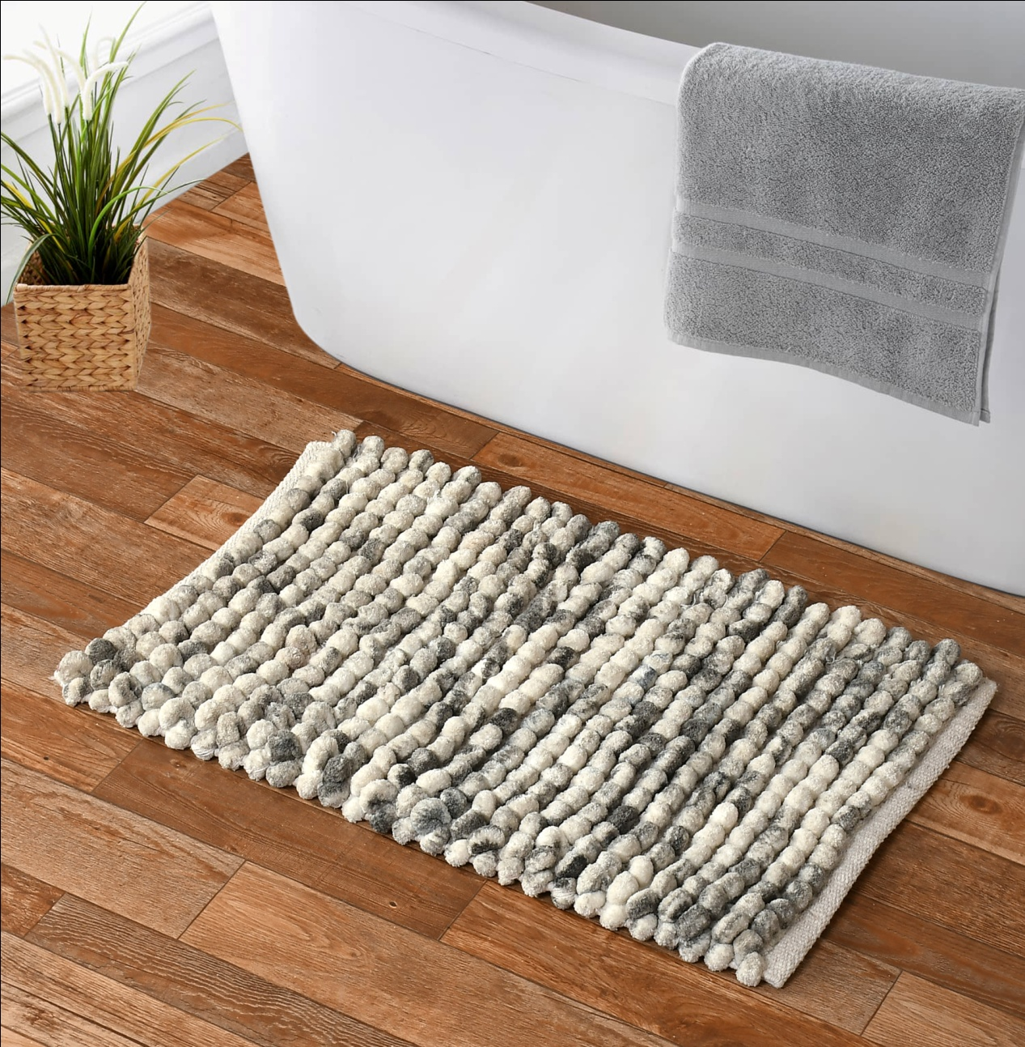
Cotton Tuffted Bathmat
Size-50x80 Cm
Quality- 2300gsm
Price- 2.95 $
Code – sro-534

Slide 16
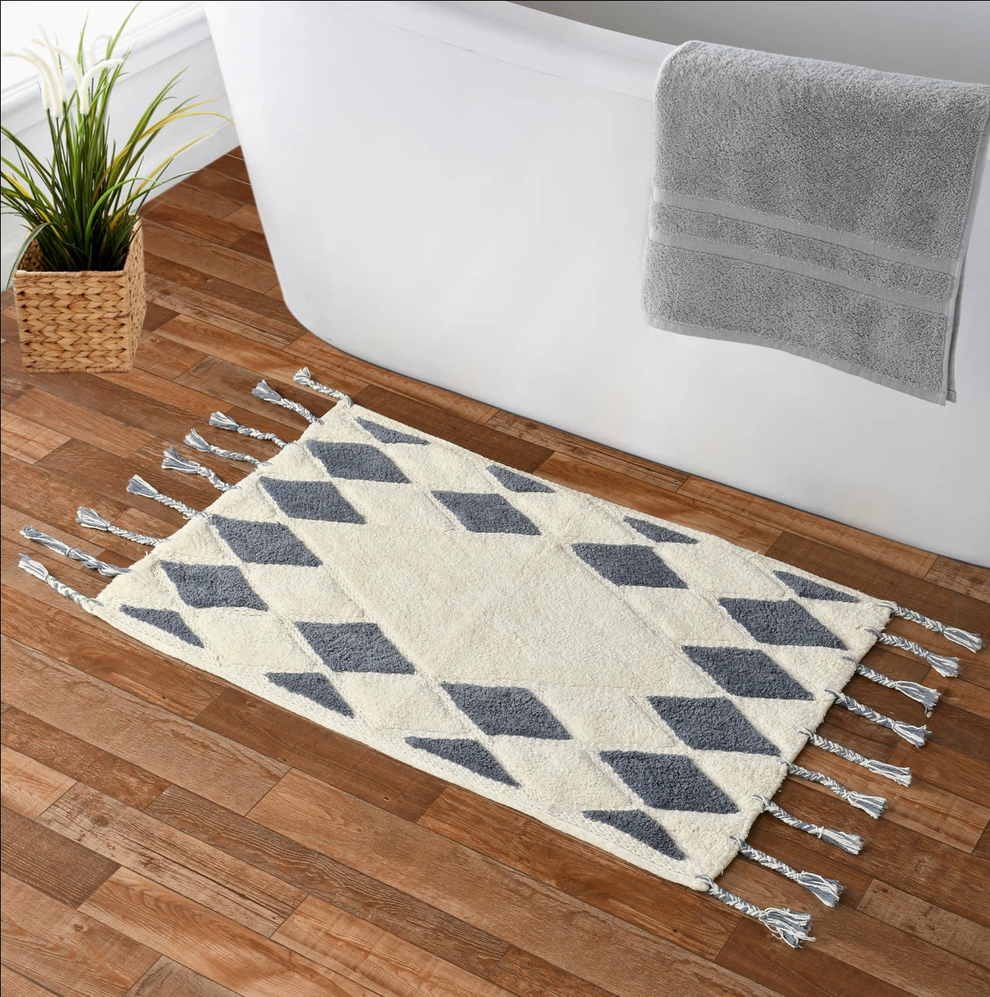
Cotton Tuffted Bathmat
Size-50x80 Cm
Quality- 1650gsm
Price- 2.50 $
Code – sro-535

