Slide 1

Shree Radhey Overseas
Shree Radhey Overseas is one of the leading Manufacturers and Exporters of textile home furnishing products in India. With a history of more than 20 years, we settled ourselves as the reputed supplier amongst our client with 0% rejection through which we have gained the confidence to supply our products to overseas customer directly

Slide 2
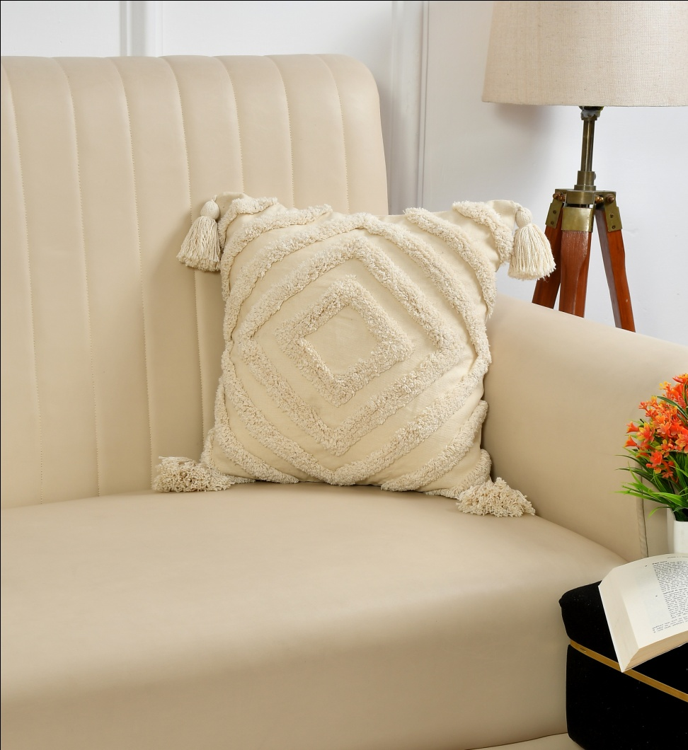
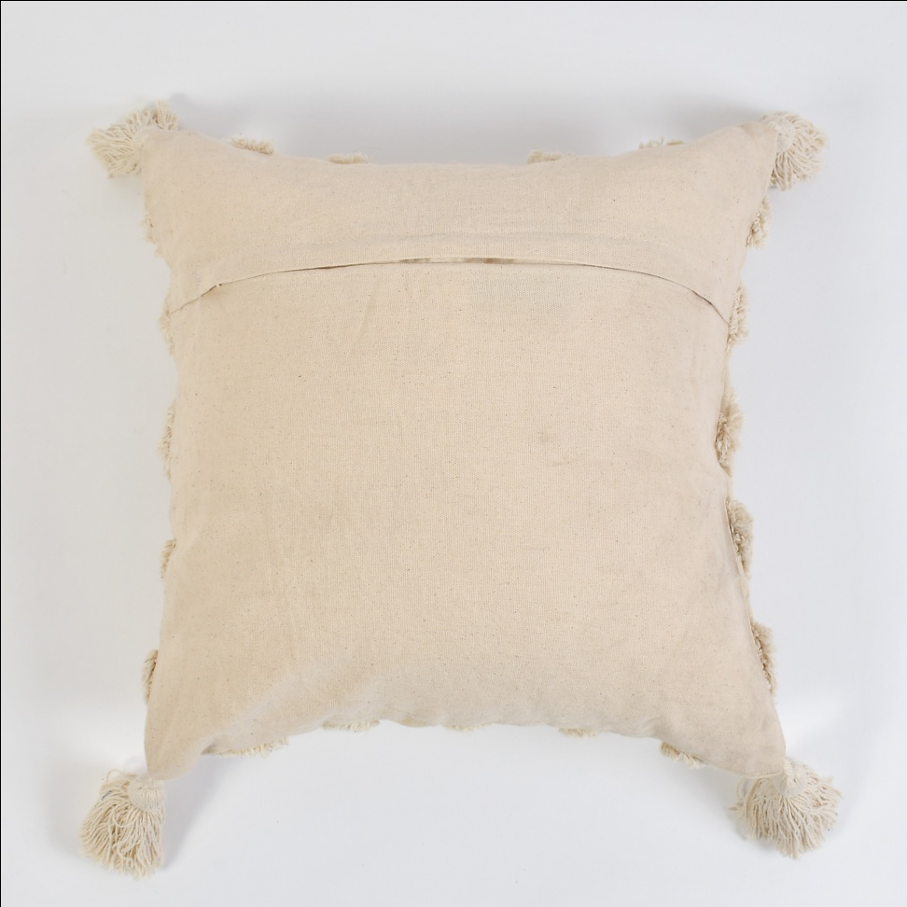
Cotton Cushion ( 45 X 45 Cm ) Filler Polyster material Price = $ 3.99 Code = Sro -537

Slide 3
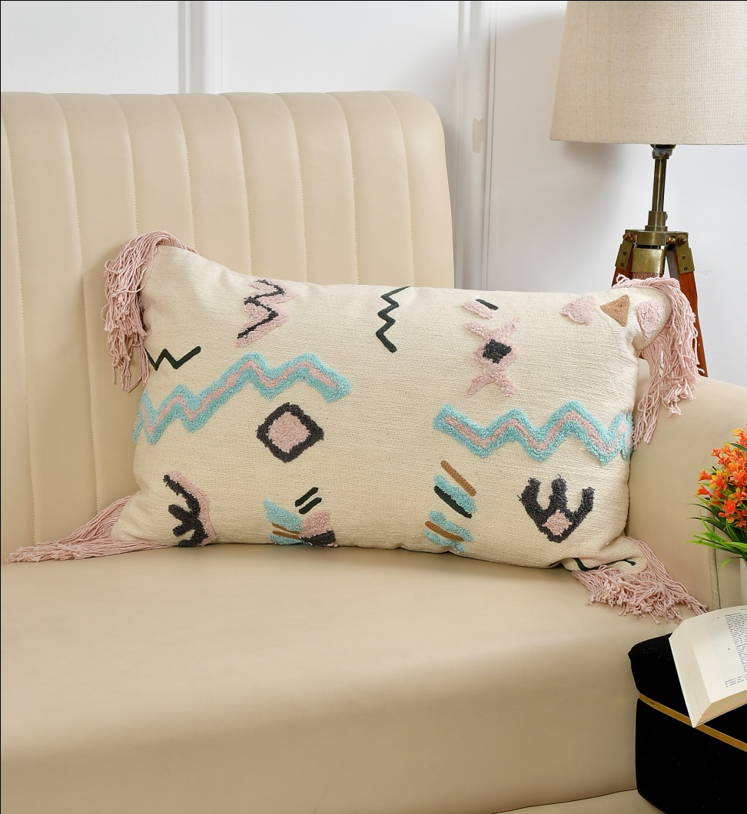
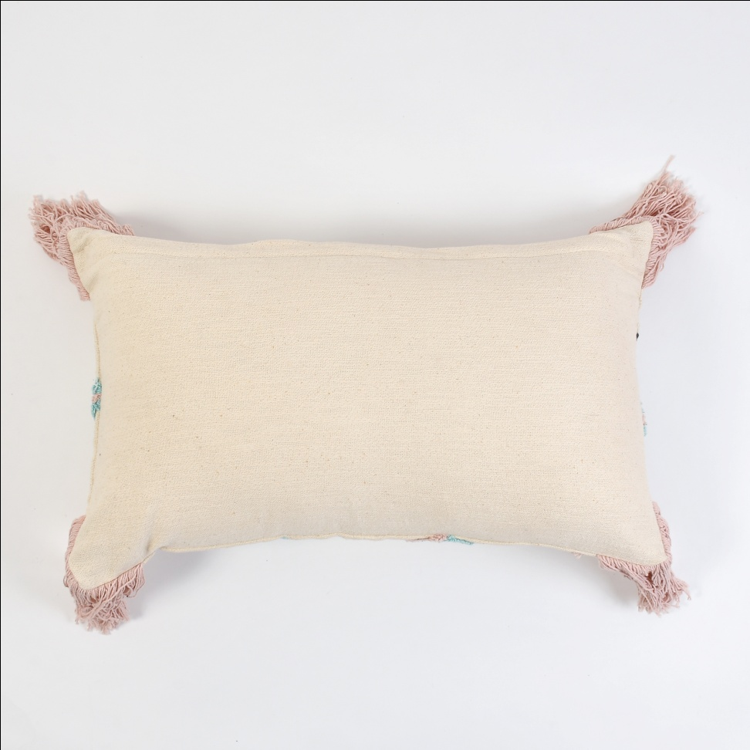
Cotton Cushion ( 45 X 45 Cm ) Filler Polyster material Price = $ 4.50 Code = Sro -538

Slide 4
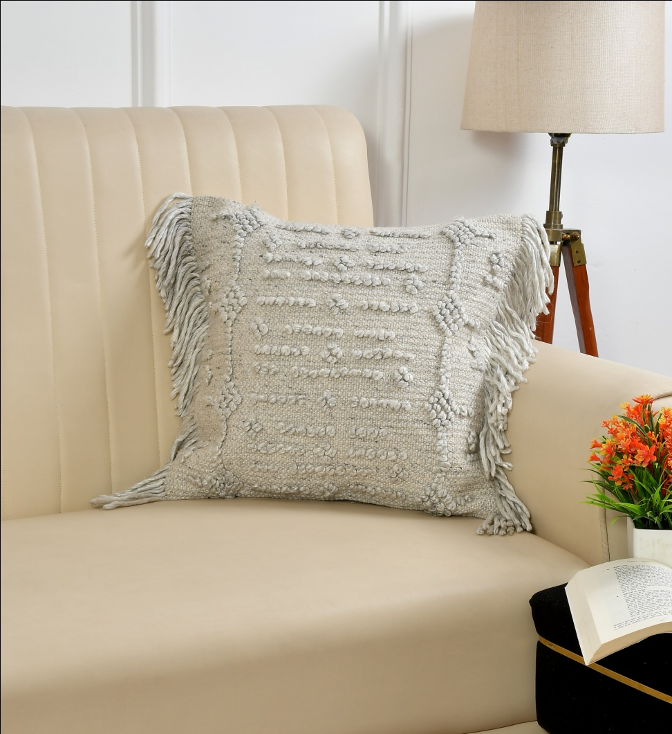
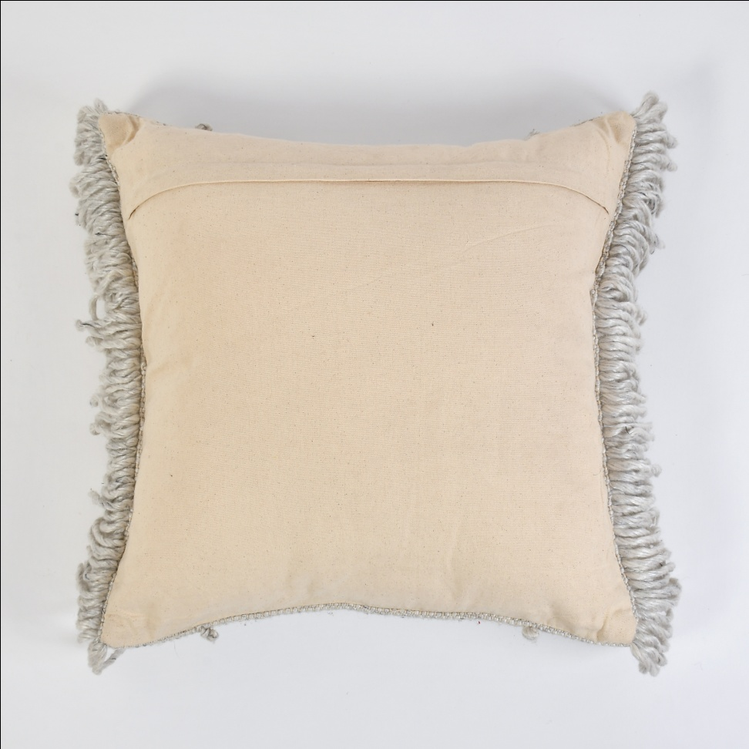
Polyster Cushion ( 45 X 45 Cm ) Filler Polyster material Price = $ 4.95 Code = Sro -539

Slide 5
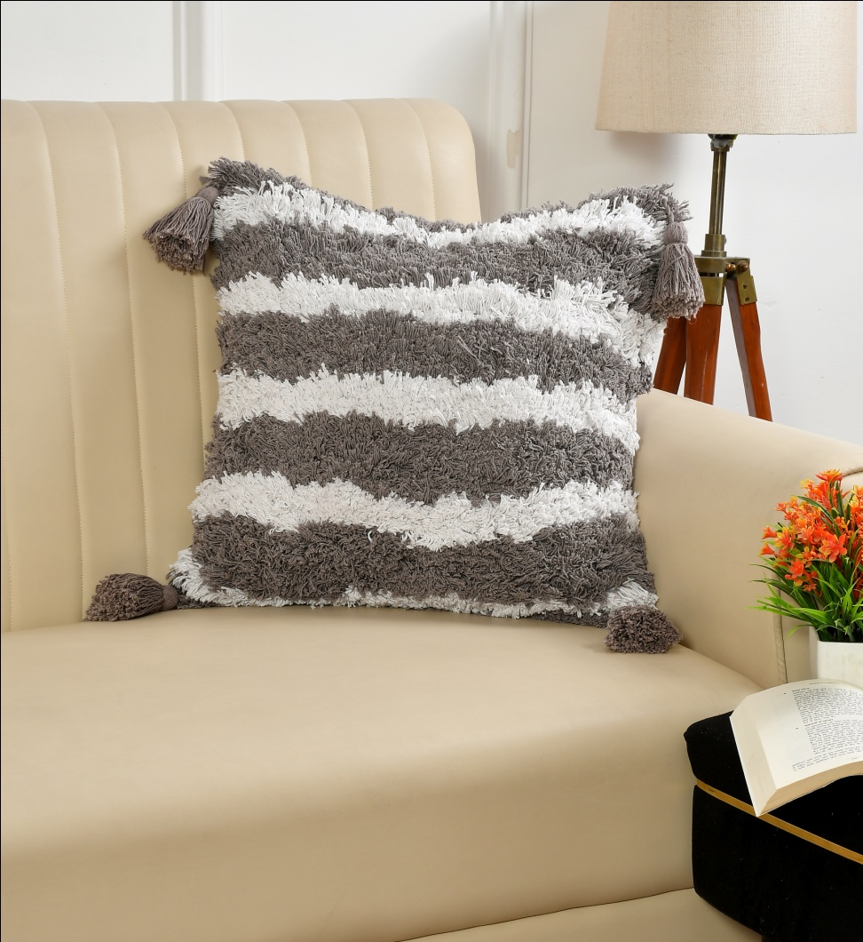
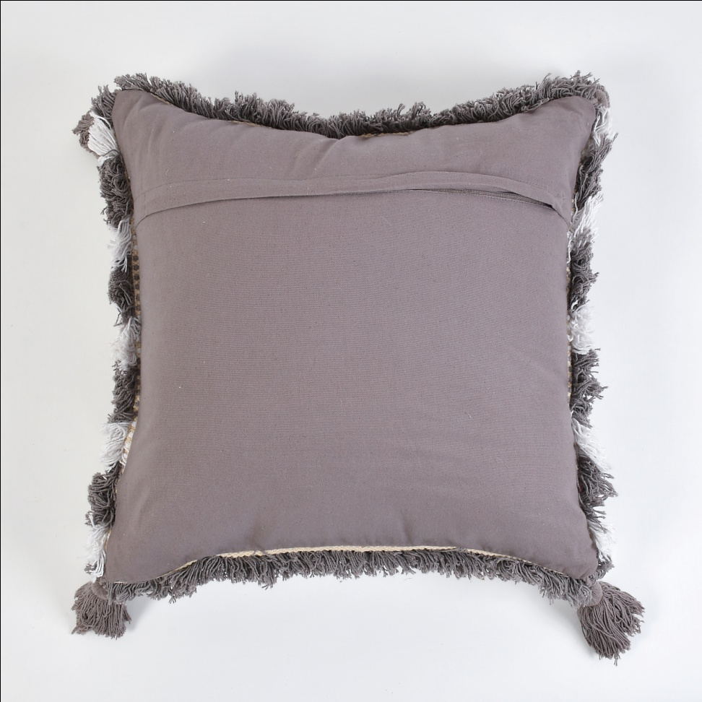
Cotton Cushion ( 45 X 45 Cm ) Filler Polyster material Price = $ 4.50 Code = Sro -540

Slide 6
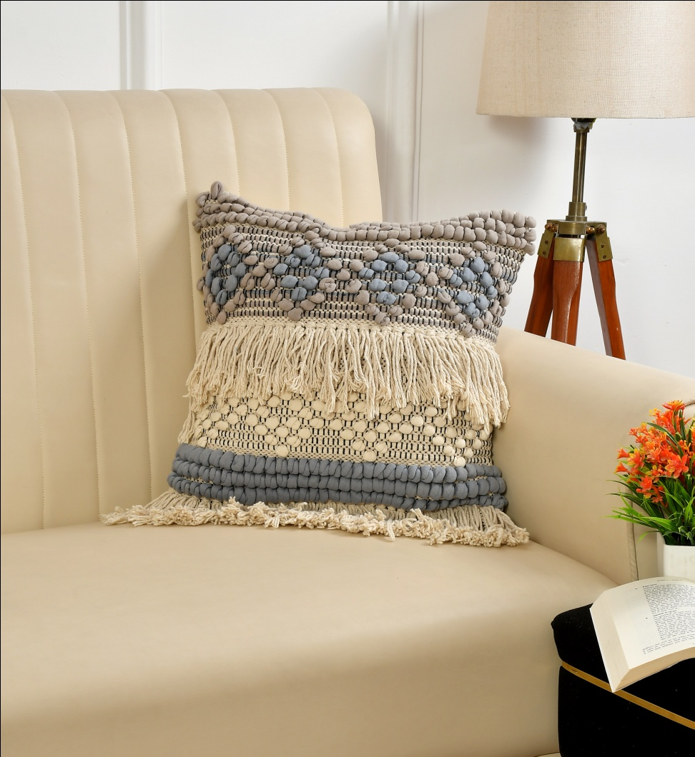
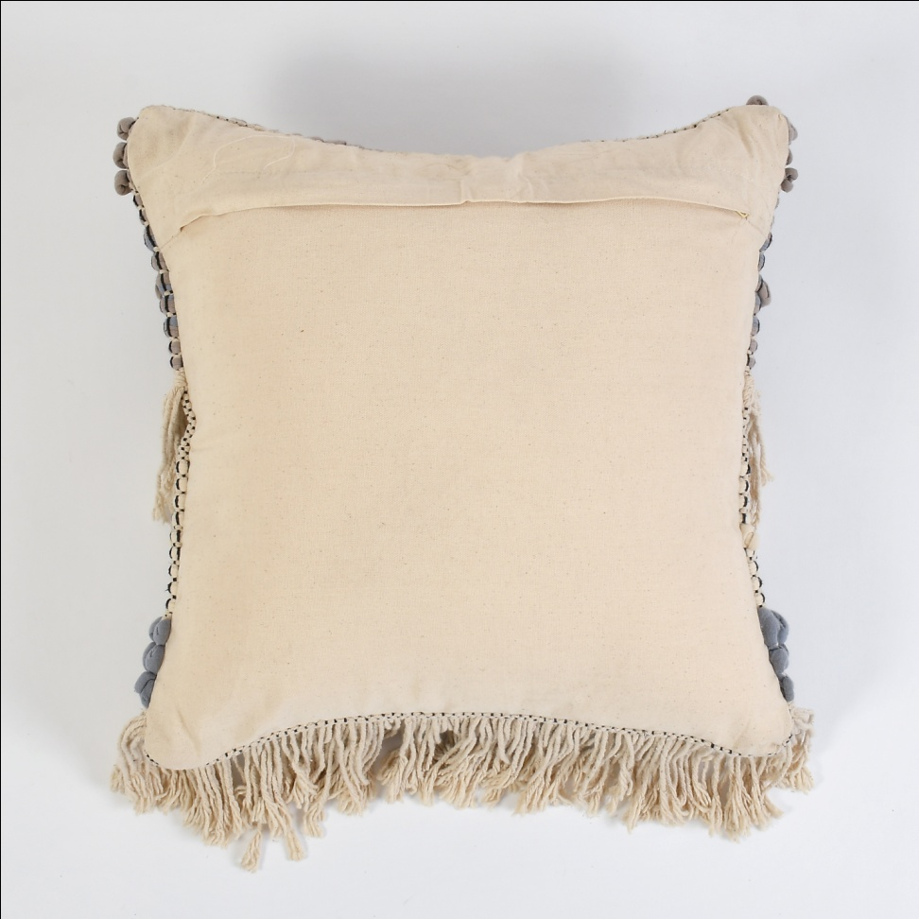
Cotton Polyster Mix Cushion ( 45 X 45 Cm ) Filler Polyster material Price = $ 4.95 Code = Sro -541

Slide 7

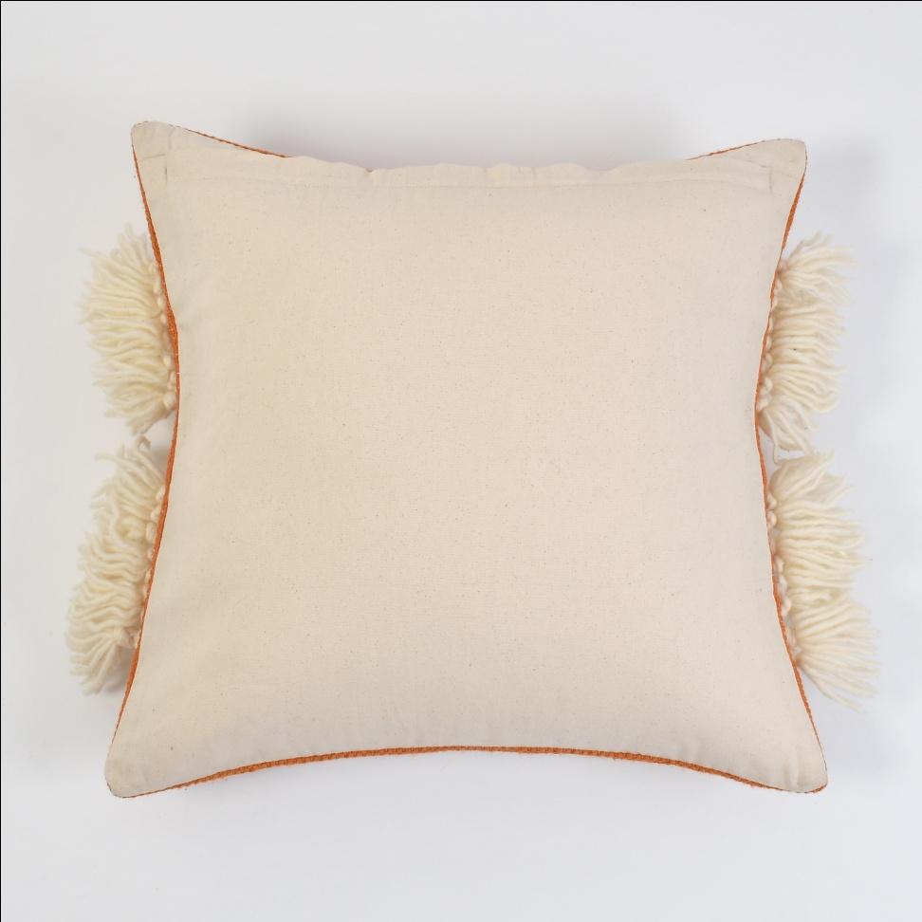
Jute Wool Mix Cushion ( 45 X 45 Cm ) Filler Polyster material Price = $ 6.50 Code = Sro -542

Slide 8
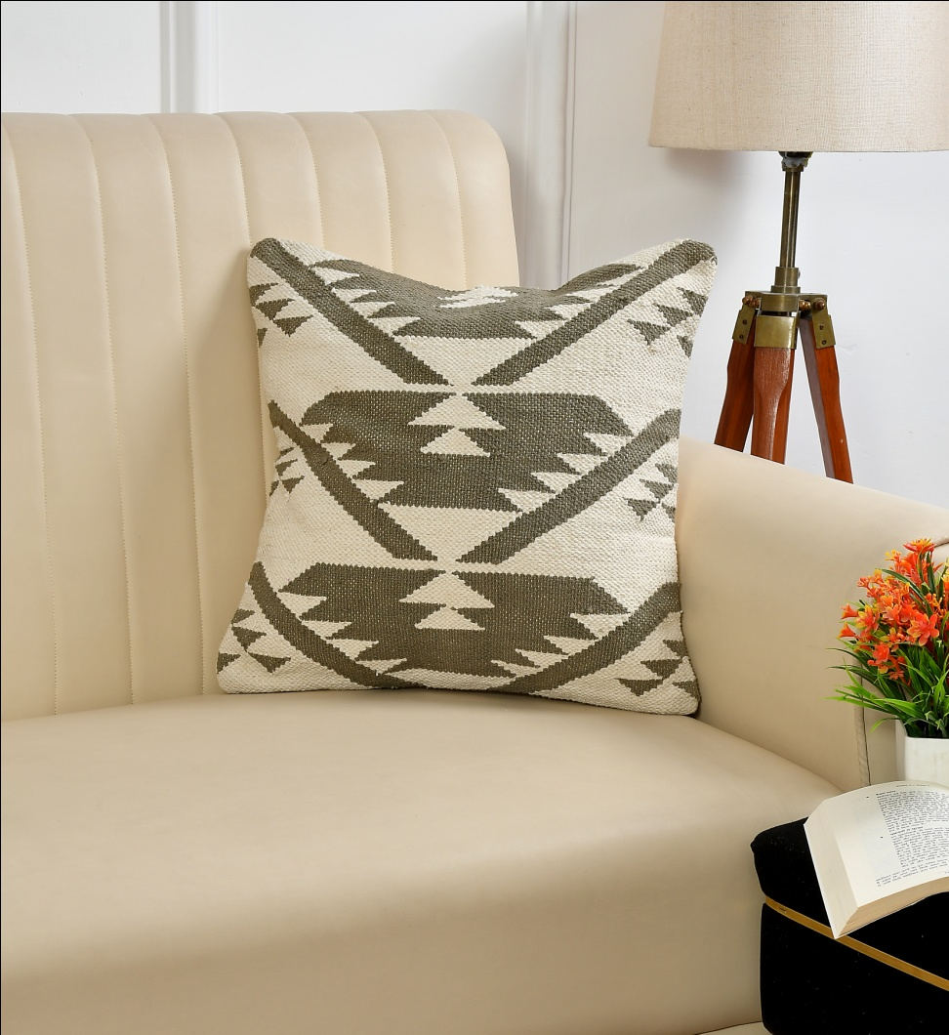
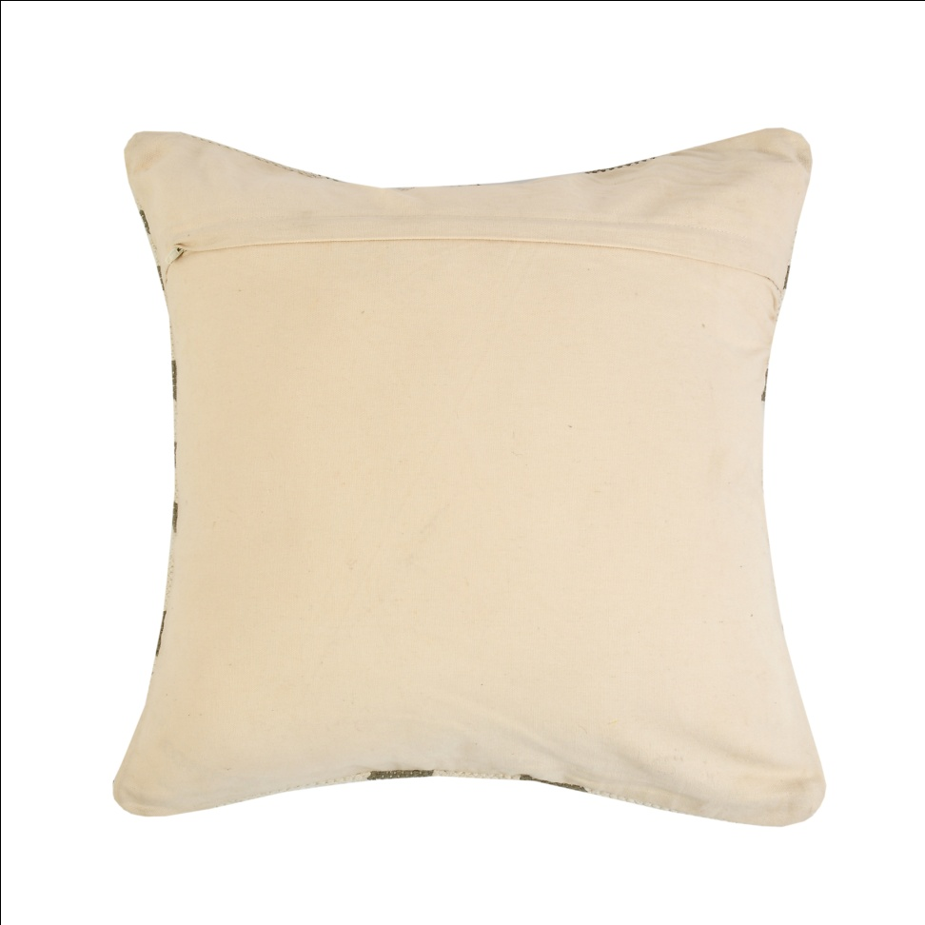
Cotton Cushion ( 45 X 45 Cm ) Filler Polyster material Price = $ 6.25 Code = Sro -543

Slide 9
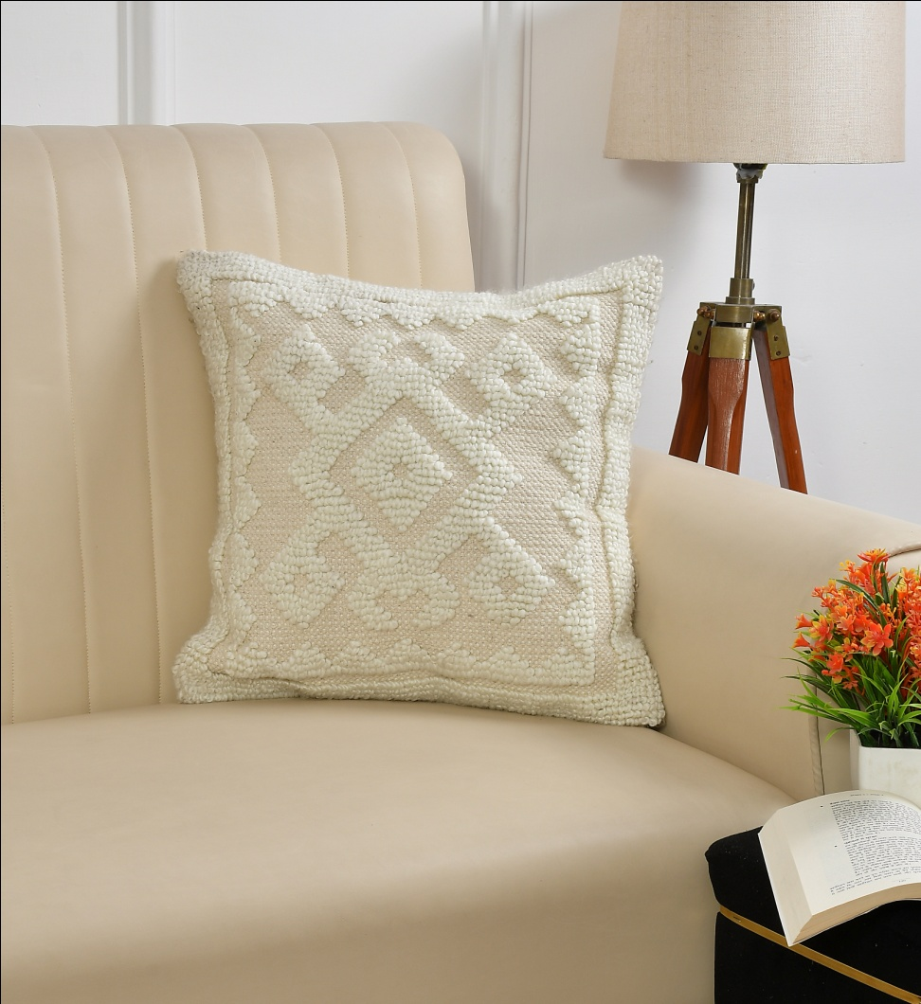
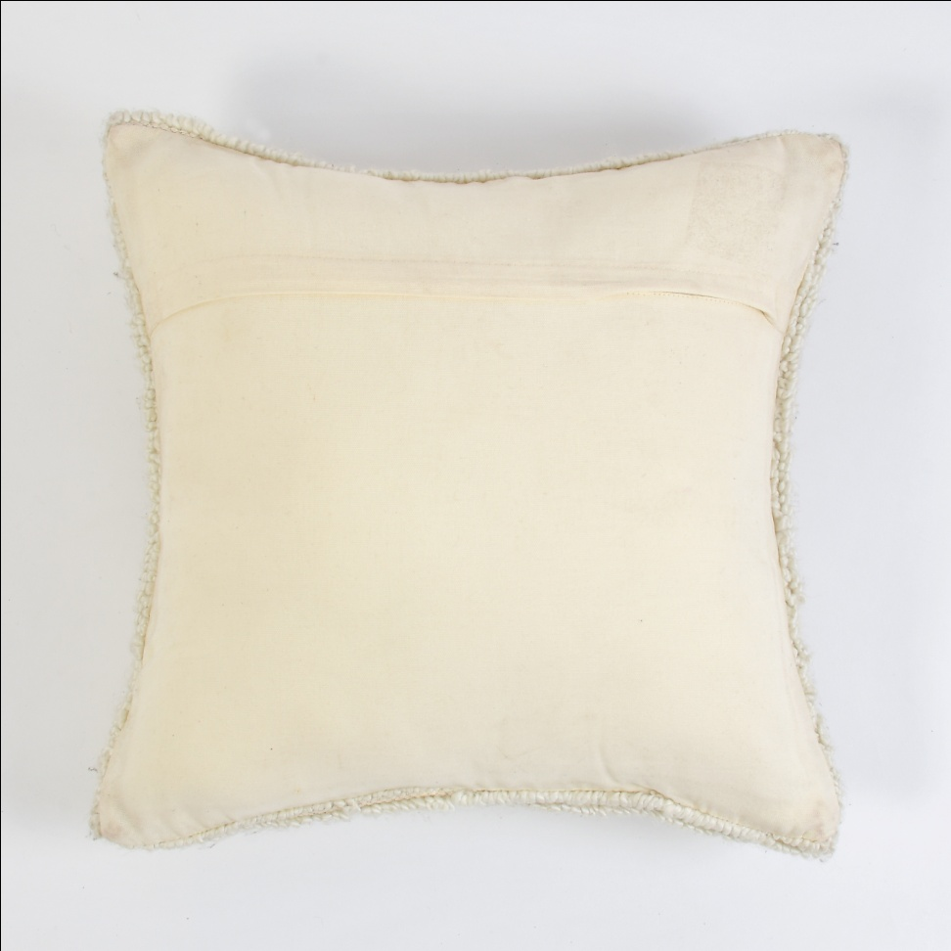
Cotton Polyster Mix Cushion ( 45 X 45 Cm )Filler Polyster material Price = $ 5.90 Code = Sro -544

Slide 10
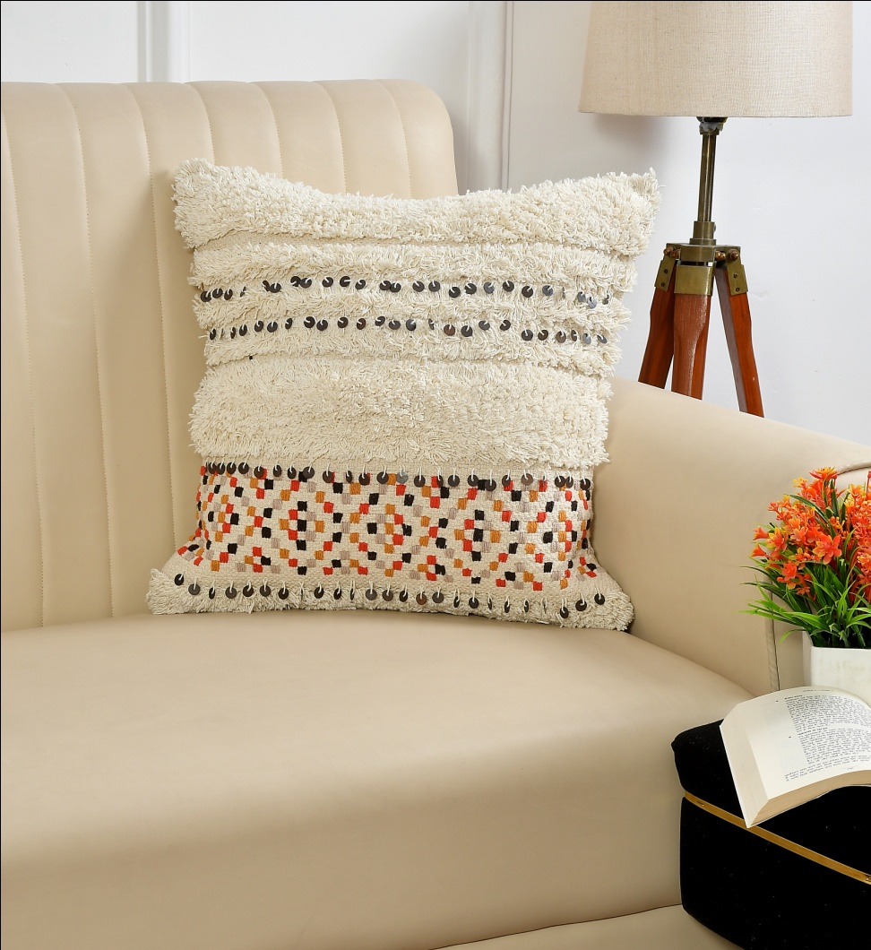
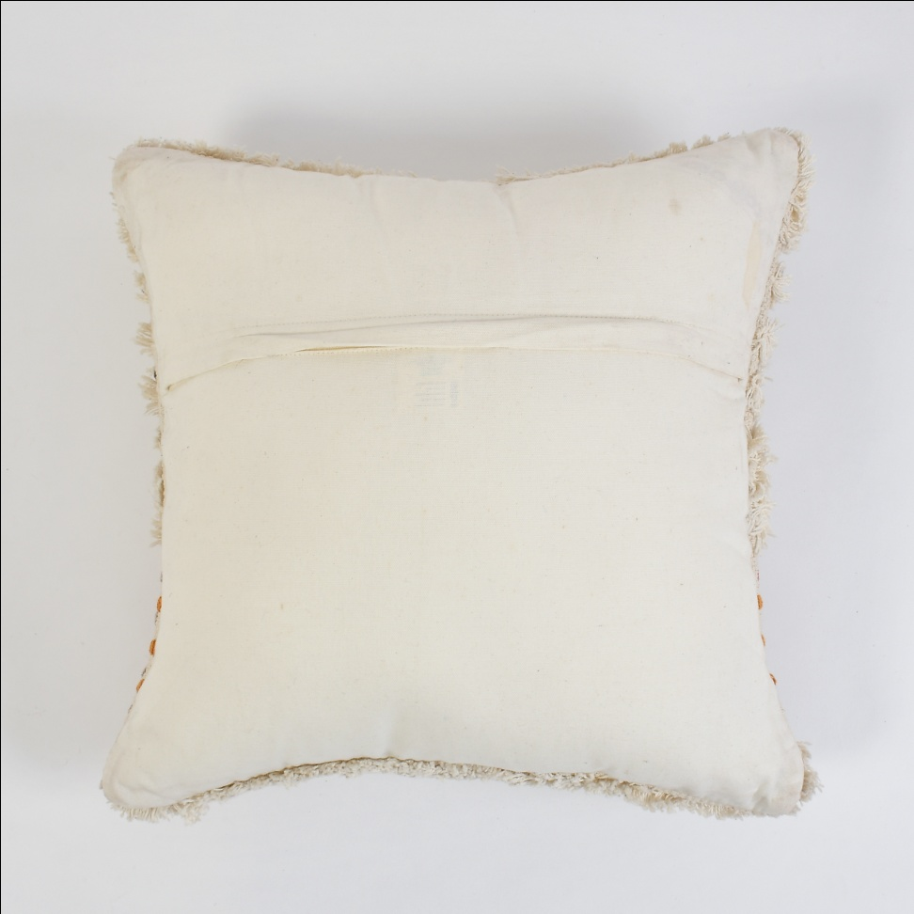
Cotton Cushion ( 45 X 45 Cm ) Filler Polyster material Price = $ 5.99 Code = Sro -545

Slide 11
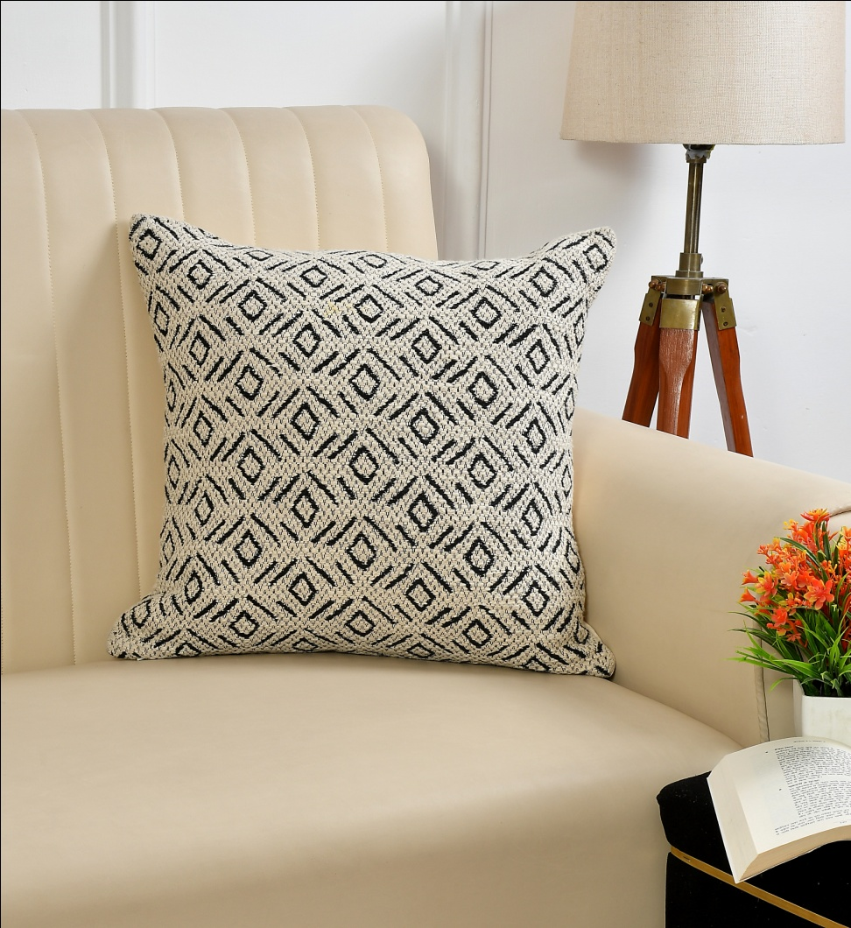
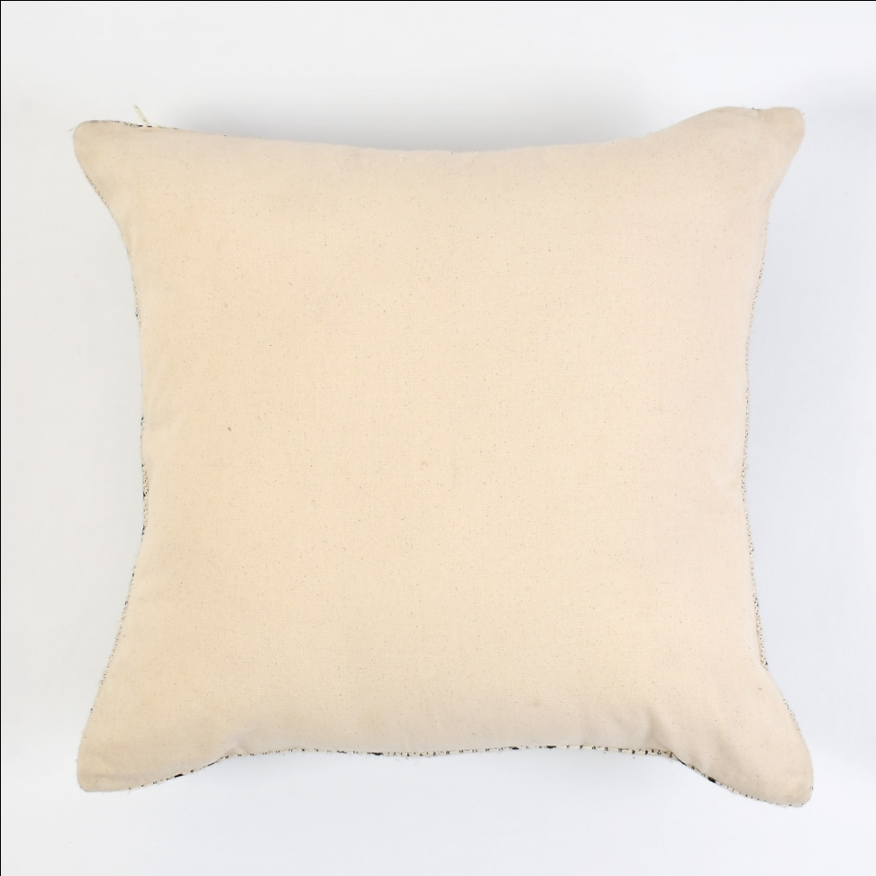
Cotton Cushion ( 45 X 45 Cm ) Filler Polyster material Price = $ 4.99 Code = Sro -546

Slide 12
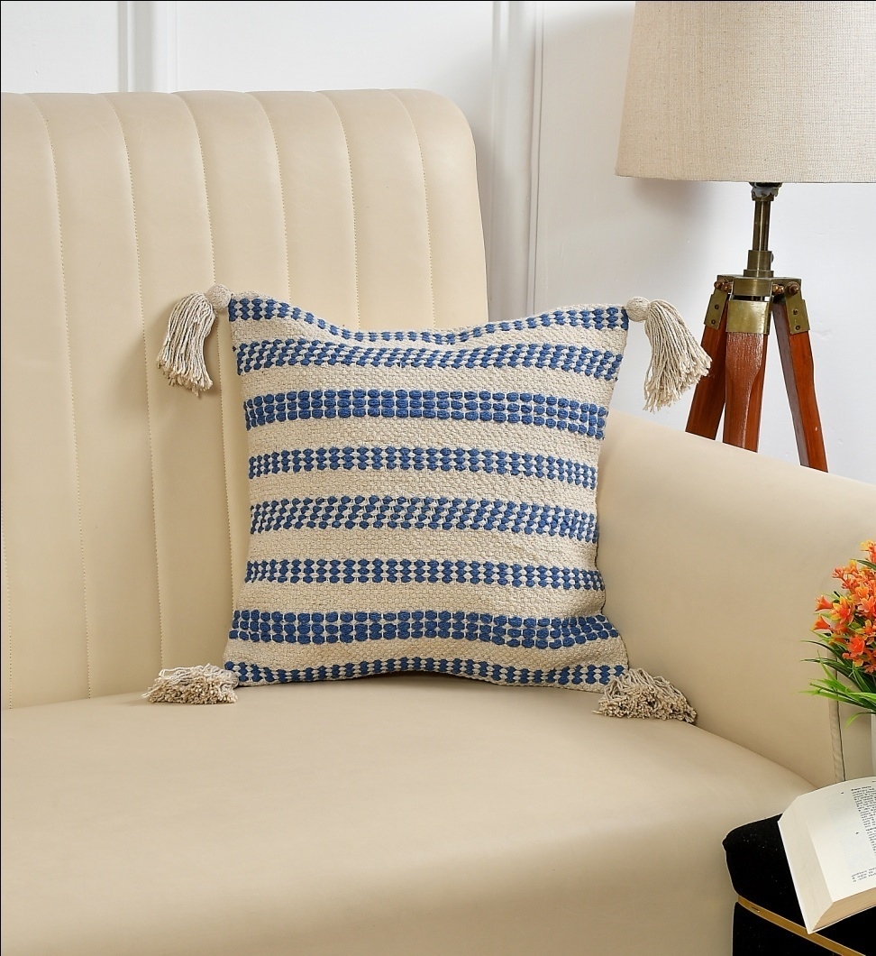
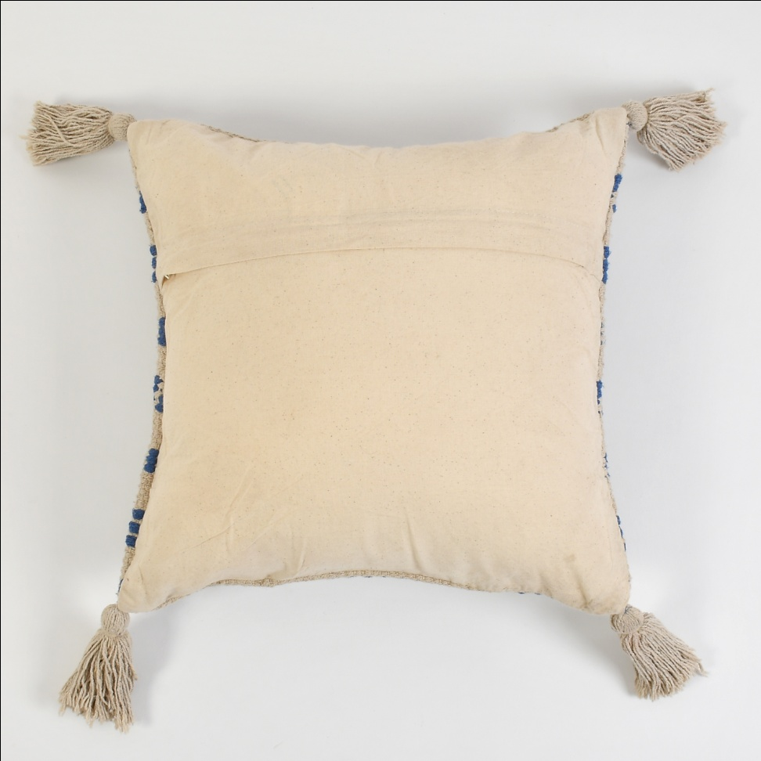
Cotton Cushion ( 45 X 45 Cm ) Filler Polyster material Price = $ 4.60 Code = Sro -547

Slide 13
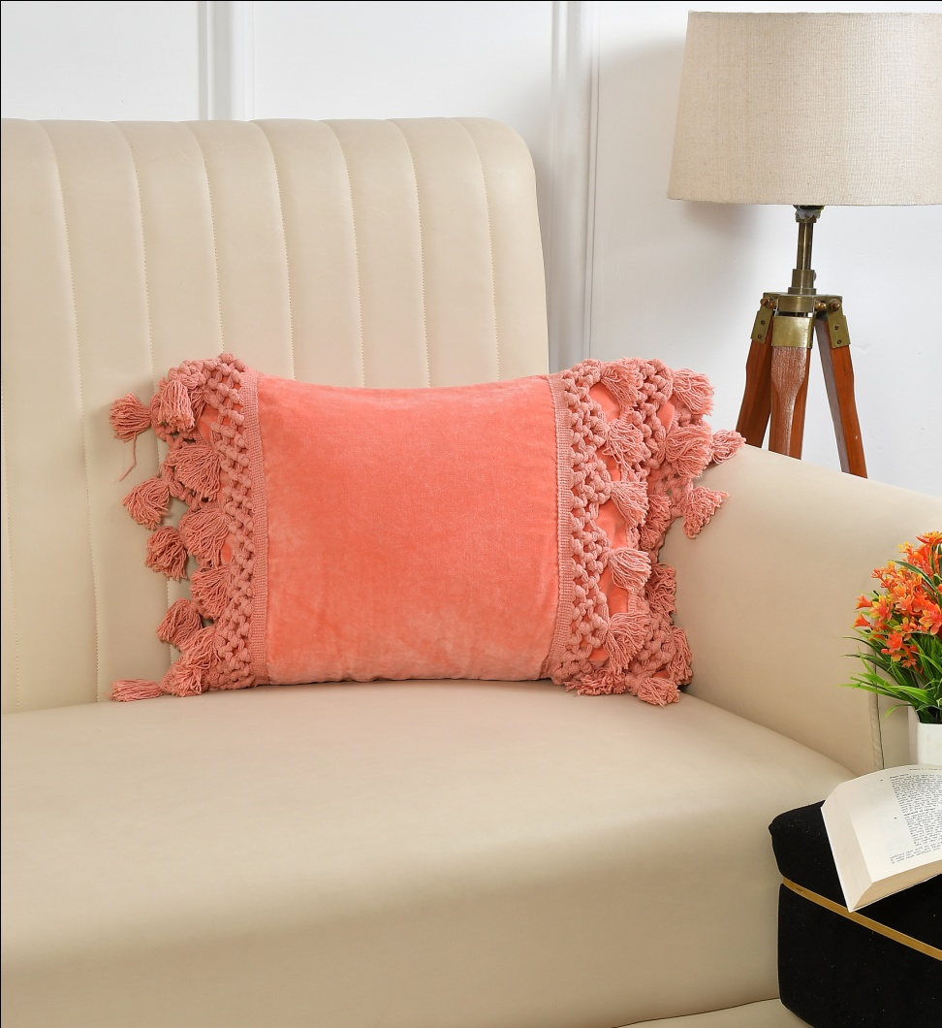
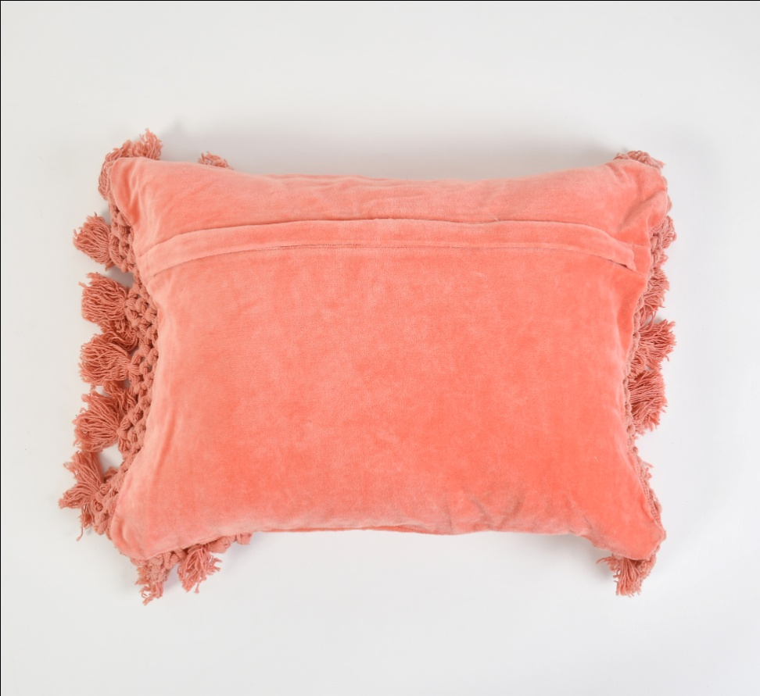
Velvet Cushion ( 45 X 45 Cm ) Filler Polyster material Price = $ 5.50 Code = Sro -548

