Slide 1

INDIAN TEXTILE INNOVATION
SAMPLES PPT
Chambray Design Collections

Slide 2
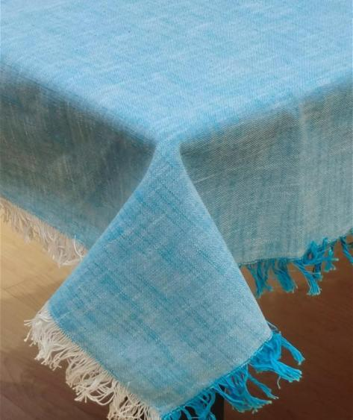
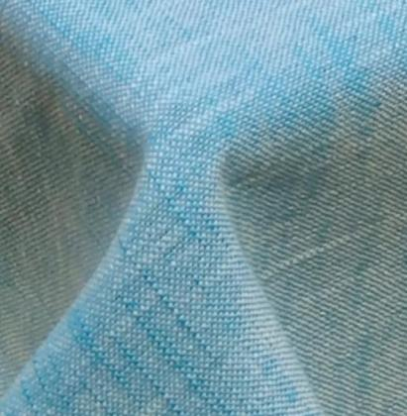
INDIAN TEXTILE INNOVATION
Chambray Design Table cloth in Slub with double coloured Raw Fringes
ITI - 622 - TURQ / WHITE

Slide 3
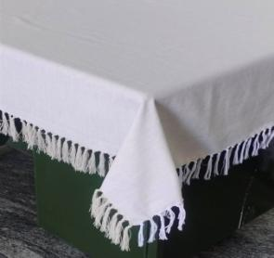
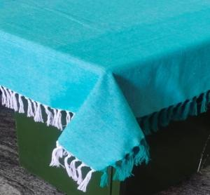
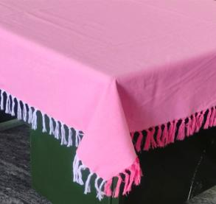
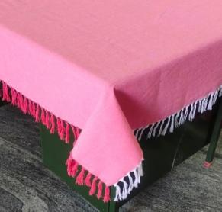
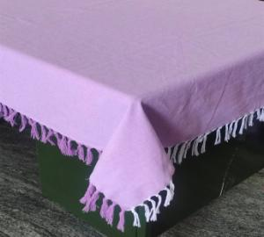
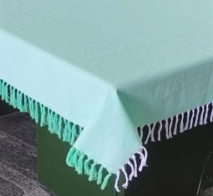
INDIAN TEXTILE INNOVATION
Chambray Design Table cloth with double coloured Single knot Fringes
ITI - 615 / IVORY
ITI - 616 / D.GREEN
ITI - 617 / BABY PINK
ITI - 618 / BRICK
ITI - 619 / LAVENDER
ITI - 620 / L.GREEN

Slide 4
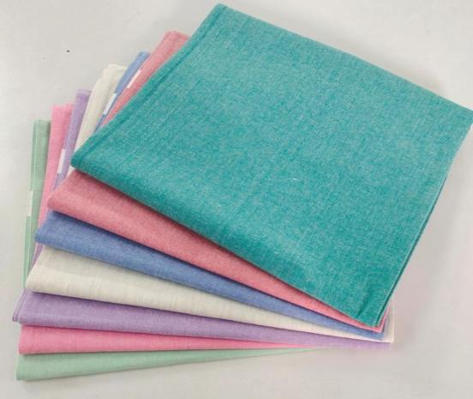
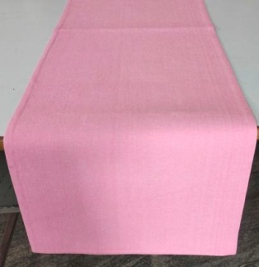
INDIAN TEXTILE INNOVATION
Chambray Design Fused Table Runners

Slide 5
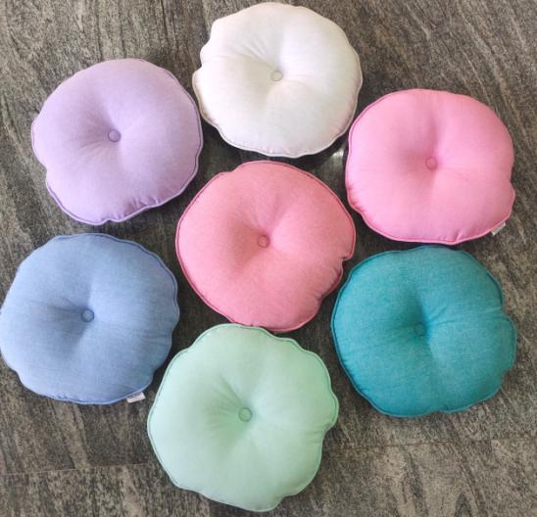
INDIAN TEXTILE INNOVATION
Round Cushions with Piping & Button / 40 Cms Dia

Slide 6
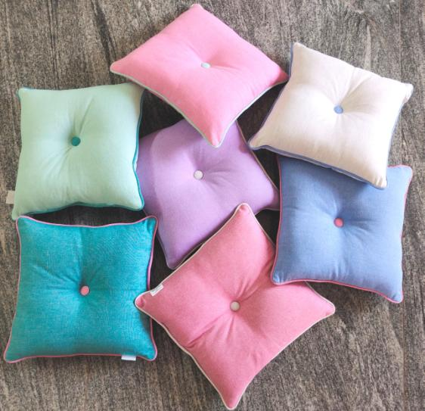
INDIAN TEXTILE INNOVATION
Square Cushions with Piping & Button / 45 X 45 Cms

Slide 7
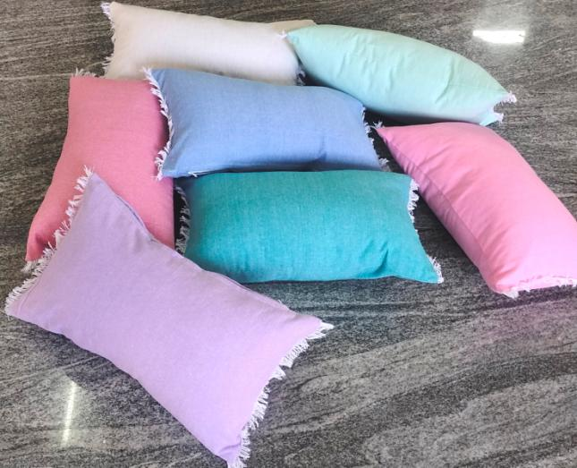
INDIAN TEXTILE INNOVATION
Rectangular Cushion with Raw Fringes / 30 X 50 Cms

Slide 8
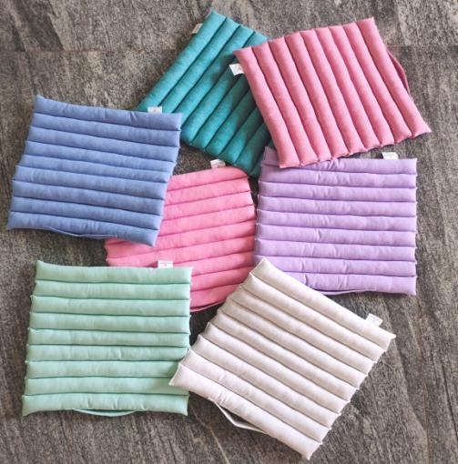
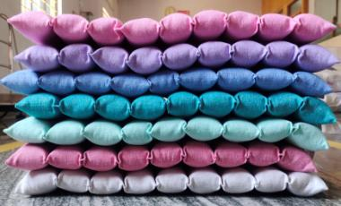
INDIAN TEXTILE INNOVATION
Seat Cushions with Tunnel Tucks / 40 X 40 cms

Slide 9
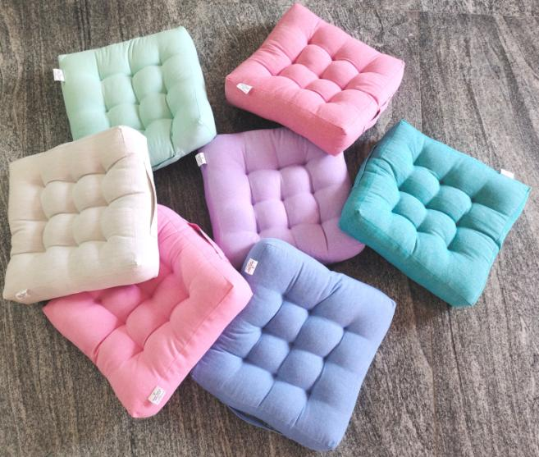
INDIAN TEXTILE INNOVATION
Box Cushions with 9 Tucks / 40 X 40 X 10 Cms

