Slide 1
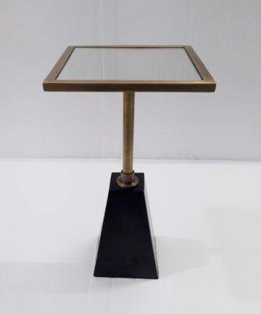
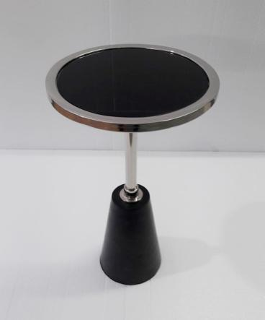
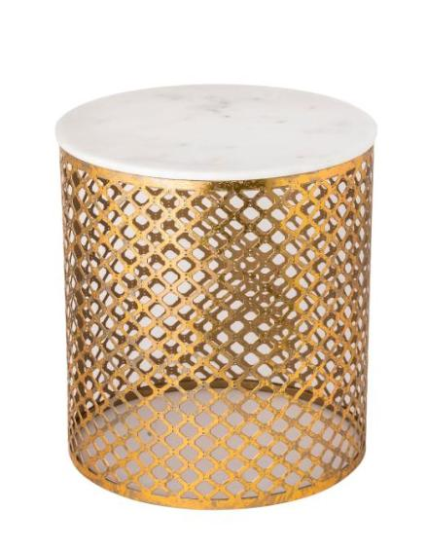
Tables
AD1233
AD1232
AD1216

Slide 2
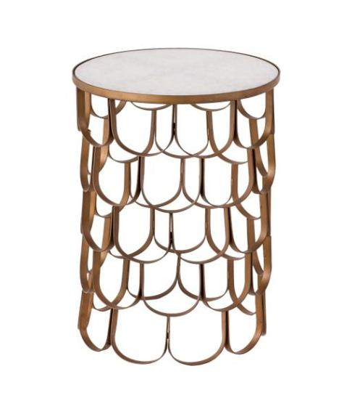
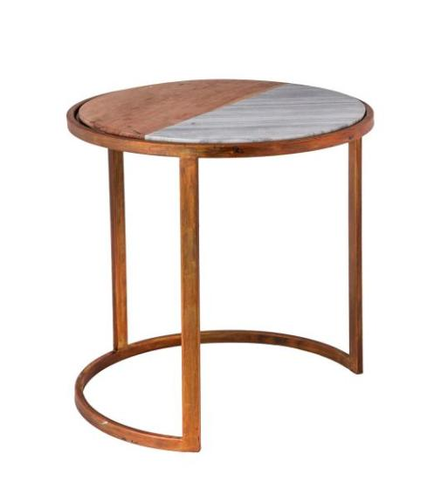
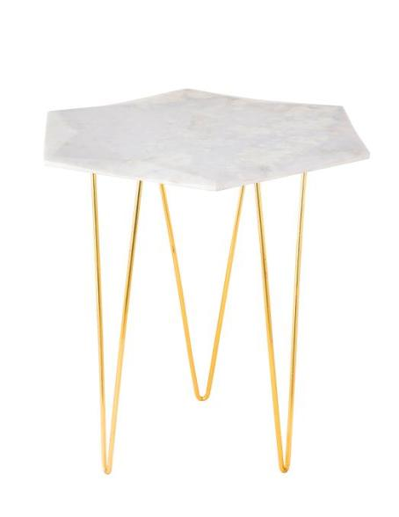
Tables
AD1208
AD1209
AD1205

Slide 3
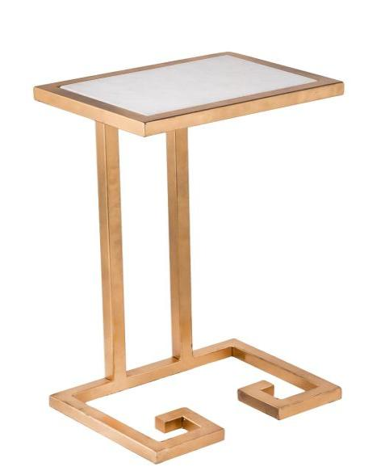
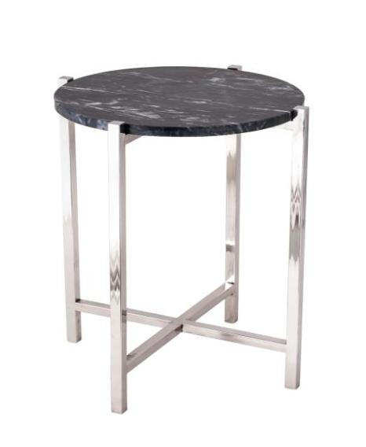
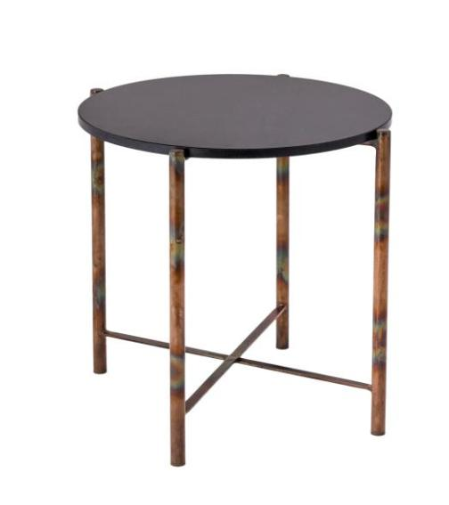
Tables
AD1198
AD1194
AD1203

Slide 4
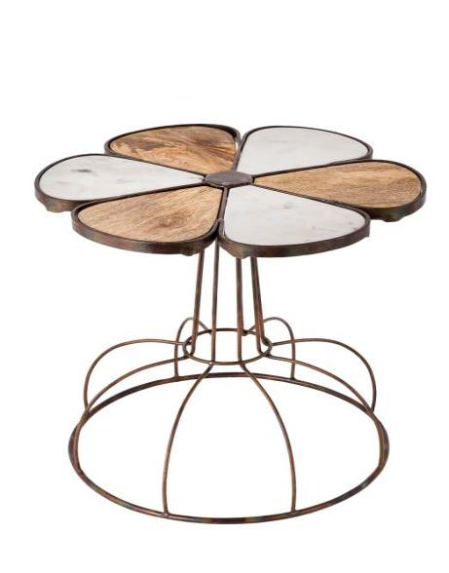
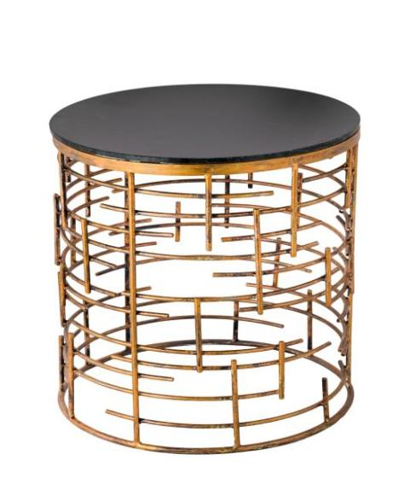
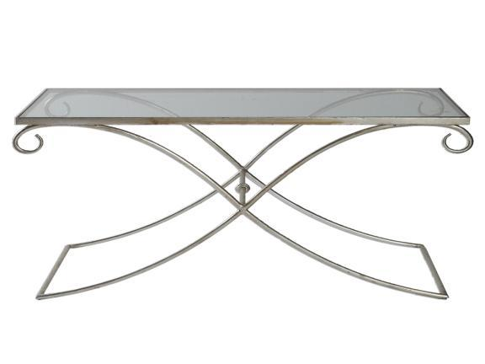
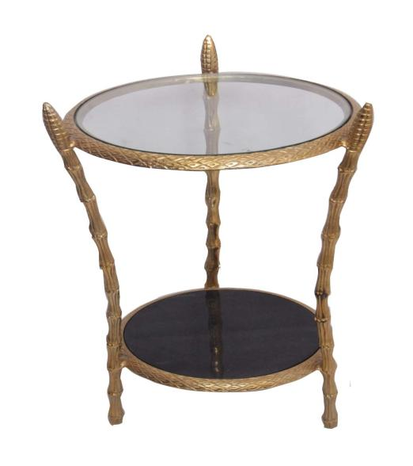
Tables
AD1193
AD1185
AD1069
AD1149

Slide 5
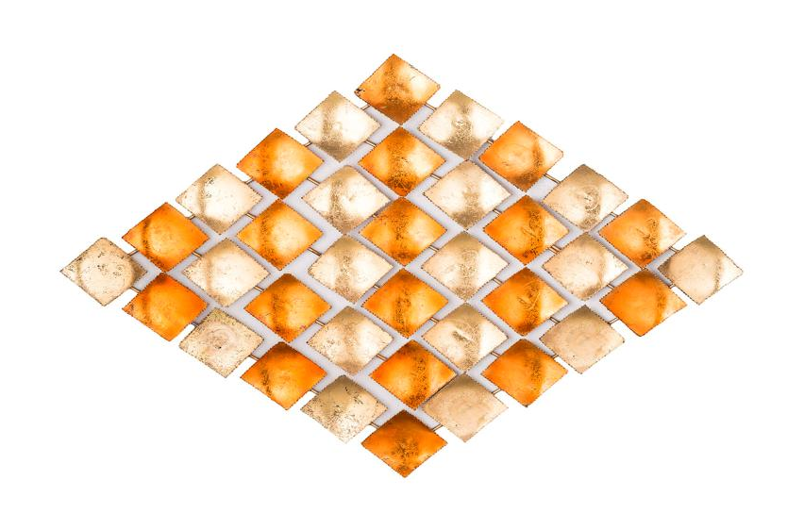
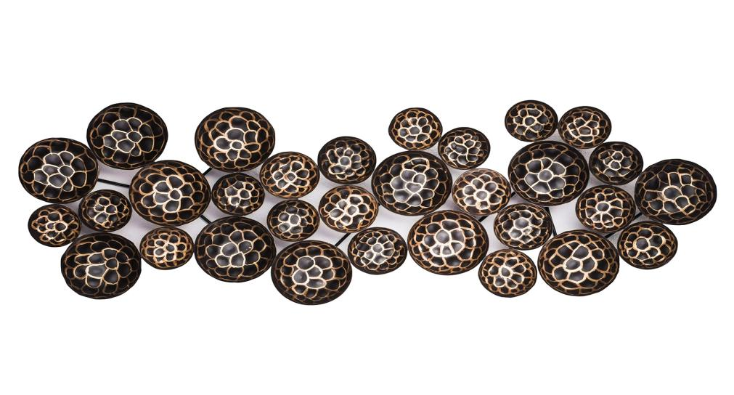
Wall Arts
AD6001
AD6003

Slide 6
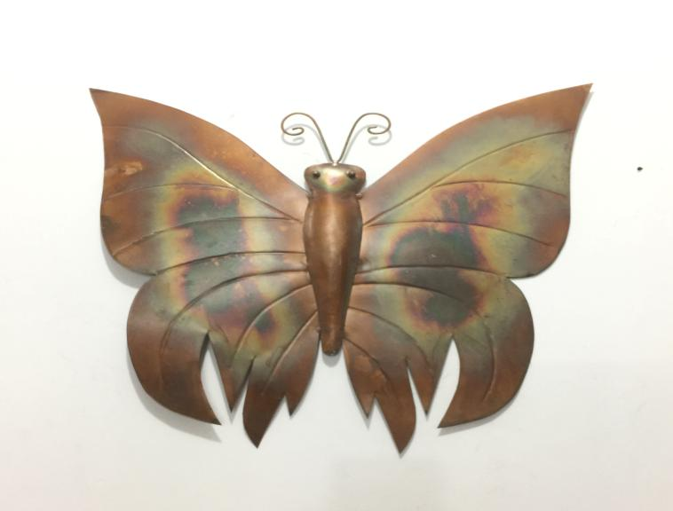
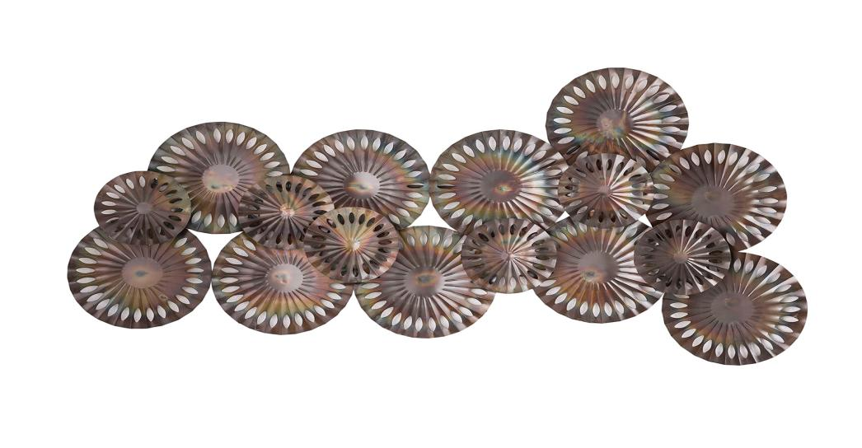
Wall Arts
AD6013
AD6007

Slide 7
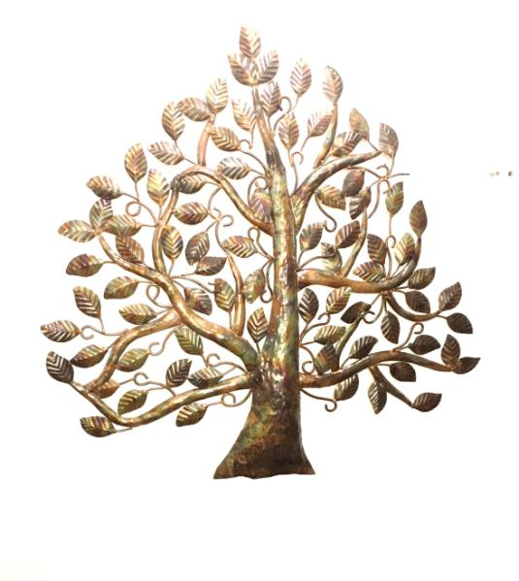
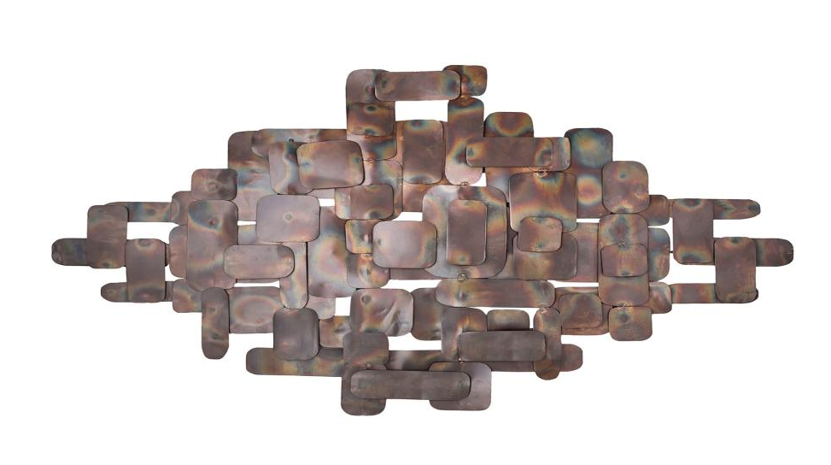
Wall Arts
AD6016

Slide 8
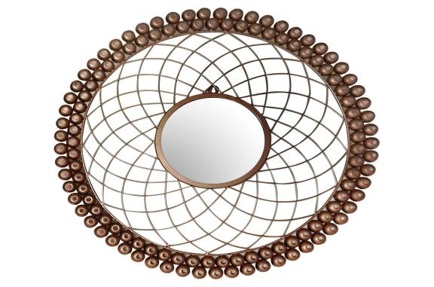
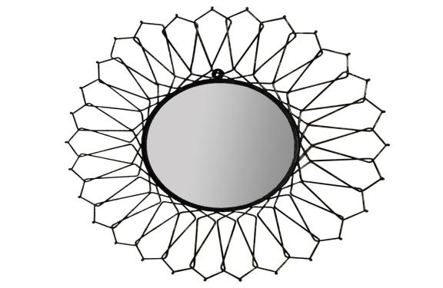
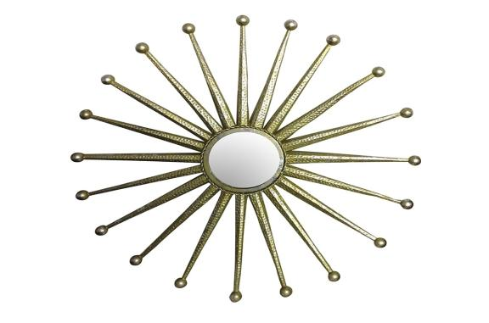
Wall Mirrors
AD6039
AD6026
AD6040

Slide 9
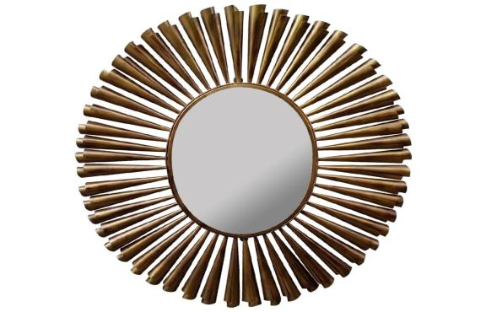

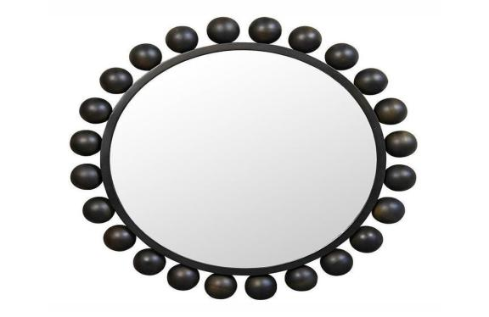
Wall Mirrors
AD6033
AD6032
AD6031

Slide 10
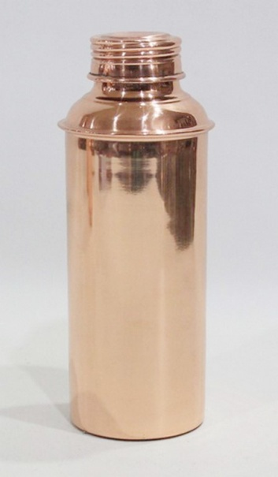
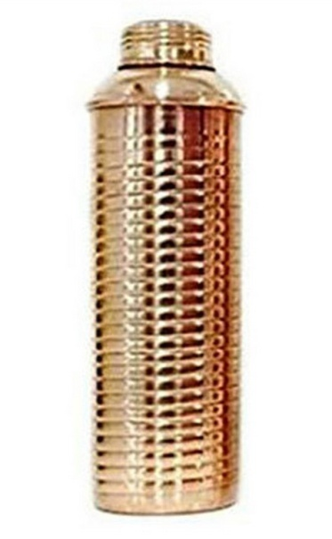
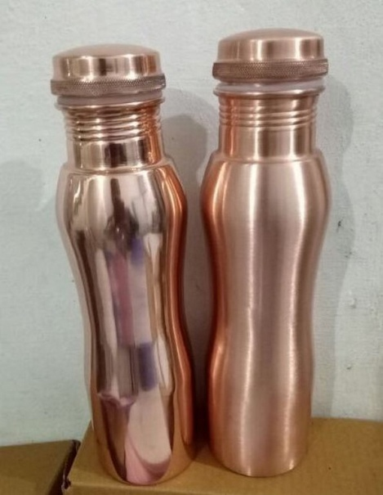
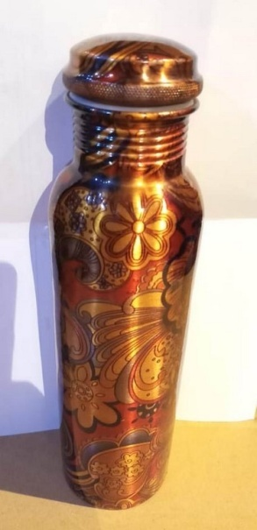
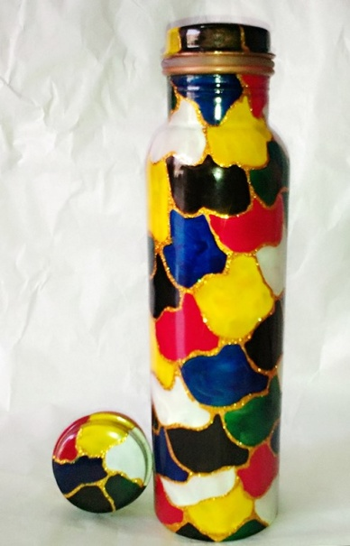
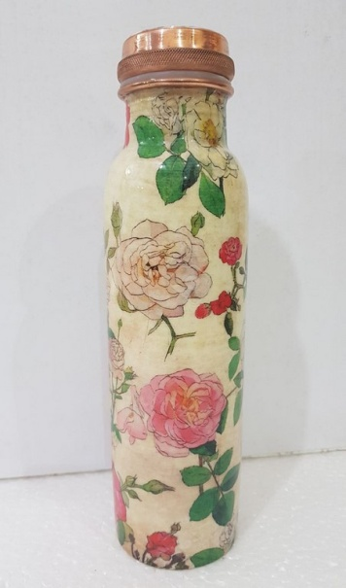
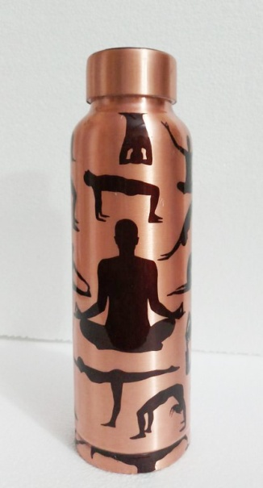
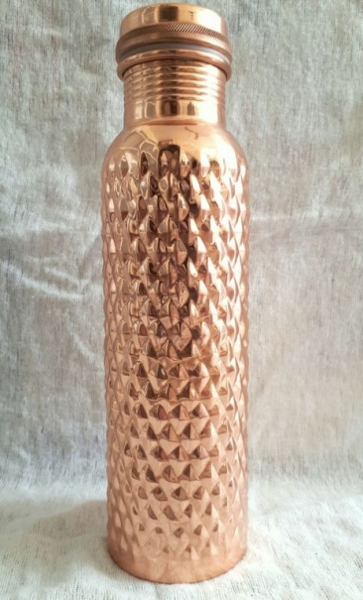
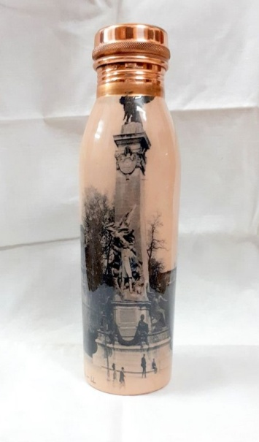
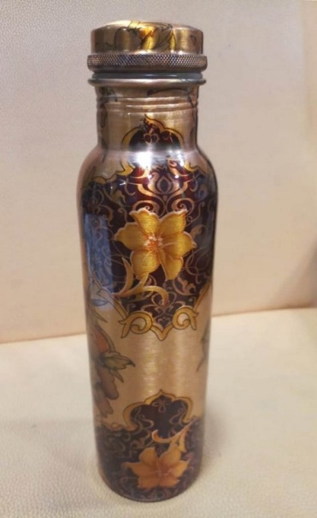
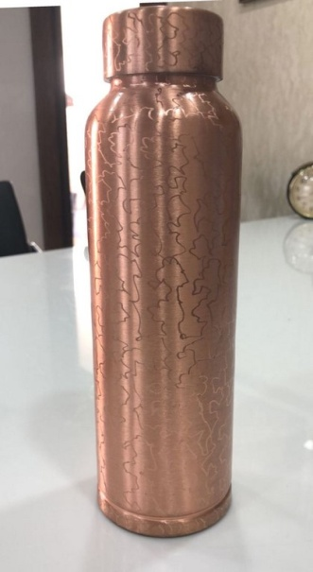
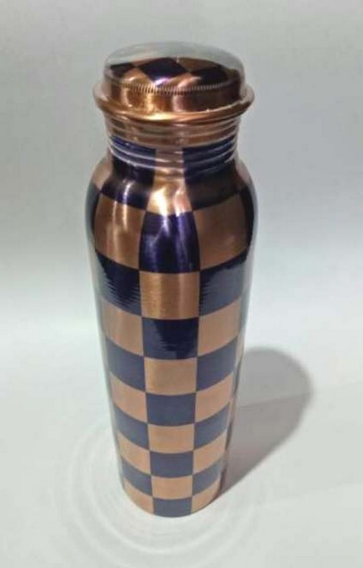
Water Bottles
AD-7685
AD-7687
AD-7696
AD-7698
AD-7701
AD-7709
AD-7713
AD-7727
AD-7735
AD-7749
AD-7761
AD-7765

Slide 11
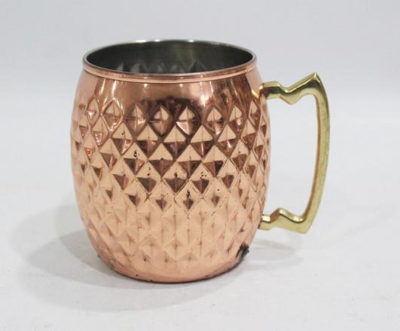
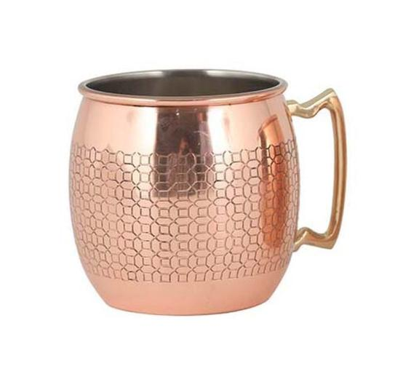
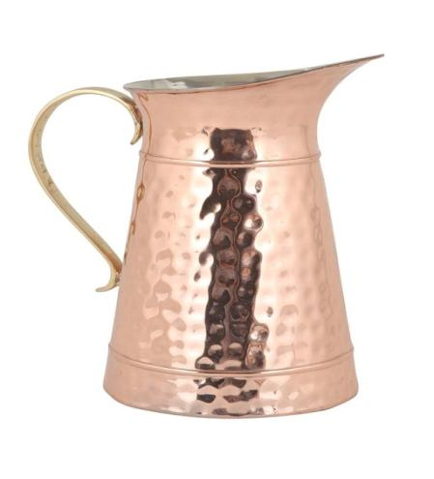
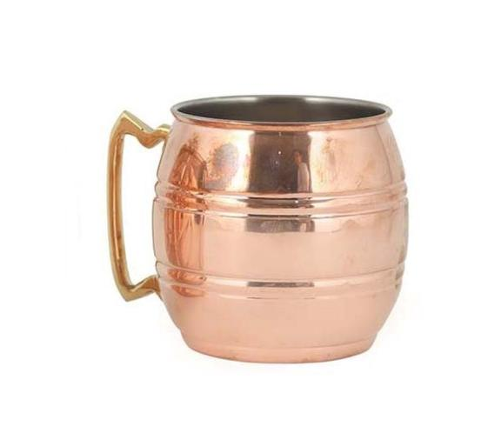
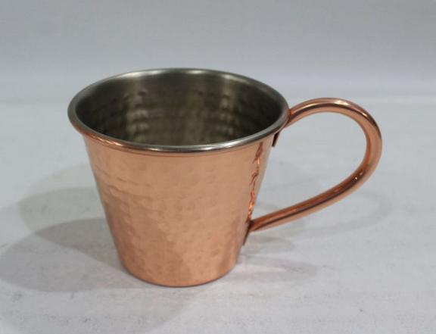
Mugs & Pitcher
AD-200254

Slide 12
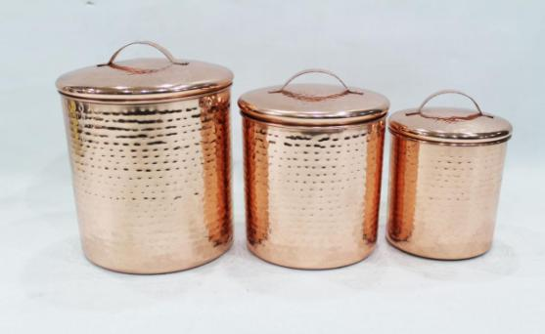
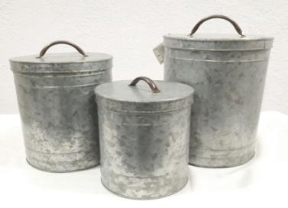
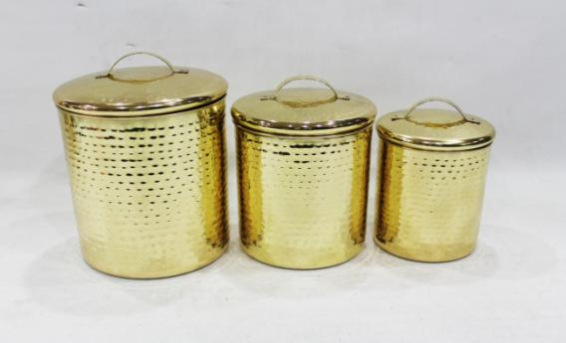
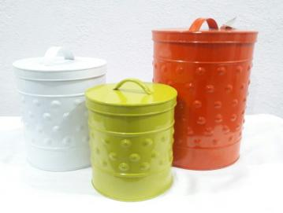
Cannisters
AD-3818-ABC
AD-3802 ABC
AD-3811-ABC
AD-3801 ABC

Slide 13
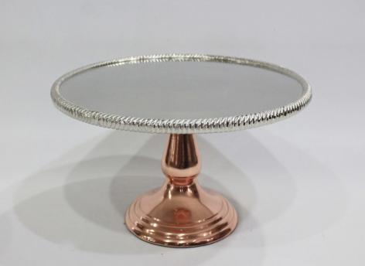
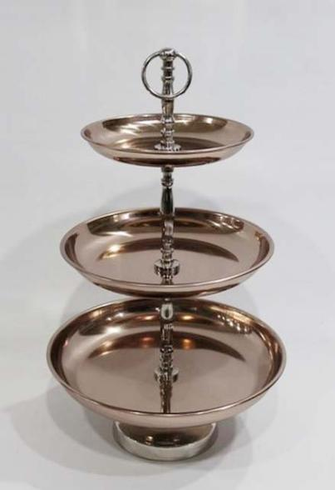
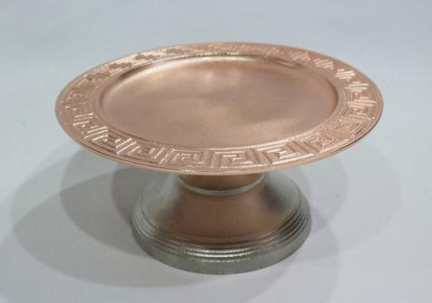
Cake Stands
AD-21556
AD-20237-RGN
AD-7204

Slide 14
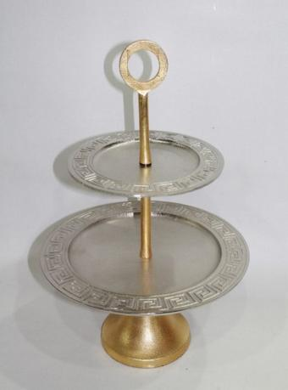
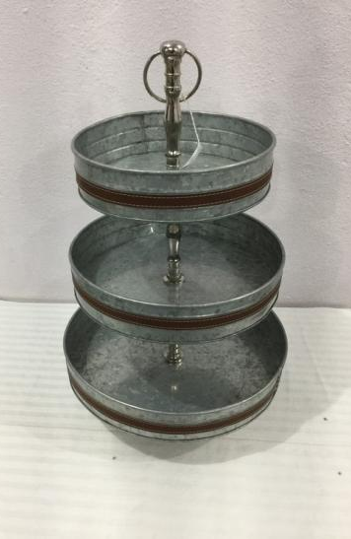

Cake Stands
AD-7163
AD-7187
AD-7164

Slide 15




Bowls
AD-6127
AD-6151
AD-6150-ABCDE
AD-6125

Slide 16





Charger Plates
AD-6140
AD6143
AD-6148
AD6142
AD-6145

Slide 17




Chopping Boards
AD-7225
AD-7226
AD-7227
AD-7238

Slide 18



Hooks
AD-323
AD-4750
AD-704

Slide 19


Photo Frames
AD-11074 A,B
AD-12850

Slide 20




Photo Frames
AD-7444
CA-7631
AD-7635
AD-7640

Slide 21




Candle/Pillar Stands
AD-7371
AD-7370
AD-3155
AD-7384

Slide 22




Candle Stands
AD-7374
AD-7379
AD-7380
AD-7377

Slide 23



Lanterns
AD-403-
AD-281
AD-273

Slide 24



Lanterns
AD-294
AD-289
AD-292

Slide 25



Table Lamps
AD613
AD614
AD615

Slide 26




Table Lamps
AD595
AD655
AD667
AD669

Slide 27



Reindeers
AD6070, CA6071
AD6083
AD6072, AD6073

Slide 28



Reindeers
AD6080, AD6081
AD6076, AD6077
AD6074, AD6075

Slide 29


Tub / Caddy
AD-7550
AD-7599

Slide 30



Water Cans
AD-7602
AD-7601
AD-7604

