Slide 1
BLUETEEK OVERSEAS

Slide 2
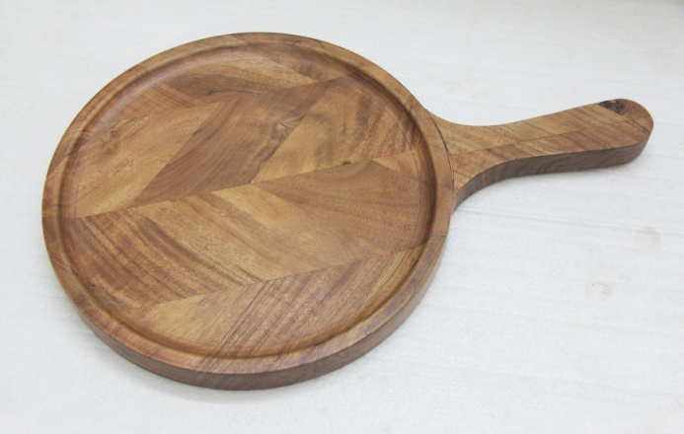
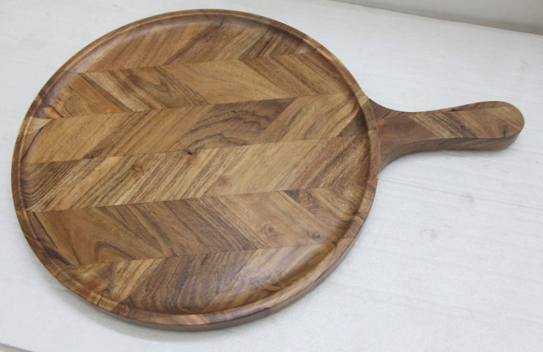
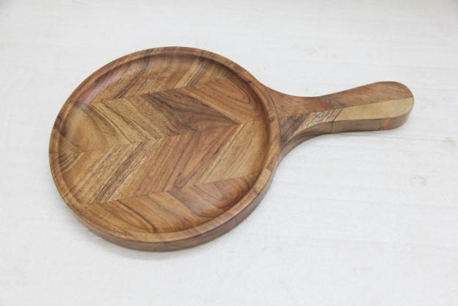
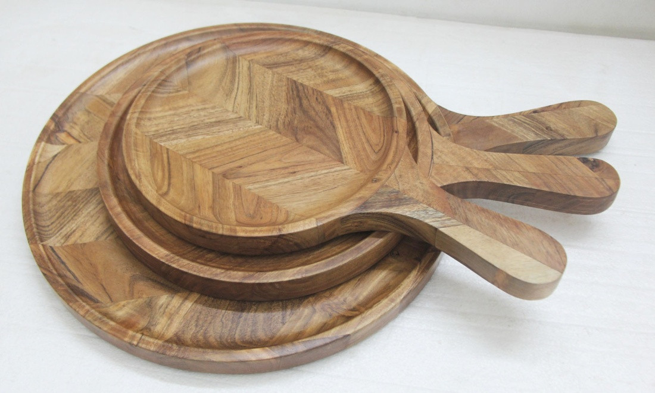
1025-22 , SIZE L- 24.75X18.75X1 IN
1025-22 M , SIZE M- 21.75X15.75X1 IN
1025-22 S , SIZE S - 18X12X1 IN

Slide 3
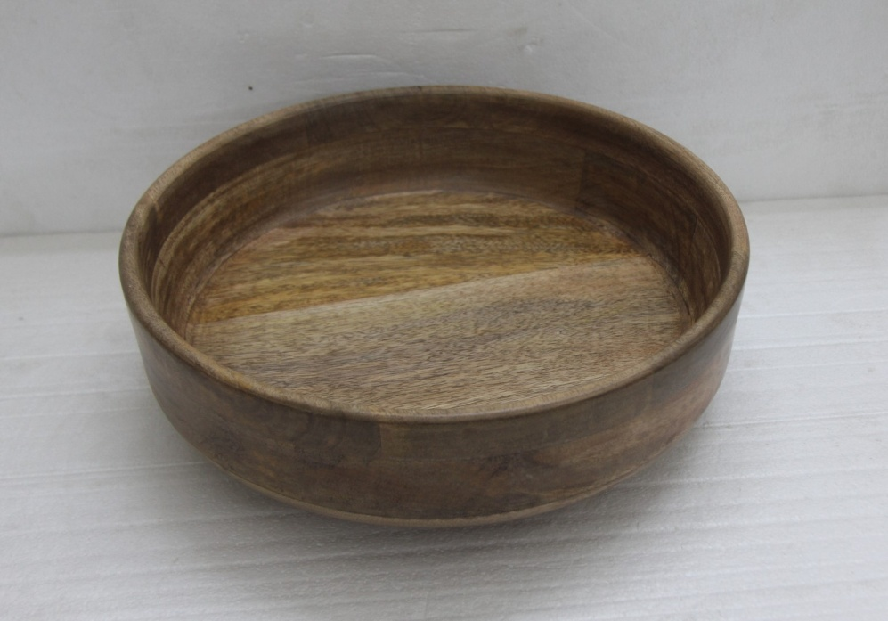
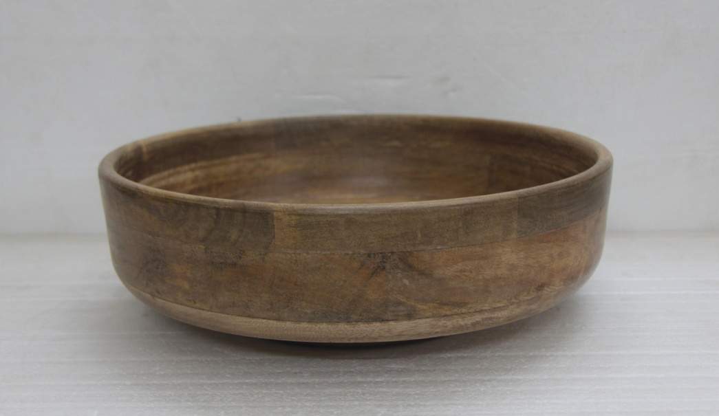
1128-22 S , SIZE- 14.75X14.75X4.25 IN

Slide 4
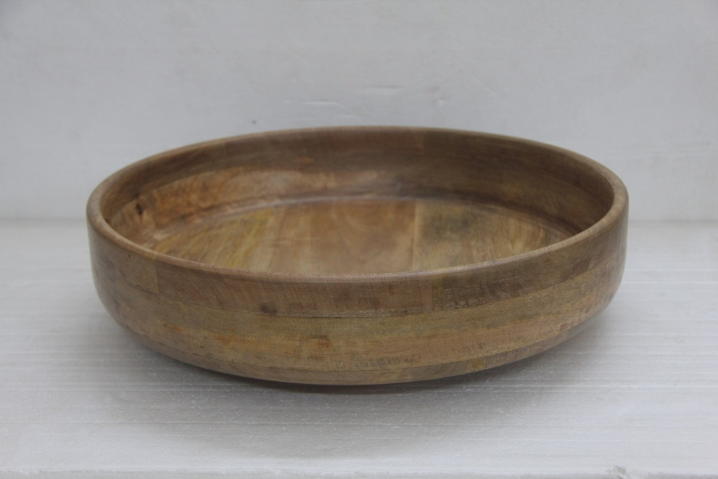
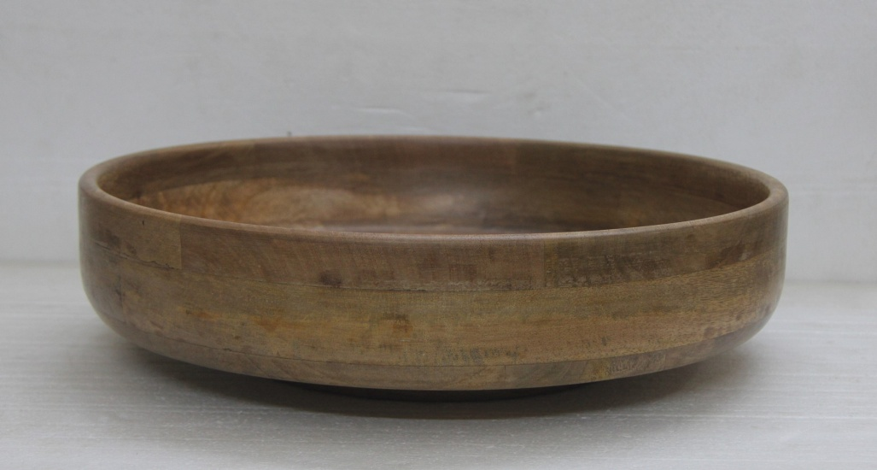
1128-22 , SIZE L- 17X17X4 IN ,

Slide 5
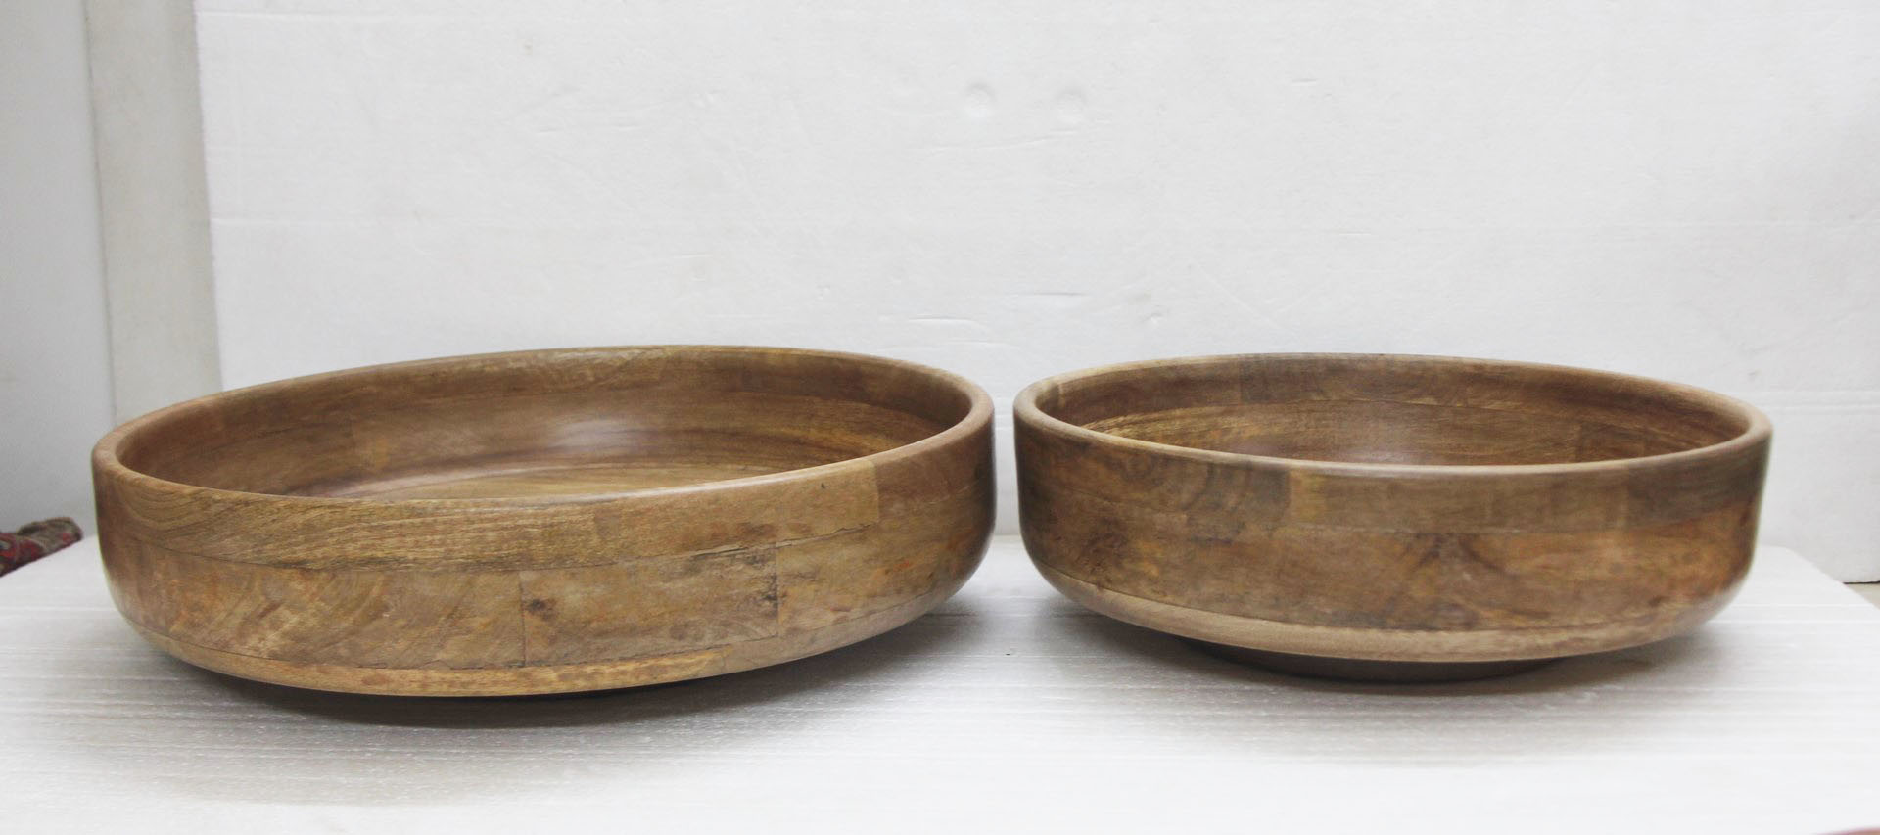
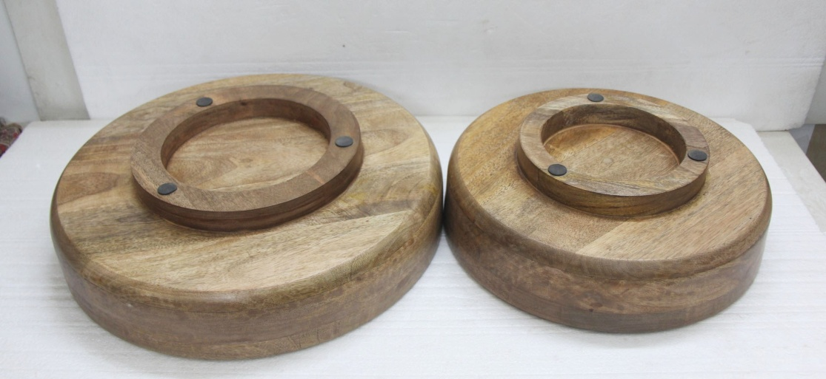

Slide 6
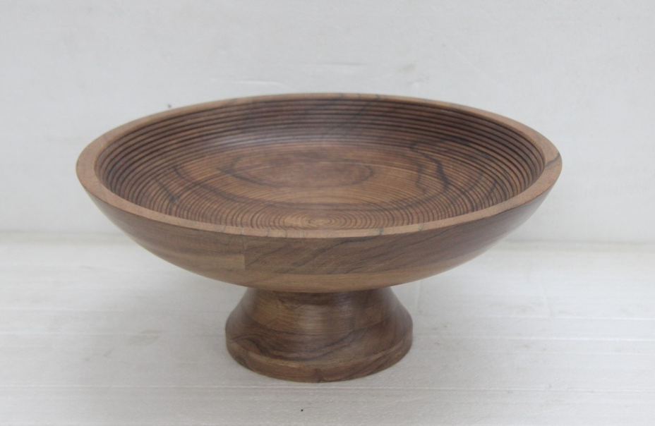
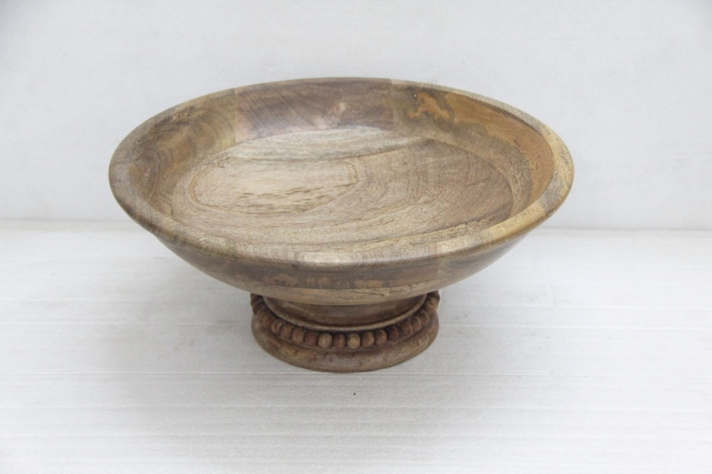
1295-22 , SIZE- 12X5 IN
1124-22 , SIZE- 13.75X6.25 IN

Slide 7
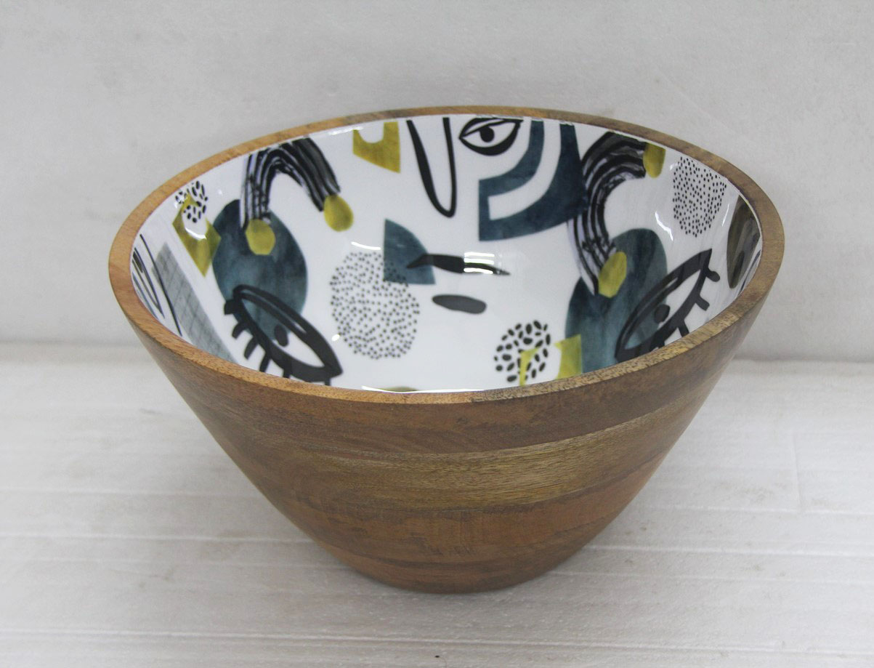
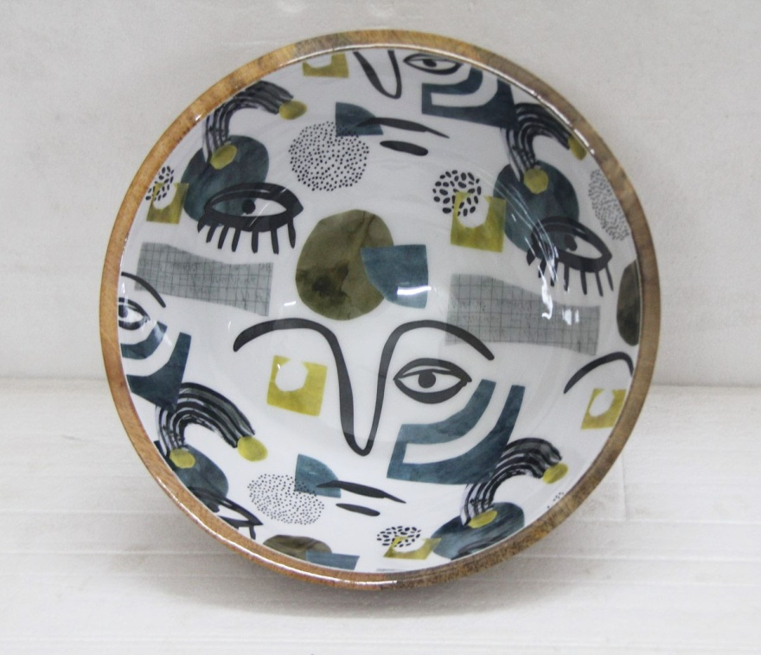
1546-22 L , SIZE L- 12X6 IN

Slide 8
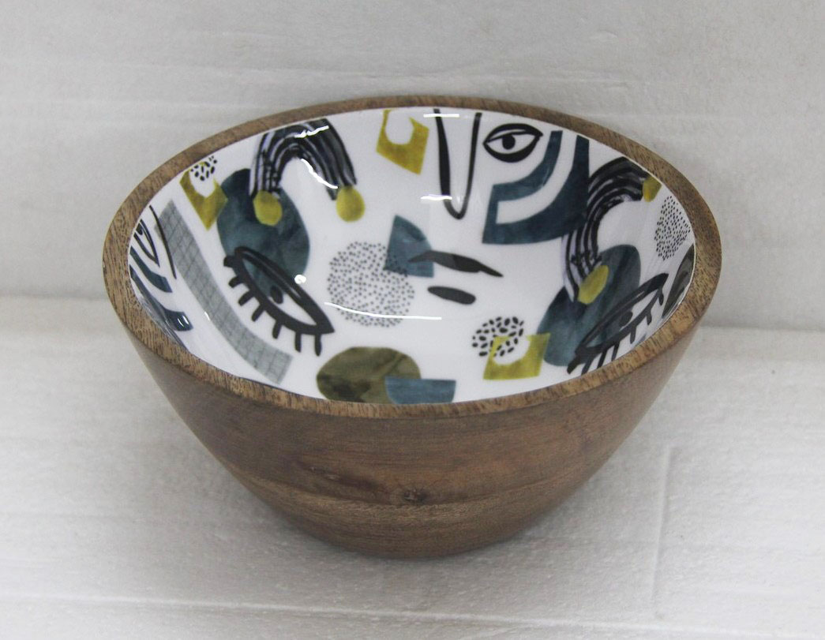
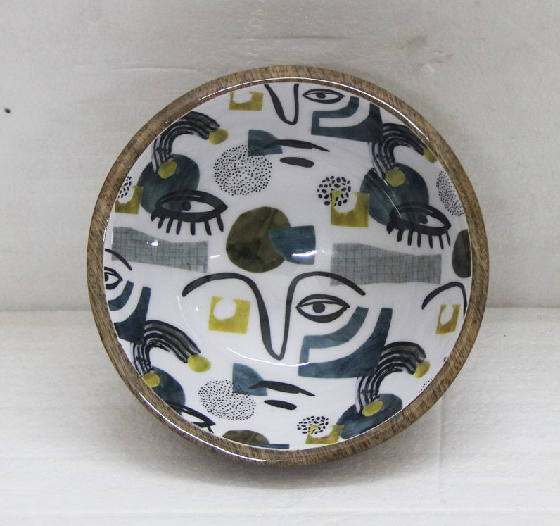
1546-22 S SIZE S- 6.5X 3 IN

Slide 9
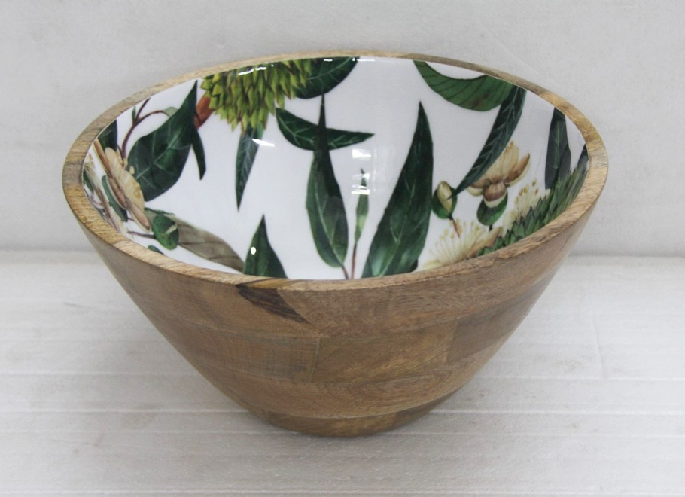
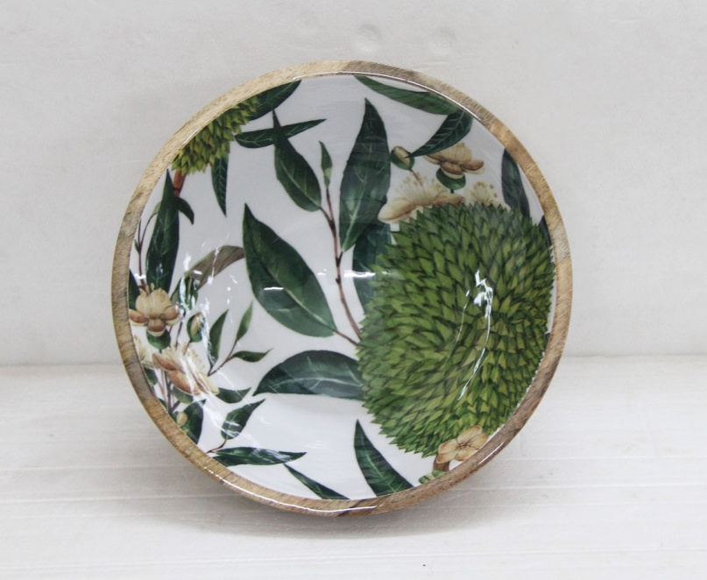
1535-22 , SIZE- 12X6 IN

Slide 10
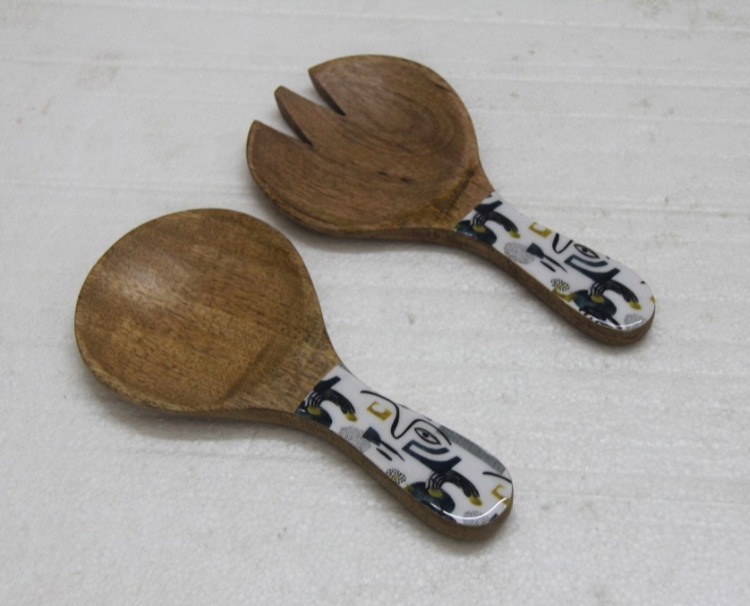
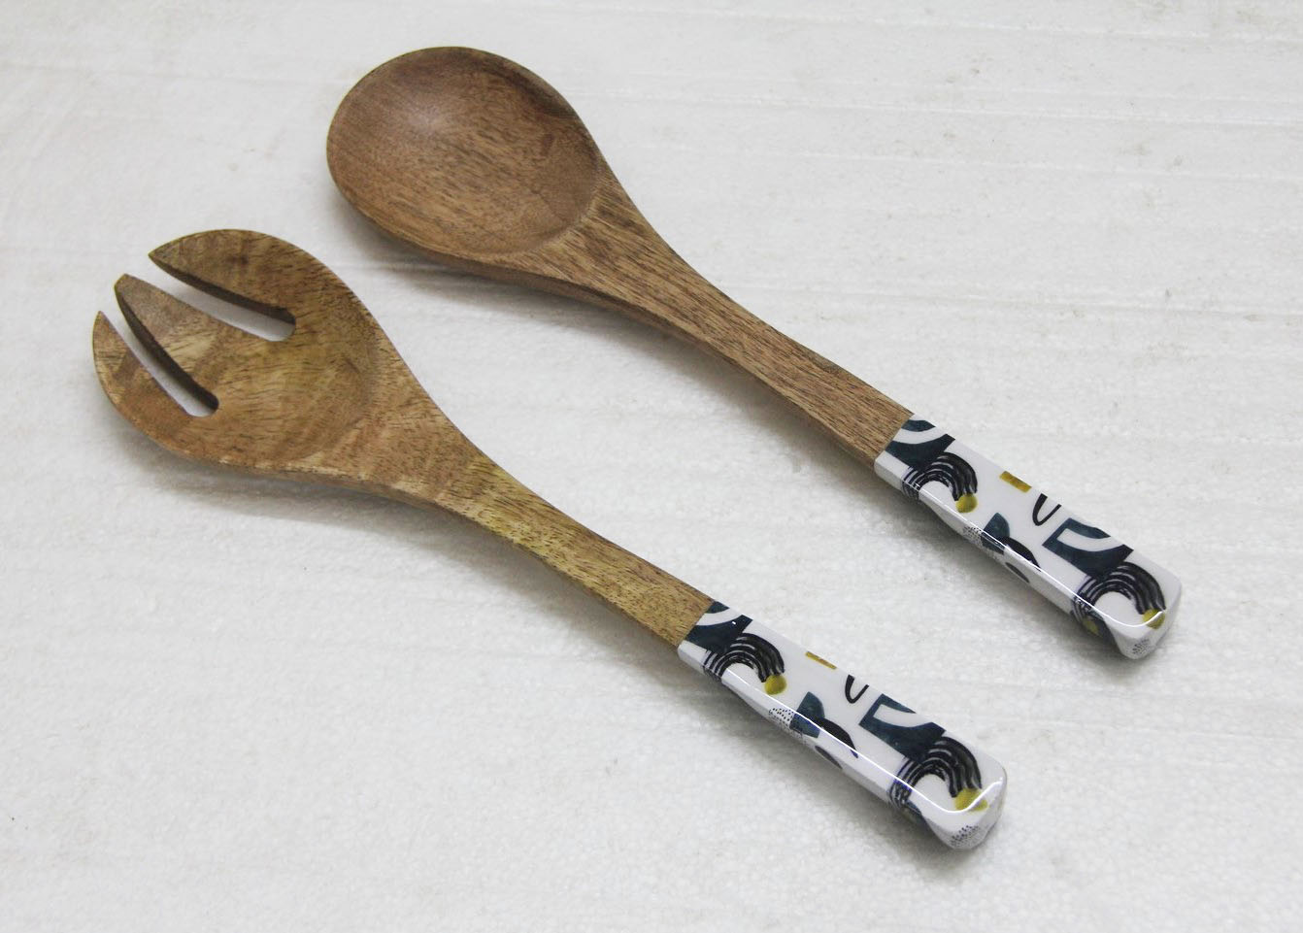
1544-22 , SIZE- 8X4X.5 IN
1152-22 , size- 12x3.5x5 IN 1

Slide 11
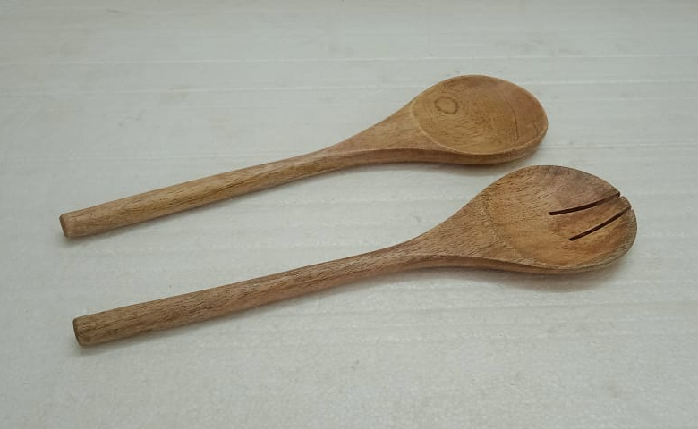
1478-22 , SIZE- 12X3.5X.5 IN

