Slide 1
OZANTEKS, ESTABLISHED IN 1973 IN DENIZLI, IS PROUD TO BE ONE OF THE LEADING TOWEL, BATHROBE, BEDLINEN, AND SEAMLESS MANUFACTURERS AND EXPORTERS OF TURKEY SINCE 1980. 90% OF OUR PRODUCTION IS FOR EXPORT AND 10% FOR THE DOMESTIC MARKET. OVER THE YEARS, WE CONTINUOUSLY IMPROVED OURSELVES TO MEET OUR CUSTOMERS REQUIREMENTS VIA THE MOST PROFESSIONAL WAY. WE HAVE BEEN LISTED AMONG THE FIRST 500 LARGEST INDUSTRY ENTERPRISES OF TURKEY SINCE 1995. WITH THE LATEST TECHNOLOGY, WE PRODUCE TOWELS, BATHROBES, HOME LINEN, SEAMLESS UNDERWEAR, SPORTSWEAR, AND PROMOTIONAL TEXTILES PRODUCTS. OUR MAIN MARKETS ARE ALL EUROPEAN COUNTRIES, USA, UK, AUSTRALIA, CHINA, RUSSIA, MIDDLE EAST…
OZANTEKS SALES VALUE IN 2021 IS 80 MILLION USD .-
OZAN GROUP SALES IN 2021 IS 105 MILLION USD .-

Slide 2
THANKS TO OUR AWARENESS THAT “RESPECT TO ENVIRONMENT IS RESPECT TO HUMAN BEING”, OUR COMMITMENT TO ADDRESSING THE ENVIRONMENTAL ISSUES IS A NEVER-ENDING COMPANY ATTITUDE. FOR PRESERVING THE HUMAN HEALTH, ENVIRONMENT, OUR PRODUCTS AND WORKERS WE HAVE;
TSE CERTIFICATE FOR QUALITY,
OEKO-TEX & STEP CERTIFICATE FOR HUMAN ECOLOGICAL SAFETY OF THE TEXTILES,
GOTS ORGANIC CERTIFICATE FOR HUMAN HEALTH AND ENVIRONMENT,
GRS CERTIFICATE FOR PRODUCTS OF WHICH AT LEAST 20% RECYCLED MATERIAL USED AS RAW MATERIAL
SEDEX, BSCI, ICS & WRAP CERTIFICATES TO MEET AGREED ENVIRONMENTAL, LABOUR AND DEVELOPMENTAL STANDARDS,
WE HAVE ESTABLISHED OUR OWN DYE-HOUSE IN 1996 AND COMPLETED OUR EXHAUST AND WASTE WATER TREATMENT AND RECYCLING FACILITIES AT THE BEGINNING OF 1999.
OUR FACTORY SITE IS 150.000 SQM. 100.000 SQM IS CLOSED AREA. 80.000 SQM OF THIS AREA IS CONSTRUCTED FOR WEAVING, CONFECTION AND UNDERWEAR UNITS AND THE REMAINING 20.000 SQM AREA IS CONSTRUCTED FOR DYEING UNITS.

Slide 3
WE PRODUCE ;
170.000 PCS BATHROBES PER MONTH.
3.000.000 PCS TOWELLING PER MONTH.
420.000 PCS SEAMLESS PRODUCTS PER MONTH.
120.000 PCS HOMETEXTILE PRODUCTS PER MONTH.
WITH ;
260 PCS FABRIC, DOBBY WEAVE AND JACQUARD LOOM,
90 DOBBY TOWELLING LOOM, 50 JACQUARD TOWELLING LOOM, 120 FLAT FABRIC WEAVING LOOM
30 PCS KNITTING LOOM,
10 KARL MAYER, 20 CIRCULAR KNITTING
56 PCS SANTONI – SEAMLESS PRODUCTION
6 PCS SHORT HEM “CM” AUTOMATION MACHINES
700 PCS CONFECTION MACHINES
AND 1300 EMPLOYEES.

Slide 6
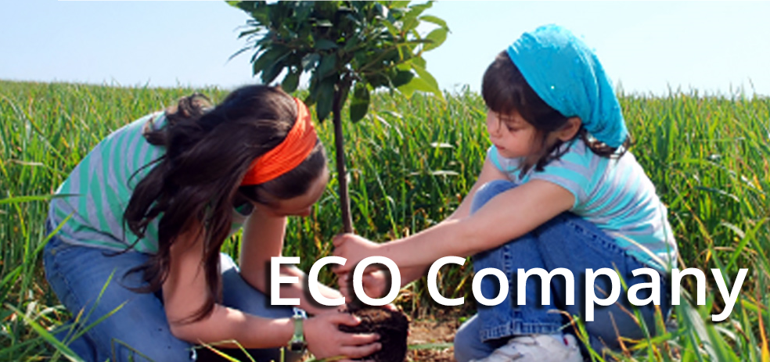
WE PAY HIGH ATTENTION TO OUR ENVIRONMENT WHERE WE LIVE

Slide 7
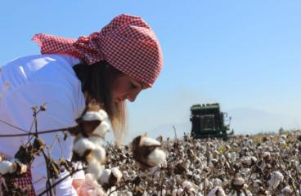
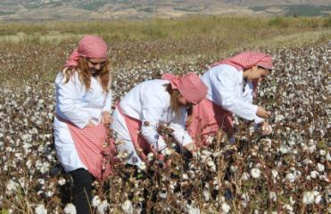
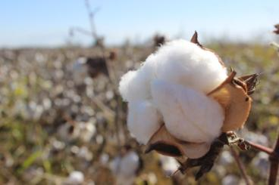
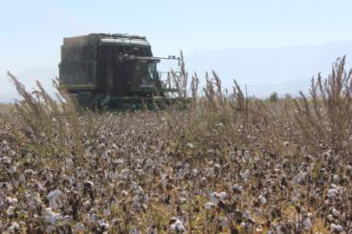
WE PRODUCE OUR COTTON IN OUR FARMS…..

Slide 8
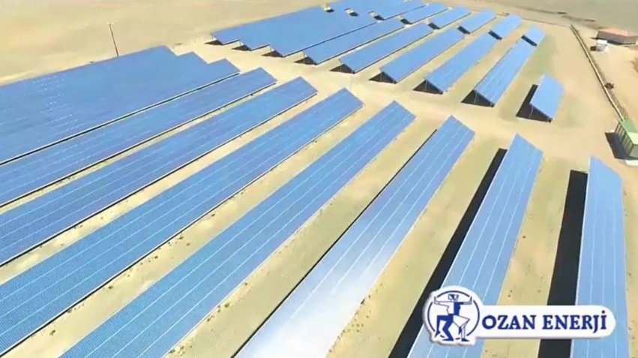
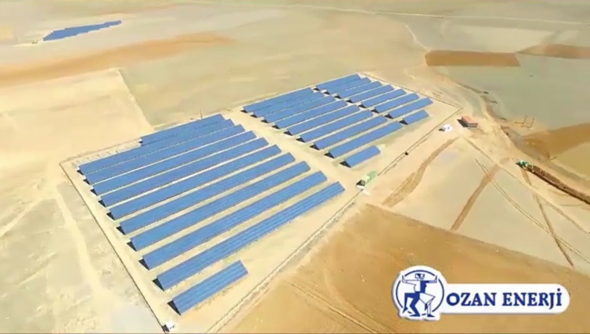
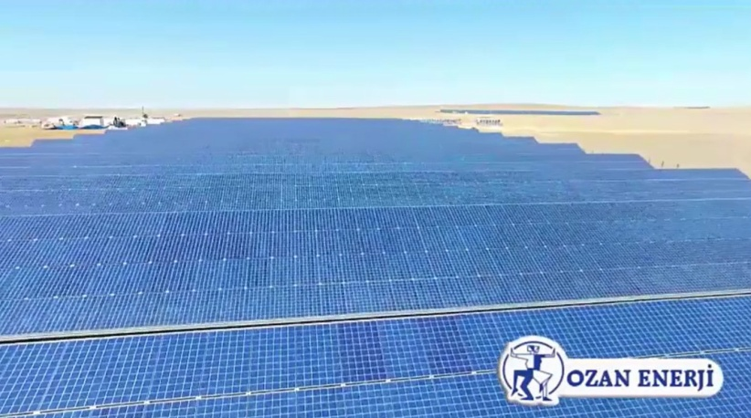
WE PRODUCE OUR GREEN ENERGY IN OUR PLANTS

Slide 9
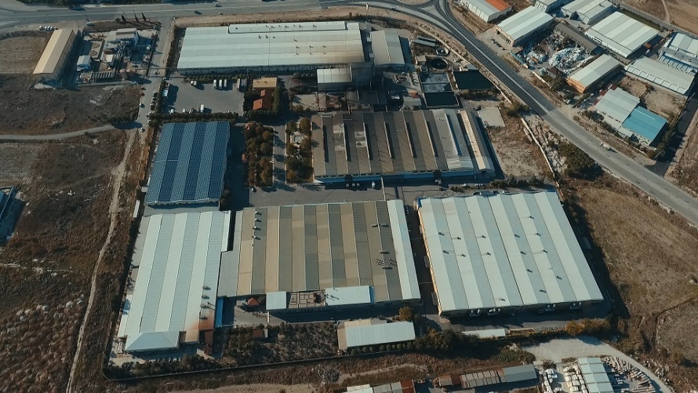
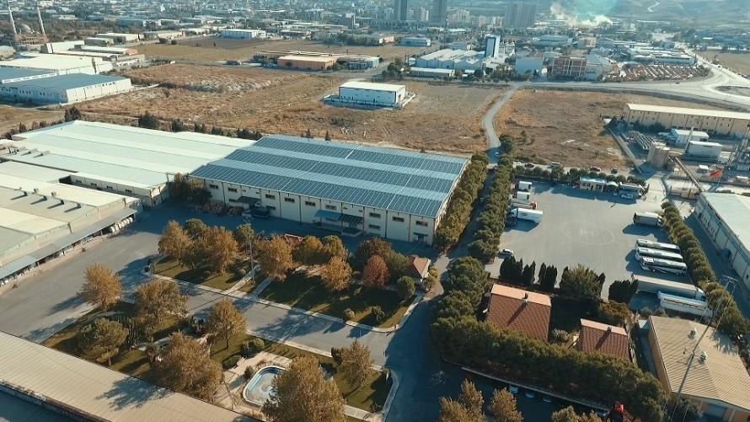
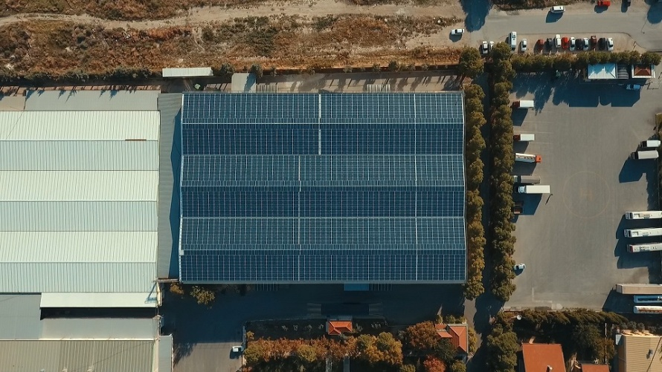
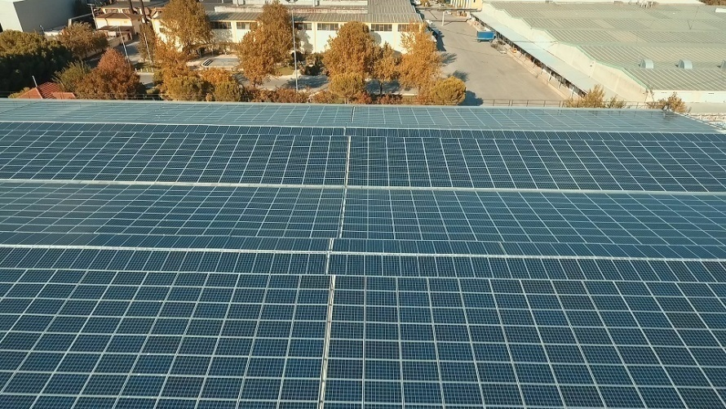
WE PRODUCE OUR GREEN ENERGY IN OUR PLANTS

Slide 10

Ozanteks as a leading and innovative company in textile industry is aware of its responsibilities for environment. Ozanteks invests on environmental friendly technologies and behaves with the aim of reducing harm to environment.
Ozanteks has started working on reducing carbon dioxide footprint and greenhouse effect in accordance to the goals of which our country has taken place on struggling against global warming and climate change by international climate change regulations.
Ozanteks invests on installing Solar Power Plants on fields and factory roofs. Ozanteks which has solar power plants with a current installed capacity of 17 MW uses its own clean energy to produce textiles.
Ozanteks prevents natural gas consumption of 2.465.223 m³ yearly by using clean energy produced at solar power plants
As known, another advantage of solar plants is to reduce carbon dioxide emitted to nature. Ozanteks with its own solar plants prevents 15.738 tons of CO₂ emission. In addition, recovery of 1,430,727 trees have been provided by our Solar Power Plants, and therefore, by replanting of 28,000,000 square meters area (an area larger than 8 times Central Park) protection of living beings life and habitat variety has been supported.

Slide 11
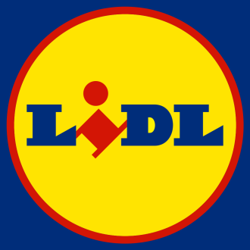
We are working with Ozanteks more than 30 years. Because they;
Are fully integrated. From yarn to inbox.
Are %100 reliable for recieved informations.
Are the only supplier who has own consodilation center for assorted boxes, pallettes, and containers to be delivered to 8 different DCs.
Are able to deliver 4M to 5M pcs within 3 months.
Have dedicated design team for German market.
Have an integrated water treatment pools for detox management.
Have an %94 pass rate from chemical management audit.

Slide 12
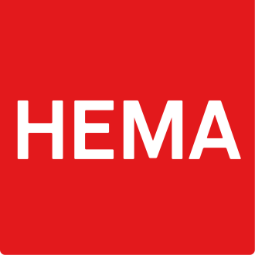
We are working with Ozanteks more than 35 years. Because they;
Are able to produce for our bathroom, kitchen, and bedding departments.
Are the first factory of which we accreditated for self-inspection process.
Are the first and biggest supplier in BCI cotton project.
Are able to deliver big volumes in promotion period within very short of time by fully controlled greige and ready stock management.
Have dedicated design team for Holland market.

Slide 13

We are working with Ozanteks more than 20 years. Because they;
Are able to produce for our bathroom, kids and nursery departments.
Are the first supplier who were expertised in Retail Link system and nominated as CPFR (Collabrative Planning Forecasting and Replenishment) supplier.
Have huge NOS (Never Out Of Stock) program experience with greige and ready management.
Have great UK market consuming knowledge.
Can keep constant quality among the whole year by using advanced automation systems.

Slide 14

We are working with Ozanteks more than 25 years. Because they;
Are able to produce for our lingerie, bathroom, kids, ladies and mens departments.
Are the first supplier who were nominated for “PLAN A” program (sustainable business program).
Have dedicated design team for UK market.
Are able to ship over 600K gowns and bathrobes within 4 months.
Can understand flow-wise shipments, and are proactive for early shipment requests.

Slide 15
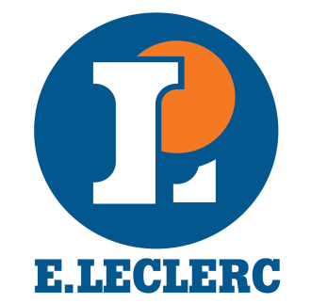
We are working with Ozanteks more than 20 years. Because they;
Are able to produce for our bathroom, bedding, kids, ladies, mens, and activewear departments.
Are the first supplier who were nominated for “Sustainability Program”.
Are producing all our products with %100 green energy which makes us very proud after 2016 Paris Climate Agreement.
Have dedicated design team for French market.

Slide 16
We, as Ozanteks, are very proud of working with our partners as a solution provider.
And we are very keen to sustain, improve, and expand these businesses with existing and new partners.

Slide 17
In order to achieve our goals;
We keep investing on automation in towel, bathrobe, bedlinen, and seamless garment divisions.
We opened R&D Department accredited by goverment.
We have dedicated design and merchandising teams serving focused markets.
We are exhibitor in Heimtextil Frankfurt and Evteks Istanbul Fairs every year.
We start preparing 2 main and 4 sub collections for our partners.
We established faster product development process with R&D dept.
We opened another consodilation center for potential NOS programs of our partners.

Slide 18
In the meanwhile;
We produce our own green energy which is 4 times of our needs. (17MW)
We prevent 16K tons of carbon dioxide emission yearly.
We recover 1.5M trees yearly. (approximately an area of 8 times Central Park)
We have implemented a new 1 ton capacity yarn-dying machine.
We have just recieved 6th towel short hem cutting, folding, and stitching automation machine.
We have just recieved pillowcase and duvet cover cutting and stitching automation machine.
We have implemented a new Biancalani drying and treatment machine.
We have updated NetGraphics CAD software which is converting picture directly to weaving structure.

Slide 19



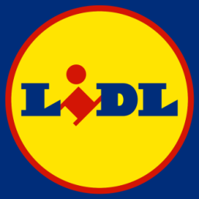
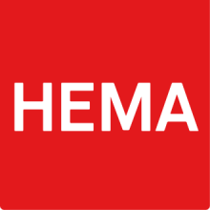

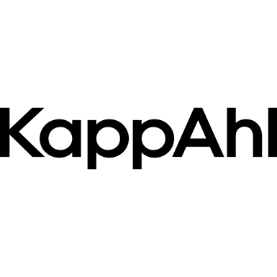
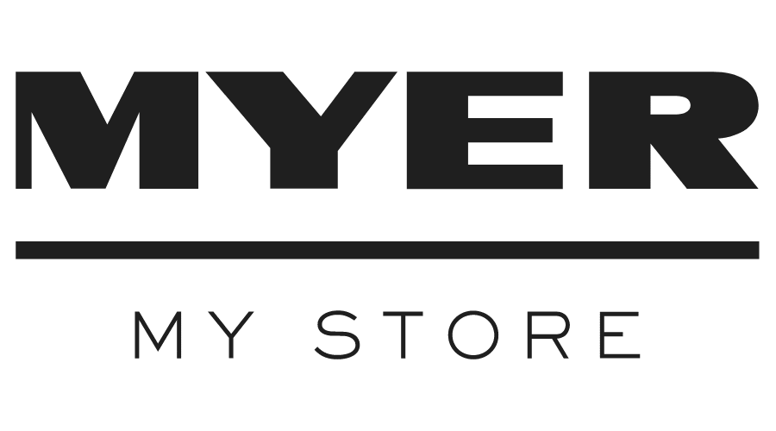
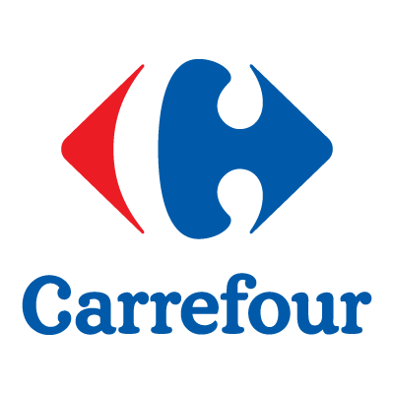



Major Clients

Slide 20
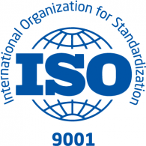


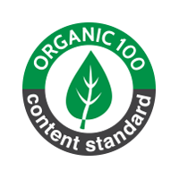
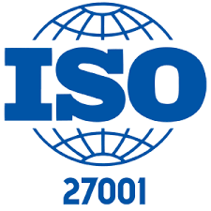

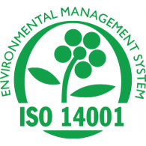



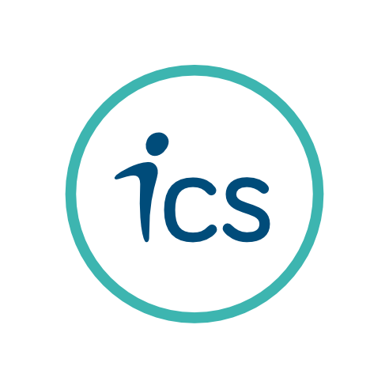


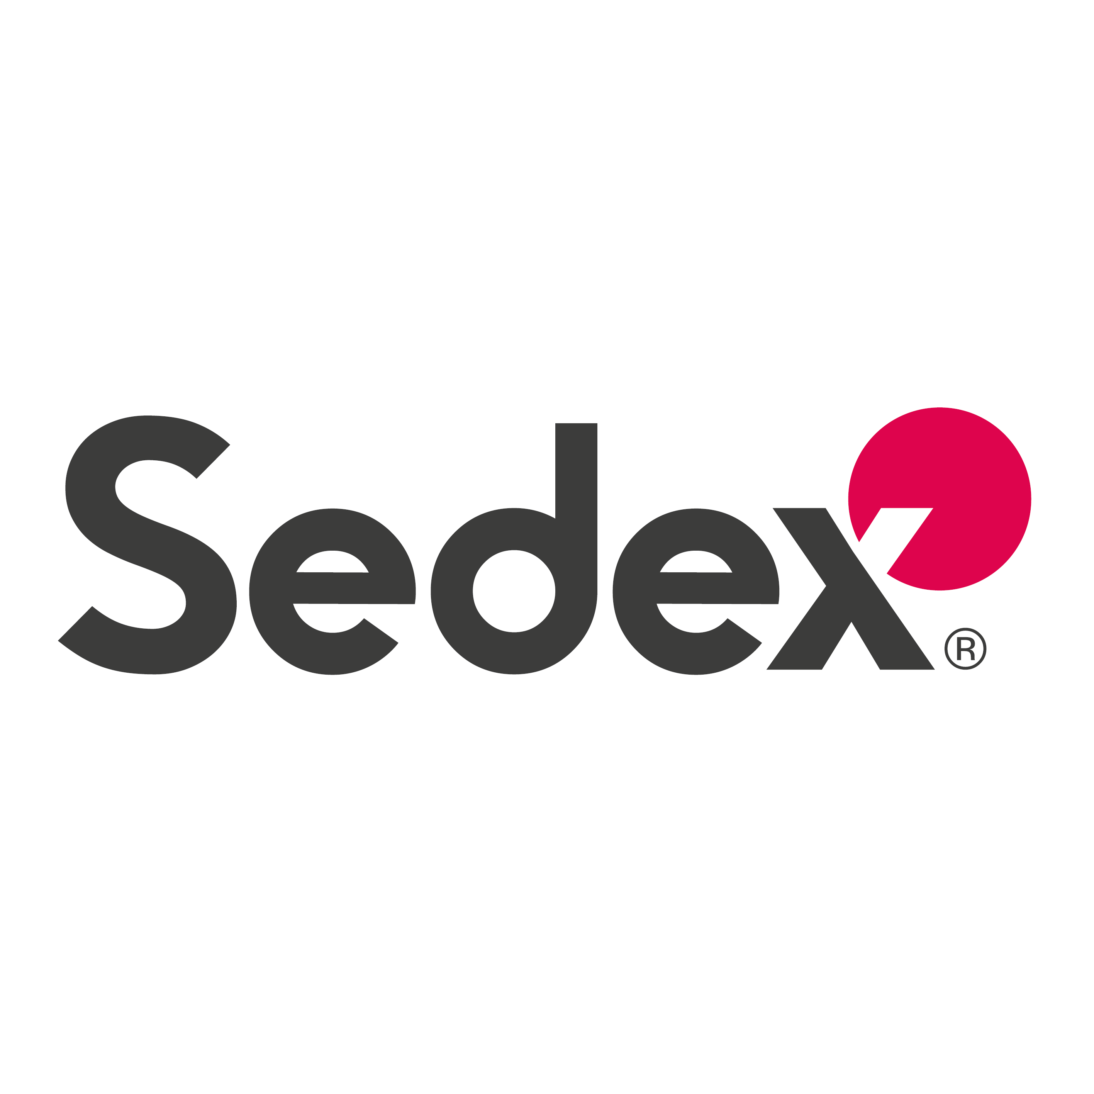
Certificates

