Slide 1
Paramount New Product
Proposal

Slide 2


Colour Block Hem With Picotting

Slide 3

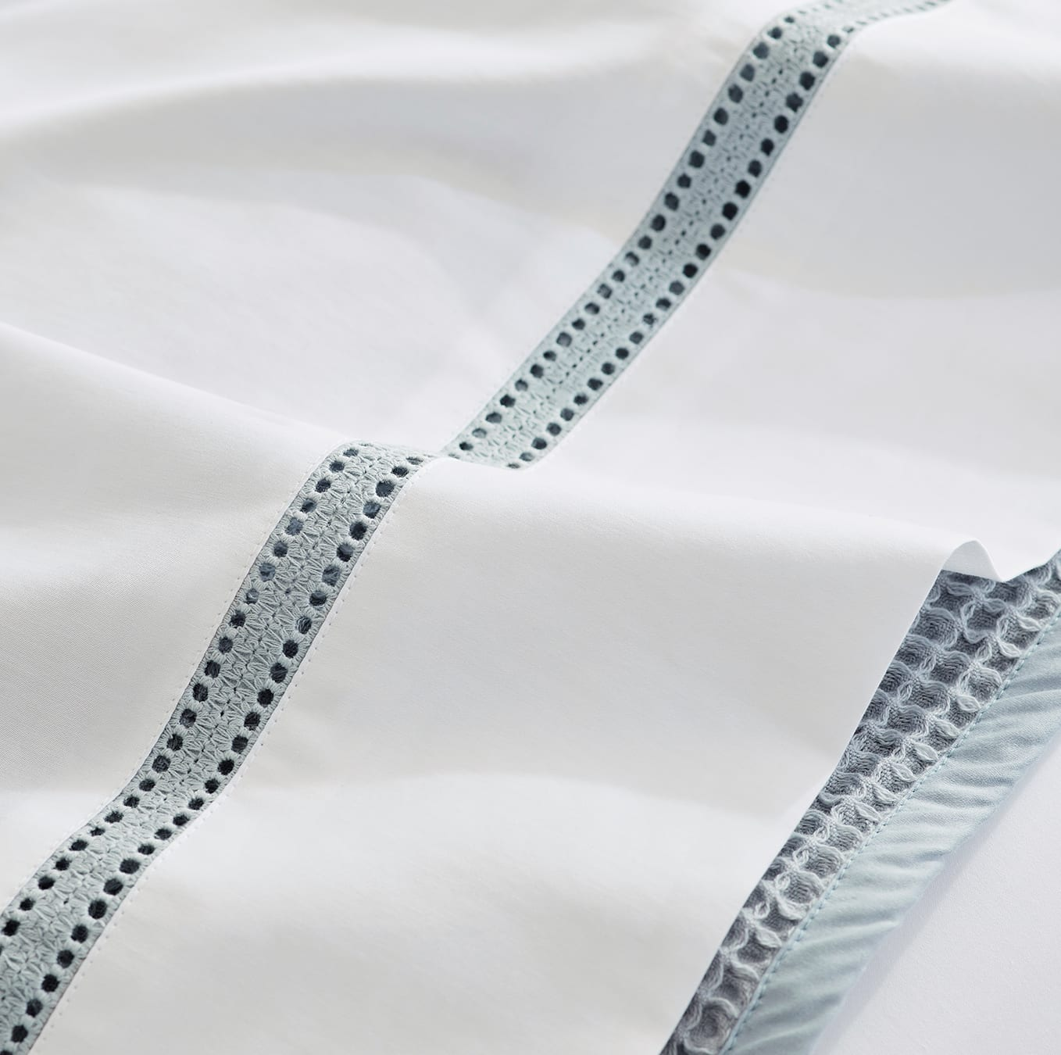
Schiffili Lace bedding

Slide 4
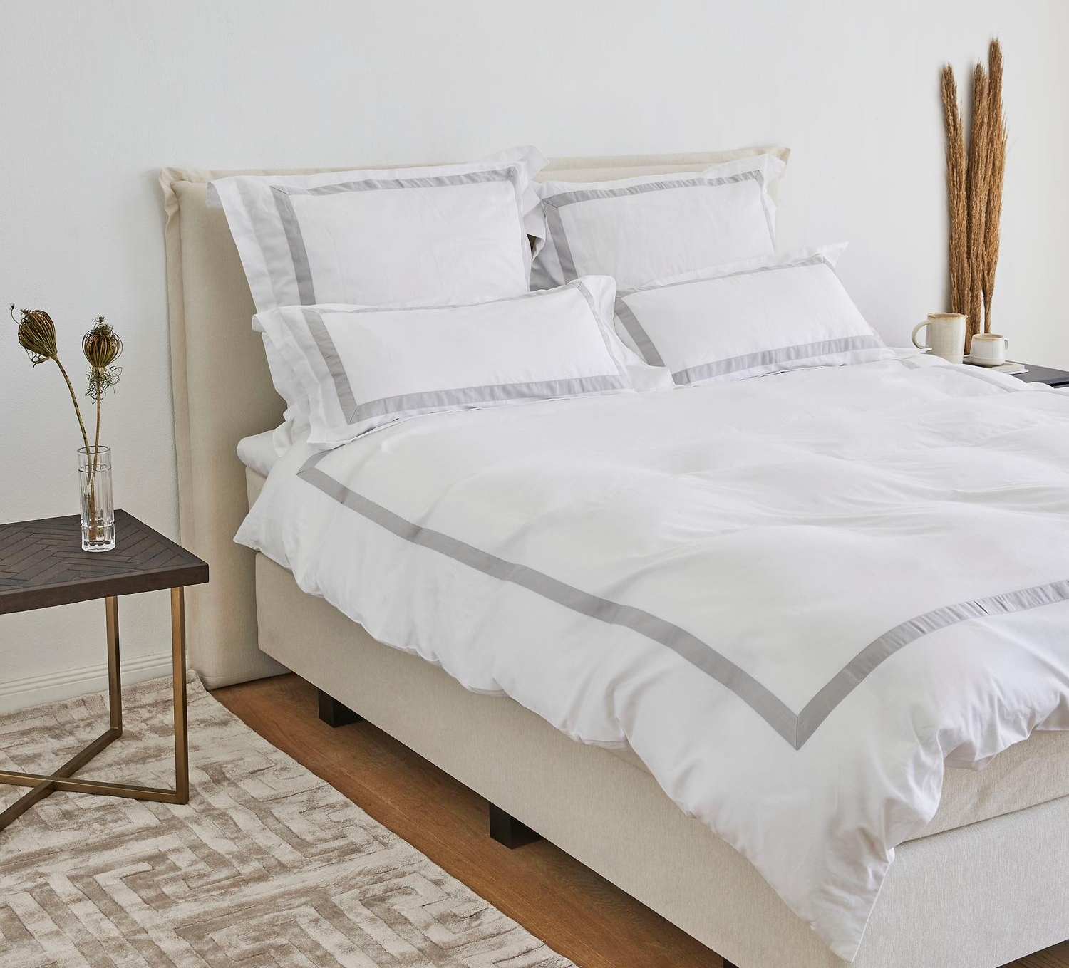

Banded

Slide 5
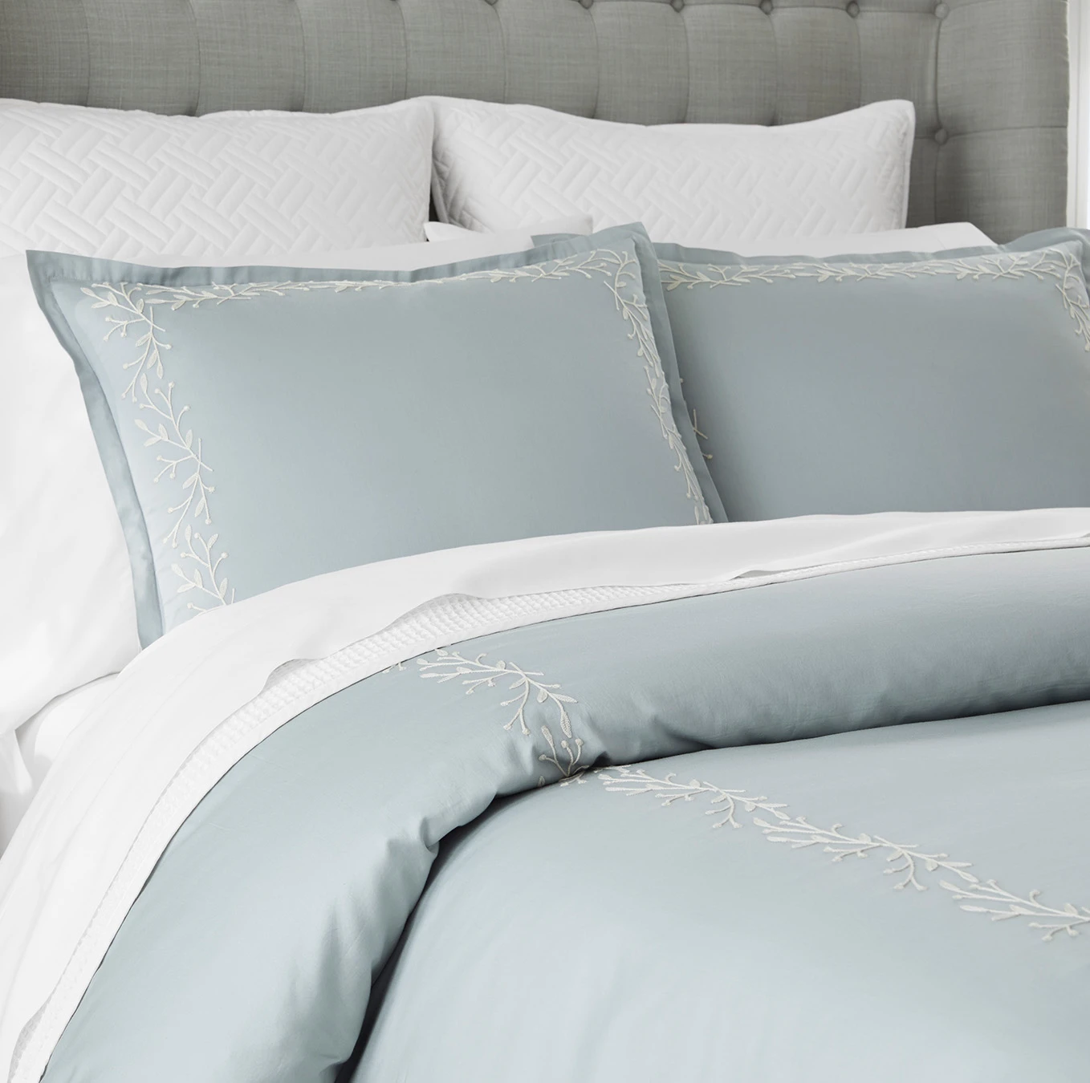
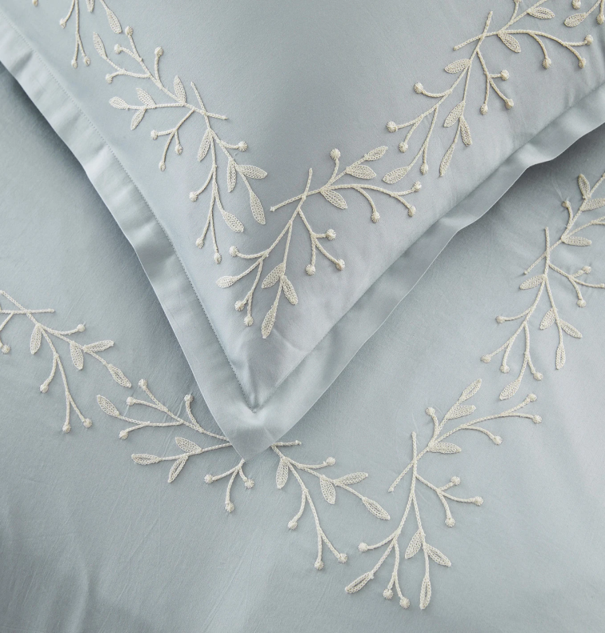
Embroidery

Slide 6
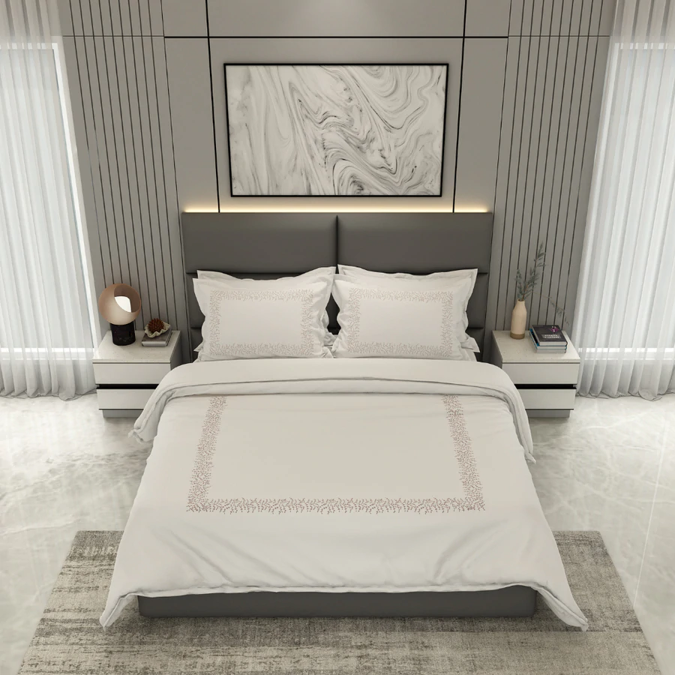
Engineered Embroidery

Slide 7
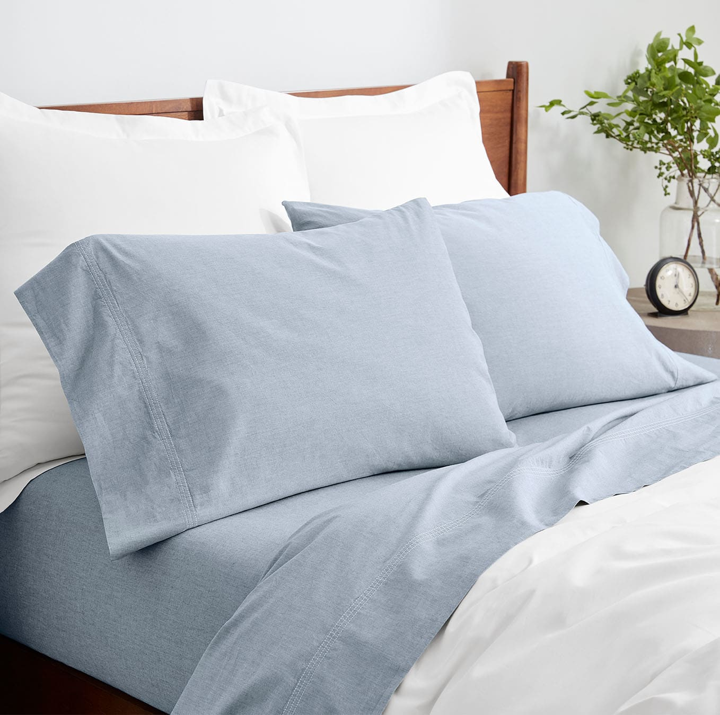
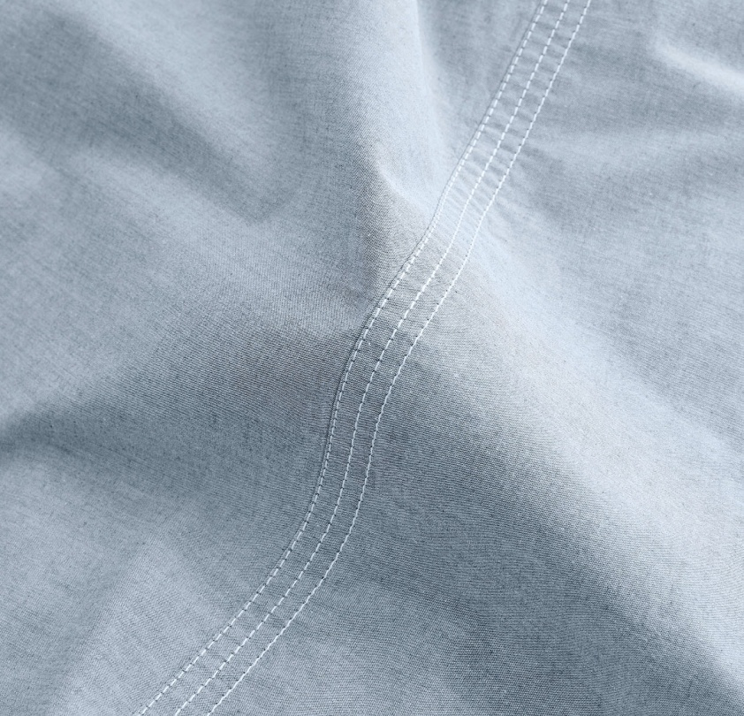
Chambray bedding

Slide 8

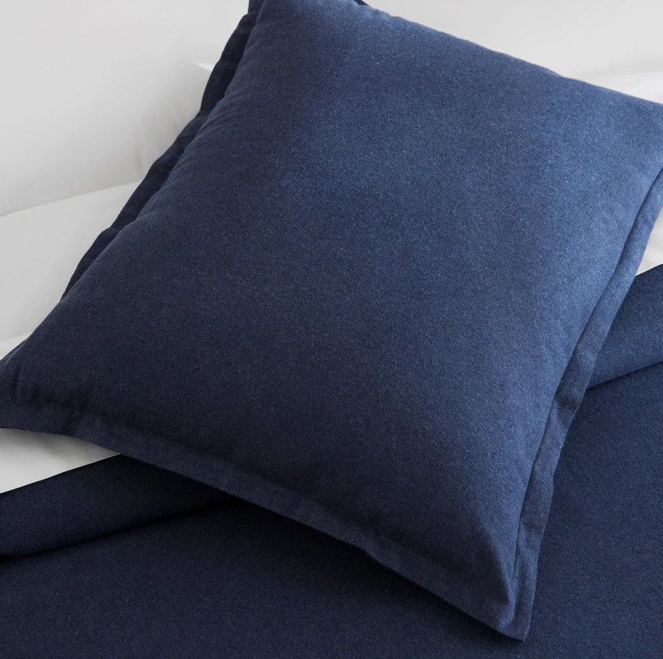
Solid dyed Flannel

Slide 9


Merrowing bed

Slide 10
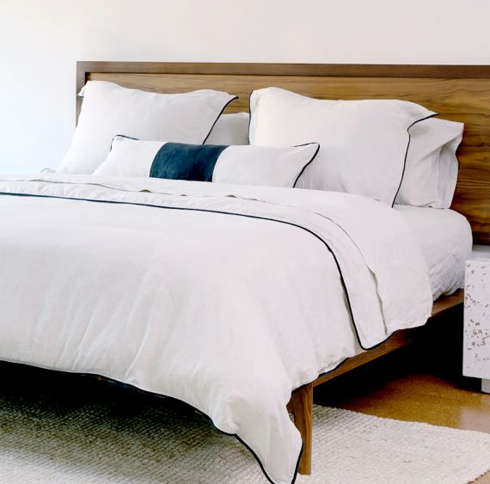

Edge Contrast Piping

Slide 11
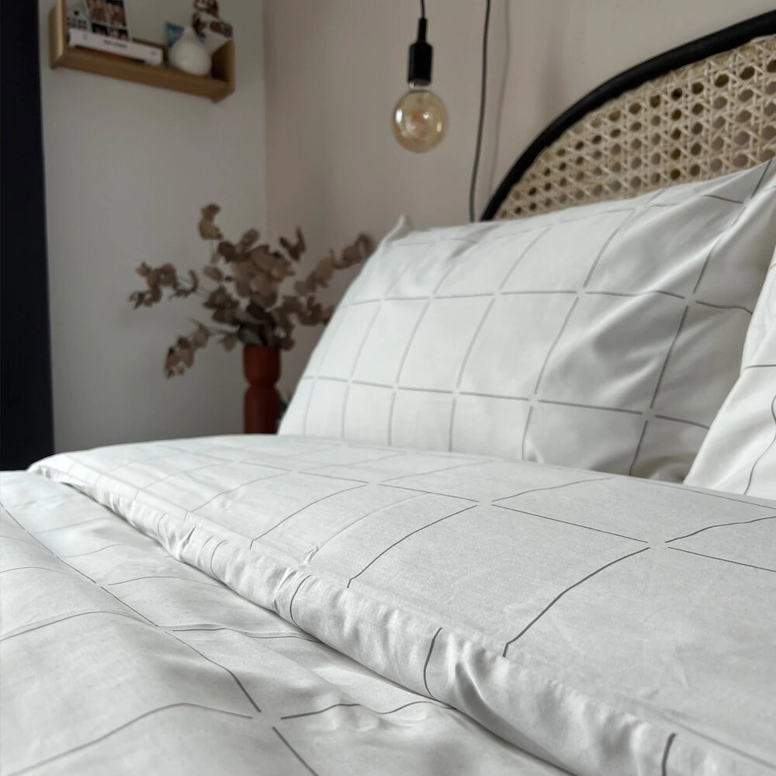
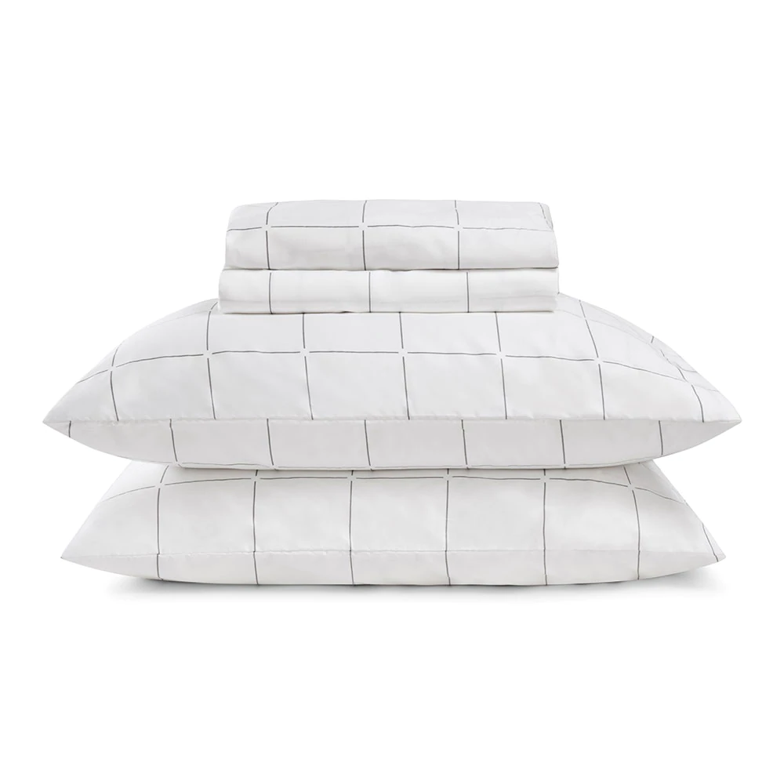
Satin Printed Checks

Slide 12

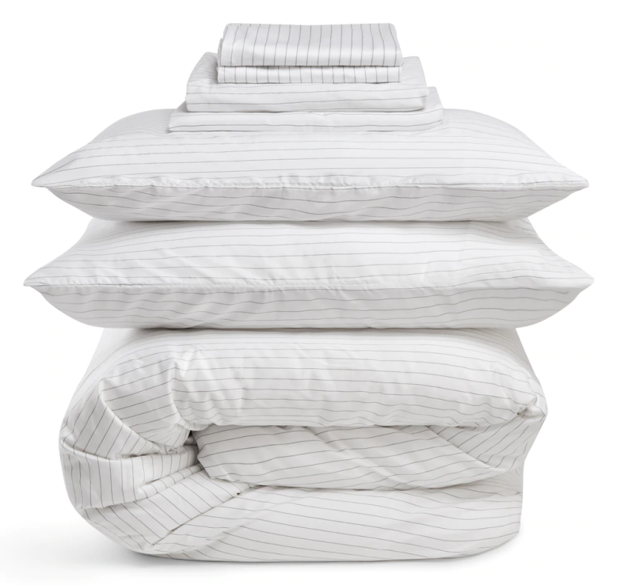
Percale yarn Dyed Stripes

Slide 13

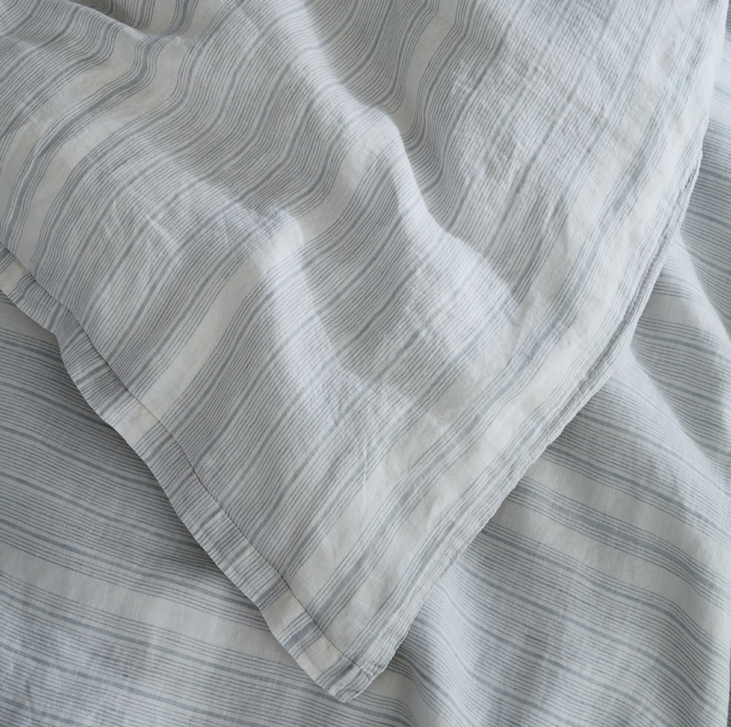
100% Linen Solid and Yarn dyed Stripes

Slide 14

Pintuck Design

Slide 15
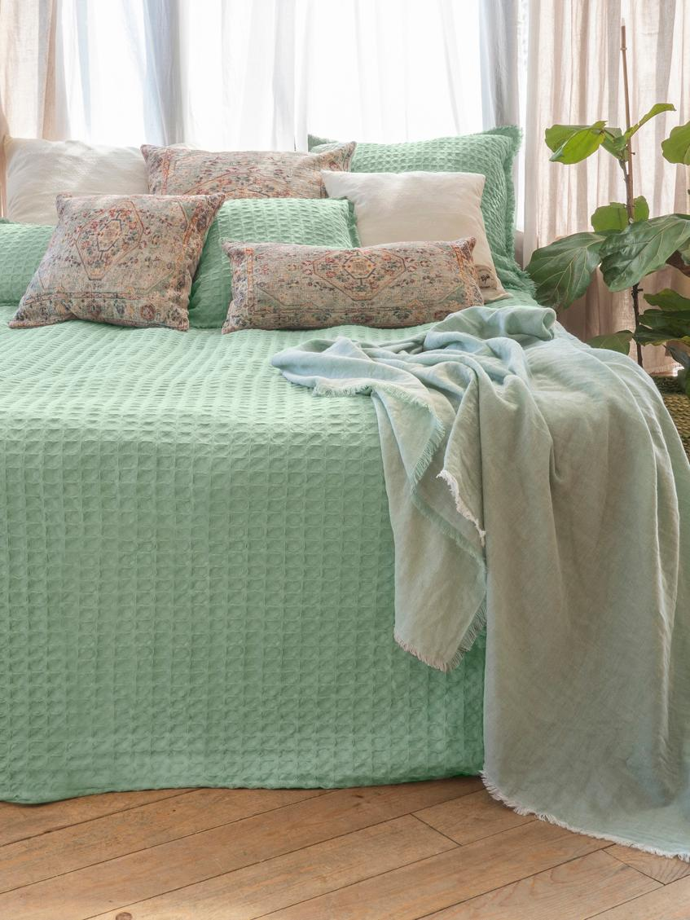
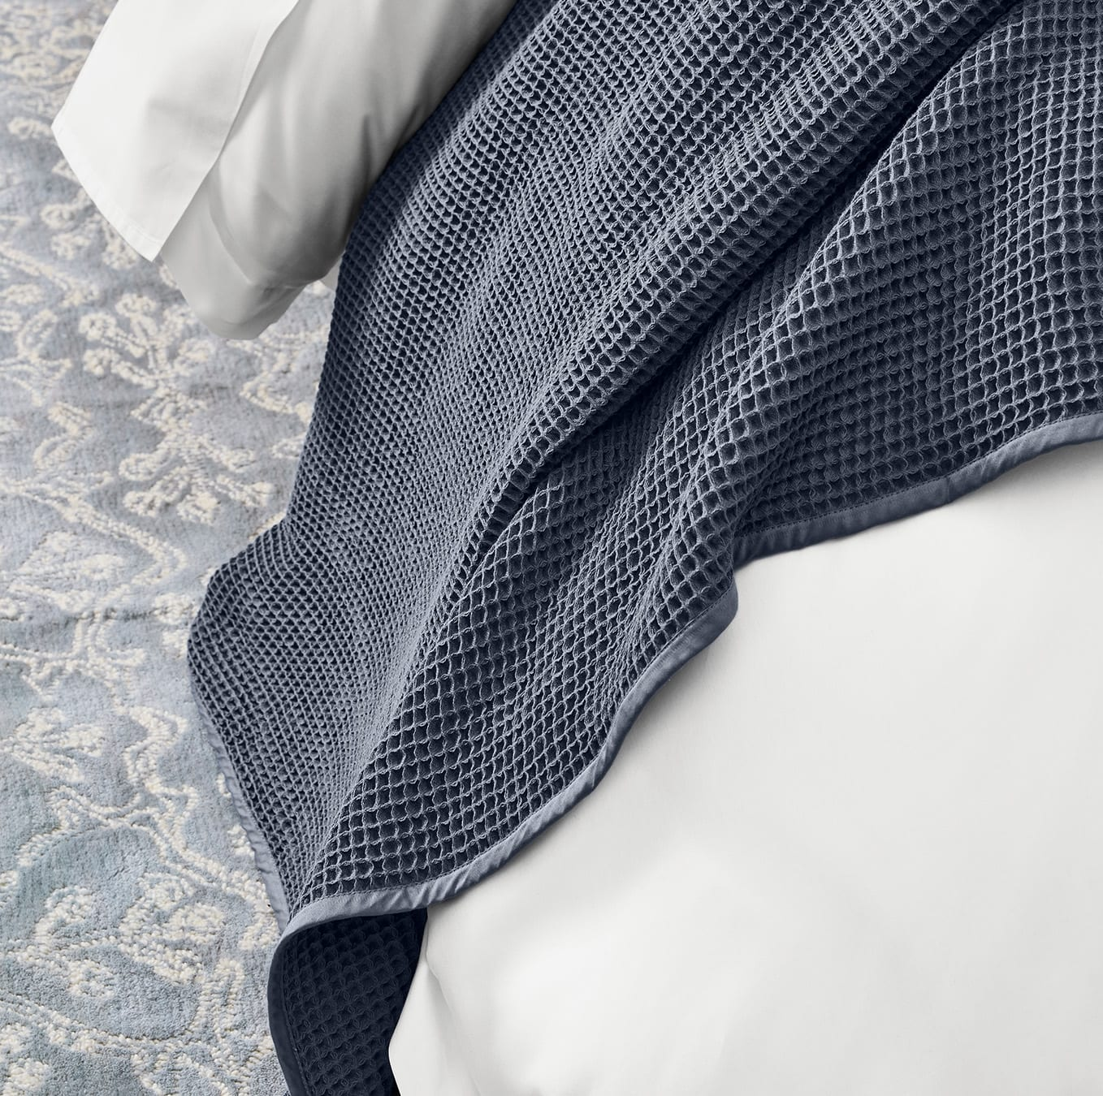
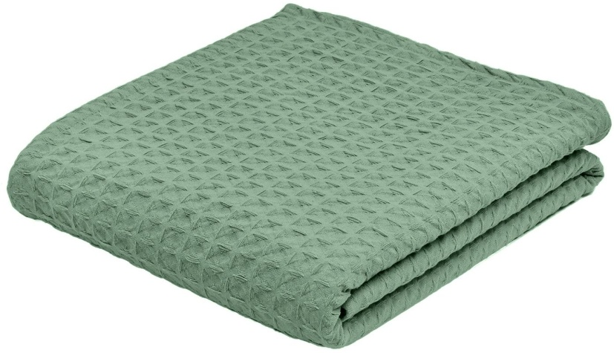
Waffle Blanket

Slide 16
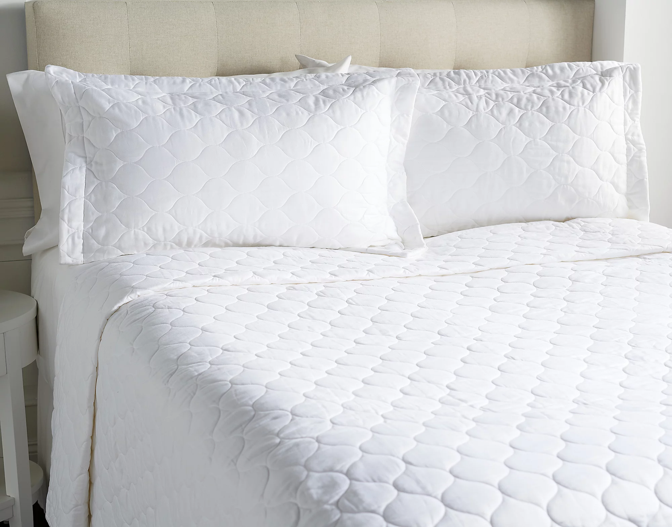
Quilted coverlet set

Slide 17
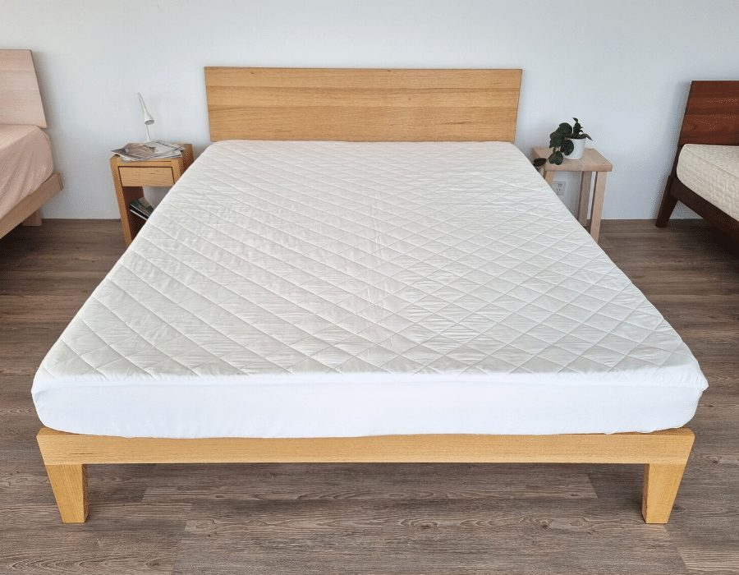
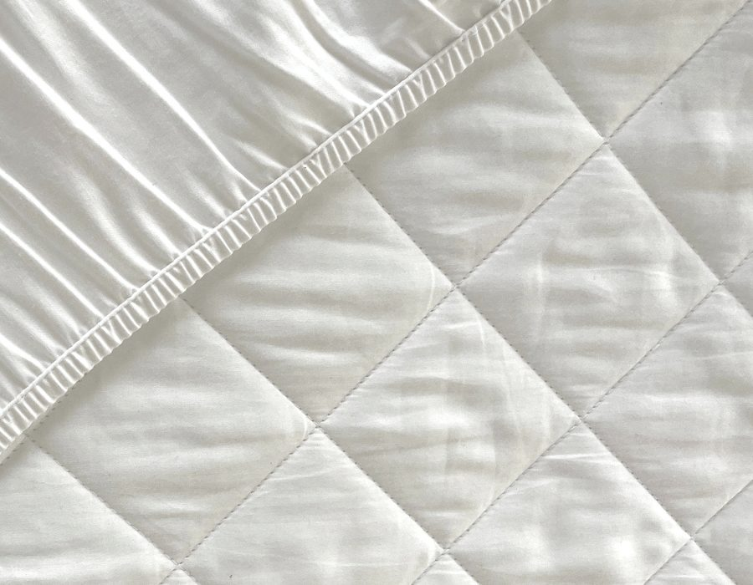
Mattress Protector

Slide 18

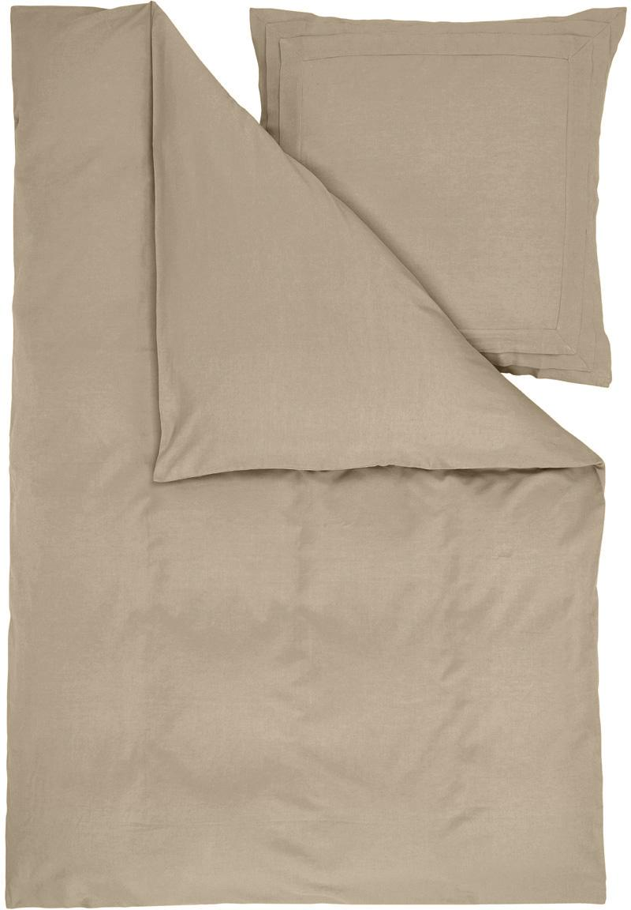
Linen Cotton Triple Flange

Slide 19
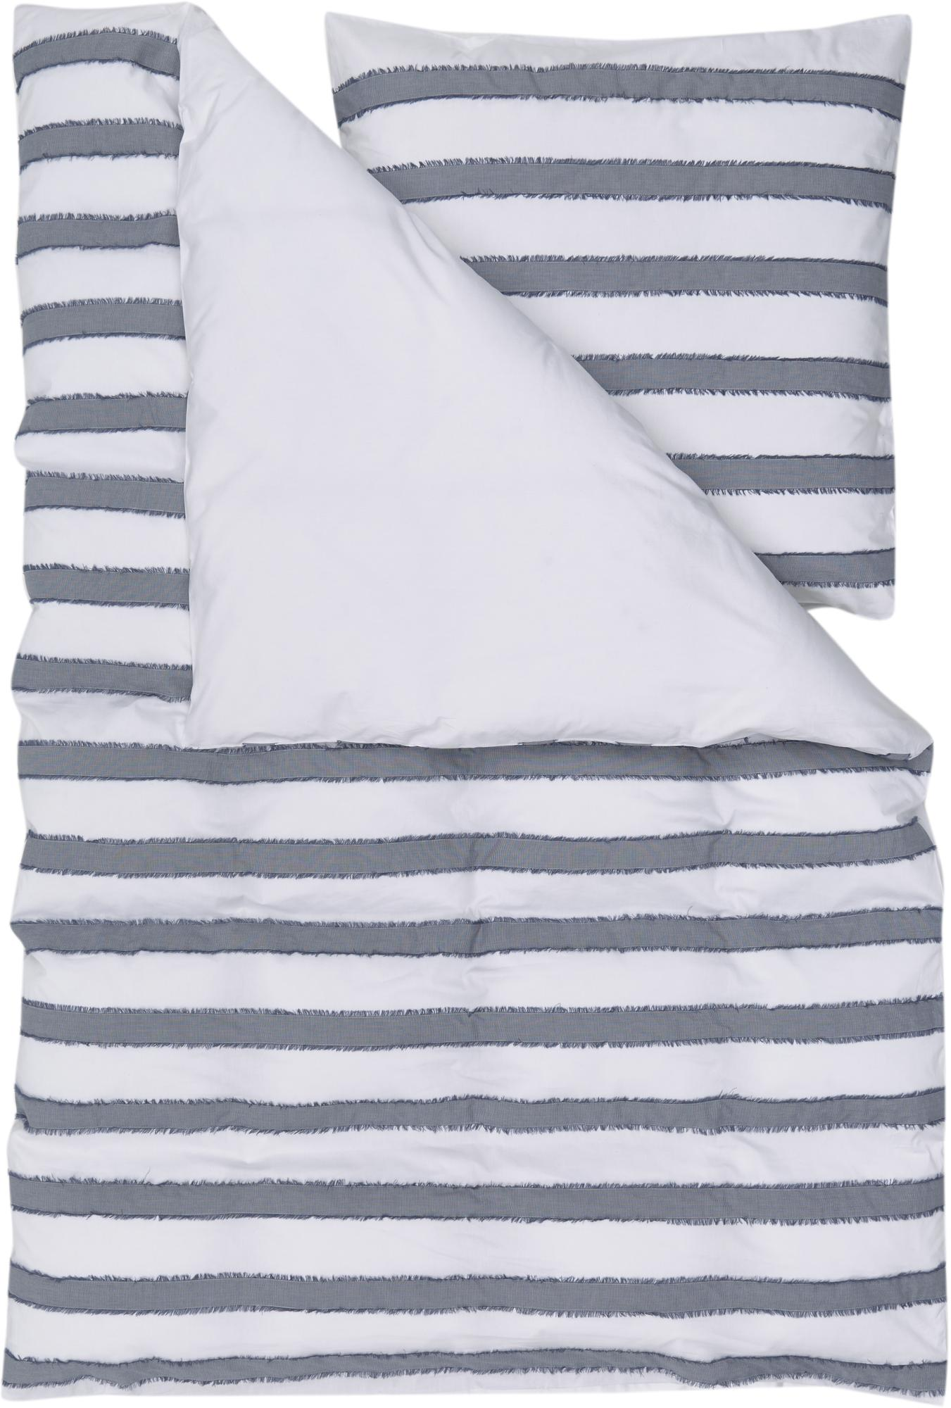
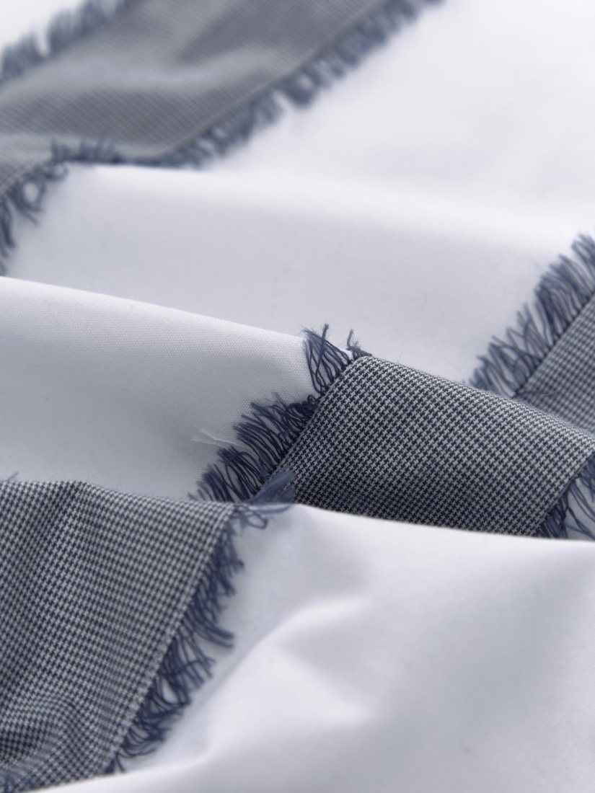
Woven Fringes

Slide 20
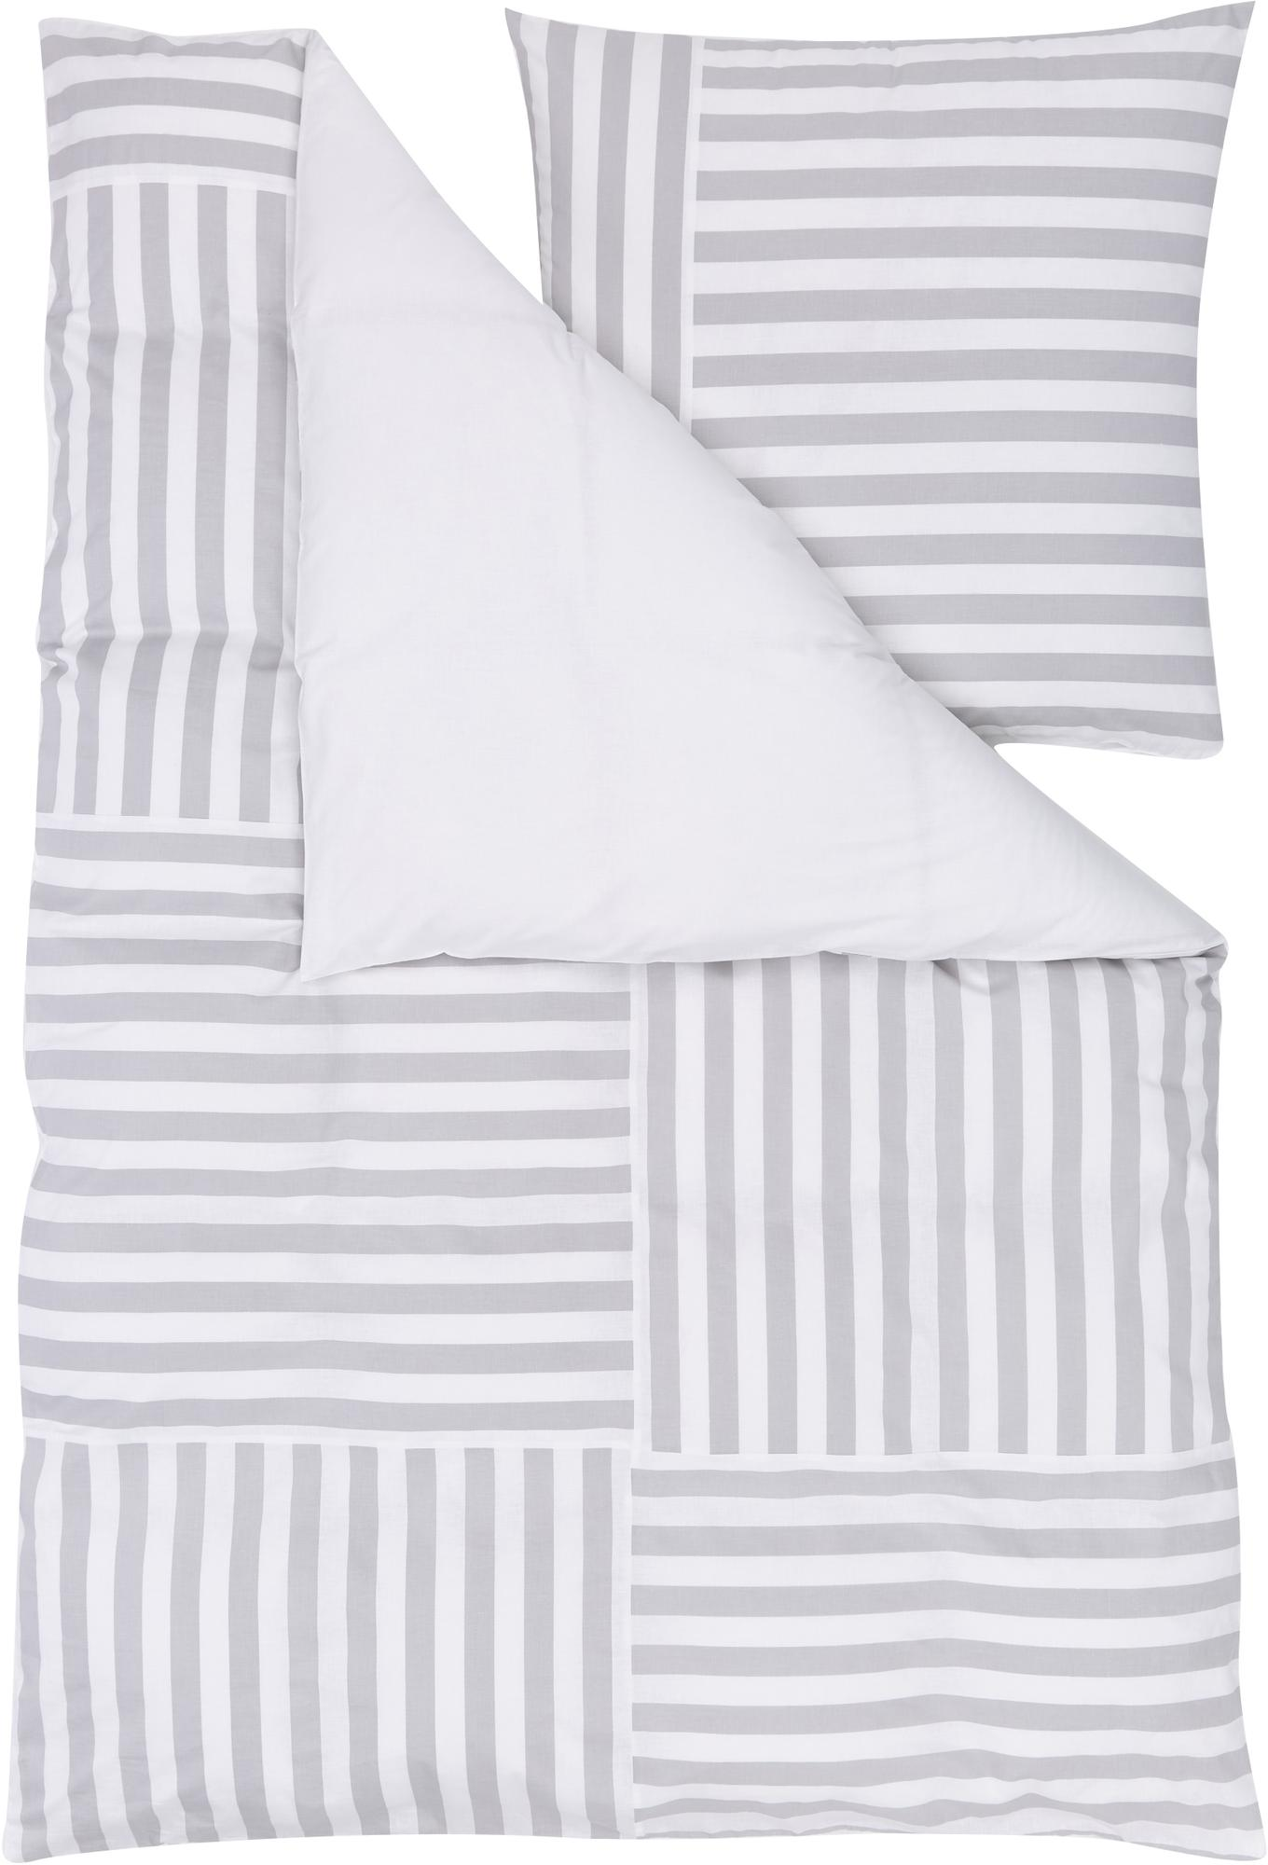

Printed Patch work

Slide 21

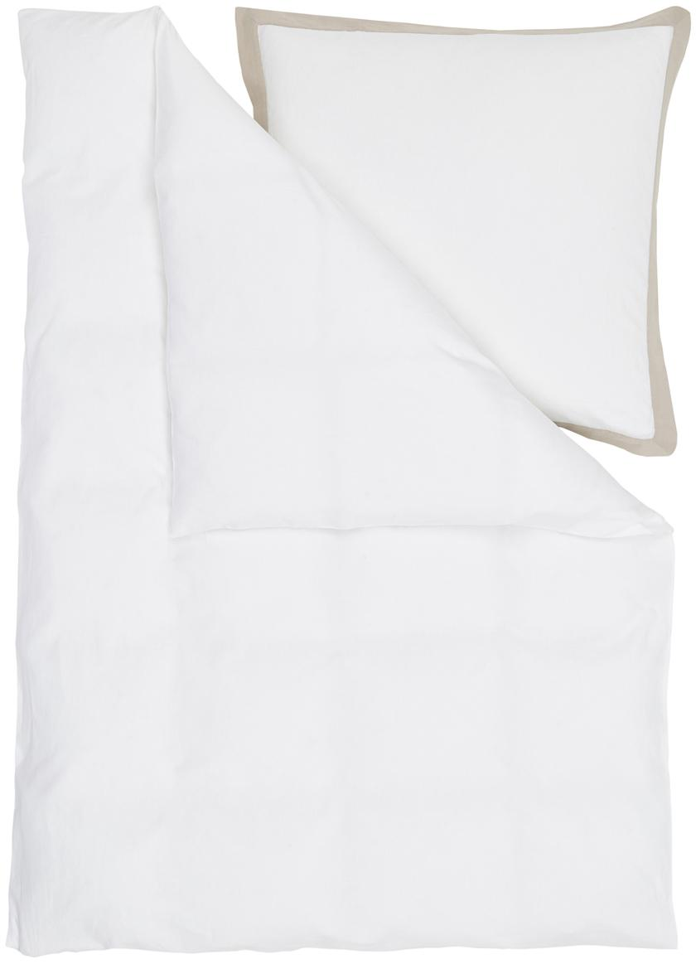
Linen Cotton Contrast Flange

Slide 22
THANK YOU !!

