Slide 1

Product presentation
Paramount Textile Mills P Ltd.,

Slide 2
PARAMOUNT TEXTILE MILLS P LTD
Wide Product Range
  Cotton Woven Grey Fabrics for Apparels & Fashion(Narrow Width)
  Cotton Woven Grey Fabrics for Sheeting & Home Textiles (Wider Width)
  Cotton Woven Grey Fabrics for Down Proof & Technical End Uses (Narrow & Wide Width)
  Cotton Woven Mercerized & Calendered Fabrics for both Home & Fashion Textiles
  Bed Linens & Home Textile Made ups
  Institutional & Hospitality Linens
  Industrial & Commercial Safety Work Wear
  Bespoke Concierge Home Textiles

Slide 3
PARAMOUNT TEXTILE MILLS P LTD
Product Range – Specific Core.
  Cotton Woven Grey Fabrics for Apparels & Fashion(Narrow Width)
    Greige Woven Fabrics from Widths 48’’ -144’’ from state of art Airjet, Rapiers & Jacquard.
    Customized Selvedge & Yarn Twists
    Custom designed with multiple yarn types:
      100% GOTS Organic & OE (Organic Blended OCS)
      100% Fair Trade Organic
      100% Recycled Cotton/Recycled PET Polyester
      100% LENZING Modal & Tencel (Air & Pro-Modal)
      100% Ecovira Viscose
      100% Supima/ 100% GIZA, 100% Belgian Linen
      100% Soy, Bamboo, Hemp, Banana & Sea Weed Fibres for Fashion.
      Count Ranges:
        3/5’s to 4/160 & 20/1 to 320/1

Slide 4
PARAMOUNT TEXTILE MILLS P LTD
        BED LINEN & HOME TEXTILES
          High Quality Made up’s from 100% Organic, Fair Trade Cotton TRACEABLE route from Farm to Production.
          NON GMO Guarantee using unique applied DNA technology chip to have absolute confidence on product.
          COTTON Blends with CUPRO/BEMBERG/CASHMERE/MODAL/TENCEL/HEMP/
          FLAX/BAMBOO
          SILVER/ARAMID/META-ARAMID/SILK
          SEA CELL/ALOE-VERA/SOY
          DOBBY/JACQUARD/ENGINEERED WEAVING for special applications in Hospitality/Home/Luxury Bespoke/Conceirge Services etc.
          Functional & Medicinal Home & Hospitality Textiles through engineered fibers and special finishing technology
          Multiple Hem/Embroidery Techniques

Slide 5
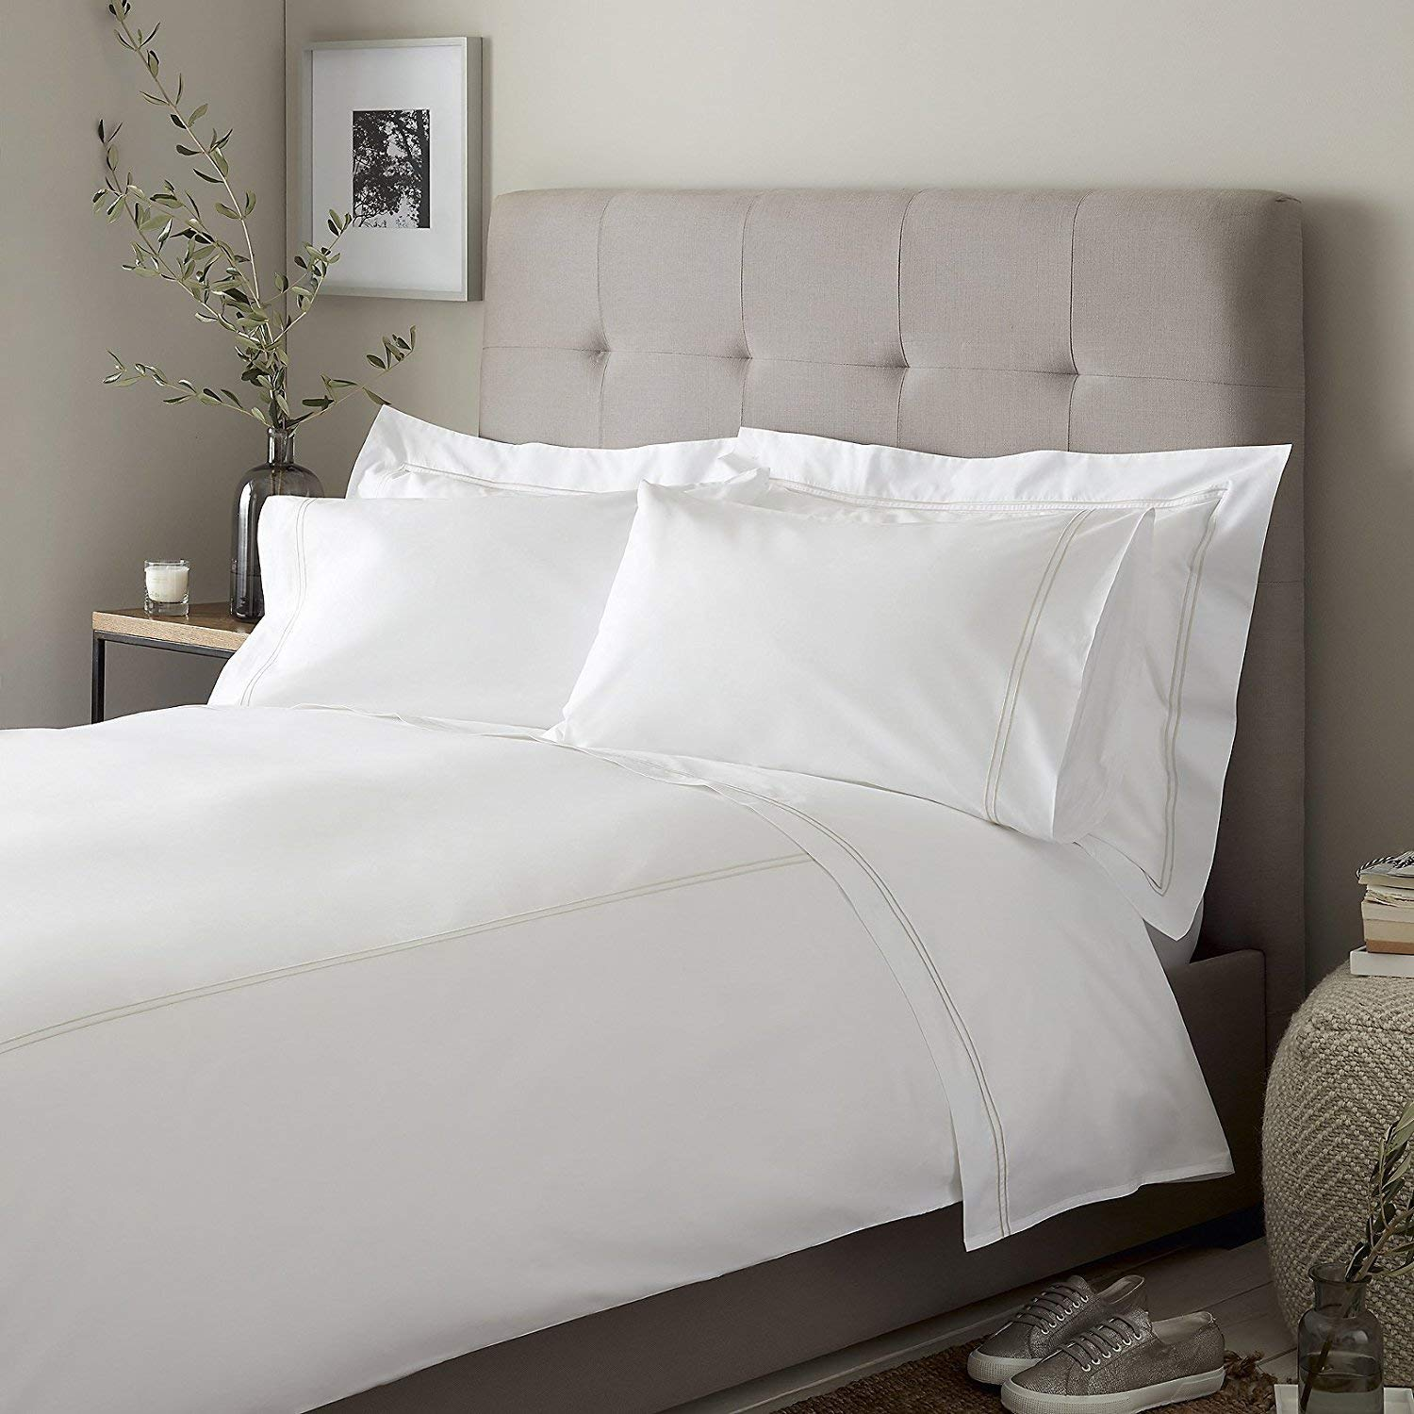
At Paramount, The FINEST HOTEL LINENS are made with passion to the last touch of precision

Slide 6
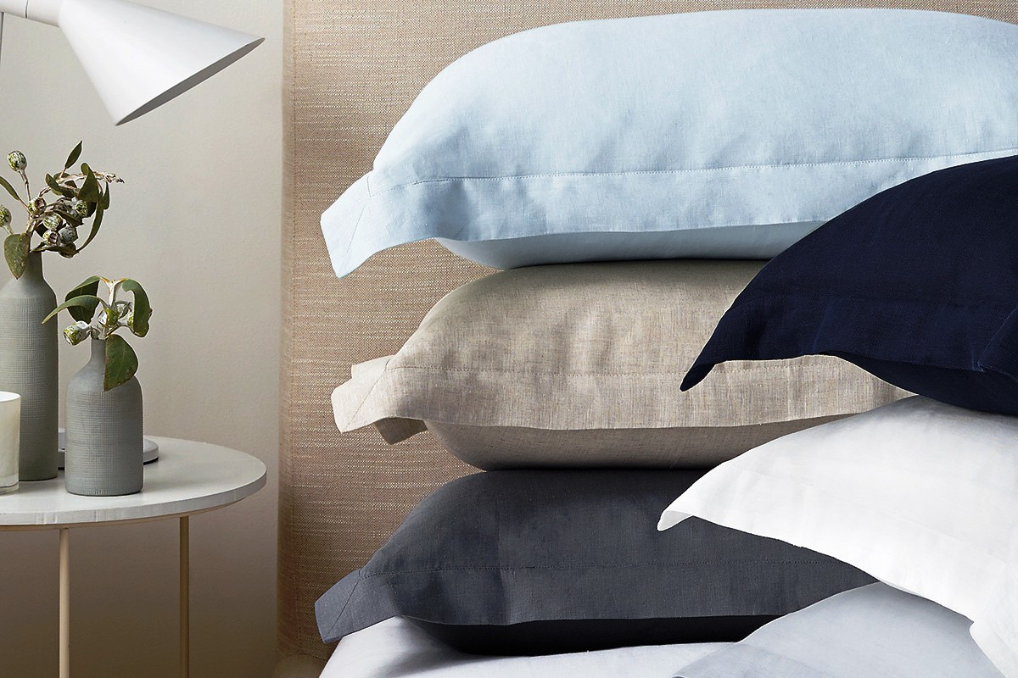
Our Belgian linen is truly an inspiration to the vintage home lovers

Slide 7
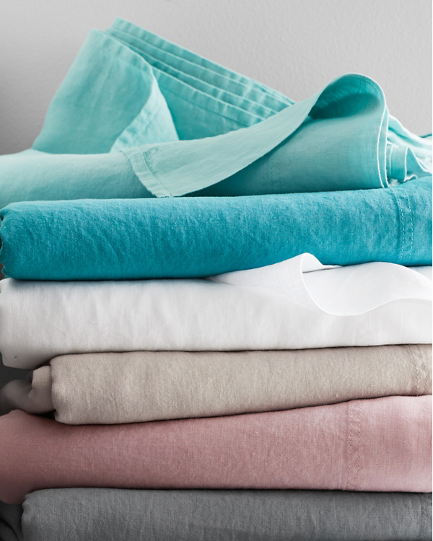

Our handpicked first flush belgian flax from southern france and belgium.

Slide 8


Product engineering at its very best.!
Permanent Cotton Seer Stretch

Slide 9
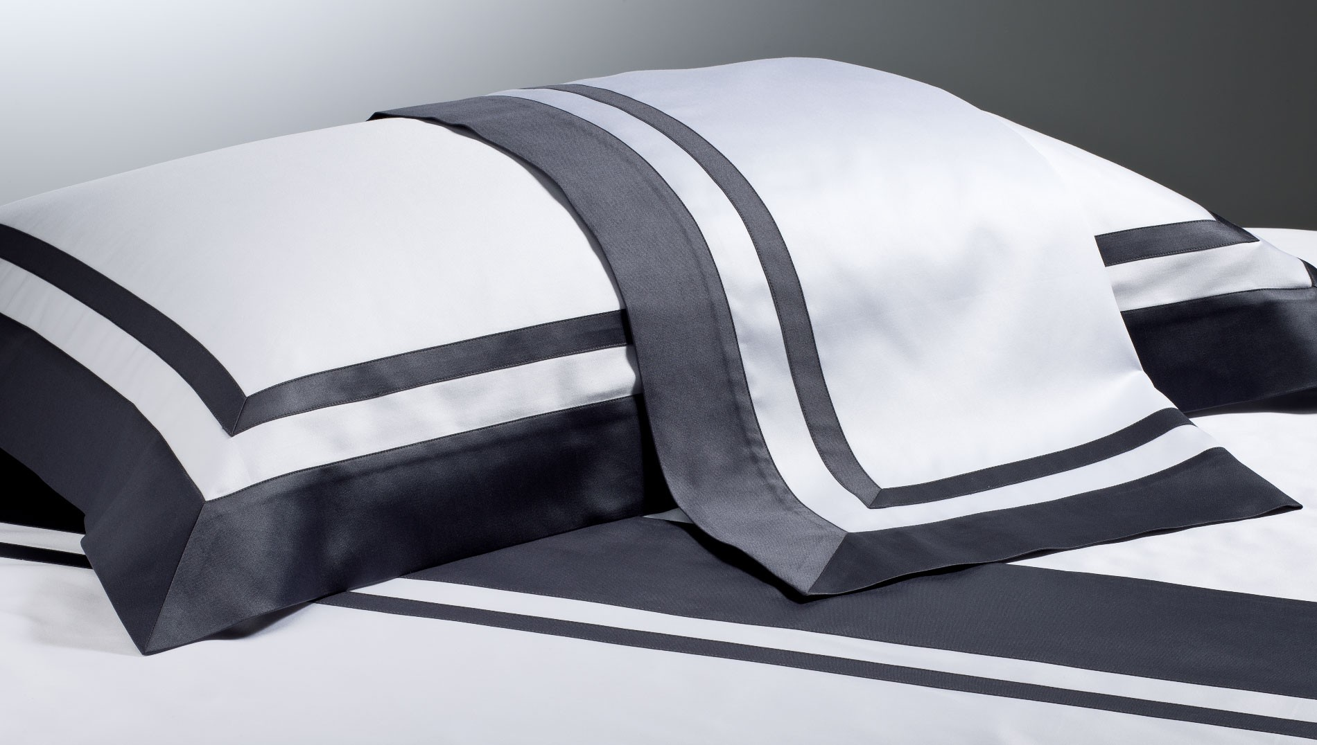
WHERE PRECISION & CLASS ARE SECOND TO NONE.
Our Stylish Italian Banding

Slide 10
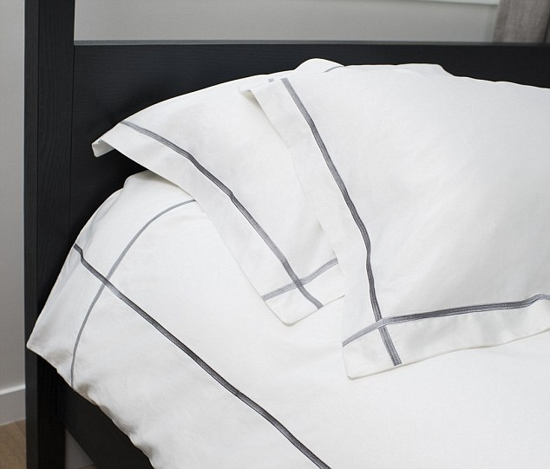
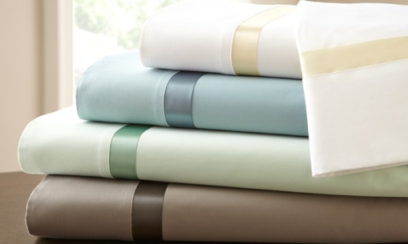
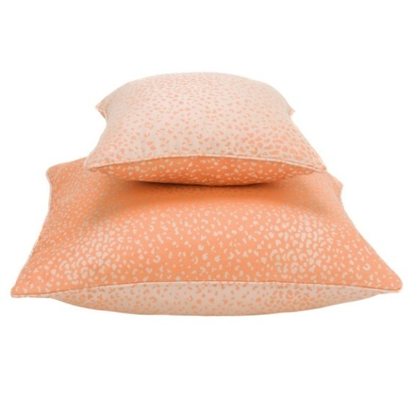
EVERY LITTLE THING MATTERS MORE TO US

Slide 11
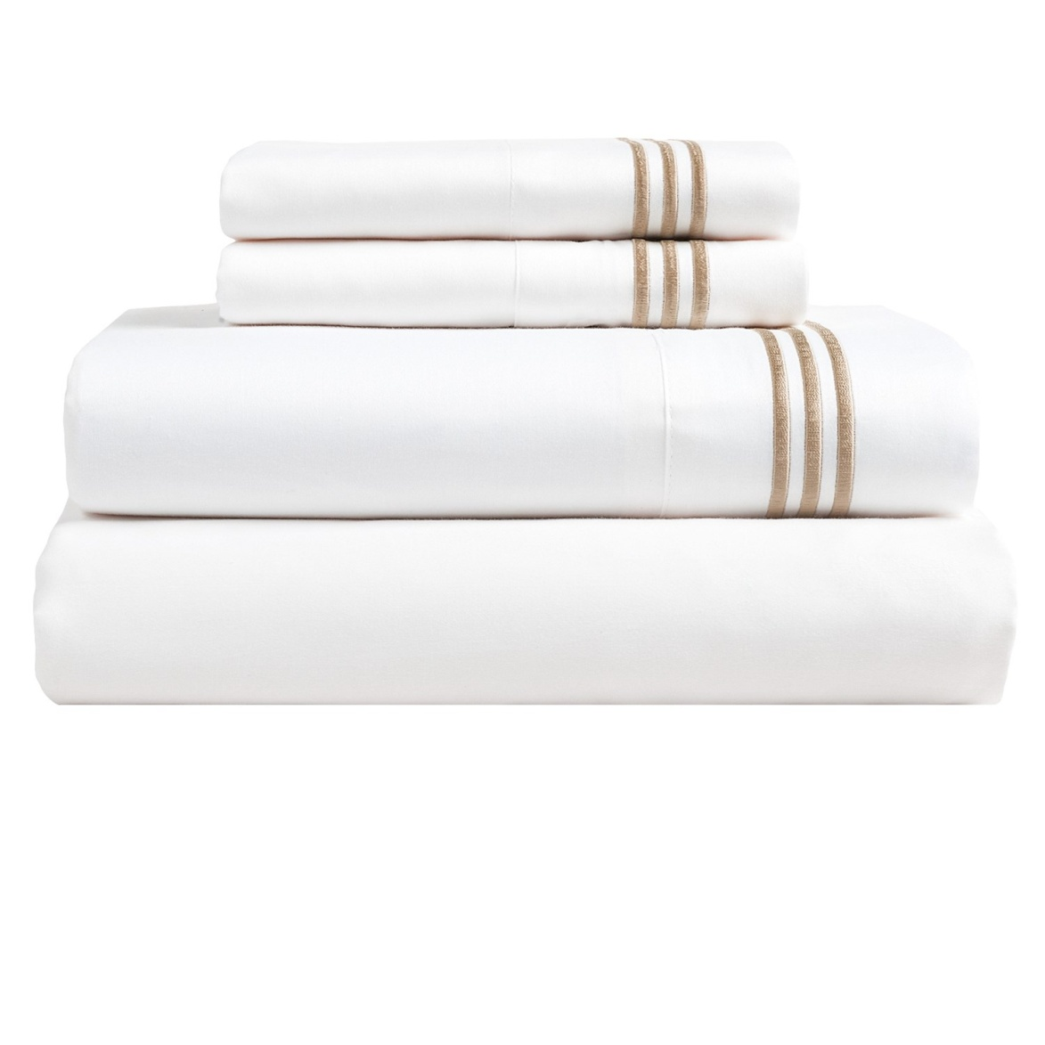
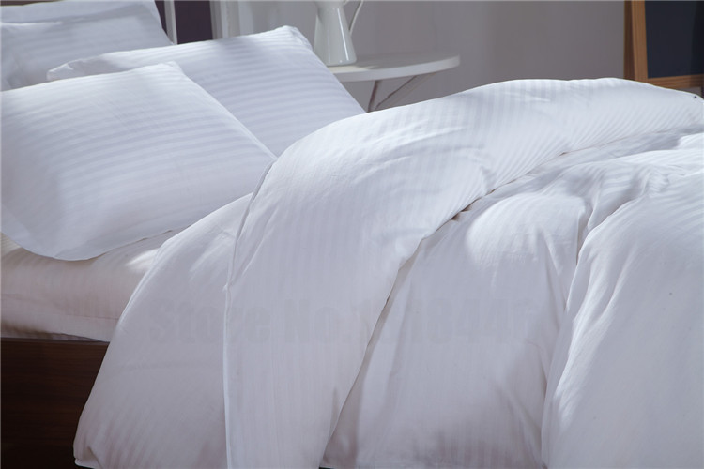
Where only the finest hands work on our linens.

Slide 12

Excellence by simplicity
The Exclusive Diamond Lace on the sleeve of the Pillow & Flat Header is done with passion and precision.

Slide 13
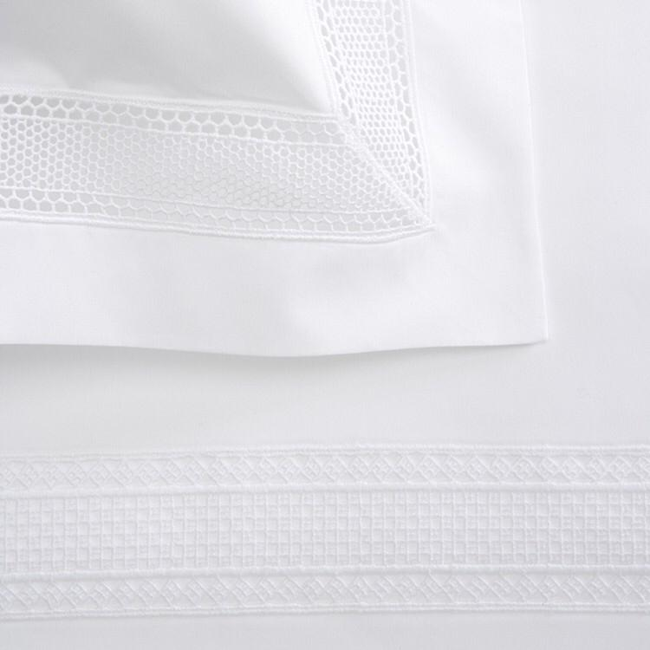
EXCELLENCE BY ELEGANCE
The Elegant Valentine Hem is a replica of the HER GRACE in the traditional royal residences of Great Britain. Simple, yet grand, the see through hem is a class of its own.

Slide 14
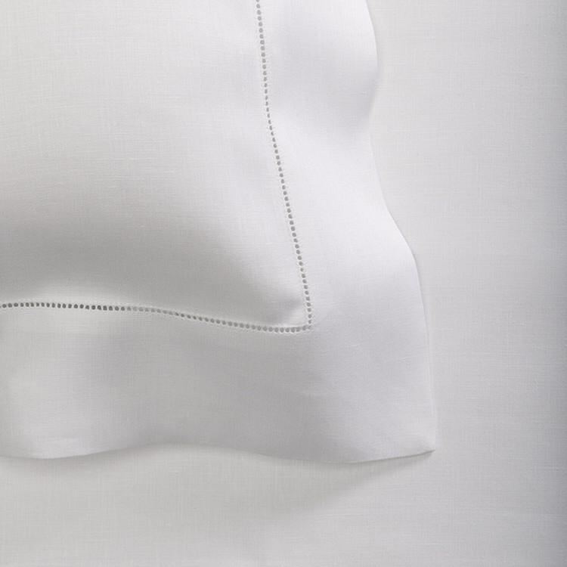
EXCELLENCE BY DEFINITION
The SIMPLE yet stylish Fagotting is a timeless classic of a calm bed room.

Slide 15
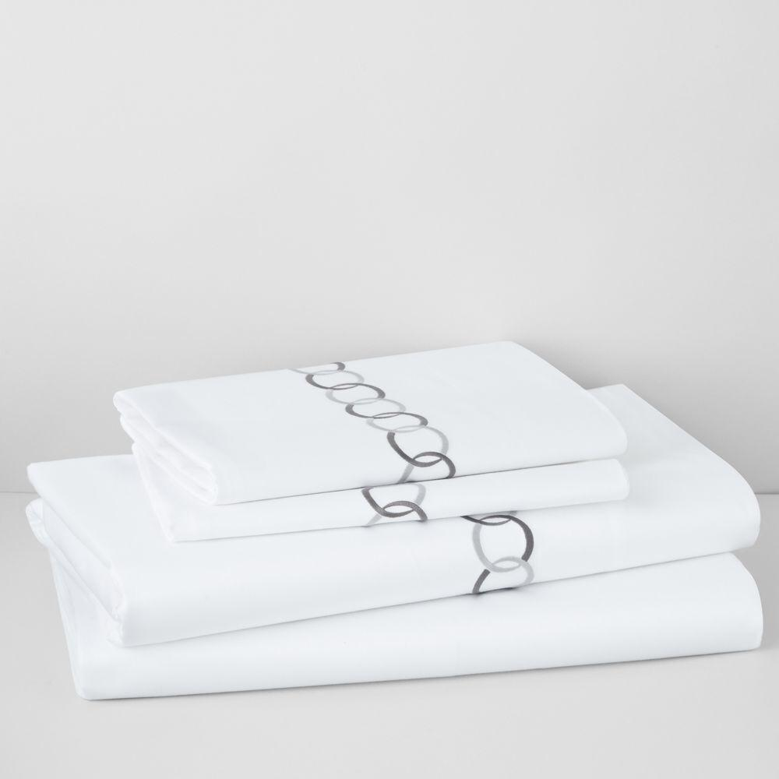
Sometimes we need her grace.
The northern circles embroidery reflect the need for a compassionate embroidery on bed. Alternated with light on dark threads, imbibing the very virtue of class.

Slide 16
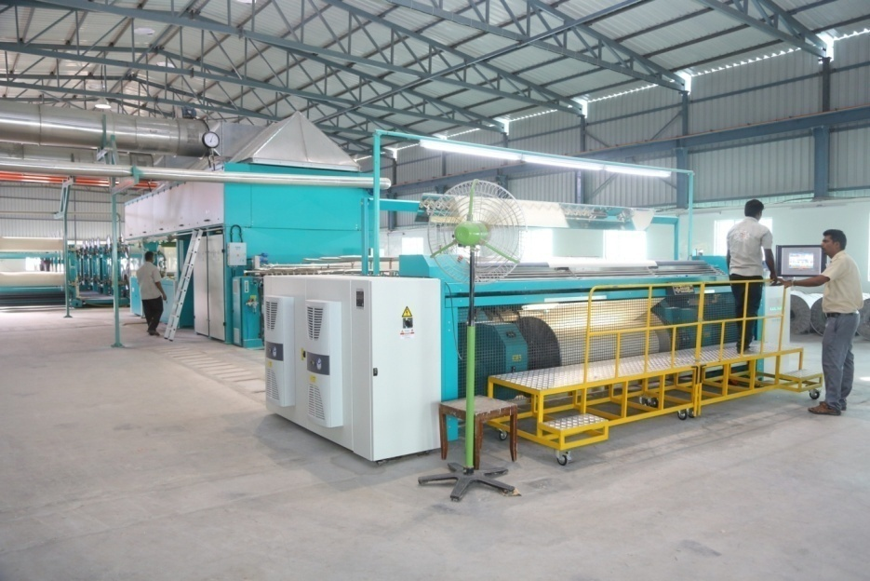
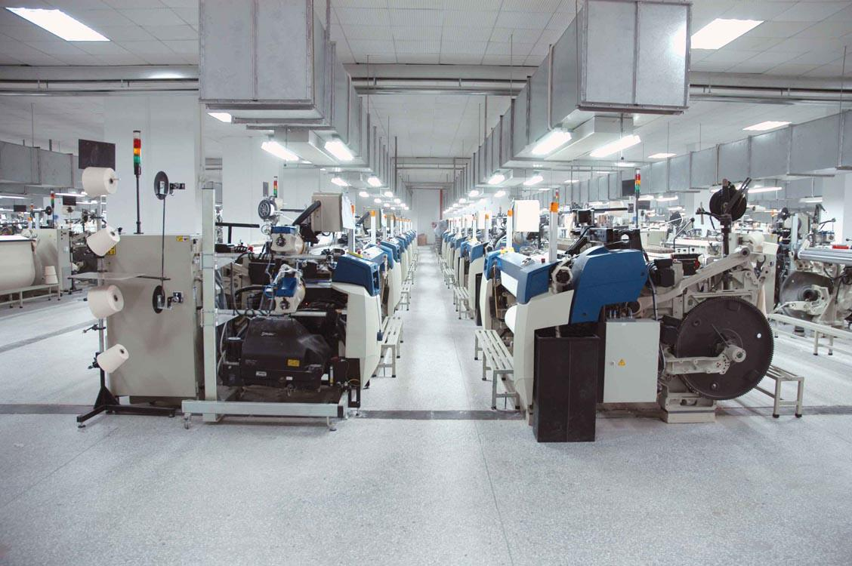
INFRASTRUCTURE

Slide 17
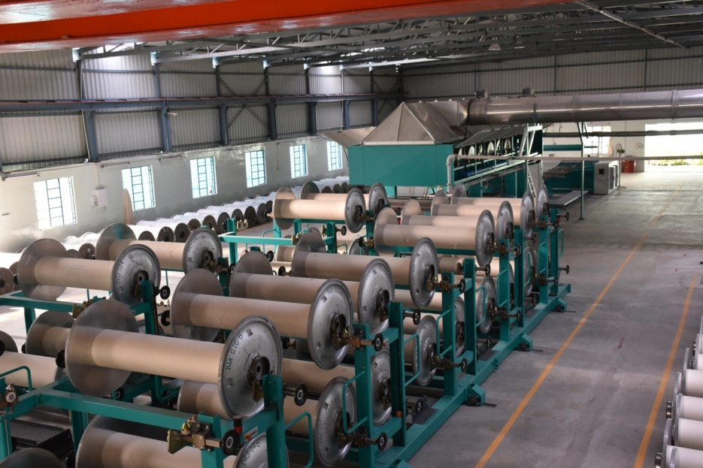
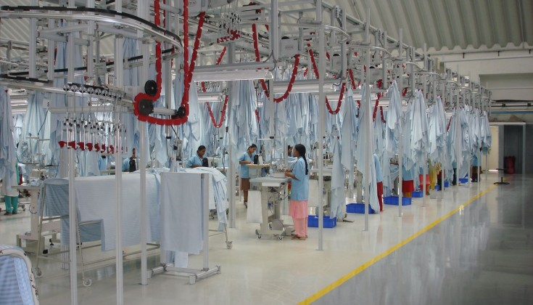

Well Established &
Organized Set up

Slide 18
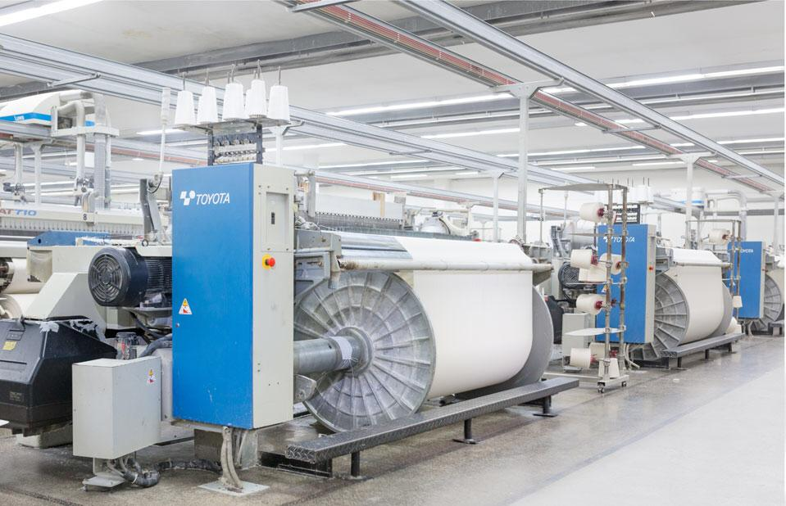
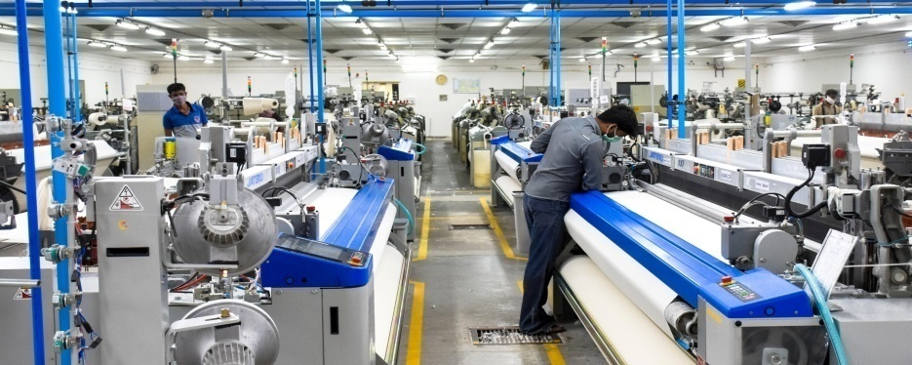
With precision & diligence.

Slide 19
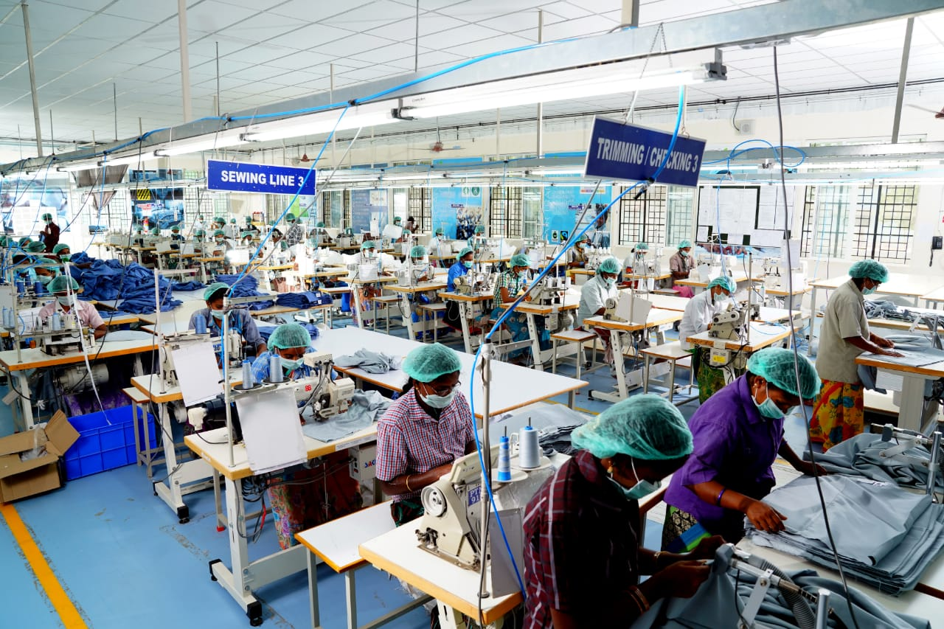
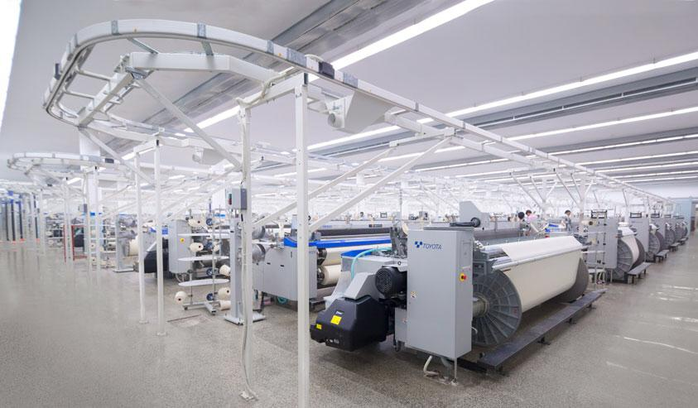
Finest Technology from the globe.

Slide 20

Its all about sustainability. !

Slide 21
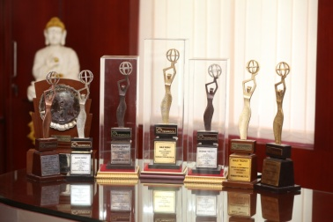
Awards & Accreditions
GOLD- Highest Global Exporter for cotton fabrics out of India for 10 years in a row.
1 Gold, 5 Silver & 6 Bronze Export Awards for the highest global export of fabrics from India from TEXPROCIL in conjunction with the TEXTILE EXPORT PROMOTION COUNCIL OF INDIA.

Slide 22

We are 100% Solar & Wind Powered.
Paramount is one of the few companies in the globe to have ZERO Carbon footprint emission. 100% of your production can be sustainable and trace a green mile. How about your linens made from Sun & Wind?

Slide 23



RENEWABLE ENERGY
All of the PRODUCTS produced in PARAMOUNT is from CLEAN & GREEN ENERGY. 100% !
Energy is Harnessed from Solar & Wind Farms that are within and nearby the Mills Premises.

Slide 24












CERTIFICATIONS.

Slide 25

The True Social Respect Adherence.

