Slide 1
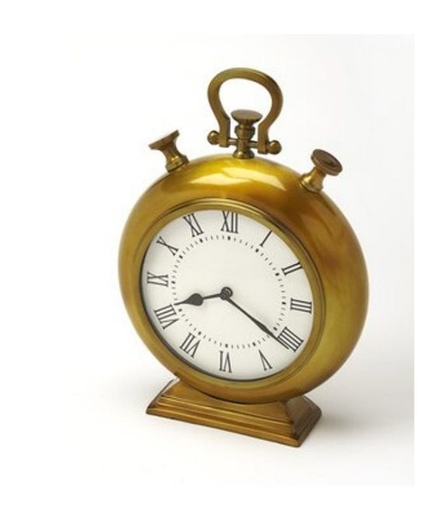
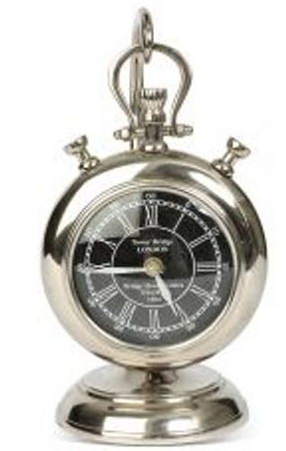
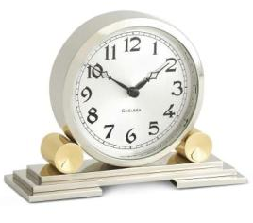
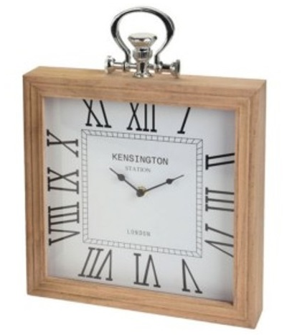
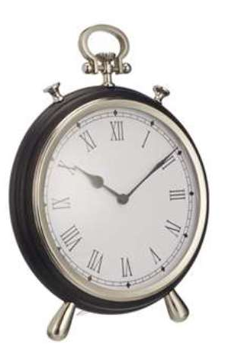
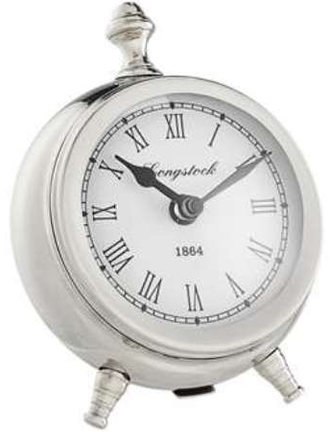
AHMAD EXPORTS
1202 1203 1204
1206 1207 1208

Slide 2
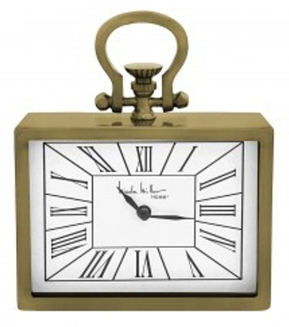
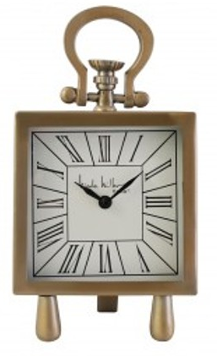
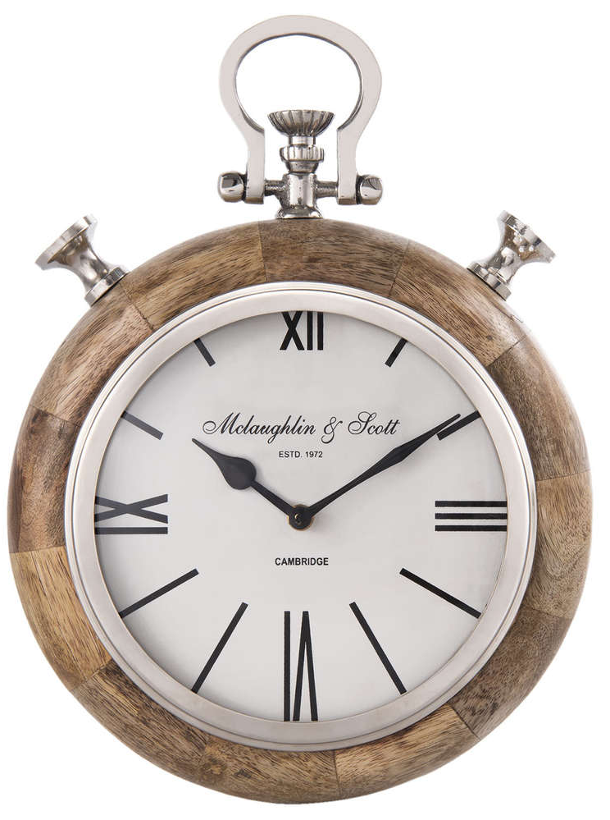
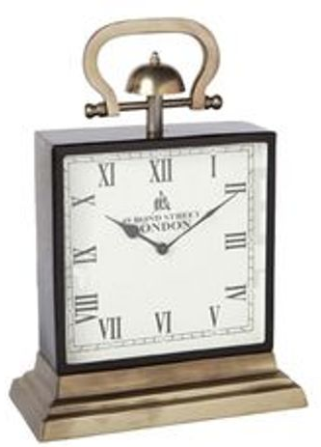
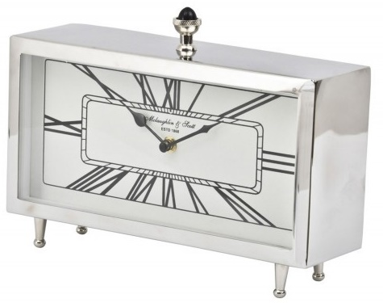
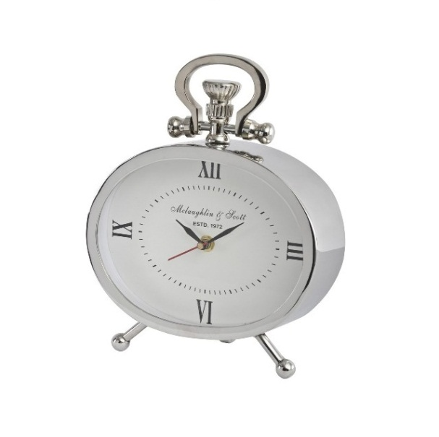
AHMAD EXPORTS
1209 1210 1802
1803 1804 1805

Slide 3
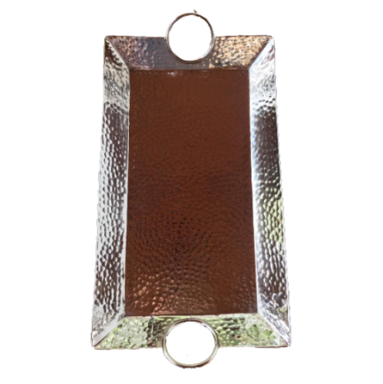
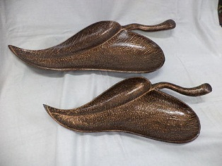
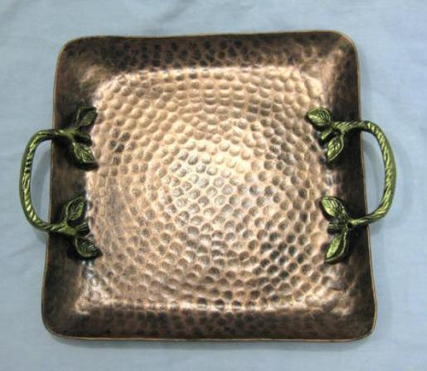
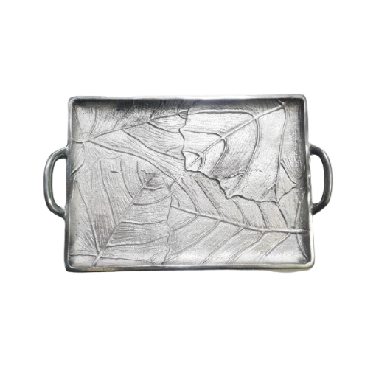
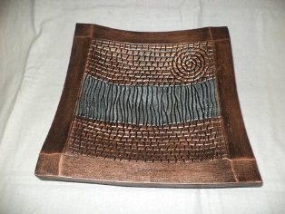
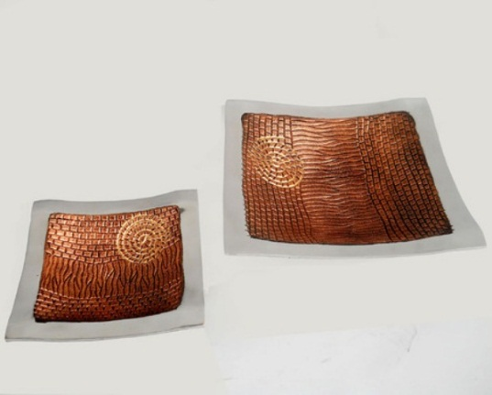
AHMAD EXPORTS
AE-9043 AE-9019 AE-9036
AE-9047 AE-9018 AE-9033

Slide 4
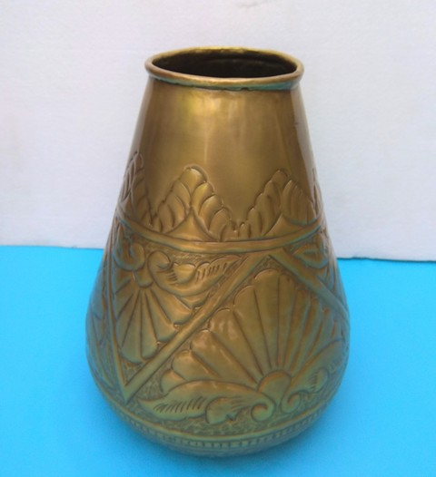
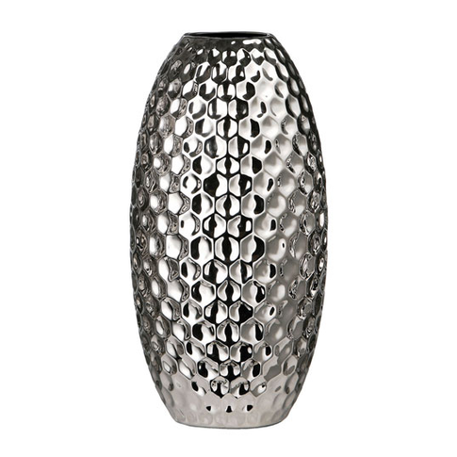
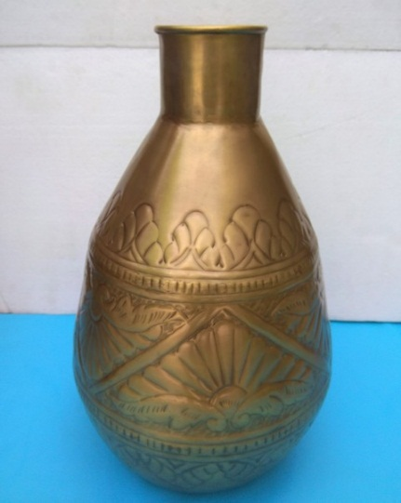
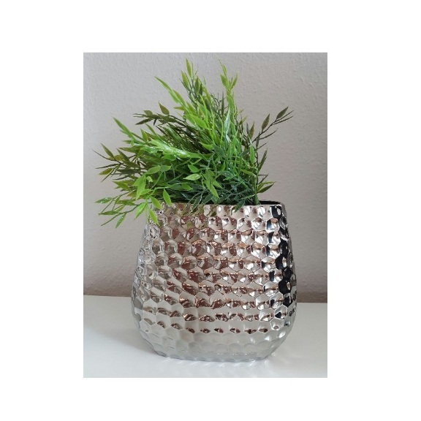
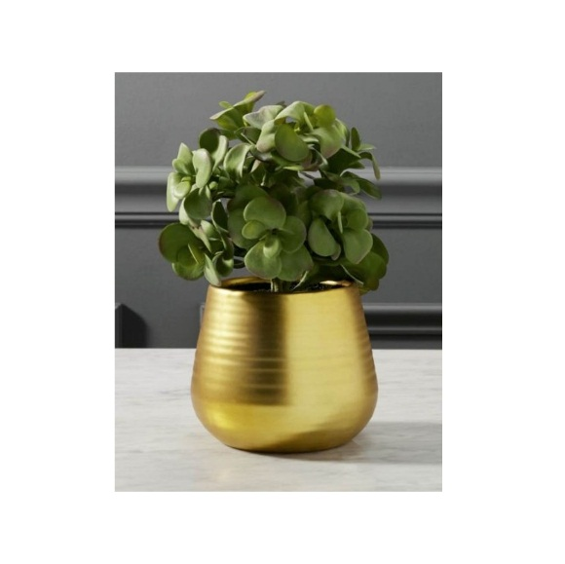
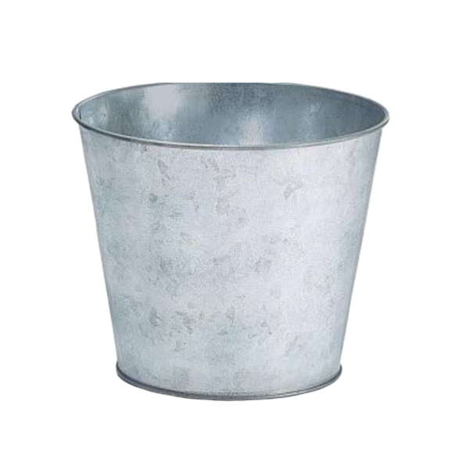
AHMAD EXPORTS
3003 AE-9005 3001
AE-9154 AE-9155 AE-9177

Slide 5



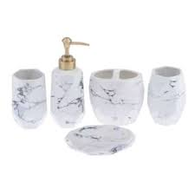

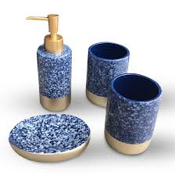
AHMAD EXPORTS
AE-20220 AE-20221 AE-20238
AE-20232 AE-20233 AE-20235

Slide 6
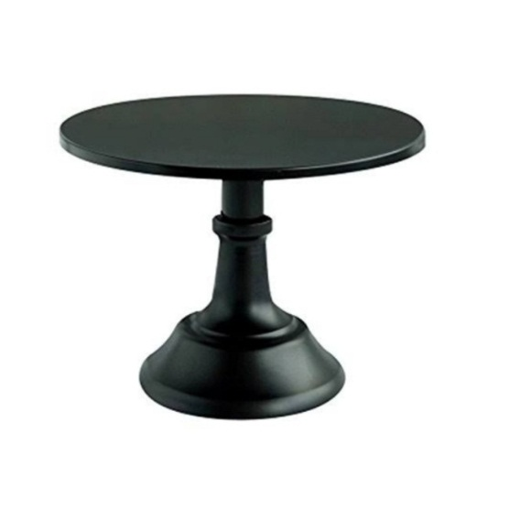
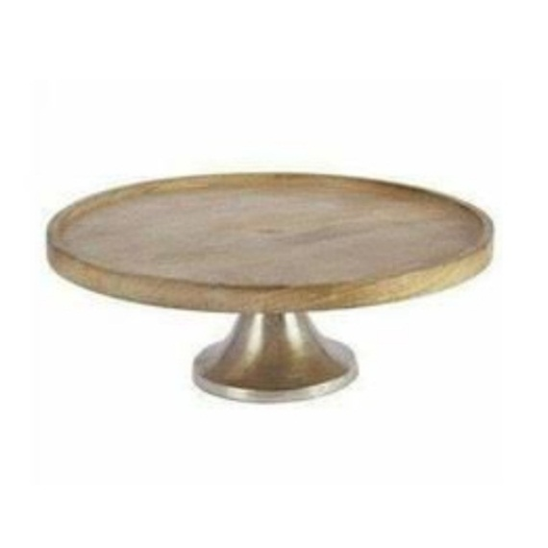
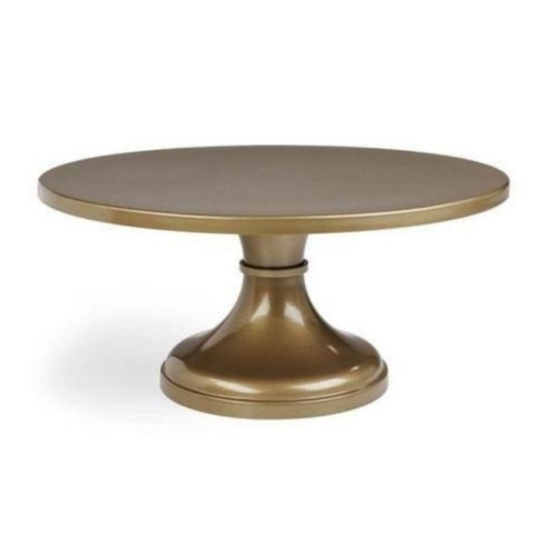
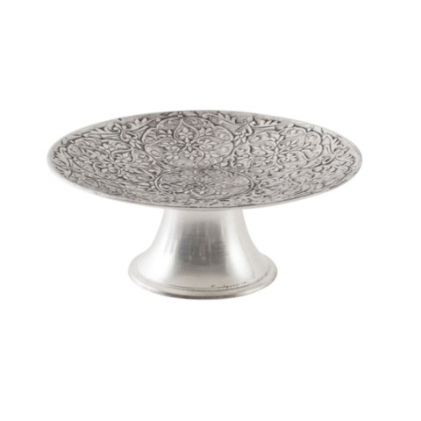
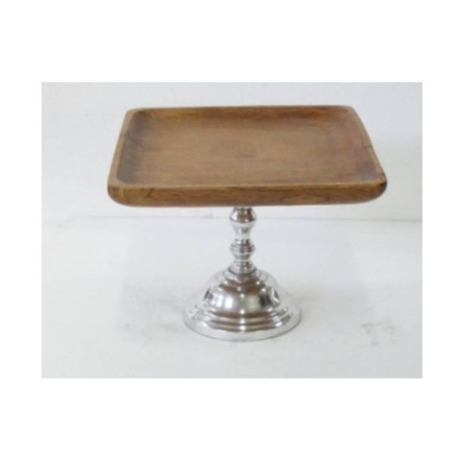
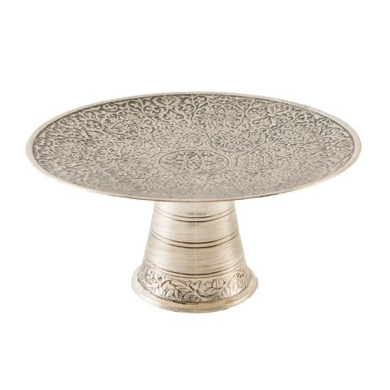
AHMAD EXPORTS
171 172 173
166 165 169

Slide 7
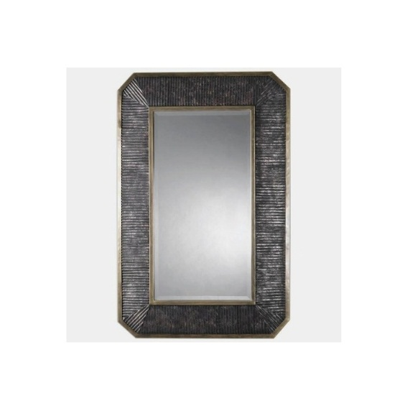
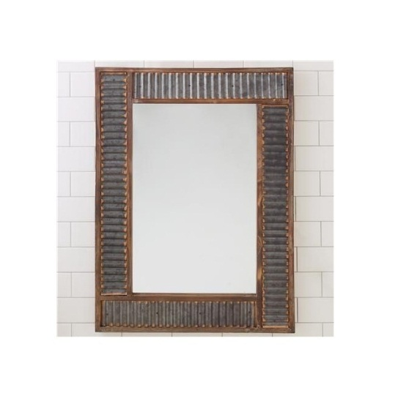
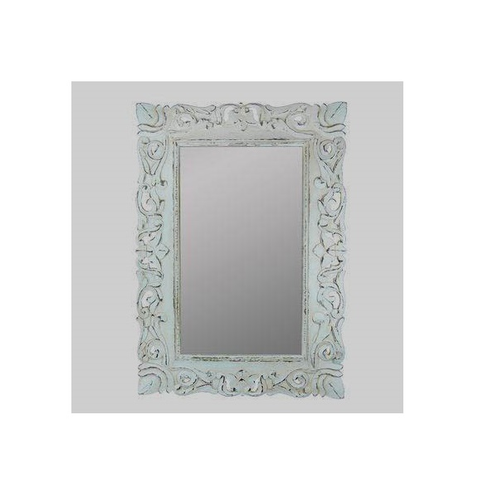
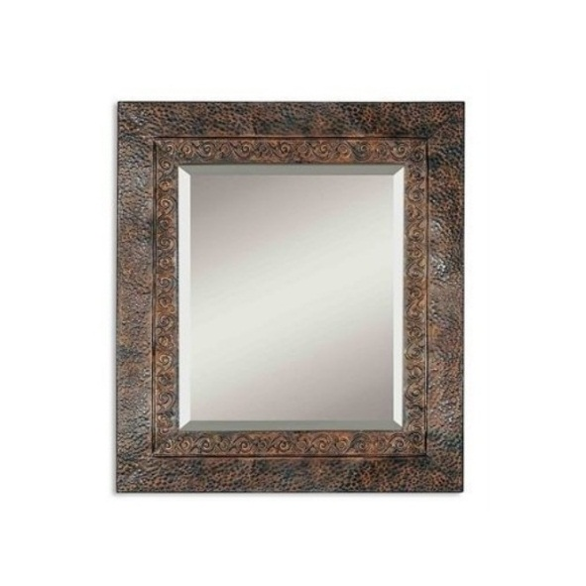
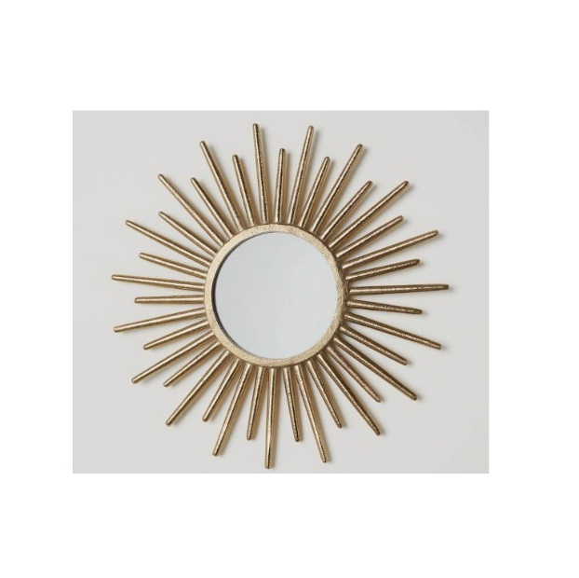
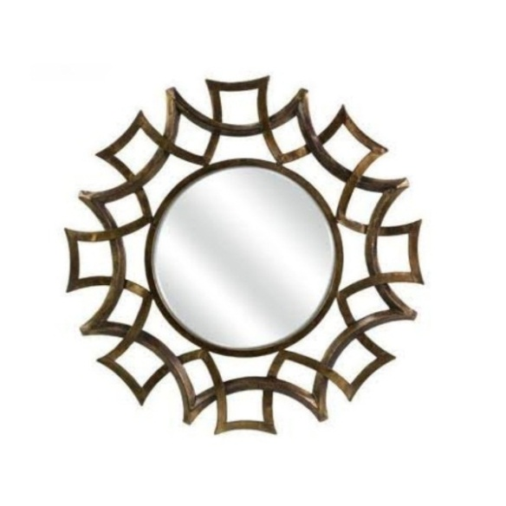
AHMAD EXPORTS
1835 1836 1837
1838 1839 1852

Slide 8
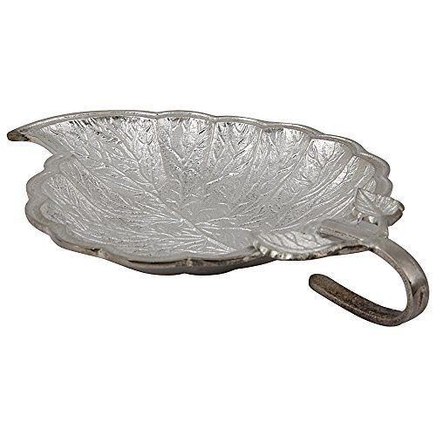
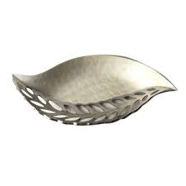
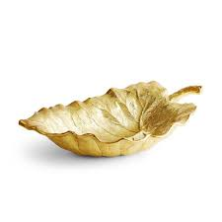
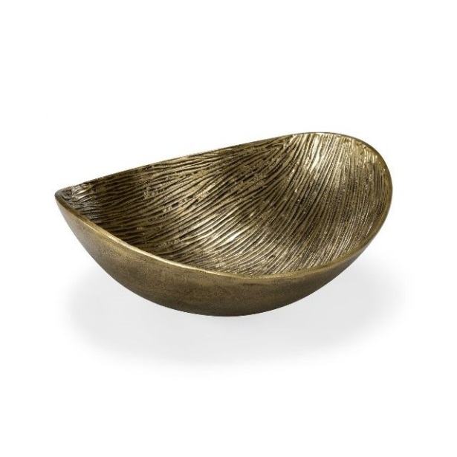
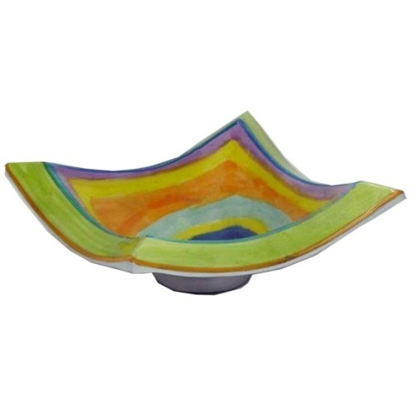
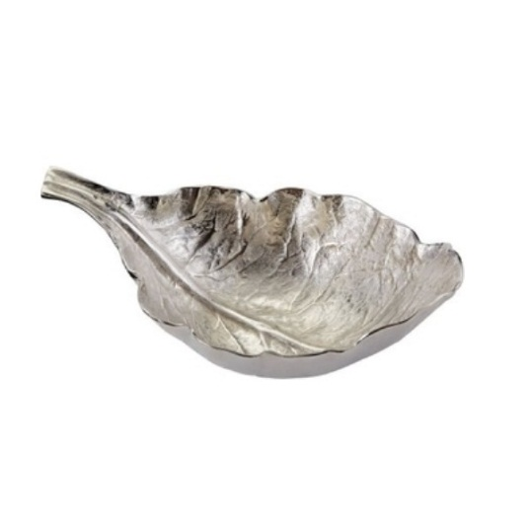
AHMAD EXPORTS
0005 0003 0004
1704 1705 1686

Slide 9
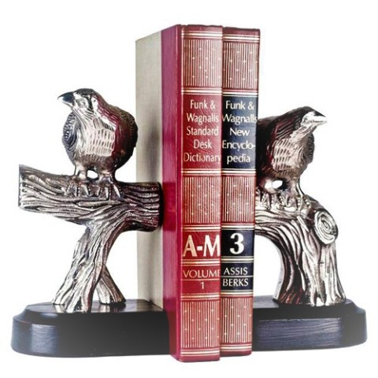
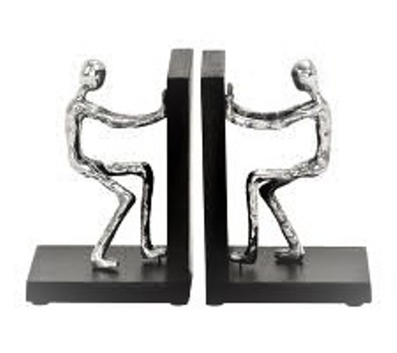
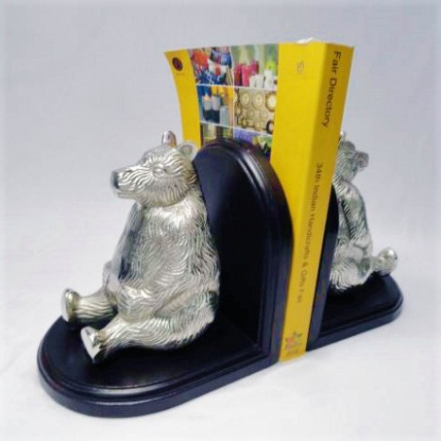
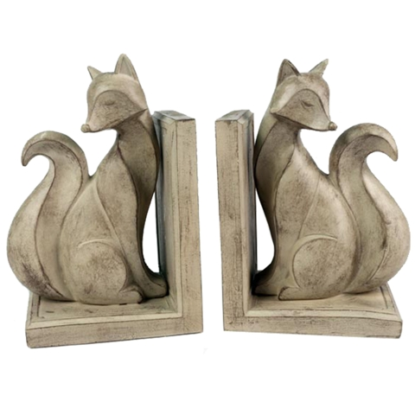
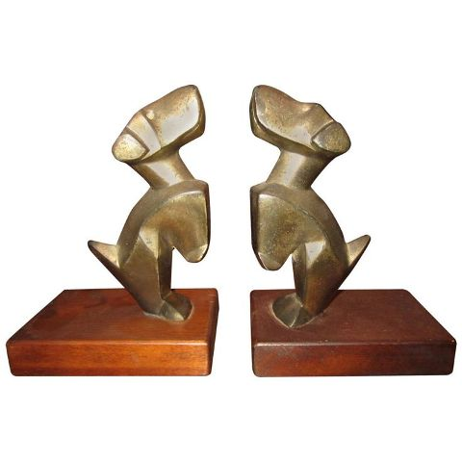
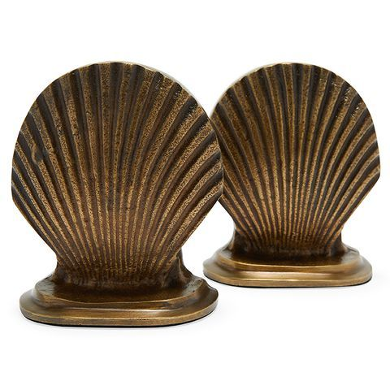
AHMAD EXPORTS
05 006 004
028 031 051

Slide 10






AHMAD EXPORTS
010 724LMS 047
052 053 054

Slide 11






AHMAD EXPORTS
1200 12-140 12-130
12-116 12-110 12-113

Slide 12






AHMAD EXPORTS
AN-360 AN-361 AN-359
AN-379 AN-367 AN-368

Slide 13






AHMAD EXPORTS
806 807 805
803 802 801

Slide 14






AHMAD EXPORTS
51 419 430
452 474 477

Slide 15






AHMAD EXPORTS
491 492 493
495 496 498

Slide 16






AHMAD EXPORTS
AE-8001 AE-8041 AE-8042
AE-8043 AE-8044 AE-8045

Slide 17






AHMAD EXPORTS
6801 6804 6806
6808 6809 6810

Slide 18






AHMAD EXPORTS
6816 6817 6818
6819 6820 6821

Slide 19






AHMAD EXPORTS
9001 9002 9003
9004 9005 9006

Slide 20

AHMAD EXPORTS
ST-1021

Slide 21

AHMAD EXPORTS
ST-1023

Slide 22

AHMAD EXPORTS
ST-1069

Slide 23

AHMAD EXPORTS
ST-1076

Slide 24


AHMAD EXPORTS
ST-1050 ST-1044

Slide 25


AHMAD EXPORTS
ST-1043 ST-1085

