Slide 1
BADAR AND SONS EXPORTS
HORN BONE PICTURE FRAMES

Slide 2
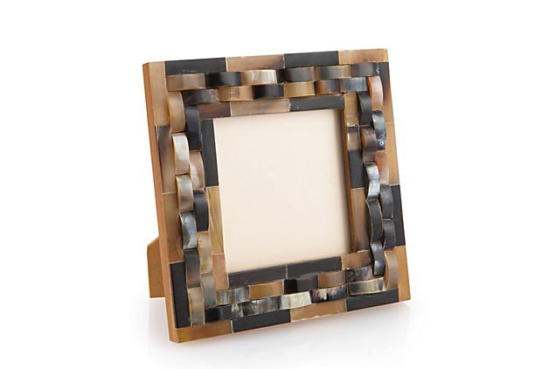
PRICE : RS.175

Slide 3
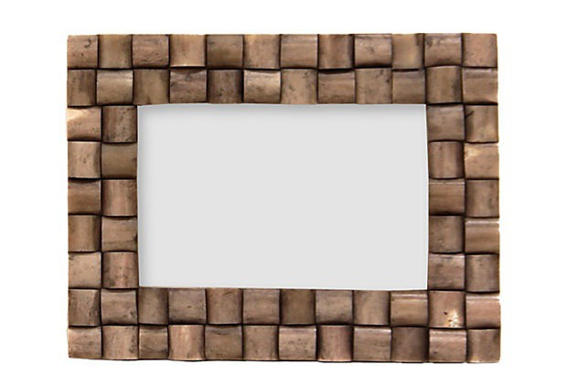
PRICE : RS.225

Slide 4
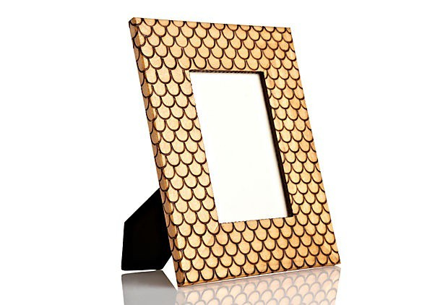
PRICE : RS.250

Slide 5
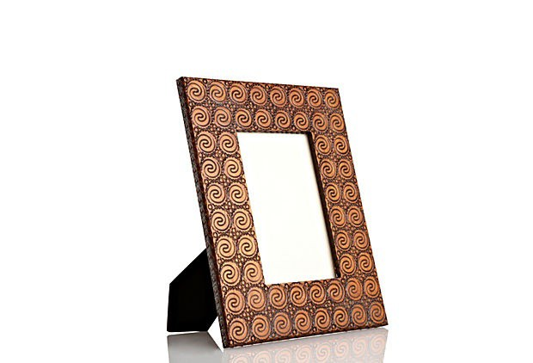
PRICE : RS.230

Slide 6
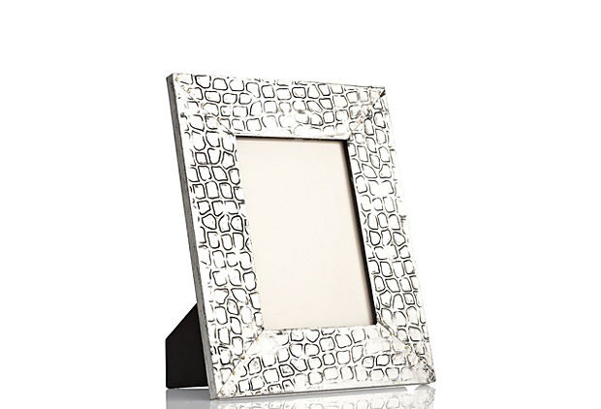
PRICE : RS.325

Slide 7
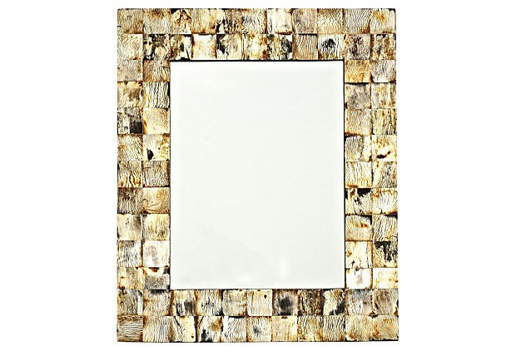
PRICE : RS.300

Slide 8
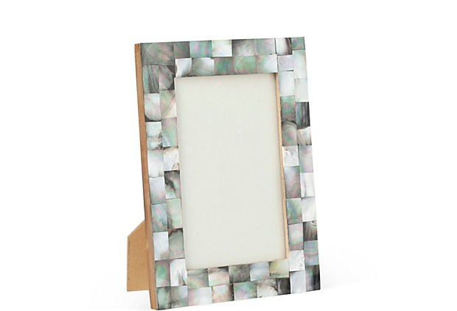
PRICE : RS.275

Slide 9
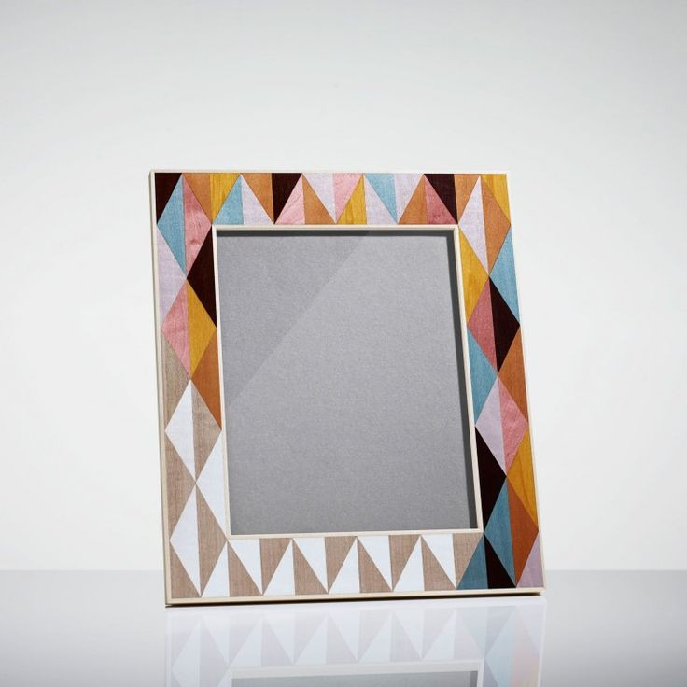
PRICE : RS. 285

Slide 10
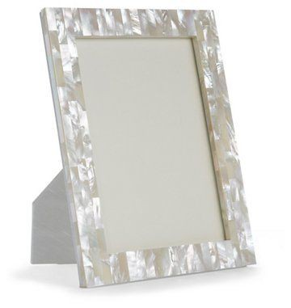
PRICE : RS.325

