Slide 1
PRESENTATION OF NEW DEVLOPMENT
BADAR & SONS EXPORTS
ADRESS; GALSHAHEED CHAND WALI MASJID
MORADABAD ‘ 244001
EMAIL ; BADARANDSONS1@GMAIL.COM
PHONE; 8 + 84457062012

Slide 2
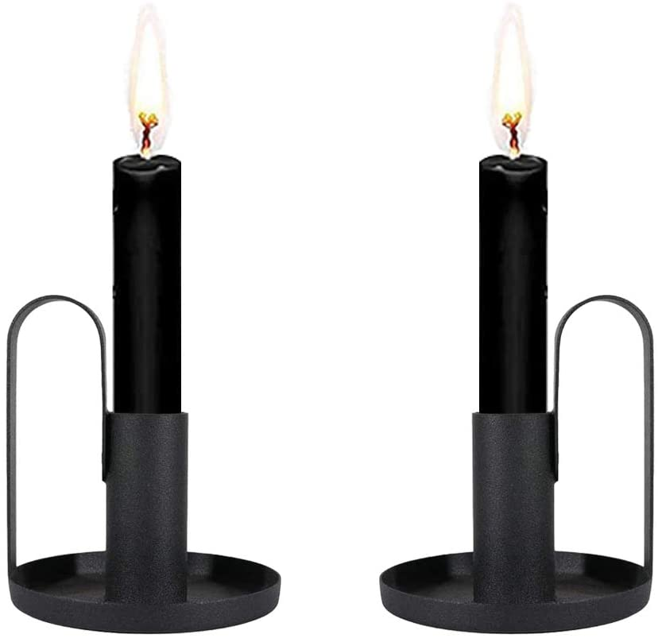
CANDLE HOLDER
ITEM NO ; BE-102521
DESCRIPTION ; CANDLE HOLDER
FNISH ;POWDER COATED
SIZE ; 3X3X5’’
MATERIAL ; IRON
PRICE: RS. 325

Slide 3
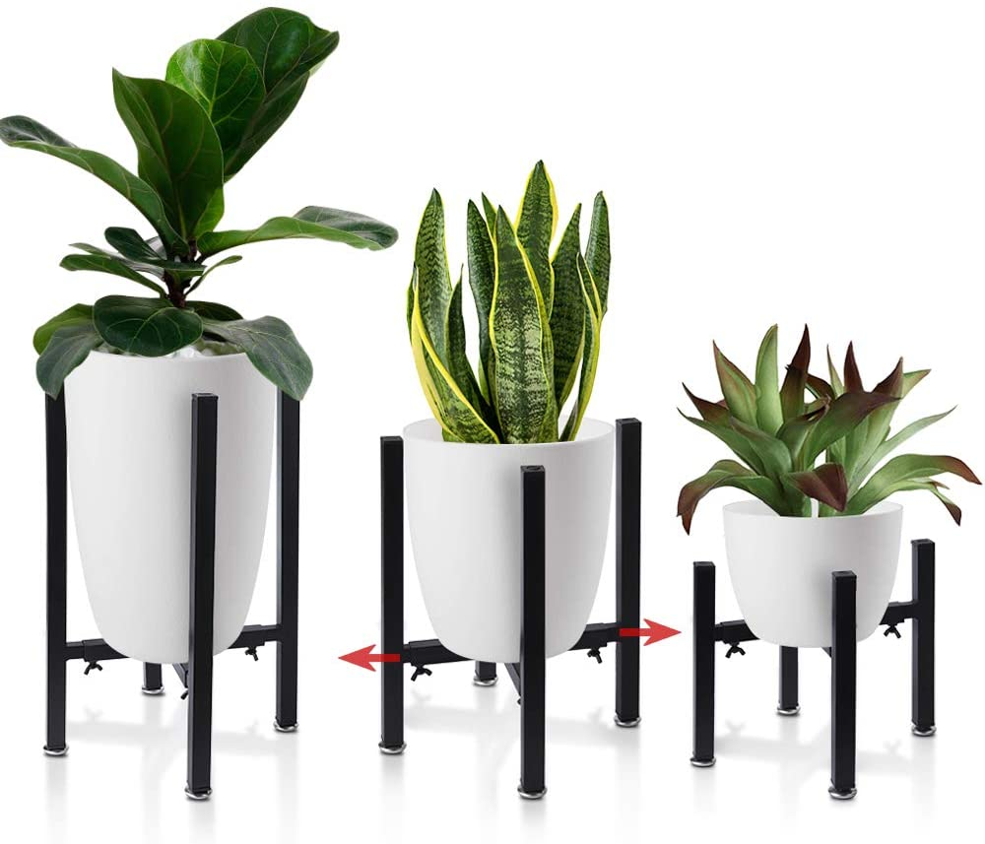
PLANTER ON STAND
ITEM NO. BE-102523
DESCRIPTION: Iron Plant Stand Adjustable 3
SIZE:L 10X10X14’’
M: 7X7X10’’
S: 5X5X7’’
FINISH: POWDER COATED
MATERIAL: IRON
PRICE: 1770

Slide 4
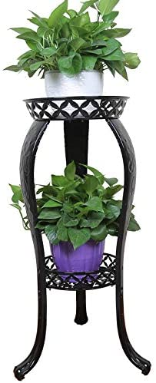
PLANTER STAND
ITEM NO. BE-102521
DESCRIPTION: IRON PLANTER STAND
SIZE: 12X10X8’’
FINISH:POWDWER COATED
MATERIAL:IRON
PRICE: RS.2200

Slide 5
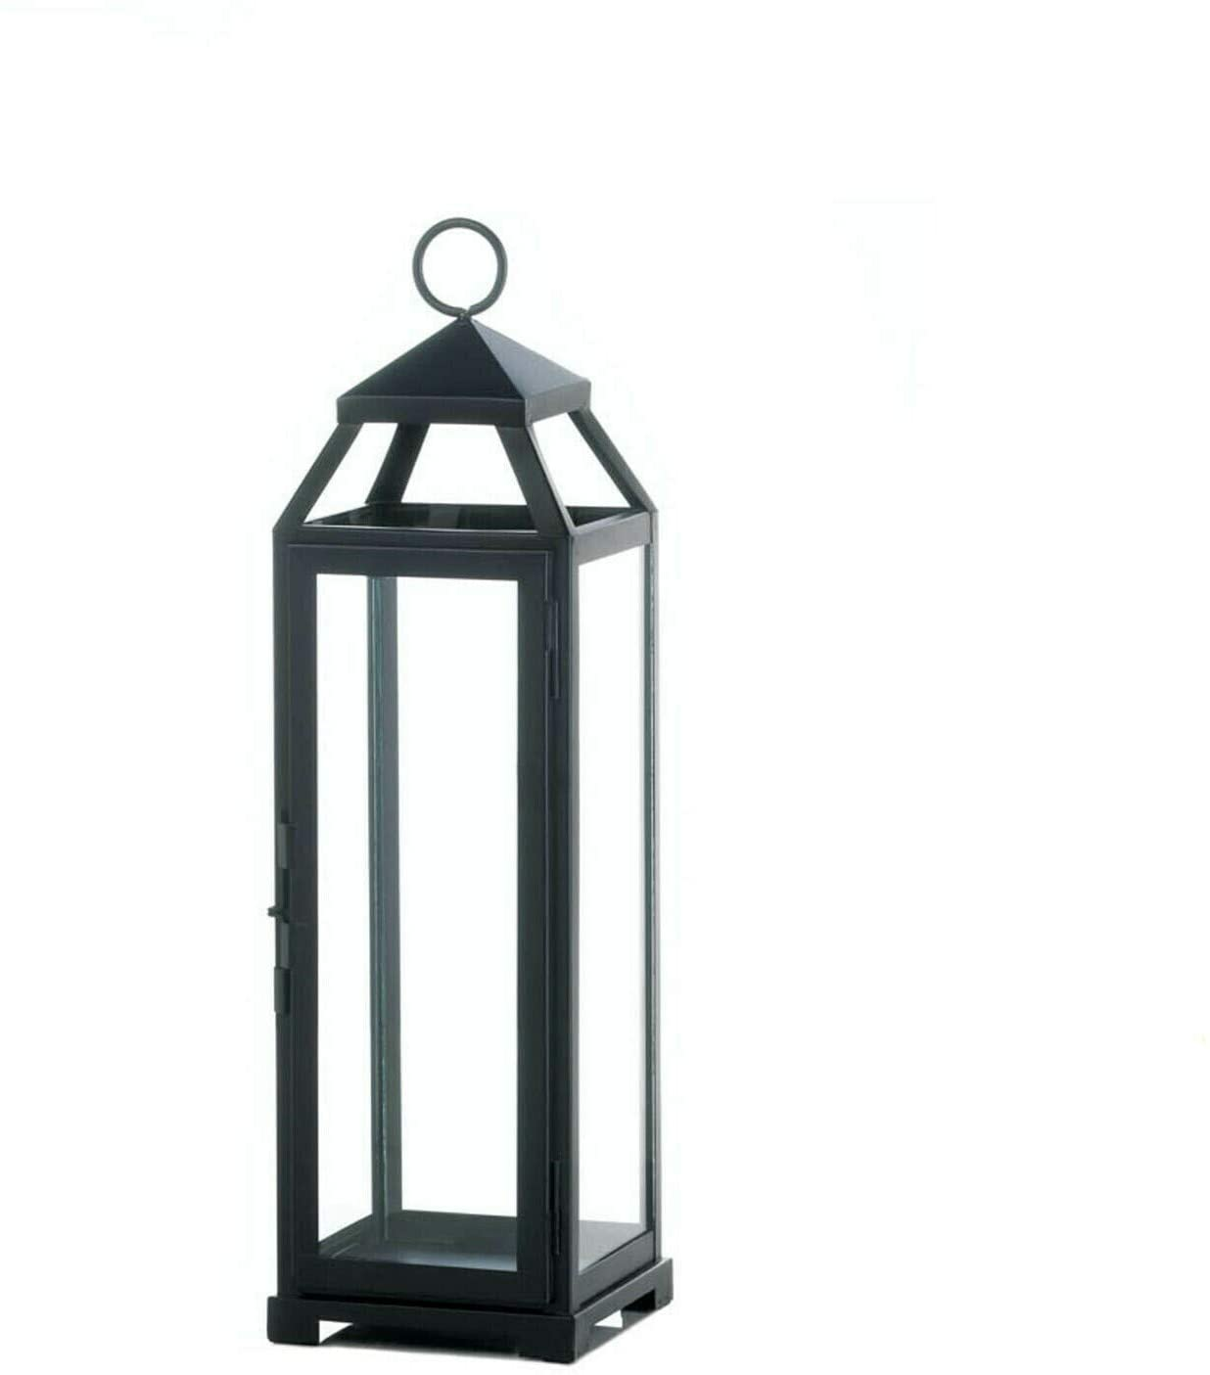
ITEM NO. BE-102521
DESCRIPTION:
SIZE:5.5" x 5.25" x 18.5"
FINISH:POWDER COTED
MATERIAL: IRON AND GLASS
PRICE: RS.1220

Slide 6
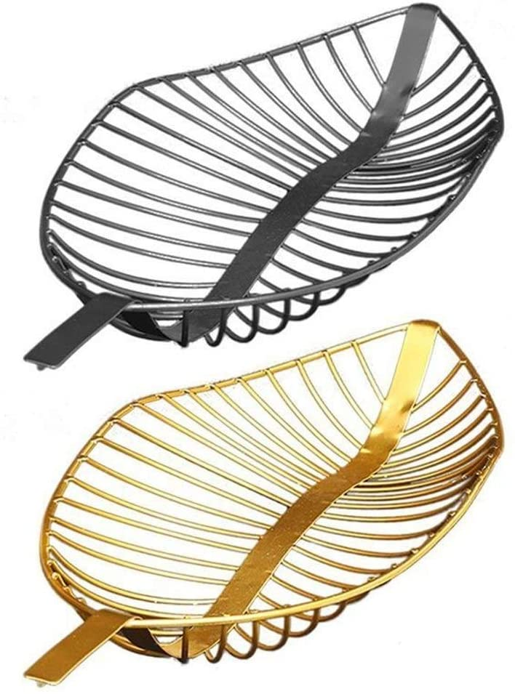
LEAF TRAY
ITEM NO. BE-102525
DESCRIPTION:LEAF TRAY
SIZE : 15.75X7.09X2.76in
FINISH:GOLD, BLACK POWDER COATED
MATERIAL: IRON
PRICE: RS.680

Slide 7
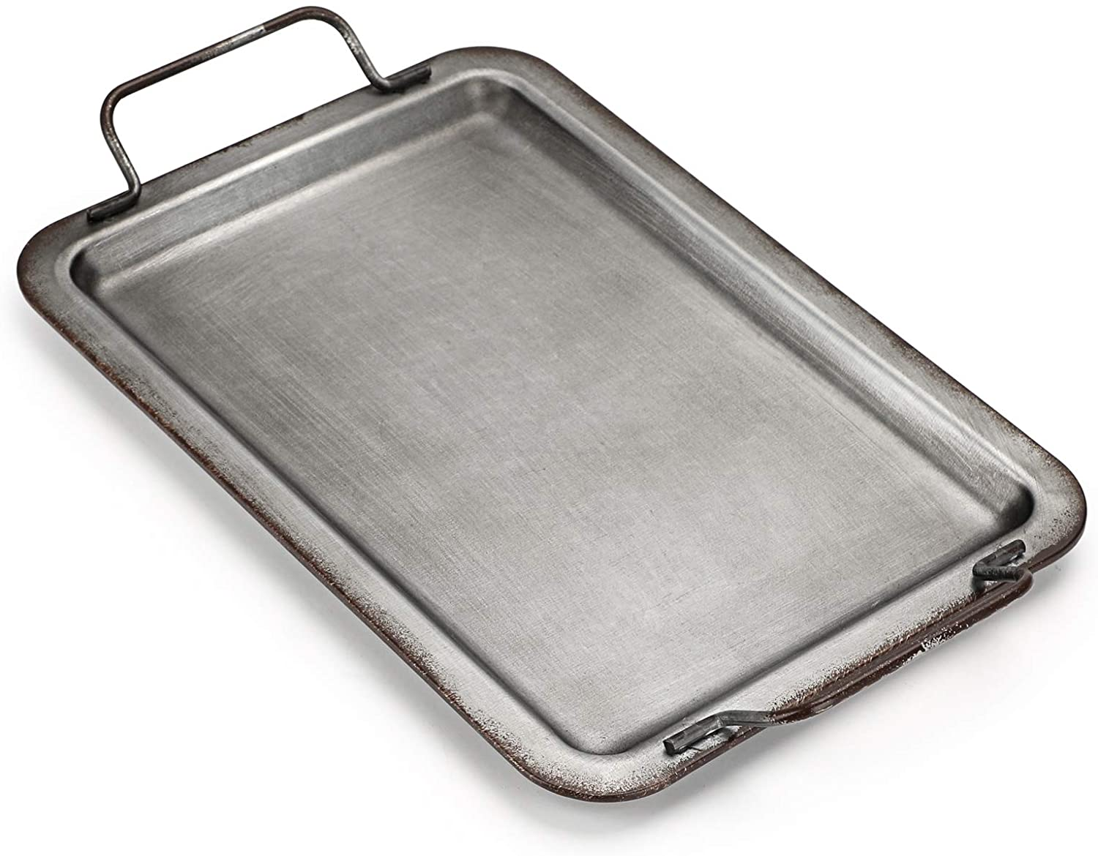
SERVING TRAY
ITEM NO. BE-102526
DESCRIPTION:GALVANIZED IRON SERVING TRAY 2
SIZE: 13X1.1X9.57 INCHES
FINISH: NATURAL
MATERIAL: IRON
PRICE: RS.490

Slide 8
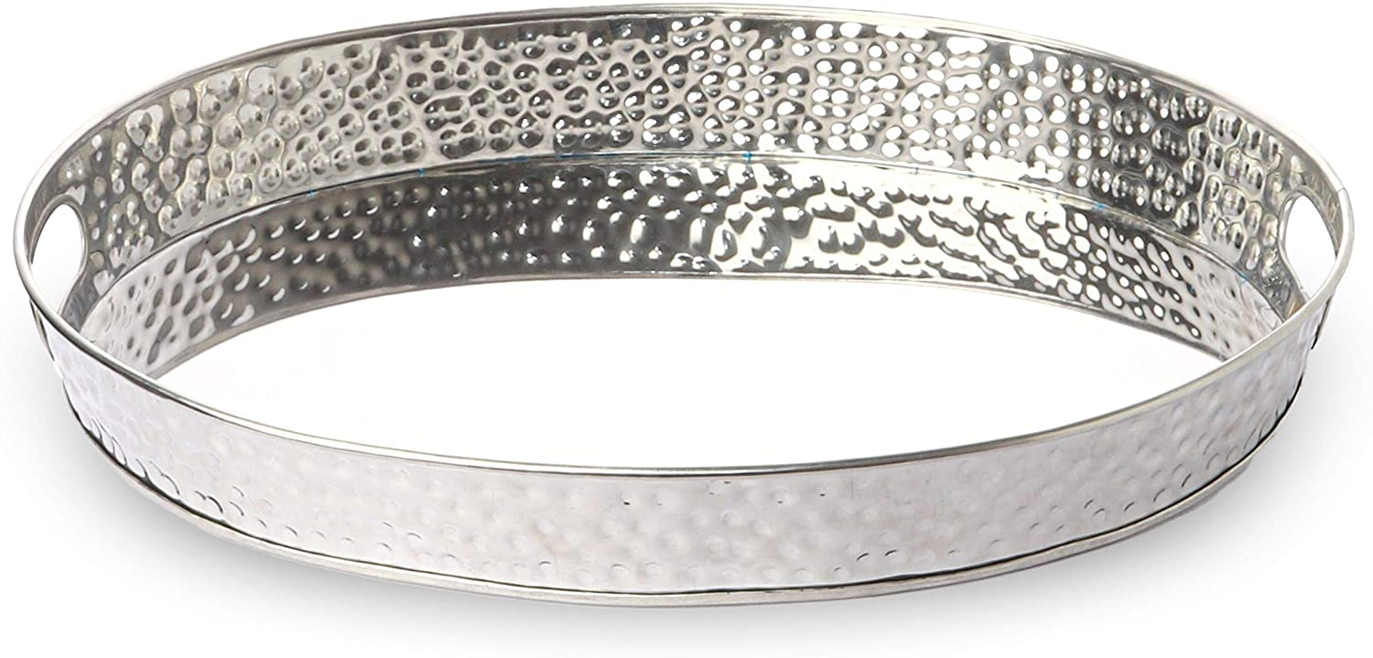
SERVING TRAY
ITEM NO. BE-102526
DESCRIPTION: HAMMERED STAINLESS STEEL TRAY SERVING
SIZE: 17 x 13 x 2 inches 2
FINISH:NATURAL
MATERIAL: STAINLESS STEEL
PRICE: RS.475

Slide 9
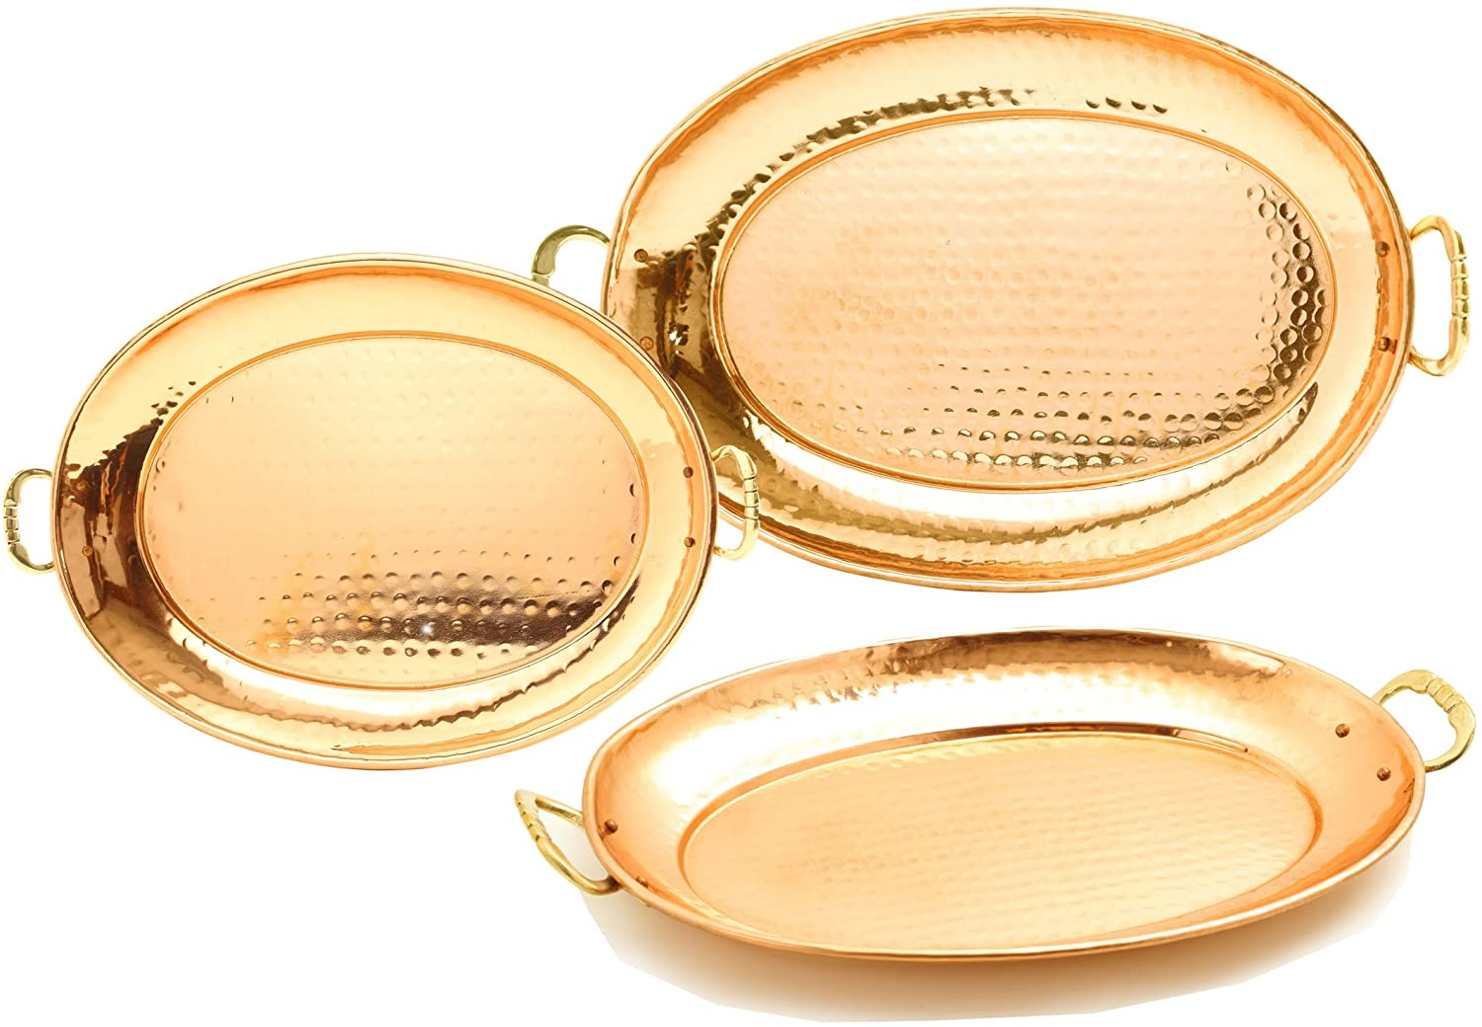
SURFING TRAY
ITEM NO. BE-102527
DESCRIPTION: COPPER HAMMED TRAY
SIZE:17 x 13 x 2 inches 2
FINISH: NATURAL
MATERIAL: COPPER TRAY
PRICE: RS.780

Slide 10
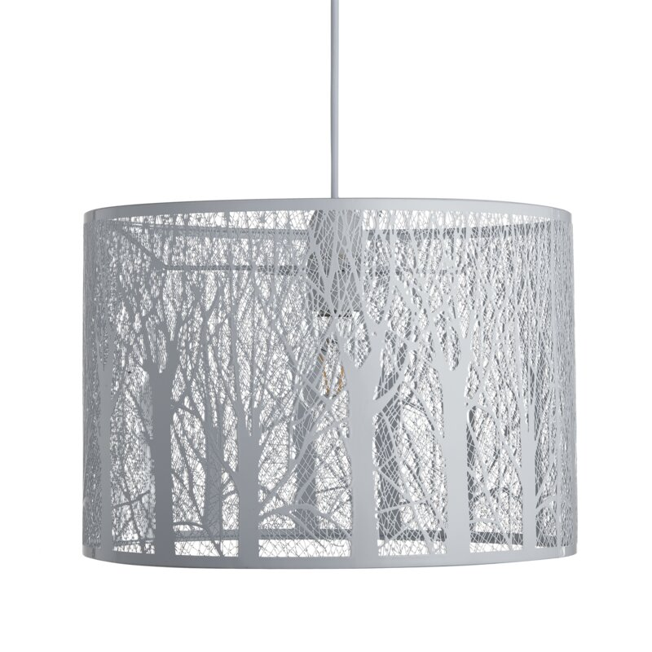
LAMP SHADE
ITEM NO. BE-102528
DESCRIPTION: LAMP SHADE
SIZE:17 x 13 x 2 inches 2
FINISH: WHITE POWDER COATED
MATERIAL: IRON
PRICE: RS.1550

Slide 11
ITEM NO. BE-102521
DESCRIPTION:
SIZE:
FINISH:
MATERIAL:

