Slide 1
PRESENTATION OF CAKESTANDS
BADAR AND SONS EXPORTS
GALSHAHEED CHAND WALI MASJID
MORADABAD (244001)

Slide 2
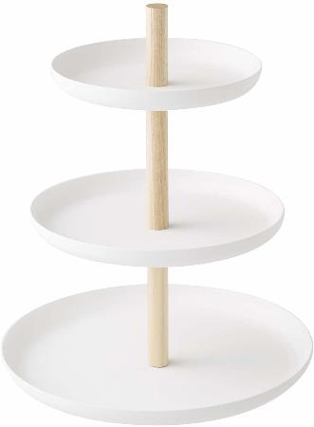
CAKE STANDS
ITEM NO.
SIZE: 7.9 x 7.9 x 9.4’’
MATERIAL: IRON
PRICE: RS.1250

Slide 3
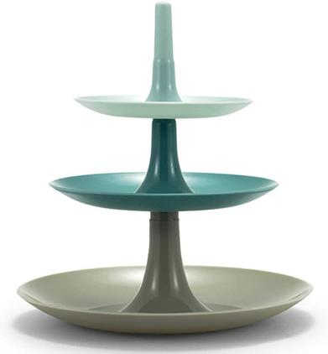
CAKE STANDS
ITEM NO. BE-150921
SIZE: 8x8x11''
MATERIAL: IRON
PRICE: RS.1490

Slide 4
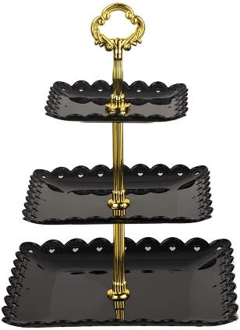
CAKE STANDS
ITEM NO. BE-150922
SIZE: 8x8x14''
MATERIAL: IRON
PRICE: RS.1550

Slide 5

CAKE STANDS
ITEM NO. BE-150923
SIZE: 9.1 x 9.1 x 3.5’’
MATERIAL: IRON
PRICE: RS.760

Slide 6
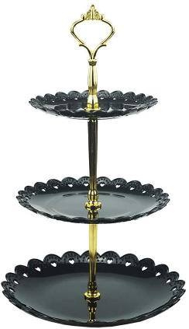
CAKE STANDS
ITEM NO. BE-150924
SIZE: 9x9x14''
MATERIAL: IRON
PRICE: RS.1670

Slide 7
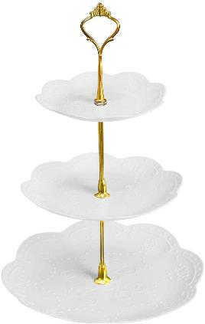
CAKE STANDS
ITEM NO. BE-150925
SIZE: 10.5x10.5x15''
MATERIAL: IRON
PRICE: RS.1670

Slide 8
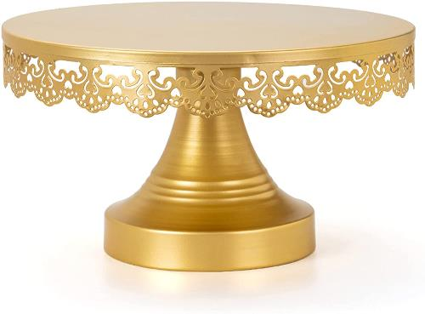
CAKE STANDS
ITEM NO. BE-150926
SIZE: 10x10x5.5''
MATERIAL: IRON
PRICE: RS.775

Slide 9
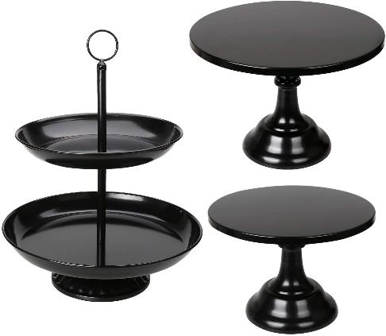
CAKE STANDS
ITEM NO. BE-150927
SIZE: 10x10x14.5''
MATERIAL: IRON
PRICE: RS.990

Slide 10
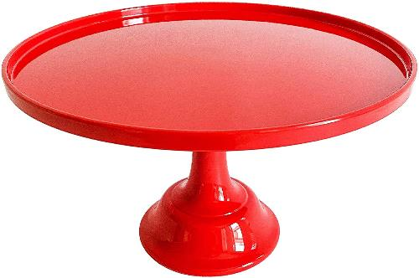
CAKE STANDS
ITEM NO. BE-150928
SIZE: 11.5 x 11.5 x 7''
MATERIAL: IRON
PRICE: RS.880

Slide 11
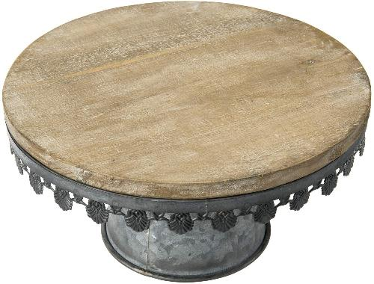
CAKE STANDS
ITEM NO. BE-150929
SIZE: 11.81 x 11.81 x 6.22''
MATERIAL: IRON & WOOD
PRICE: RS.875

Slide 12
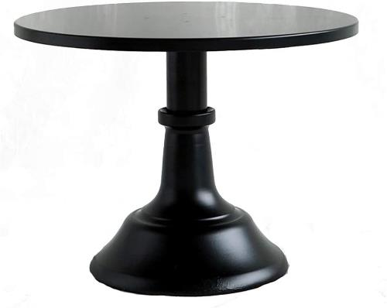
CAKE STANDS
ITEM NO. BE-150930
SIZE: 12.6 x 3.94 x 3.15’’
MATERIAL: IRON
PRICE: RS.870

Slide 13
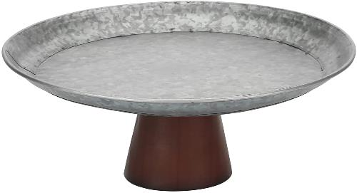
CAKE STANDS
ITEM NO. BE-150931
SIZE: 12.6 x 12.6 x 5''
MATERIAL: IRON
PRICE: RS. 630

Slide 14
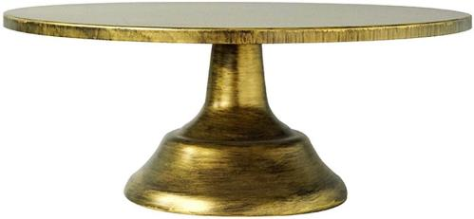
CAKE STANDS
ITEM NO. BE-150932
SIZE: 12x12x4.75''
MATERIAL: IRON
PRICE: RS.750

Slide 15
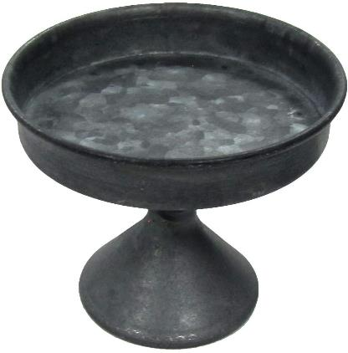
CAKE STANDS
ITEM NO. BE-150933
SIZE: 12X12X9.5’’
MATERIAL: IRON
PRICE: RS. 580

Slide 16
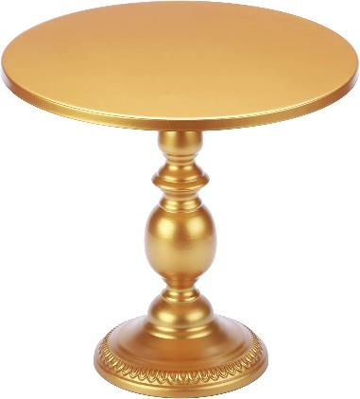
CAKE STANDS
ITEM NO. BE-150934
SIZE: 12x12x11''
MATERIAL: IRON
PRICE: RS. 1280

Slide 17
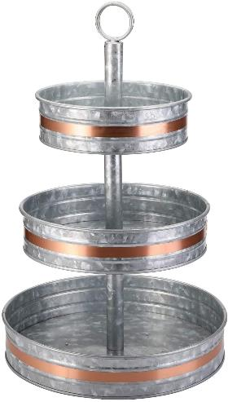
CAKE STANDS
ITEM NO. BE-150935
SIZE: 12X12X18''
MATERIAL: GALVANIZED & COPPER
PRICE: RS.1390

Slide 18
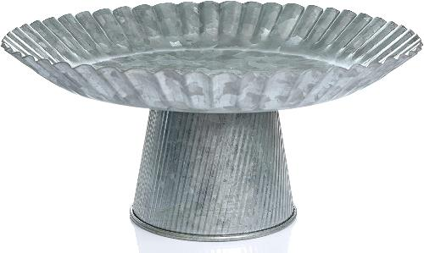
CAKE STANDS
ITEM NO. BE-150936
SIZE: 9X9X7’’
MATERIAL: GALVANIZED
PRICE: RS.790

Slide 19
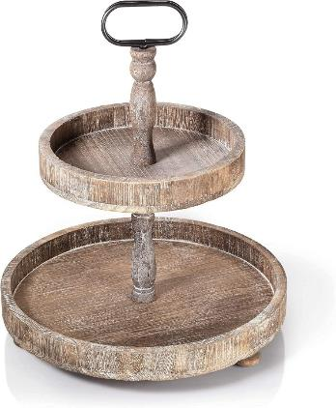
CAKE STANDS
ITEM NO. BE-150937
SIZE: 15 x 15 x 18''
MATERIAL: IRON & WOOD
PRICE: RS.1100

Slide 20
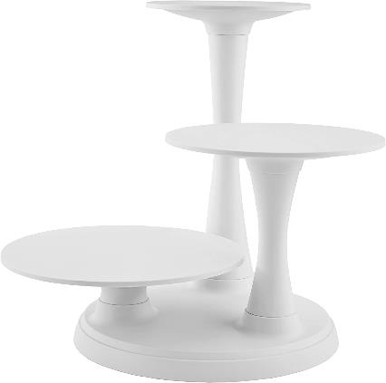
CAKE STANDS
ITEM NO. BE-150938
SIZE: 16.2 x 15.5 x 7.2''
MATERIAL: IRON
PRICE: RS. 1340

Slide 21
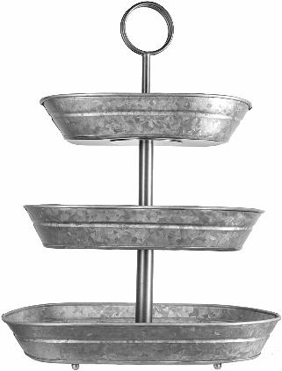
CAKE STANDS
ITEM NO. BE-150939
SIZE: 16.54 x 9.84 x 2.56''
MATERIAL: GALVANIZED
PRICE: RS.1450

Slide 22
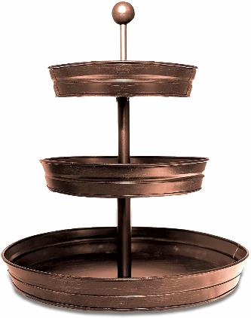
CAKE STANDS
ITEM NO. BE-150940
SIZE: 17X17X20''
MATERIAL: IRON
PRICE: RS.1590

Slide 23
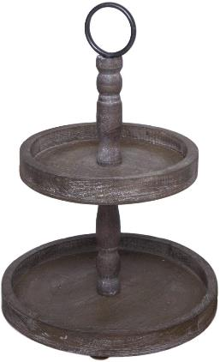
CAKE STANDS
ITEM NO. BE-150942
SIZE: 12.5X12.5X17.5''
MATERIAL: WOOD
PRICE: RS.1200

Slide 24
THANK YOU
SHARE YOUR FEEDBACK BY EMAIL WE HOPE YOU LIKED OUR PRODUCTS.
Copyright notice: Please don’t copy and share our designs without our permission.
E-MAIL- BADARANDSONS1@GMAIL.COM
PHONE: +91-9058824453
FEEL FREE TO CONTACT US.
BEST REGARDS
NAWAZ

