Slide 1
PRESENTATION OF BAR ACCESSORIES
BADAR AND SONS EXPORTS
GALSHAHEED CHAND WALI MASJID
MORADABAD (244001)

Slide 2
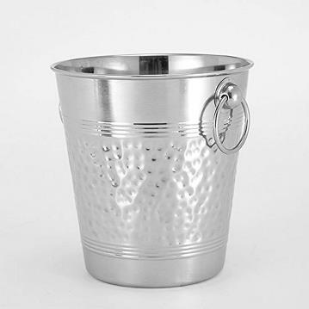
WINE BUCKET
ITEM NO. BE-090921
SIZE: 6X6X8''
MATERIAL: STAINLESS STEEL
PRICE: RS. 780

Slide 3
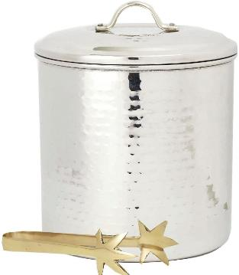
WINE COOLER
ITEM NO. BE-090922
SIZE: 7.5X7.5X9''
MATERIAL: STAINLESS STEEL
PRICE: RS. 950

Slide 4
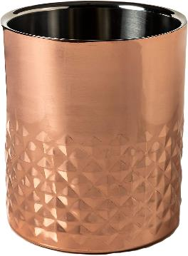
WINE BUCKET
ITEM NO. BE-090923
SIZE: 7.5X7.5X15''
MATERIAL: STAINLESS STEEL
PRICE: RS. 890

Slide 5
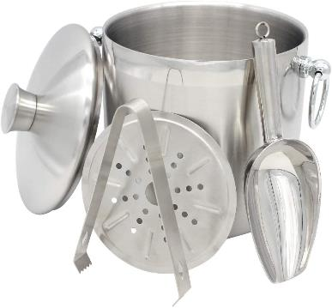
WINE COOLER
ITEM NO. BE-090924
SIZE: 7X7X8.5''
MATERIAL: STAINLESS STEEL
PRICE: RS. 1250

Slide 6
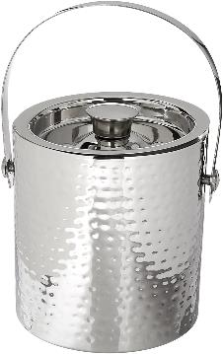
WINE BUCKET
ITEM NO. BE-090925
SIZE: 7X7X12''
MATERIAL: STAINLESS STEEL
PRICE: RS. 880

Slide 7
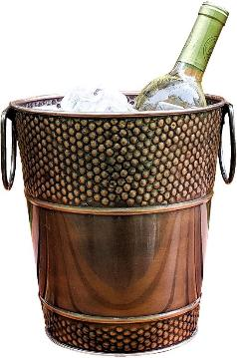
WINE BUCKET
ITEM NO. BE-090926
SIZE: 8 x 8 x 9’’
MATERIAL: STAINLESS STEEL
PRICE; RS. 990

Slide 8
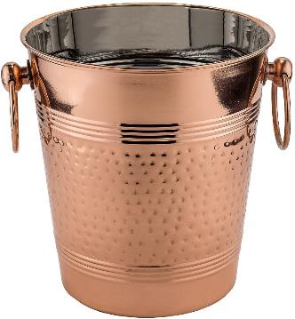
WINE BUCKET
ITEM NO. BE-090927
SIZE: 8X8X9.25''
MATERIAL: STAINLESS STEEL
PRICE: RS. 990

Slide 9
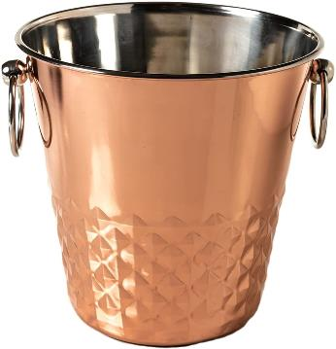
WINE BUCKET
ITEM NO. BE-090928
SIZE: 15X15X20''
MATERIAL: STAINLESS STEEL
PRICE: RS. 990

Slide 10
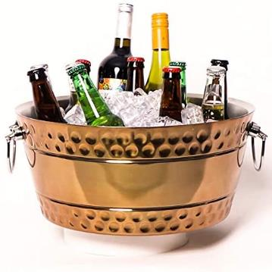
WINE BUCKET
ITEM NO. BE-090929
SIZE: 28X9.5X8.5’’
MATERIAL: STAINLESS STEEL
PRICE: RS. 780

Slide 11
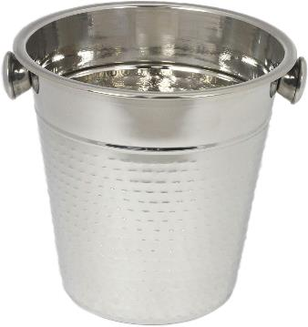
WINE BUCKET
ITEM NO. BE-090930
SIZE: 8.5X8.5X12’’
MATERIAL: STAINLESS STEEL
PRICE: RS. 750

Slide 12
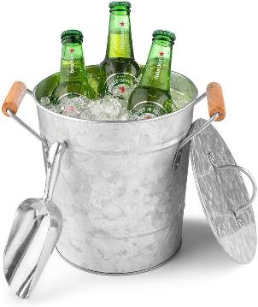
WINE BUCKET
ITEM NO. BE-090931
SIZE: 10X8.5X11’’
MATERIAL: STAINLESS STEEL
PRICE: RS.620

Slide 13
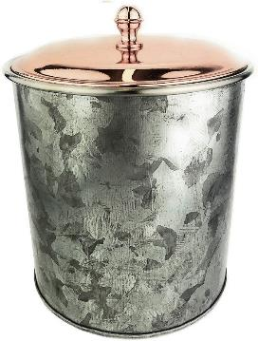
WINE BUCKET
ITEM NO. BE-090932
SIZE: 8.5X8.5X14.5’’
MATERIAL: STAINLESS STEEL
PRICE: RS. 670

Slide 14
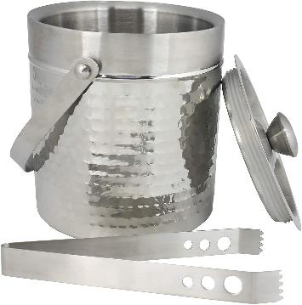
WINE COOLER
ITEM NO. BE-090933
SIZE: 9.5X9.5X14’’
MATERIAL: STAINLESS STEEL
PRICE: RS. 980

Slide 15
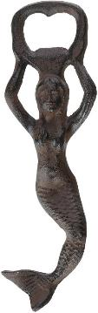
BOTTLE OPNER
ITEM NO. BE-090934
SIZE: 2.5 x 1 x 7’’
MATERIAL: ALUMINIUM
PRICE: RS. 280

Slide 16
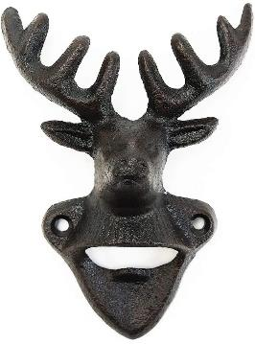
BOTTLE OPNER
ITEM NO. BE-090935
SIZE: 3.94 x 1.97 x 5.3’’
MATERIAL: ALUMINIUM
PRICE: 350

Slide 17
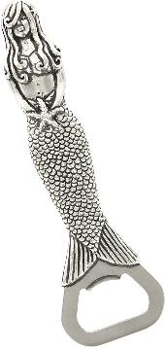
WINE COOLER
ITEM NO. BE-090936
SIZE: 4.2 x 2.3 x 10.1’’
MATERIAL: ALUMINIUM
PRICE: RS. 320

Slide 18
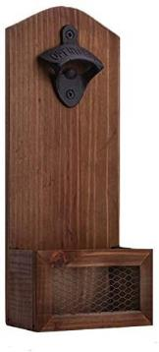
WINE COOLER
ITEM NO. BE-090937
SIZE: 4.7 x 2.8 x 11.8’’
MATERIAL: WOOD & IRON
PRICE: RS.450

Slide 19
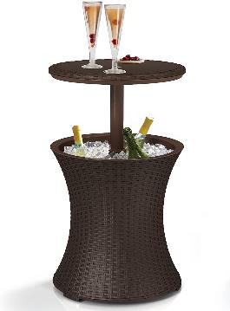
WINE TABLE
ITEM NO. BE-090938
SIZE: 15.5x15.5x32.5''
MATERIAL: IRON
PRICE: RS.1220

Slide 20
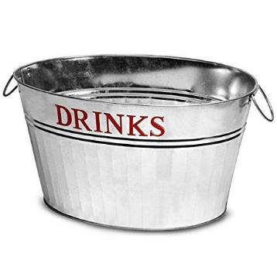
WINE TUB
ITEM NO. BE-090939
SIZE: 17.5x10x12''
MATERIAL: GALVANIZED
PRICE: RS.590

Slide 21
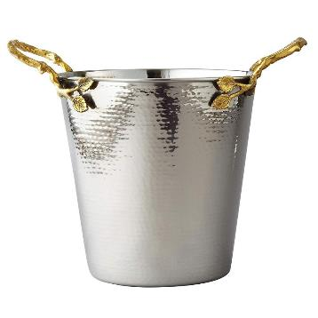
WINE BUCKET
ITEM NO. BE-090940
SIZE: 15.5x8.25x16.5''
MATERIAL: STAINLEESS STEEL
PRICE: RS.950

Slide 22
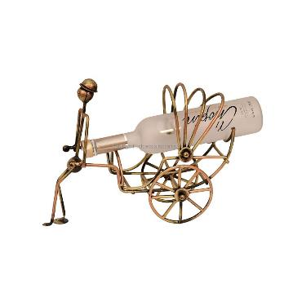
WINE BOTTLE HOLDER
ITEM NO. BE-090941
SIZE: 7.5X3.25X5''
MATERIAL: IRON
PRICE: 390

Slide 23
THANK YOU
SHARE YOUR FEEDBACK BY EMAIL WE HOPE YOU LIKED OUR PRODUCTS.
Copyright notice: Please don’t copy and share our designs without our permission.
E-MAIL- BADARANDSONS1@GMAIL.COM
PHONE: +91-9058824453
FEEL FREE TO CONTACT US.
BEST REGARDS
NAWAZ

