Slide 1
BADAR AND SONS EXPORTS
PRESENTATION OF PLANTERS
ADDRESS: GALSHAHEED CHAND
MORADABAD (244001) INDIA
PHONE: +91-7983649482
E-MAIL: BADARANDSONS1@GMAIL.COM

Slide 2
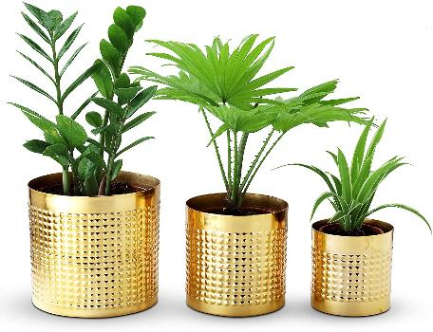
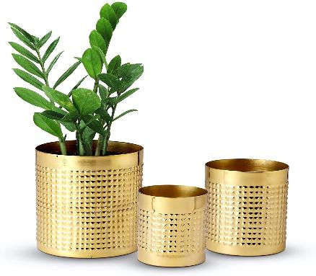
Item#: BD78618 description: Planter Gold Oro size: large 6x6 medium 5x5 small 4x4 inches
PRICE: RS. 1925

Slide 3
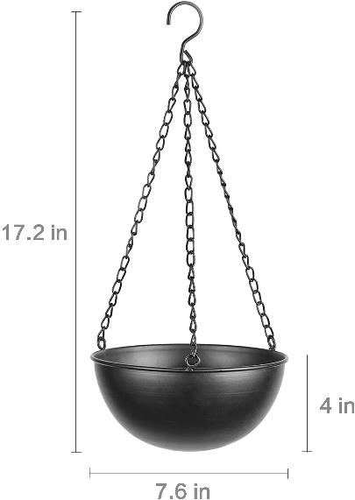
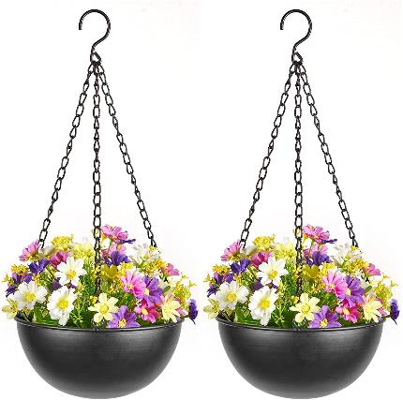
Item#: BD7860 description: Hanging Planter size: 7.6x7.6x27.5’’
PRICE: RS. 480

Slide 4

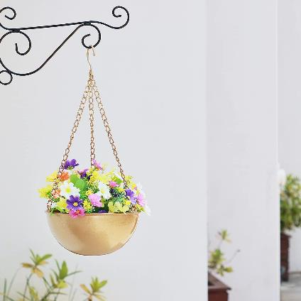
Item#: BD78602 description: Hanging Planter size: 7.6x7.6x17.5’’
PRICE: RS.480

Slide 5
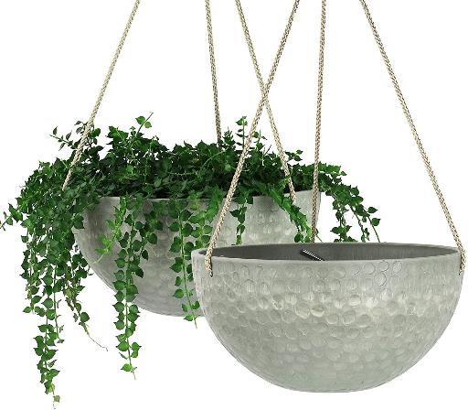
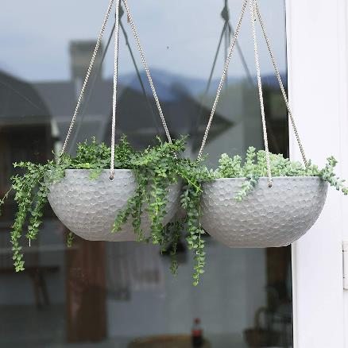
Item#: BD78607 description: Hammered Hanging Planter size: 10 x 10 x 4.7’’
PRICE: RS. 520

Slide 6
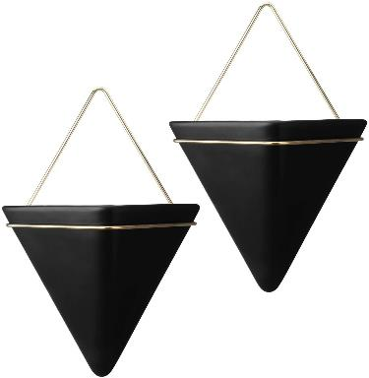
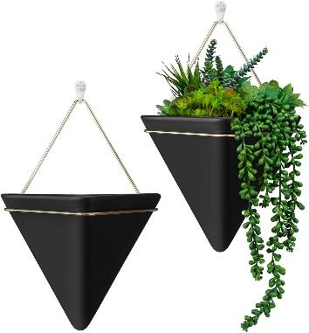
Item#: BD78612 description: Pocket Planter size: 8.2 x 8.2 x 7.8’’
PRICE: RS.380

Slide 7
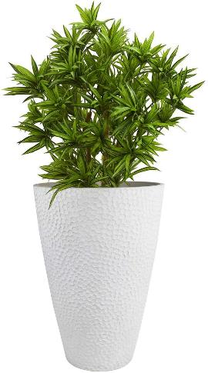
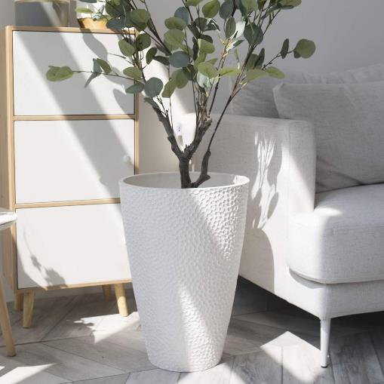
Item#: BD78604 description: Hammered Planter size: 7.9 x 13.8 x 20’’
PRICE: RS. 780

Slide 8
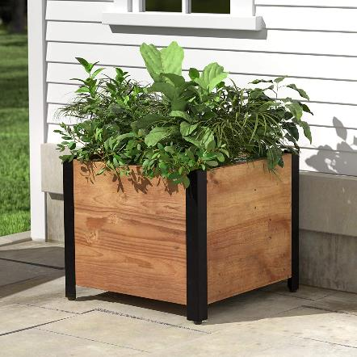
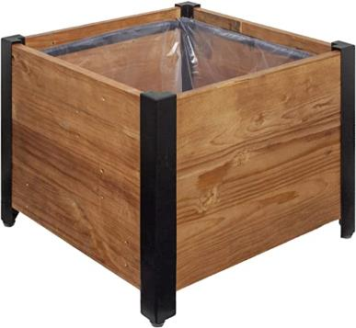
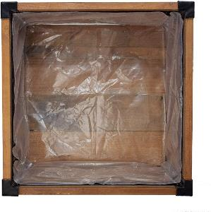
Item#: BD78608 description: Wooden Planter size: 17.72 x 17.72 x 15.35’’
PRICE: RS.690

Slide 9
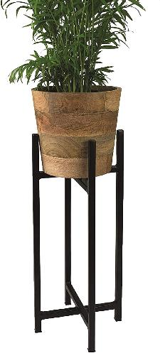
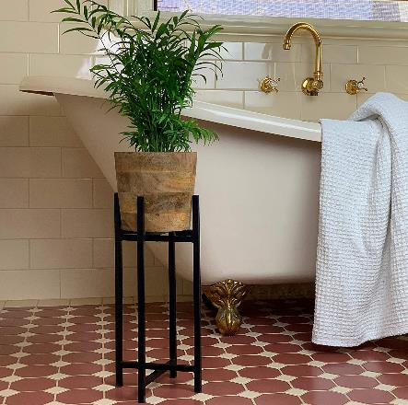
Item#: BD78609 description: On Stand Wooden Planter size: 20.5 x 7 x 20.5 depth 6.5’’

Slide 10
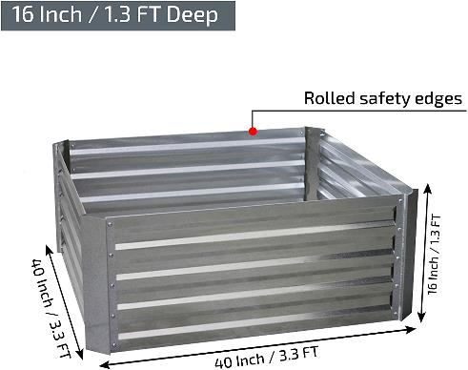
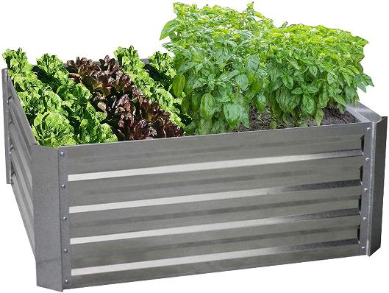
Item#: BD78610 description: Galvanized Planter size: 40 x 40 x 16’’
PRICE: RS.580

Slide 11
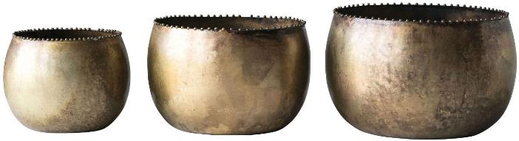
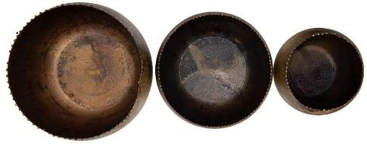
Item#: BD78611 description: Round Planter Set Of 3 size:7 x 7 x 5’’
PRICE: RS. 2350

Slide 12
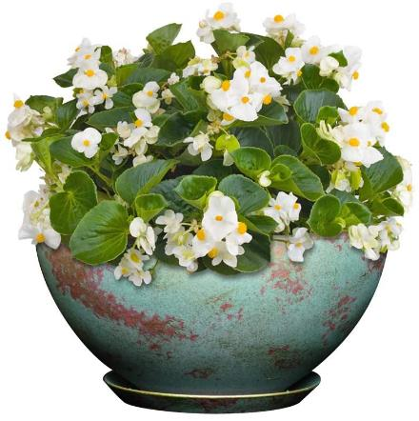
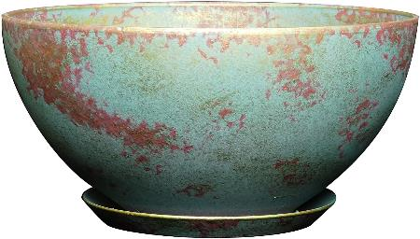
Item#: BD78613 description: Blue Patina Planter size: 10 x 10 x 5’’
PRICE: RS. 520

Slide 13
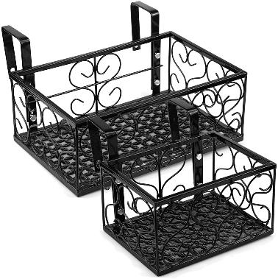
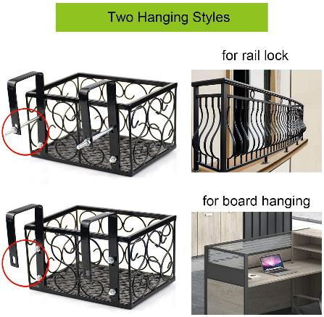
Item#: BD78610 description: Railing Planter size: 12 x 8 x 6.25’’
PRICE: RS. 1450

Slide 14
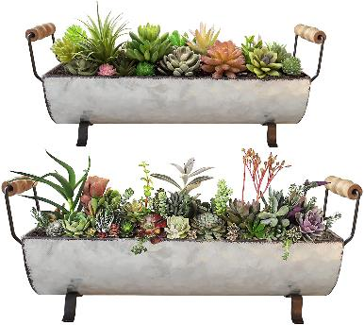
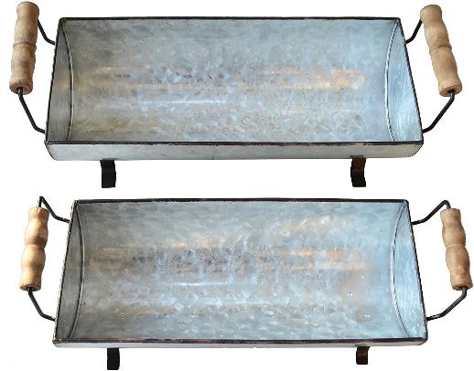
Item#: BD78615 description: Raised Planter size:15 x 6.5 x 2’’
PRICE: RS. 620

Slide 15
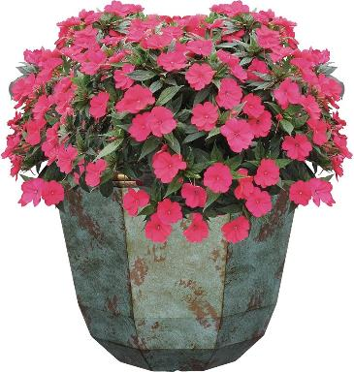
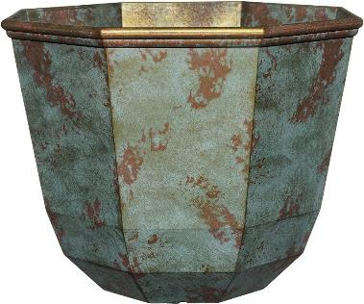
Item#: BD78616 description: Blue Patina Planter size: 15 x 15 x 11’’
PRICE: RS. 620

Slide 16
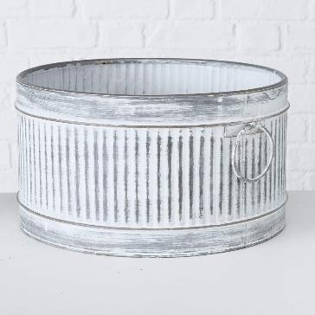
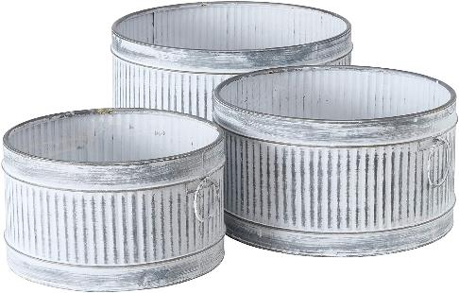
Item#: BD78617 description: White Wash Round Planter size: 15.7 x 15.7 x 8.3’’
PRICE: RS. 1550

Slide 17
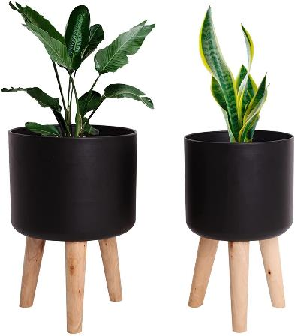
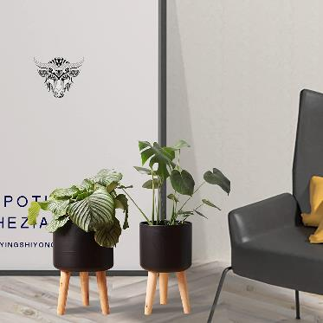
Item#: BD78620 description: Wooden Stand Planter size: "11 x 9.6 x 16.5’’
PRICE: RS. 1750

Slide 18
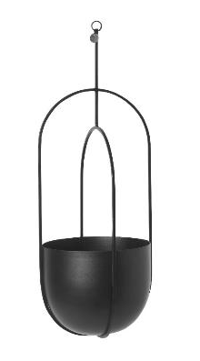
Item#: BD78611 description: Hanging planter size: 51.5x18.5 cms
PRICE: 670

Slide 19
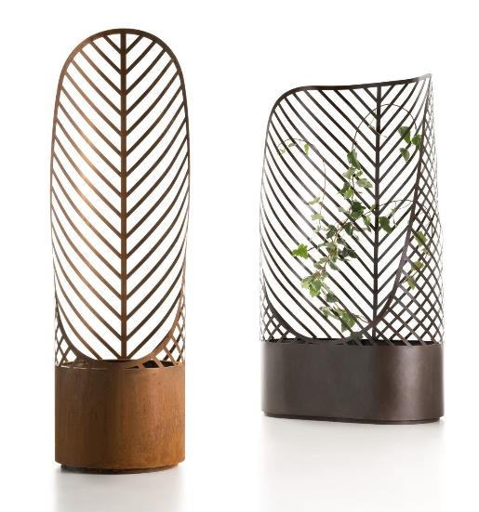
End Of Presentation Thanks For Review.

