Slide 1
GARDENING PRODUCTS
BADAR AND SONS EXPORTS
GALSHAHEED CHAND WALI MASJID
MORADABAD -244001
PHONE: +91-9058824453

Slide 2
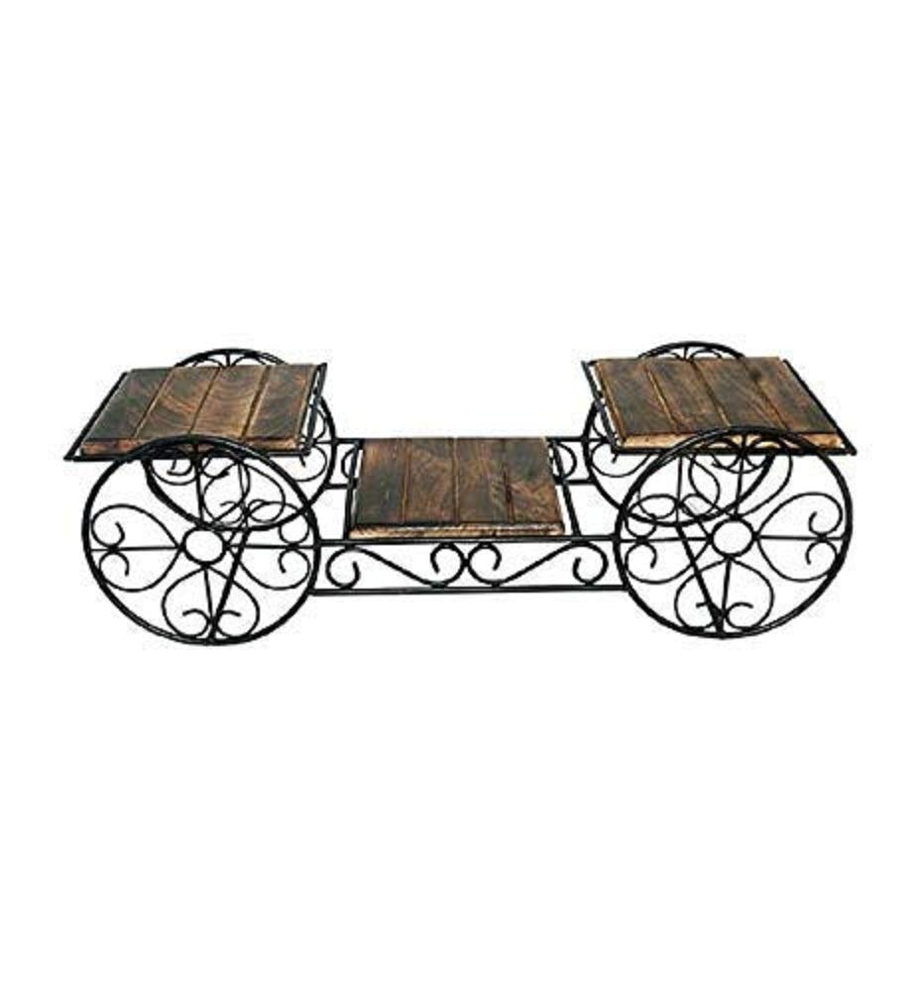
PRICE: RS. 425

Slide 3
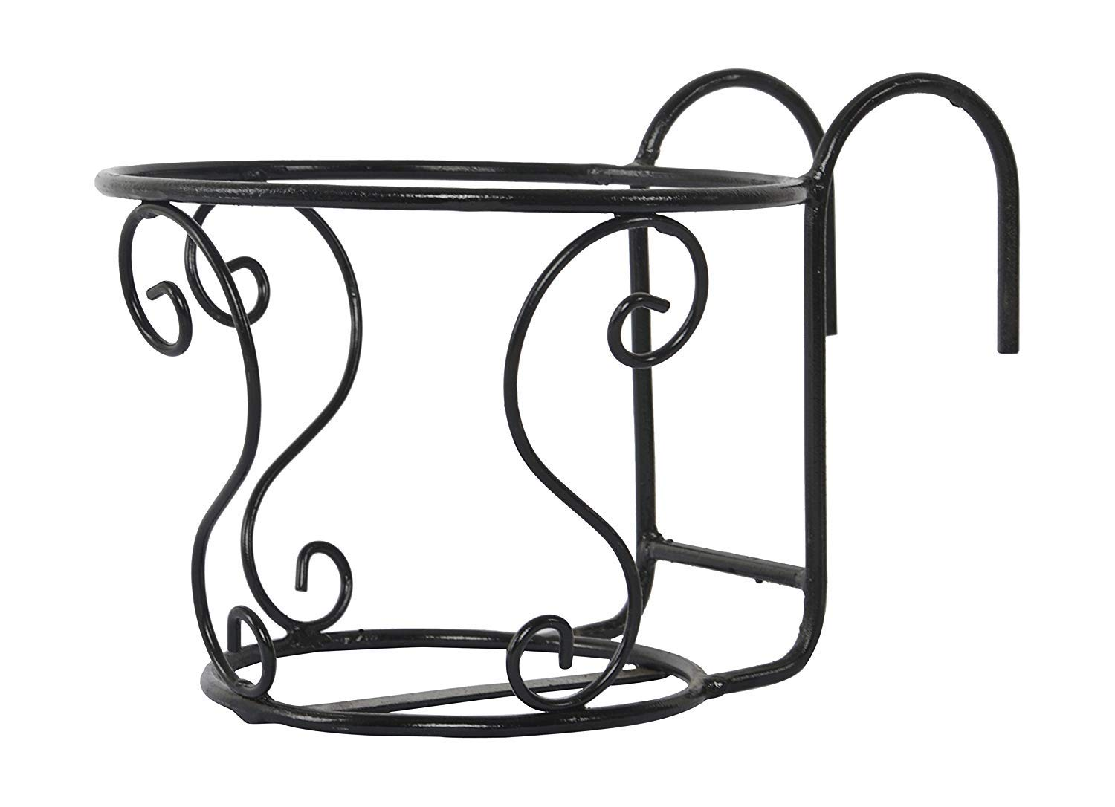
PRICE: RS. 520

Slide 4
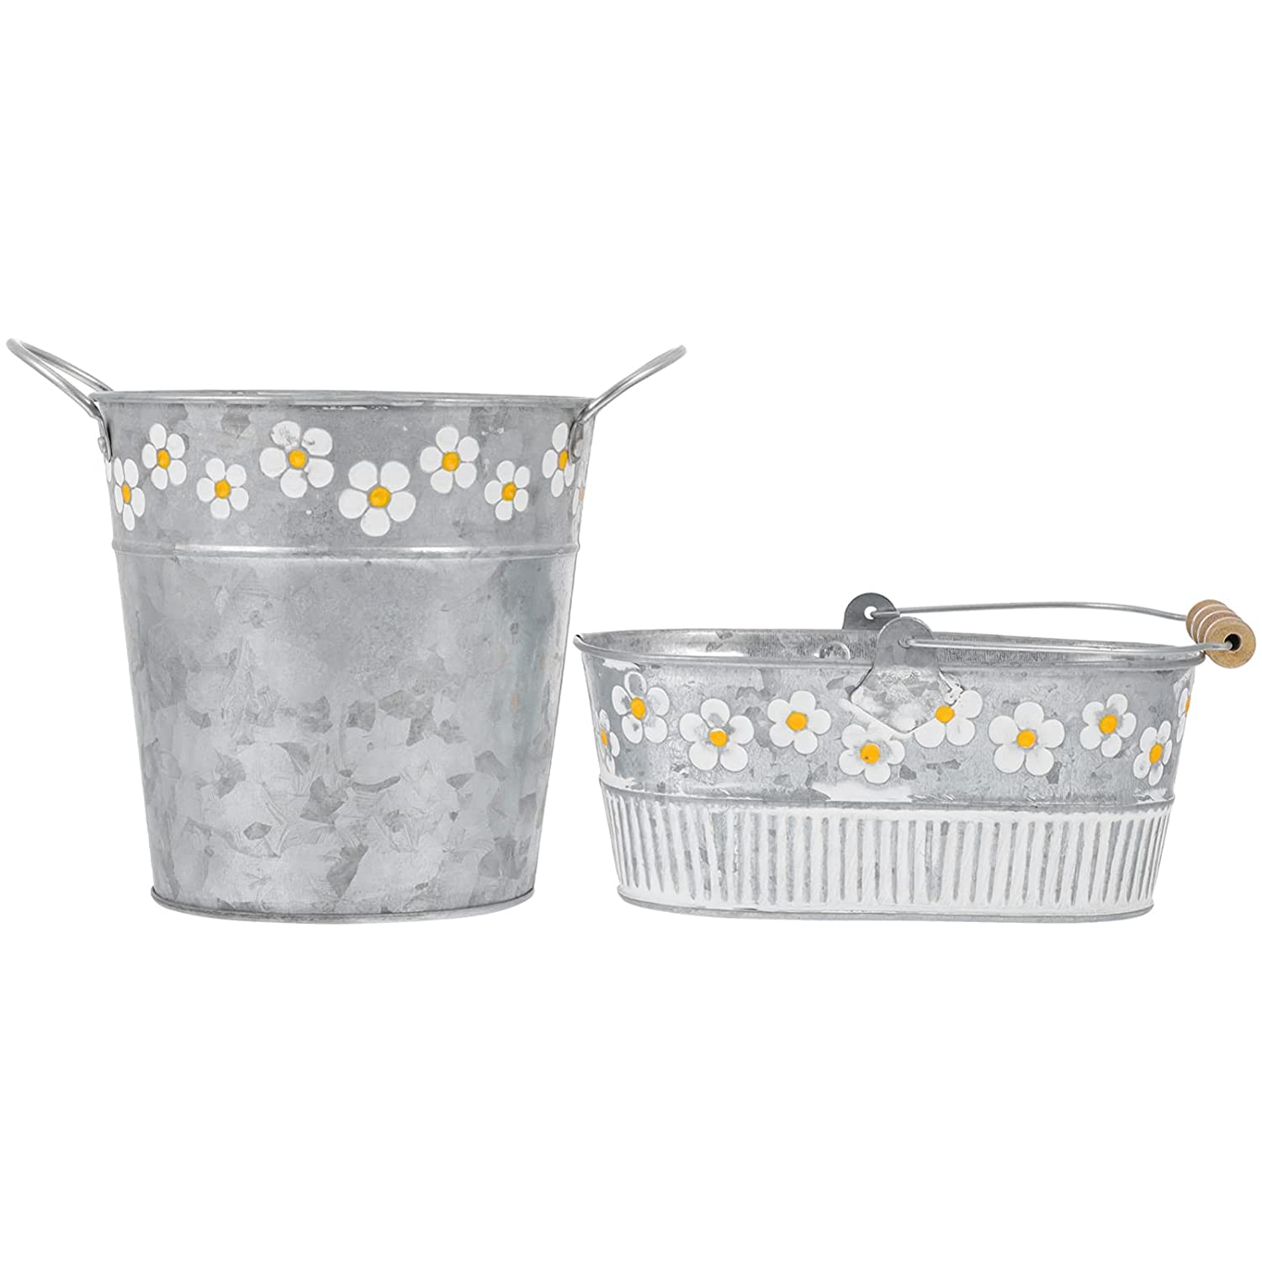
PRICE: RS. 670

Slide 5
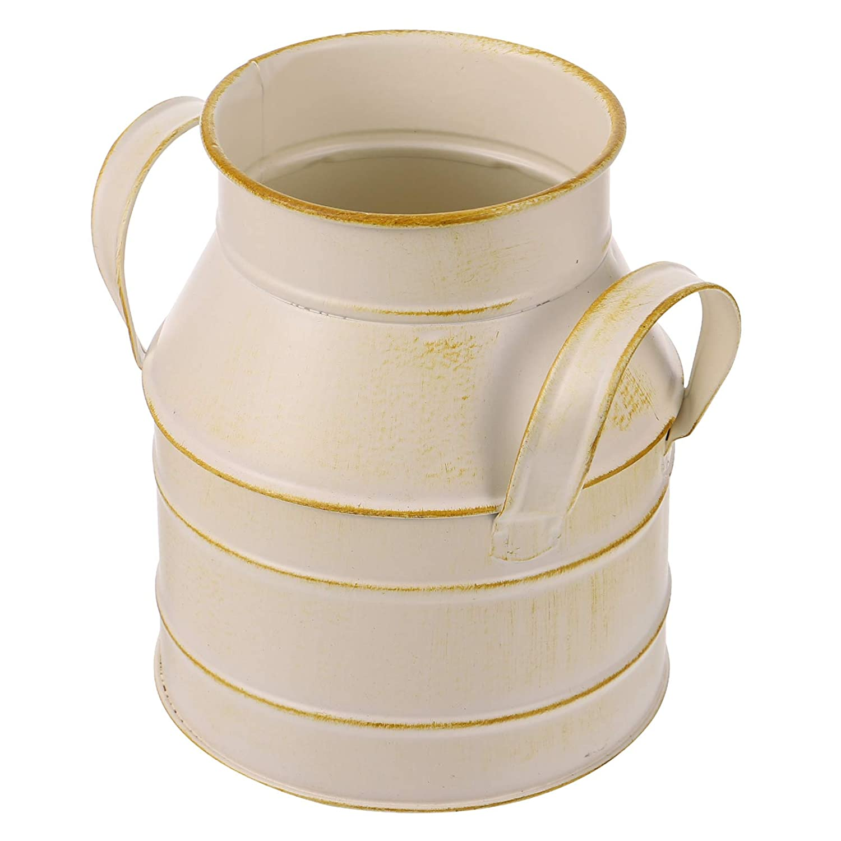
PRICE: RS. 550

Slide 6
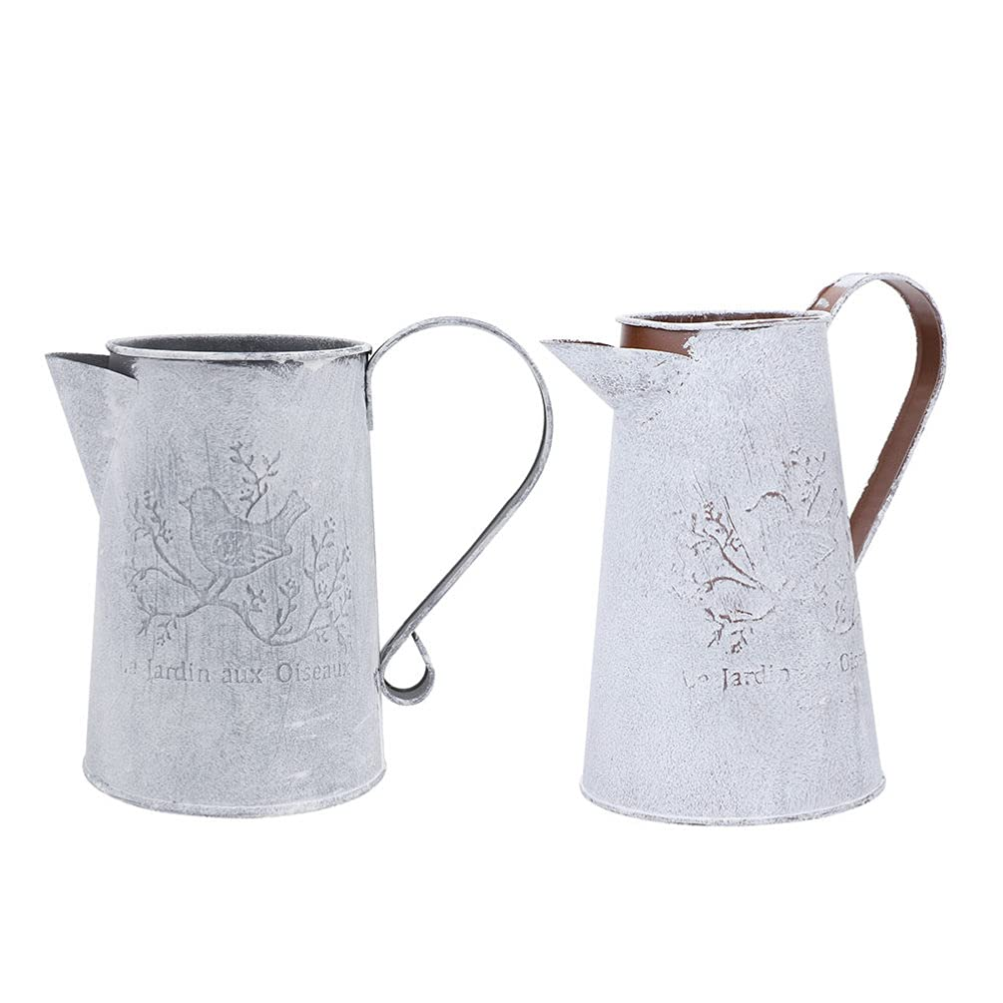
PRICE: RS. 780

Slide 7
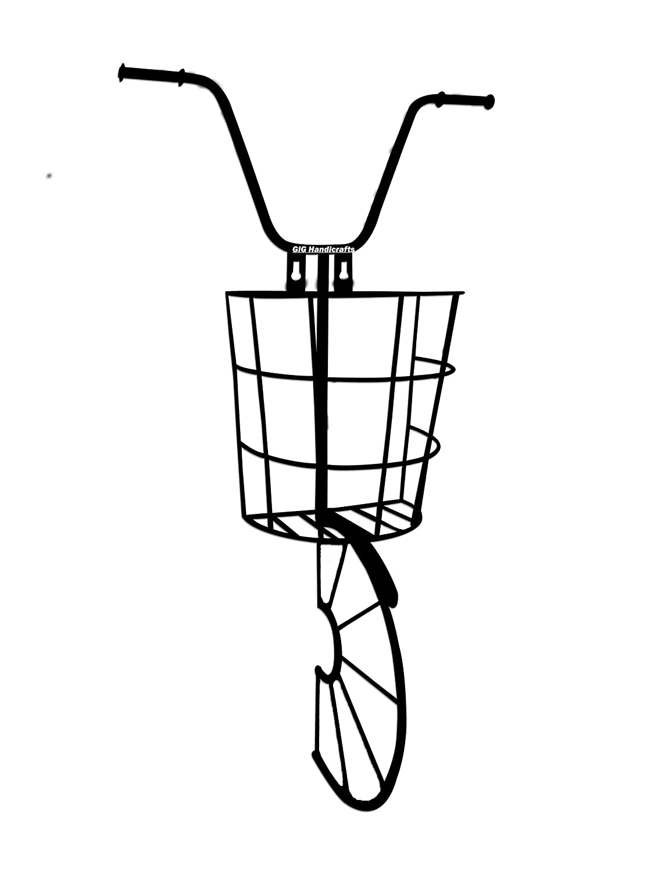
PRICE: RS. 790

Slide 8
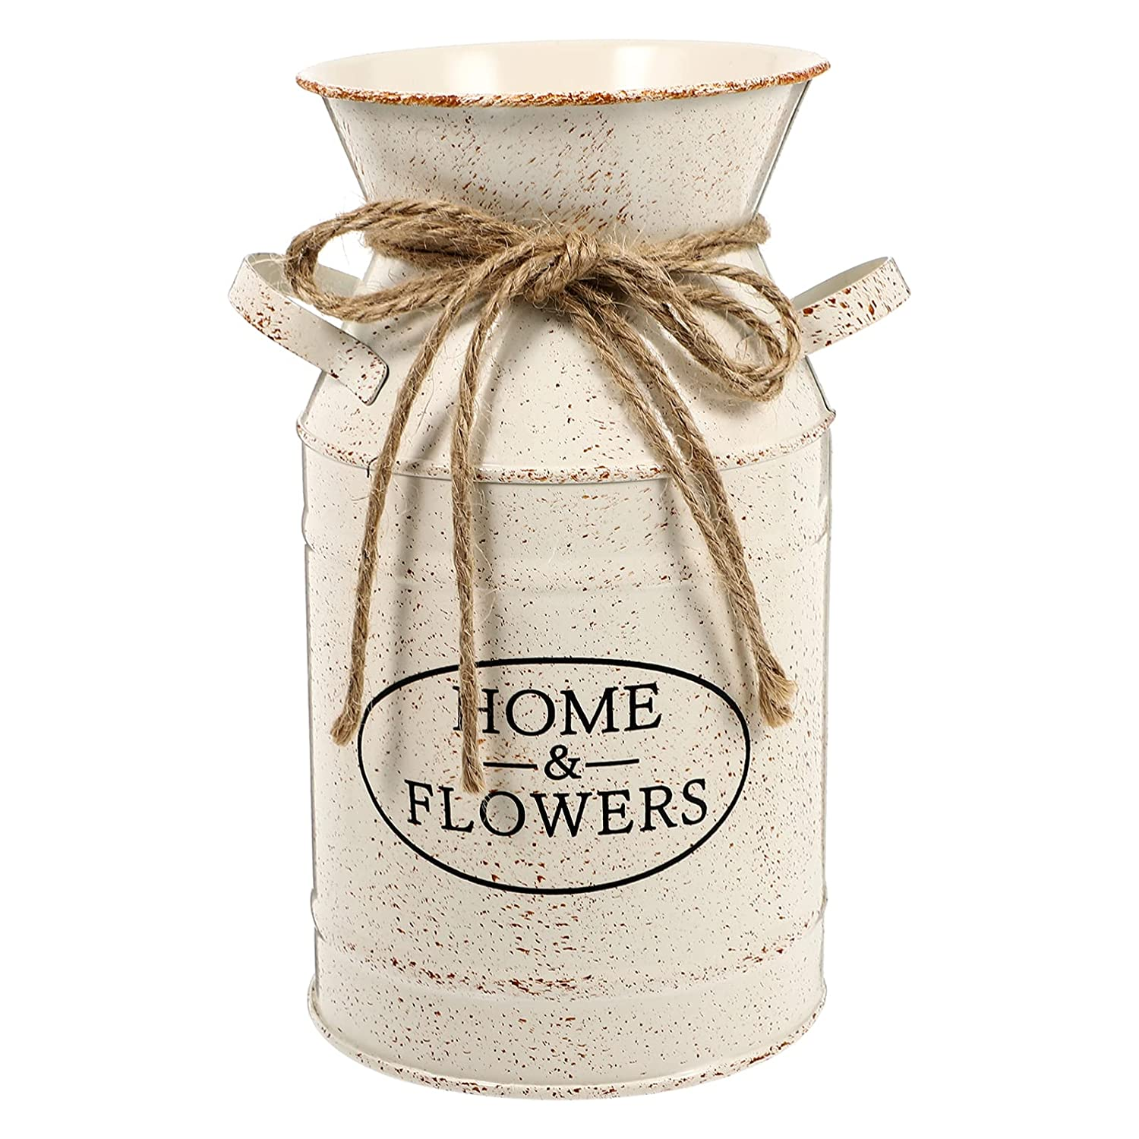
PRICE: RS. 670

Slide 9
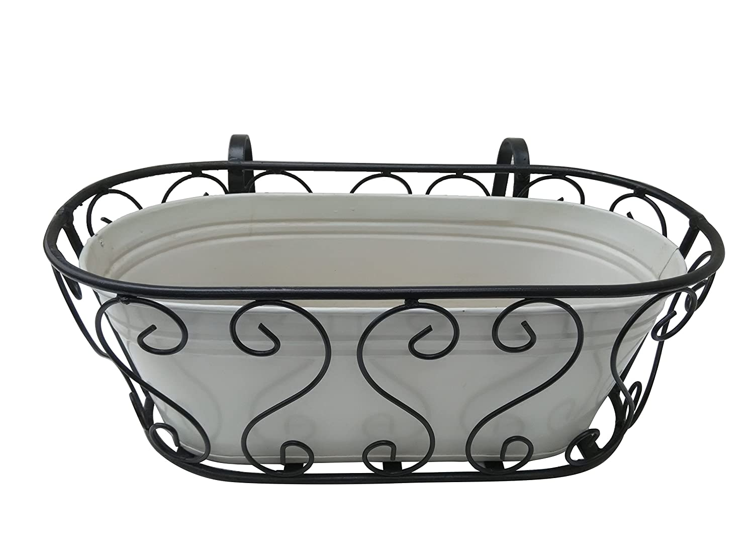
PRICE: RS. 580

Slide 10
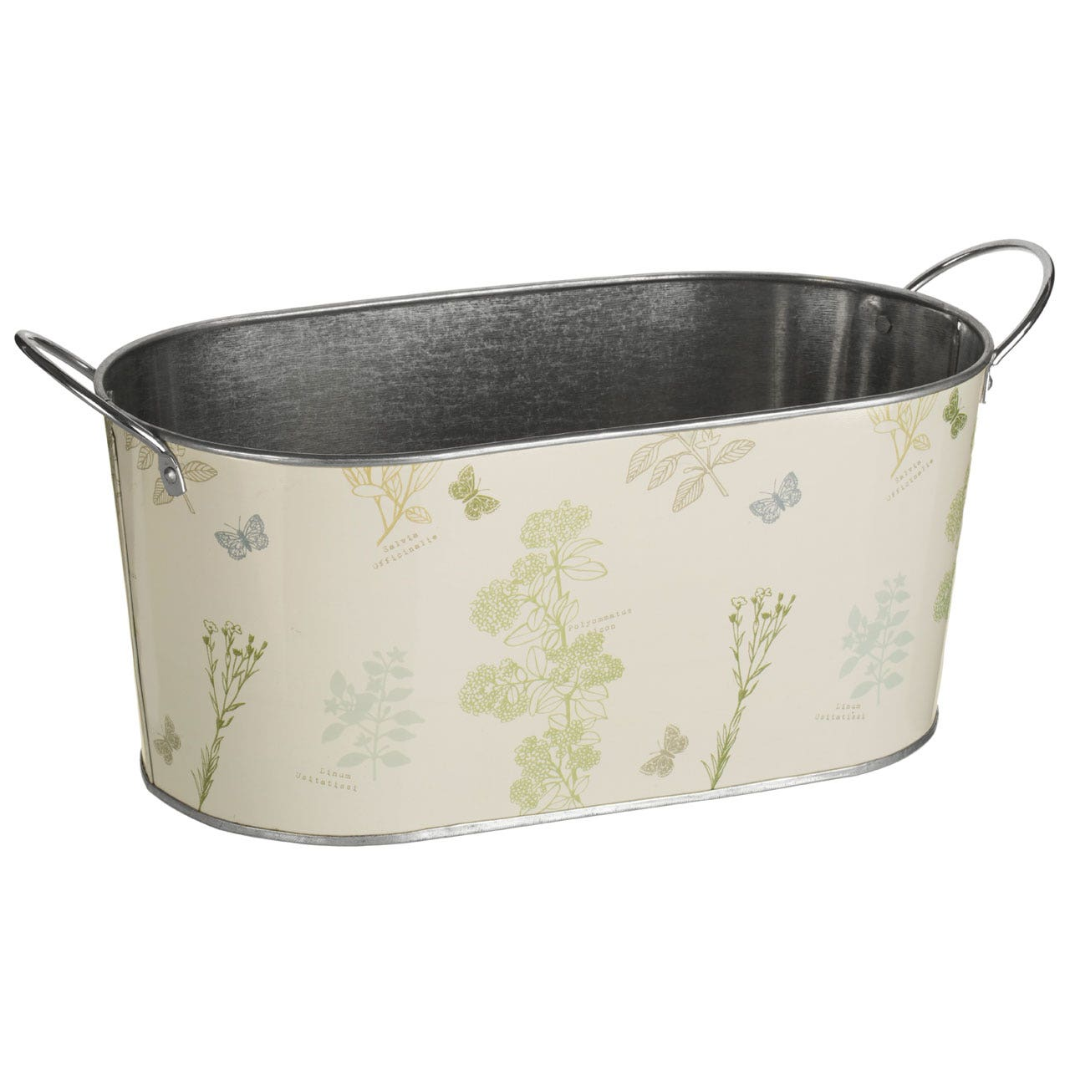
PRICE: RS. 425

Slide 11
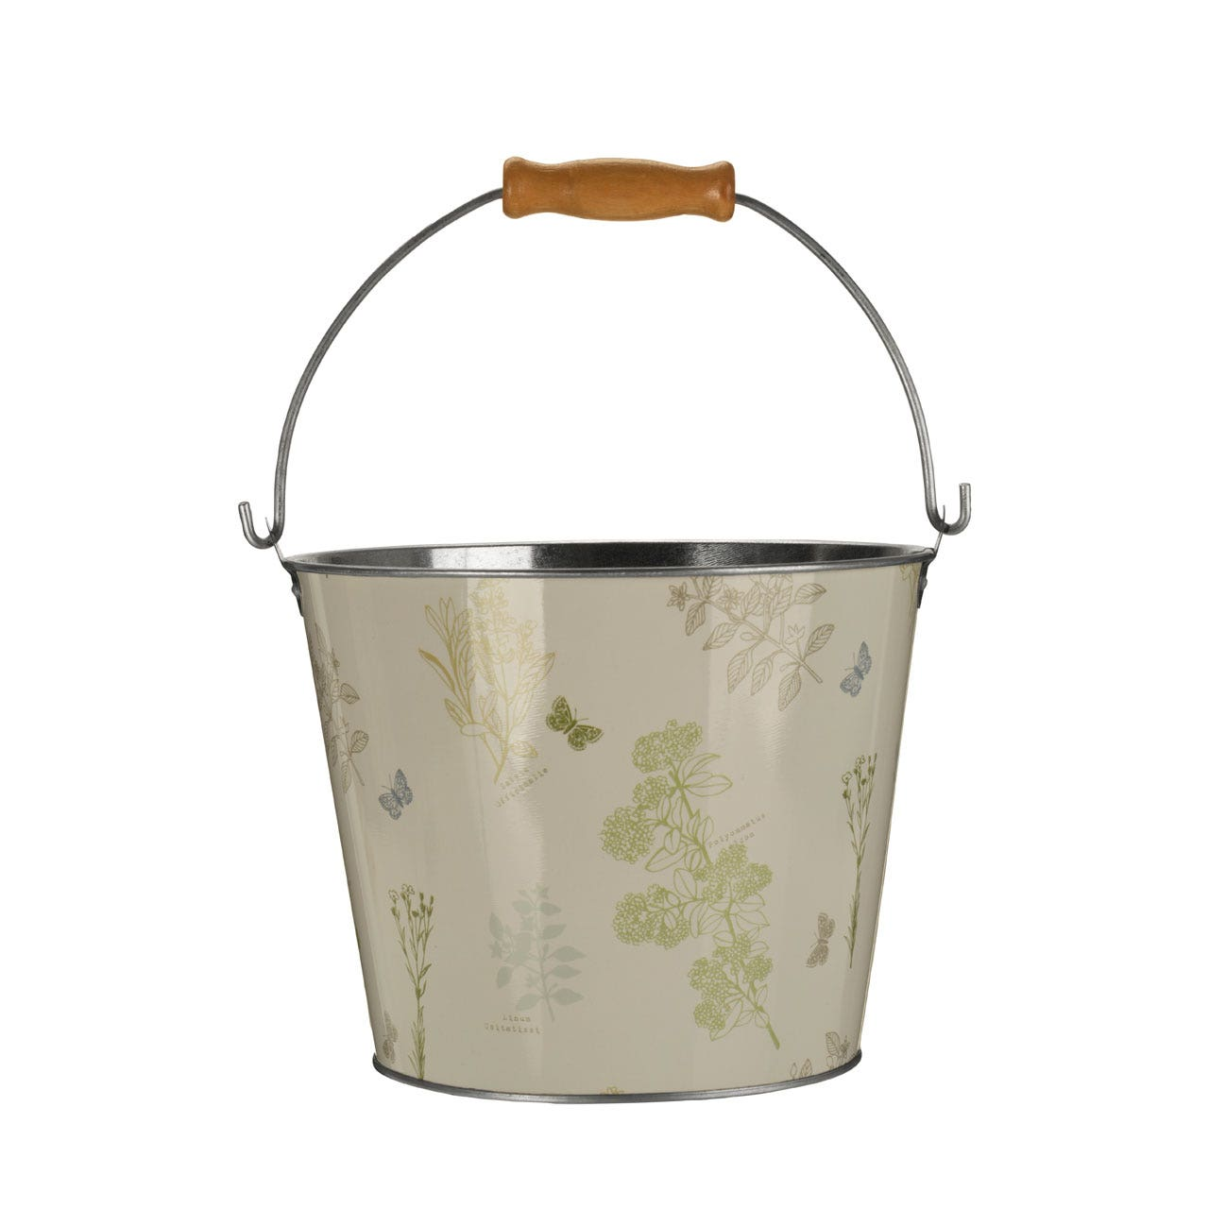
PRICE: RS. 570

Slide 12
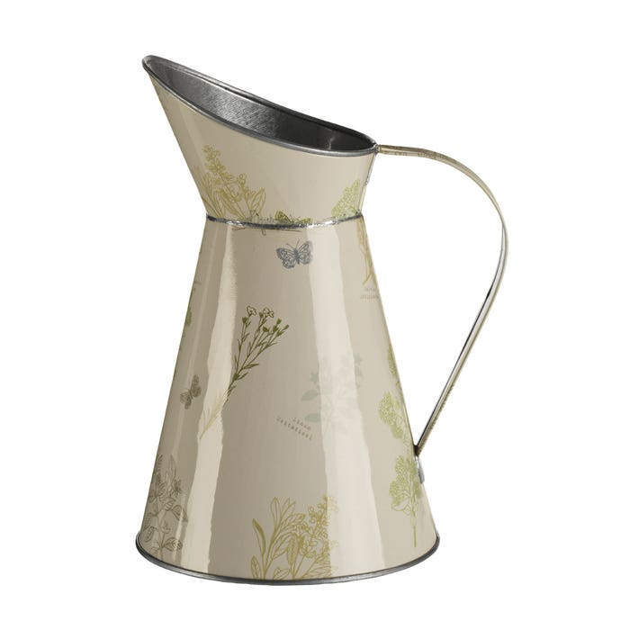
PRICE: RS. 470

Slide 13
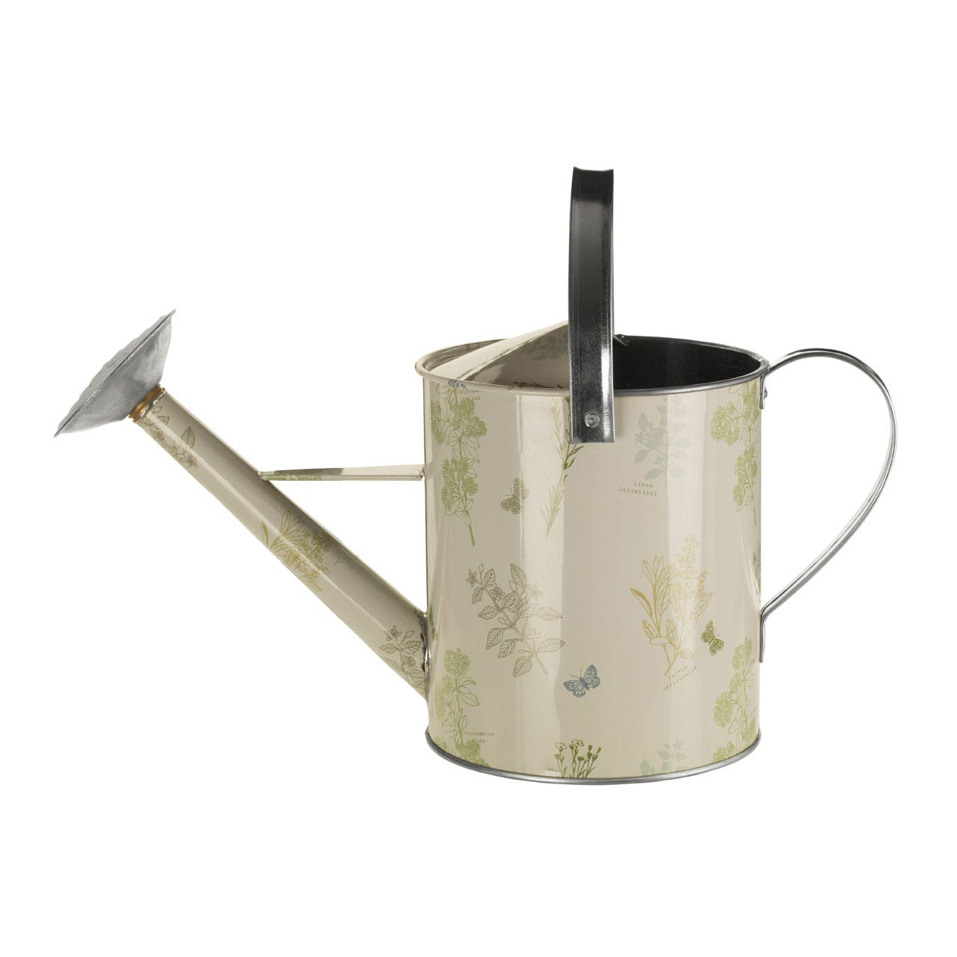
PRICE: RS. 670

Slide 14
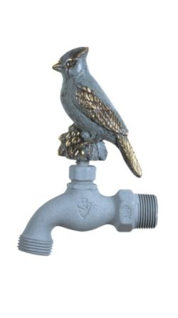
PRICE: RS. 480

Slide 15
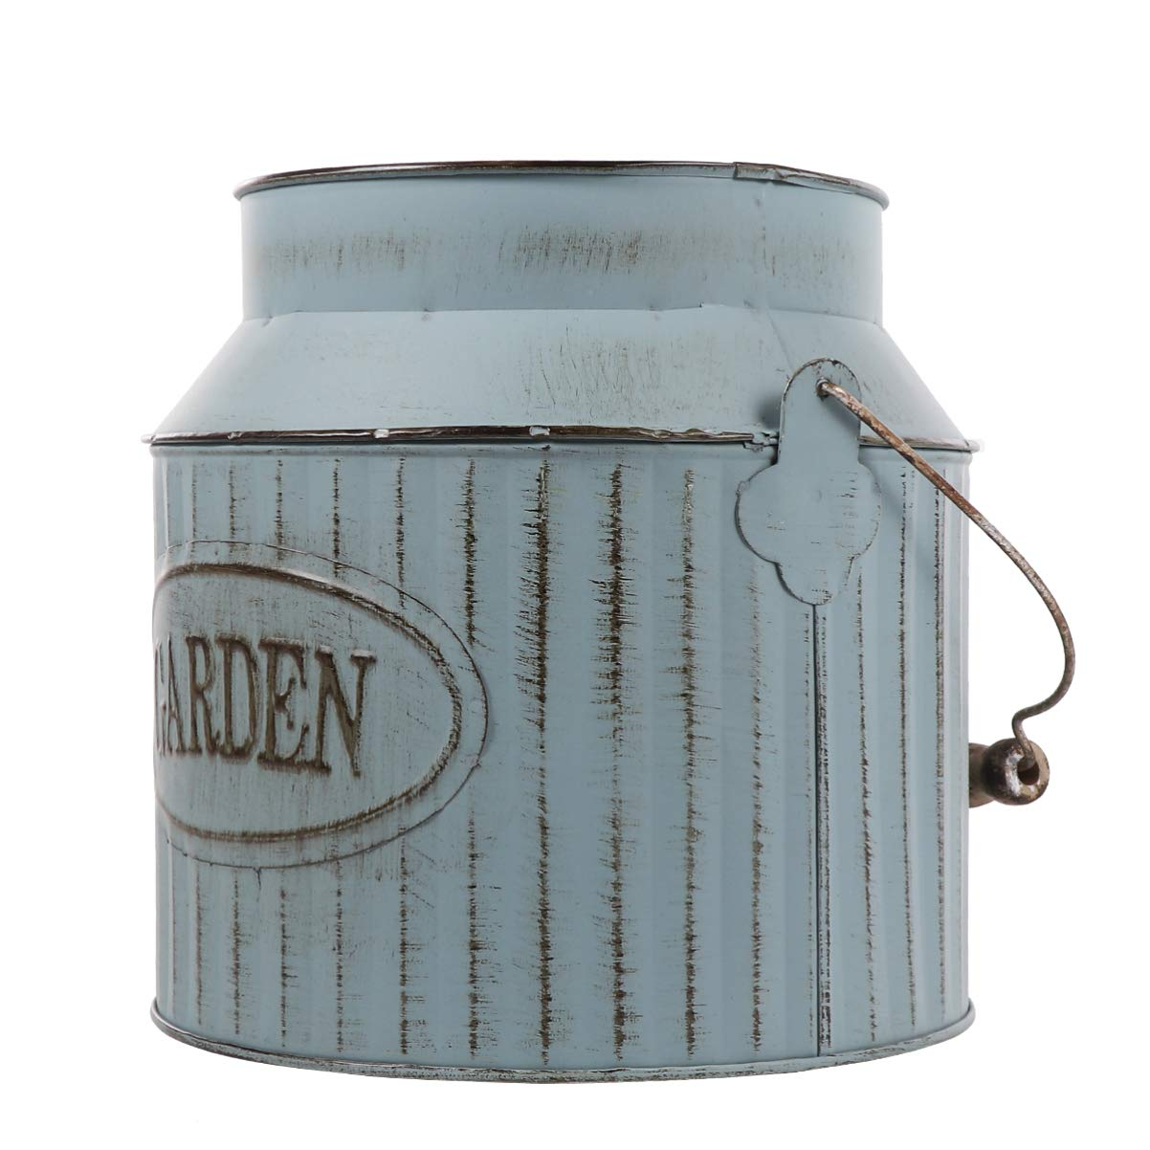
PRICE: RS. 580

Slide 16

PRICE: RS. 490

Slide 17
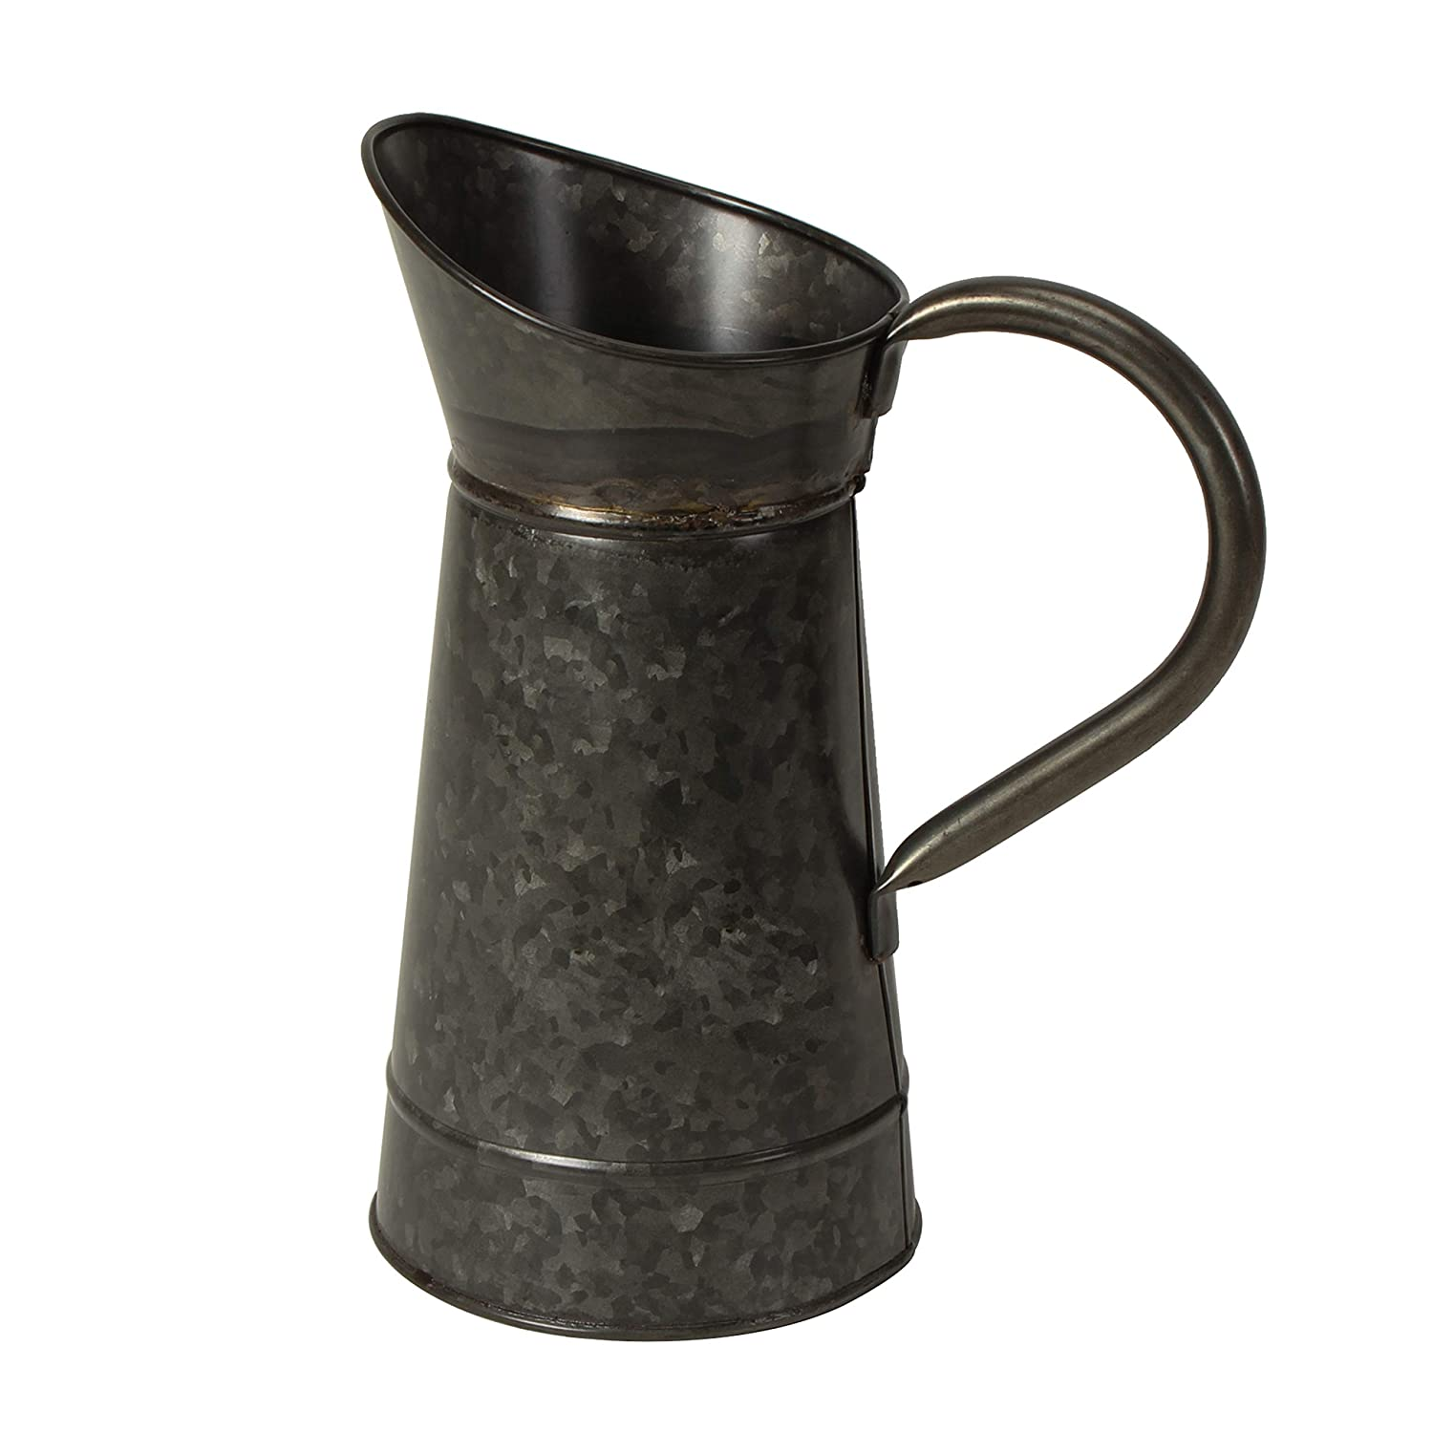
PRICE: RS. 580

Slide 18
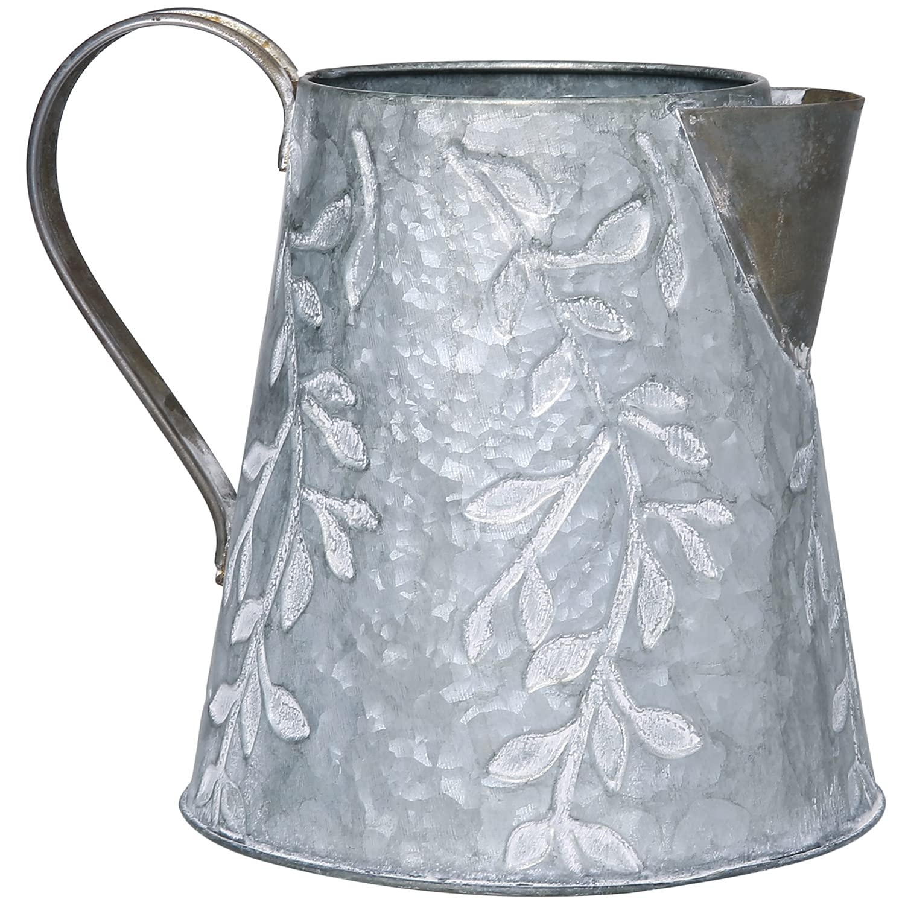
PRICE: RS. 470

Slide 19
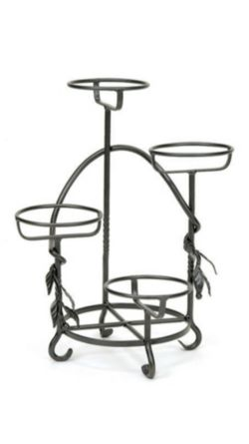
PRICE: RS. 1220

Slide 20
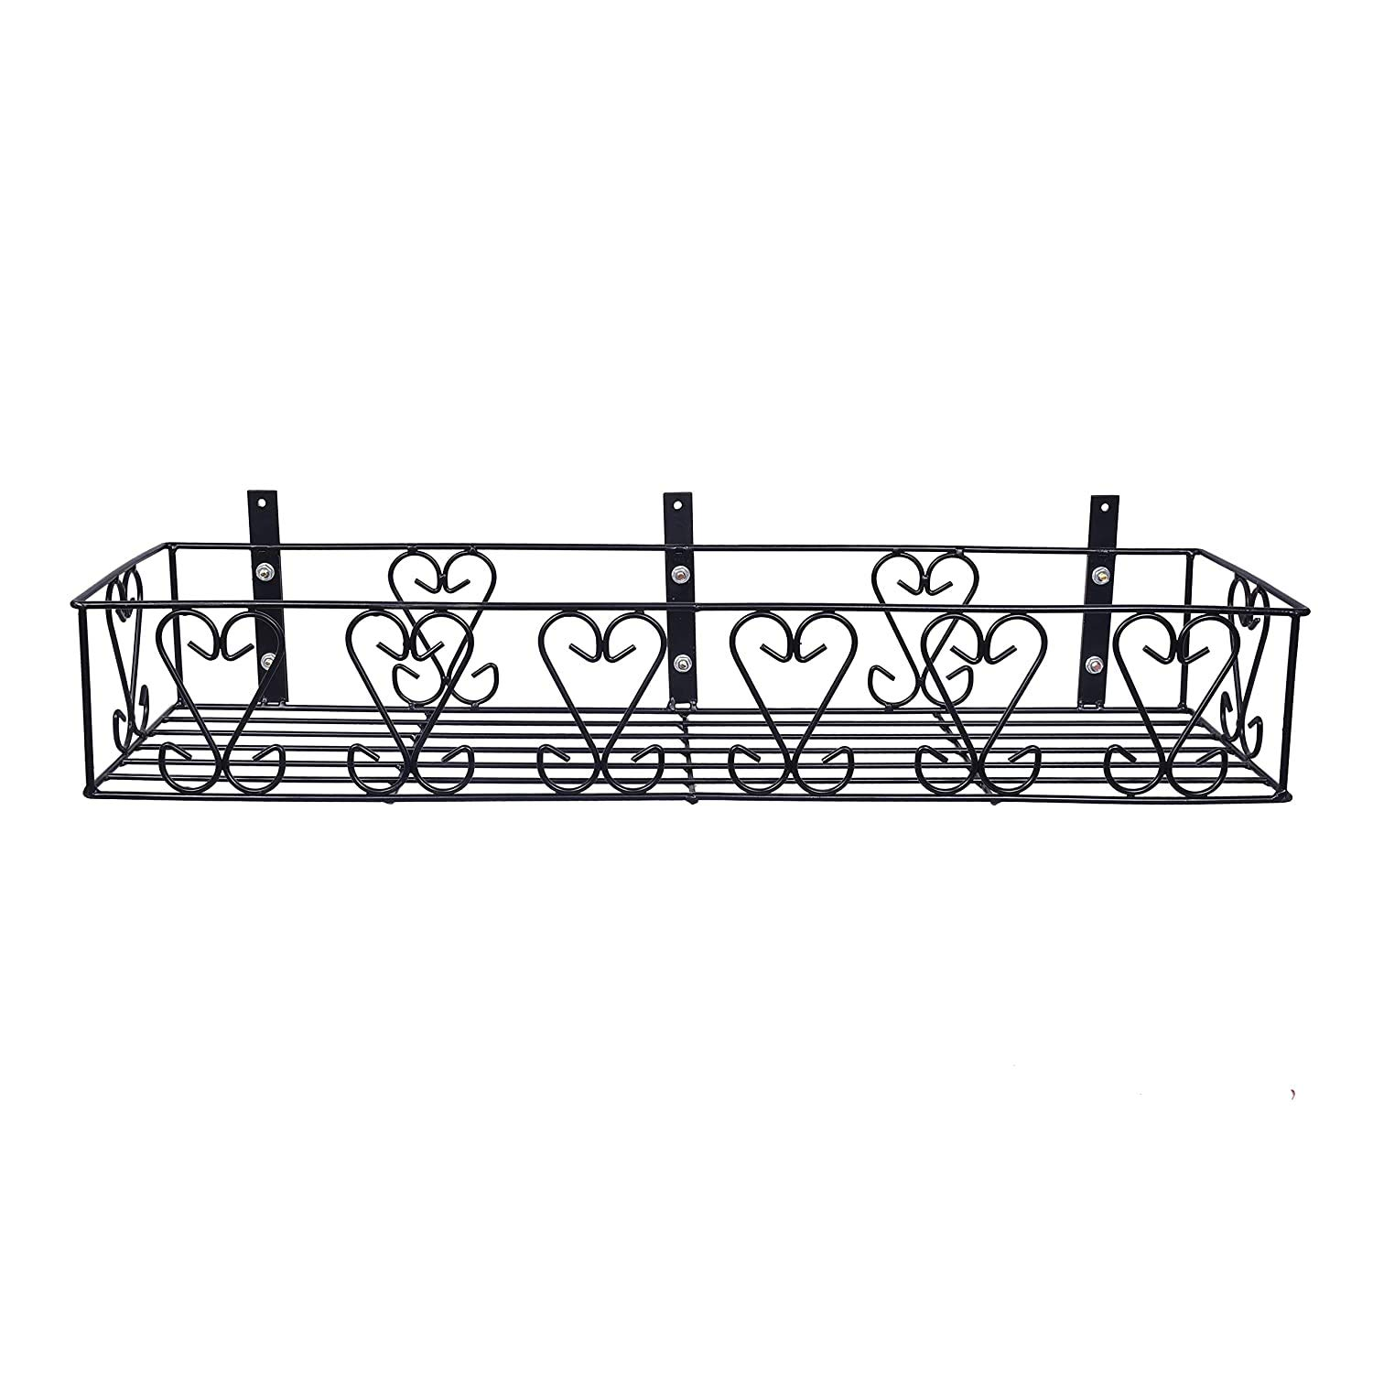
PRICE: RS. 770

