Slide 1
BADAR AND SONS EXPORTS
CUTLERY SETS NEWLY DEVELOPED 2021 METALS
IRON/ALUMINIUM/BRASS AND MORE PLEASE SELECT DESIGN WHICH YOU WANT TO DEVELOPED WITH YOUR REQUIREMENTS BADAR AND SONS ARE RESPONSIBLE FOR ALL QUALITY WE DELIVERS YOU OUR BEST PLEASE MAKE A CHANCE TO WORK WITH US.
THANKING YOU!

Slide 2
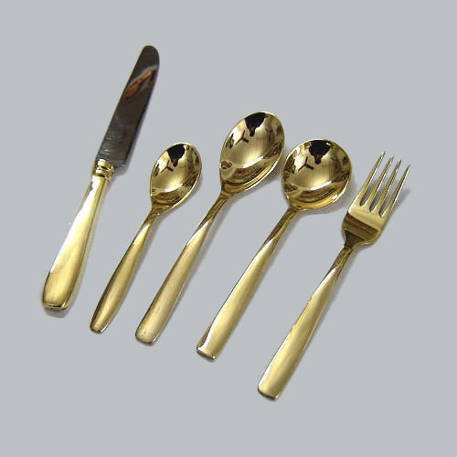

PRICE: RS. 520

Slide 3
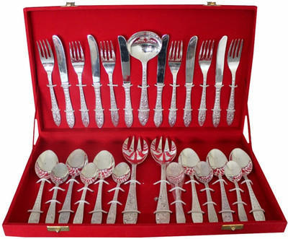
PRICE: RS. 1250

Slide 4
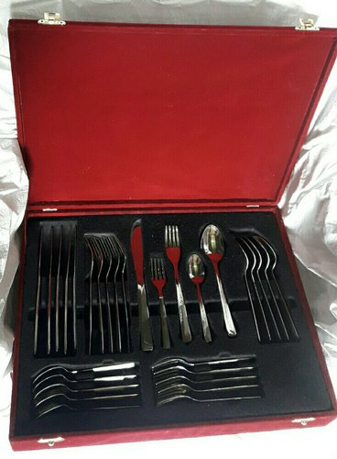
PRICE: RS. 1320

Slide 5
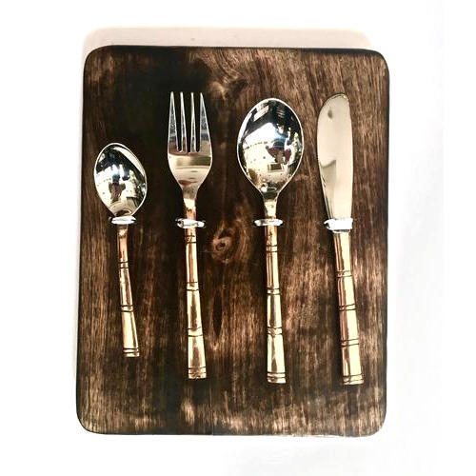
PRICE: RS. 580

Slide 6
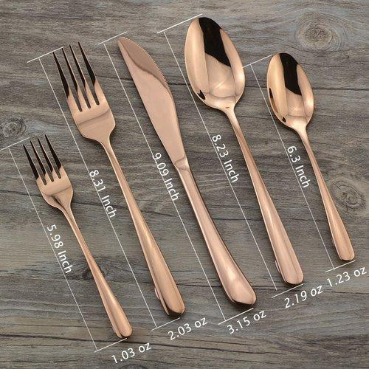
PRICE: RS. 570

Slide 7
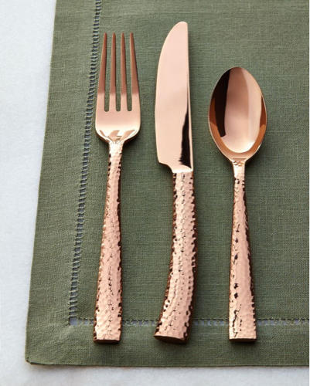
PRICE: RS. 380

Slide 8
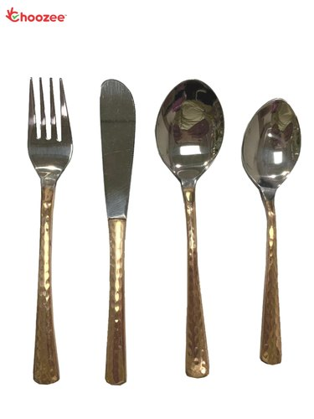
PRICE: RS. 385

Slide 9
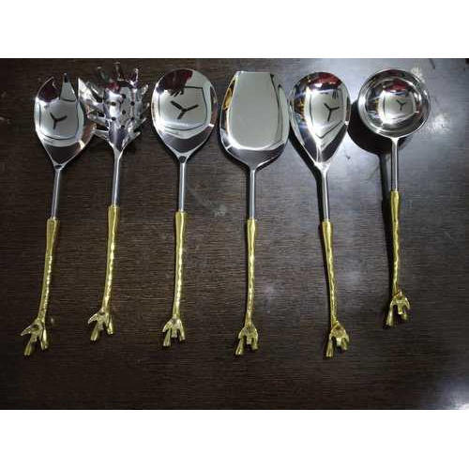
PRICE: RS. 620

Slide 10
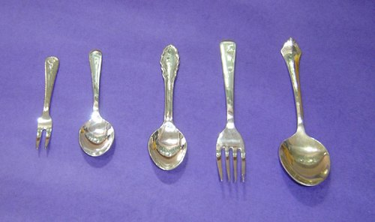
PRICE: RS. 520

Slide 11
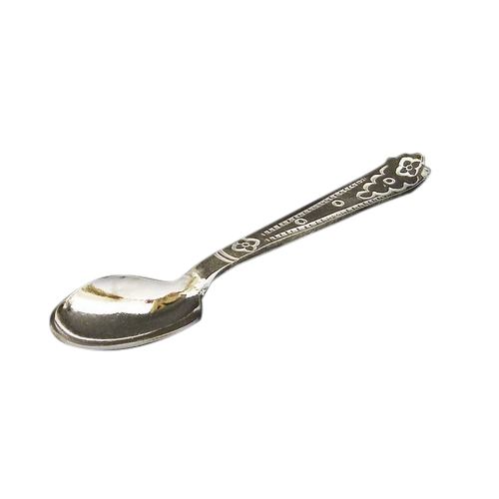
PRICE: RS. 110

