Slide 1
BADAR AND SONS EXPORTS
PRESENTATION OF CUTLERY 2020

Slide 2
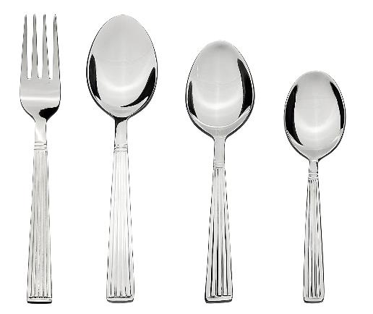
About this item
24 piece cutlery set contains: 6 Table Spoons , 6 Tea Spoons, 6 Forks, 6 Dessert Spoons
Made from 100% food grade stainless steel which prevents rusting
1.5mm thick stem to ensure durability
Smooth edges for safety
PRICE: RS. 350

Slide 3
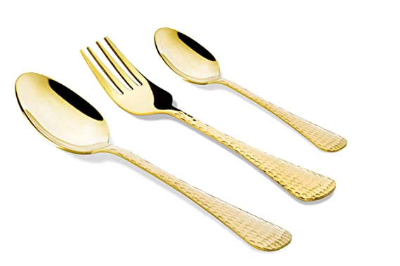
About this item
Gold cutlery gift set, 6 DINNER SPOON, 6 DESSERT SPOON, 6 DINNER FORK made from high grade anti-rust STAINLESS STEEL. Durable and heavy gauge built for lifelong use
FUNCTIONAL- Mirror finished surface for long-lasting shine with smooth edges and no rough spots. Proper gauge thickness will never bend and well balanced weight ensures comfortable handling for both adults and kids.
MULTI-PURPOSE SILVERWARE-- Designed for parties, restaurant, formal & casual dining and everyday use. Can be used with curry, vegetables, fruits, stew, soup, desserts, cakes, tea and various foods. Makes a great gift with gift wrap packaging box option available.
PERFECT CURVE- Each piece is crafted with precision for elegant sleek design. The perfect grip gives the feeling of quality in hand.
Scratch resistant, easy to clean and dishwasher safe.
PRICE: RS. 380

Slide 4
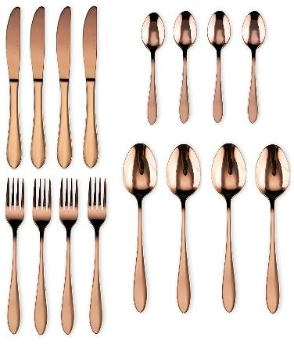
About this item
Dishwasher Safe : This stainless steel silverware set is sleek, simple, and exquisite. Because our satin polish utensils and flatware serving pieces are built of best quality stainless material.
Timeless Design : Smooth surface and highest quality matte polish, simple classic modern design would match well with your existing cutlery and elevate everyday meals into a fine dining experience.
Smoothened edges and ergonomic handles.
Classic look with simple detailing .Dishwasher safe for hassle-free cleaning .
The heavy gauge and substantial sizing result in perfect balance and the feeling of quality in the hand.
.
PRICE: RS. 550

Slide 5
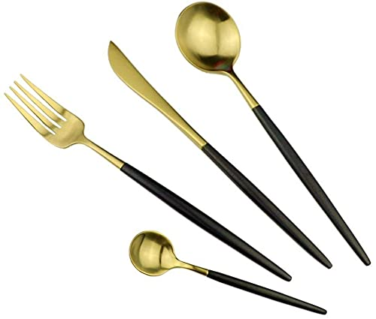
About this item
The Pack consist of 4 Pcs, each of Knife, Table Spoon, Table Fork, and Tea Spoon.
Elegantly designed and balanced to fit securely in hand. Perfect curve, ergonomic design make it comfortable feeling when holding in hand.
Widely used everyday in home, hotel, restaurant, entertaining, party, wedding, buffet, bistro, camping, picnic, etc.
These Cutlery sets are made of durable high quality Stainless Steel, can be used home for years.
PRICE: RS. 425

Slide 6
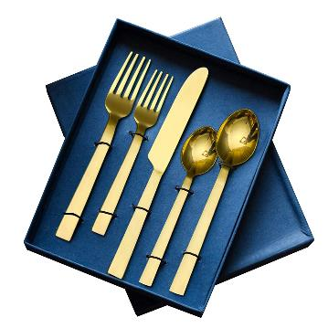
About this item
ABOUT: Beautiful dinner Cutlery set made with stainless steel artistically designed with handle that fits every Dining space. Classy looking Flatware enhances your everyday meals into a fine dining experience.
MATERIAL, DIMENSIONS, SET SIZE: [Material] Stainless steel Gold plating & food grade lacquer coating; [Dimensions] Big Spoon - 8 x 1.5; Small Spoon - 6.25 x 1.4; Big Fork - 7.5 x 1.5; Small Fork - 6.5 x 1; cheese Knife- 9.25 x 1 inches; [Set Size] 5 flatware
USAGE: [1] Ideal for any formal dinner or occasion at home or a party, this Complete Table Cutlery Set can be used in cafes, restaurants, lounges & weddings; [2] Can be used for dinner with family; [3] Dinner Cutlery set used regulary in home is loved by modern families; [4] Perfect Gift Choice for Diwali,Valentine, Thanks Giving, Wedding, Christmas, anniversary, friends, relatives etc.
WASH CARE, DISCLAIMER: [Wash Care] Clean with a damp cloth and dry immediately [DISCLAIMER] Do not soak in water
SATISFACTION GUARANTEED: If you have any queries or concerns regarding the cutlery set. Please feel free to contact us
PRICE: RS. 620

Slide 7
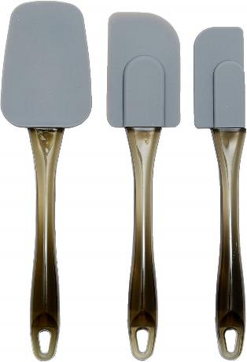
About this item
3-Piece spatula set includes a small one-sided mini spatula, a medium spatula, and a large spatula
Ideal for reaching into narrow jars, scraping cake batter from the side of a bowl, mixing ingredients, and more
Heat resistant silicone heads work well for scraping and reaching into edges and corners
Securely attached contoured plastic handles with hole at the end for convenient hanging storage
Handles measure 6-1/2 inches long
Dishwasher safe for quick, easy cleanup
Gray color for a sleek, modern look
PRICE: RS. 480

Slide 8
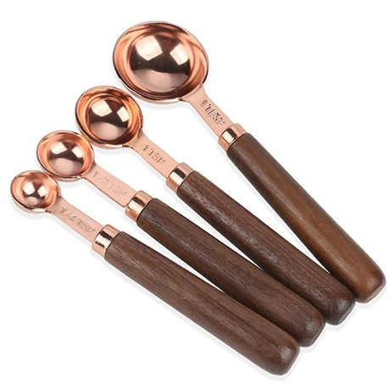
About this item
Meaure Small Amounts Of Dry And Liquid Ingredients With Ease And Precision
Material:Metal Stainless Steel(Rose Gold With Shinning) +Solid Wood Handle
Size(4Pcs Measuring Spoons): 1 Table Spoon(15ml)- +1 Tea Spoon(5ml)+1/2 Tea Spoon(2.5ml) +1/4 Tea Spoon(1.25ml) tems No.:MSW4
Each Measurement Is Engraved On The Handle Of Each Measuring Cup, Easy To Read
Before First Use, Wash With Warm Soap Water And Dry Thoroughly
PRICE: RS. 350

Slide 9
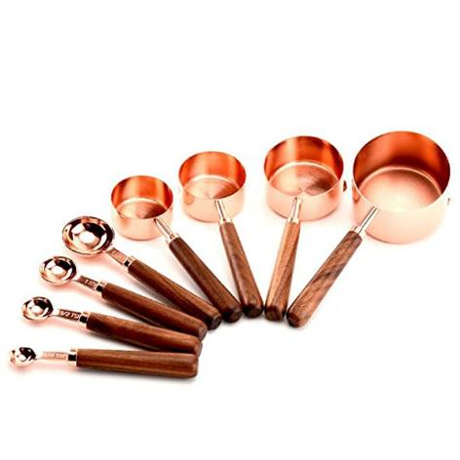
About this item
Meaure Small Amounts Of Dry And Liquid Ingredients With Ease And Precision
Material: Metal Stainless Steel+ Solid walnut wood
Size: 8 Pieces Sets =4 Measuring Cups(1 Cup +1/3 Cup +1/2 Cup +1/4 Cup )+4 Measuring Spoons (1 Tbsp, 1/2 Tbsp, 1 Tsp, 1/2 Tsp, 1/4 Tsp)
Color:Rose Gold With Shinning Items No.:MCSW-8
Before First Use, Wash With Warm Soap Water And Dry Thoroughly
PRICE: RS. 390

