Slide 1

01
Helping Brands Communicate Through Innovation in Technology

Slide 2

02
ExperientialEtc is a 4 year old, 360 degree activation agency which is disrupting the way traditional activations have been done by integrating latest, cutting edge & futuristic technology in its most simplest form to create jaw dropping experiences.

Slide 3
THE TIMELINE
2019
STABILISE
2022
DISRUPTION
2018
PREPARE
2020
ACCELERATE
Design and Production studio gets our creative juices flowing.
DIGIPLAY gains traction. Activations at their peak with the brands.
International events executed and Middle East presence is established.
2021
ADAPTATION
Global Expansion
Penetration in Metaverse
Pivoting more towards digital solutions to integrate scalability
More clients invest their trust in us .
HOLOVSN and HOLOMIST take the industry by storm.
Distribution channel established in 8 cities
2017
THE ORIGINS
Bigger Team Bigger facility .
Franchise network expands to 20 distributors.
Sustainability & Hardihood
Revolutionized and successfully pivoted to digital tech.
Augmented reality, Artificial intelligence and virtual conferences take forefront.
The Inception. The itch.
First 4 months of the business and 4 clients to boast of.

Slide 4









4
Our Competition

Slide 5









5
Why Choose Us
Design & Content
Tech
Testing the elements, graphics and the animation of the content to give character to the idea.
The array of distinctive characteristics gives the client the edge to select one tech over the other.
Service
Analytics
An after sales follow-up is mandatory to ensure the upkeep and maintenance of the technology.
Providing the headcounts of the engagement to the client is as satisfying as the experience.
Ideation
Understanding the theme of the campaign and the nerve of the target consumer

Slide 6
02
Campaigns that we are proud of
AR Image Processing: Dairy milk : https://www.youtube.com/watch?v=Owlcjlb44I8
Holobyk: Amazon Prime : https://www.youtube.com/watch?v=SanZAvnm7IM
Holomist: TATA Motors : https://youtu.be/gjr9lqUR4qM
Web-AR: Amazon Prime : https://youtu.be/Z3f2MQEtiTA
Motion & Sound Sensors: TVS Eurogrip : https://youtu.be/SRGHOYk5FM4
AR Effects : Mi : https://youtu.be/6YYdqToJEzs
Load Gauge & Sound Sensors : FoxStars : https://youtu.be/U8xM7iQXsMg
Virtual Store : Mi : https://youtu.be/7xqeccJztxQ
Native AR App : Mi : https://youtu.be/kkb5rUZnk3g
Image Processing : Mi : https://www.youtube.com/watch?v=F9yk6o_wTKU
App Development : Mi : https://www.youtube.com/watch?v=UJNEtYFj7rg
Web Games : MI : https://www.youtube.com/watch?v=CZIE5yG59h0
Educational AR App : https://www.youtube.com/watch?v=XNXVAAAEAjY
Artificial Intelligence : Mi : https://www.youtube.com/watch?v=ZS2qUR5XEg8
Holonet : Yamara : https://www.youtube.com/watch?v=jZmtc40ff7c

Slide 7
Knowledge - Our competitors are pushing boxes
Ideation - With our brains we translate contemporary solutions with a modernized twist
Relationship building - We fulfil our client's expectations in their budget.
Our Directors have a strong reputation in the market.
Excessive workload
A small team trying to achieve big things
Our company has little market presence
Resource limitations
Experiential marketing is expanding with many future opportunities for success.
We adopt the latest technologies quicker than our competitors
The emerging need for on-ground activation and phygital activities.
Clients choosing the traditional medium over experiential marketing.
Feasibility of execution in a tight timeline

Slide 8
Deployment of Funds
8
Manpower
ExperientialEtc has a talented but small team to ease the load we always have to outsource.
Hardware & Software
Hardware & Software plays an important role in our work, from making rendition to executing plans. With all the latest technology we will be able to reach new heights.
Marketing
ExperientialEtc is looking to create its presence nationally and internationally, Marketing will definitely help us create a positive brand value.
Inventory
The current inventory is sometimes insufficient to fulfil the client requirements.
Administration and compliance
As we expand, the support system will also be upgraded from time to time to ensure that we are systematic, compliant and follow procedures.
Research & Development Paper
Research & Development plays vital part in innovating new products and services and also a key factor in developing new competitive advantages

Slide 9











































Clients Who Trust Us

Slide 10

US Clients Pipeline

Slide 11
Revenue Projections
6
₹ 90 Cr
2025
₹ 60 Cr
These projections are a reflection of expansion fueled by current raise only.
Increase in revenue due to further rounds has not been depicted in these projections
2024
₹ 40 Cr
2023
₹ 20 Cr
Investment Advisors SNARD Finance
2022

Slide 12







Featured On

Slide 13
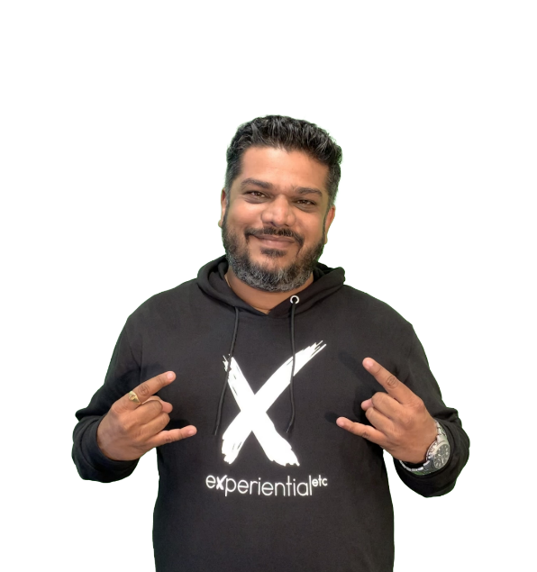



Core Team
Karan Bhardwaj
MD & Chief Executive Officer
Prashant Pandey
Chief Operating Officer
Sonal Mahendru
Chief Technology Officer
Kulbir Singh
Chief Revenue Officer - USA

Slide 14

MUMBAI | NOIDA | SAN FRANCISCO
www.experientialetc.com | us.experientialetc.com
THANK YOU

