Slide 1
Shipping Instructions

Slide 2
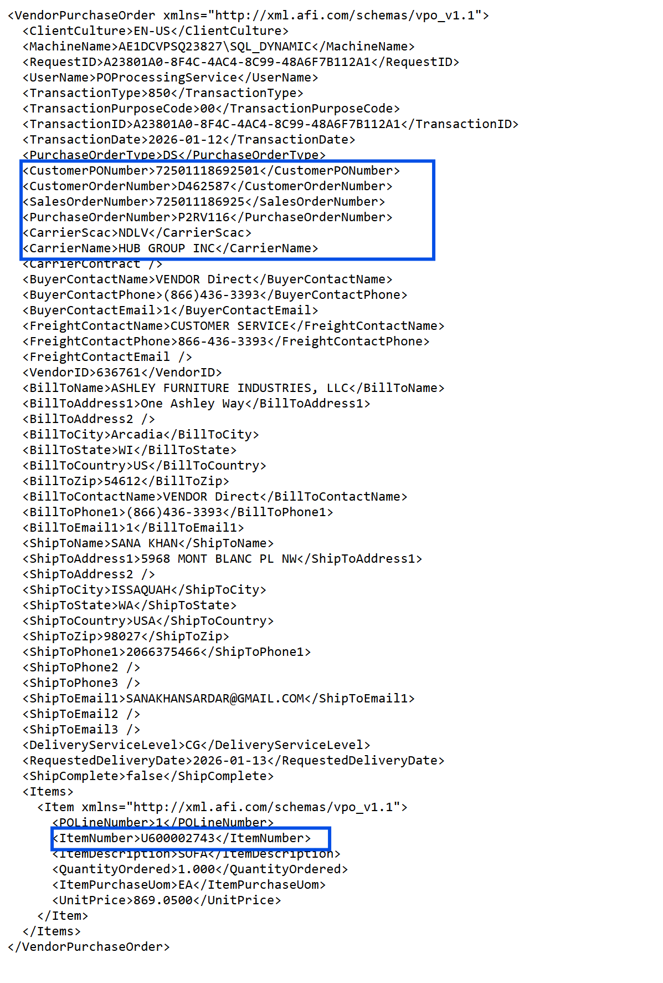
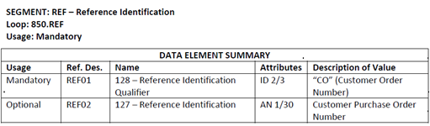
LTL-Hub Group shipment :
850 XML:
Carrier SCAC Field:
NDLV-indicates to ship LTL-Hub Group
  All Ashcomm PO Numbers:
    Always begin with a 725
    14 digits long
  EDI Segment:
856-ASN:
Send carrier SCAC NDLV-Hub Group
Send the Hub Group Tracking number, not the assigned Hub Group contracted carrier.

Slide 3
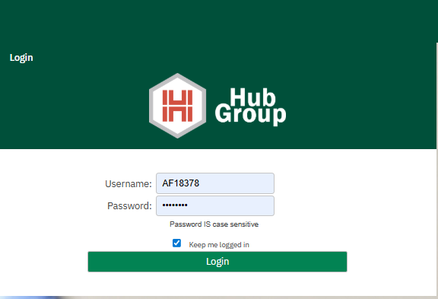
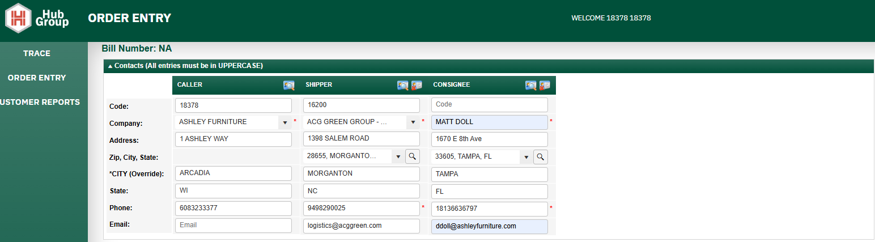
Portal Login:
Order Entry:
Caller ID: preloaded Ashcomm account information.
Shipper: Your vendor preloaded warehouse information. (Vendors with multiple warehouse will have more than one shipper address available in the drop-down menu.
Consignee-fill in customer or ship to location information.
Note all * fields are required.

Slide 4
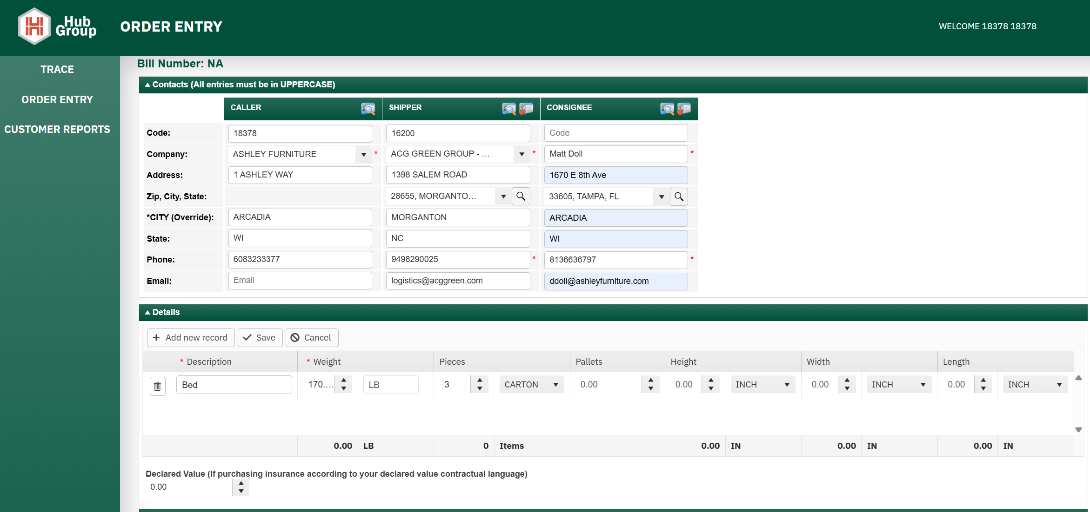


Details:
Description:
  Simple-indicate series or type of product category.
    Enter weight
    Designate either number of pieces and select carton in the drop down menu.
    Dimensions aren’t needed.
    Note all * fields are required.

Slide 5
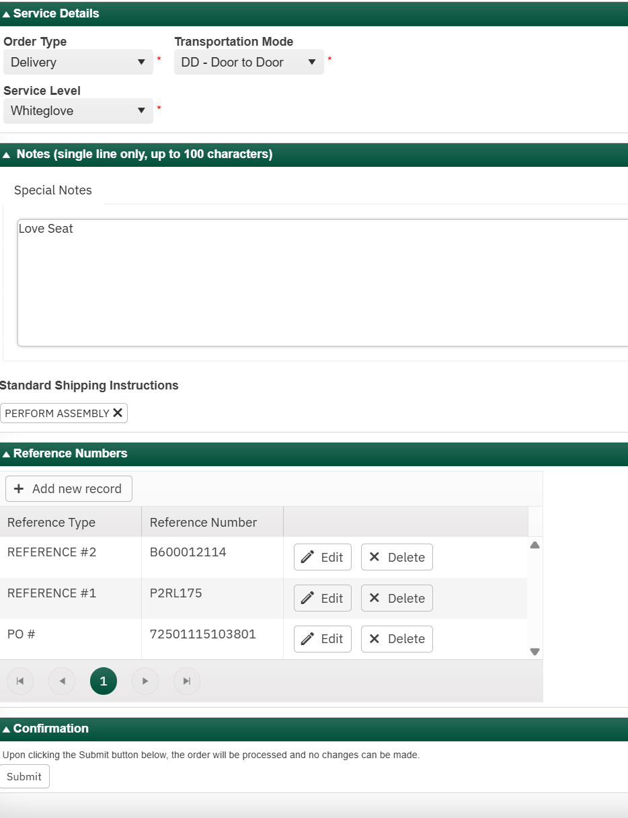
Service Details:
Order type-Select-“Delivery” from the drop down.
Transportation Mode-Select “DD-Door to Door”.
Service Level:
  Ashcomm/Site orders
    Select “White Glove”
Special Notes:
  Ashcomm/Site orders
    Insert brief description of the item(s), do not include any special characters.
Standard Shipping Instructions:
  Store/Ashcomm/Site orders
    Select “Perform Assembly”
Reference Type:
    Under ‘PO #’ field indicate <CustomerPONumber> (All Ashcomm PO Numbers:
      Begin with a 725
      14 digits long
      Under ‘Reference 1’ field indicate <PurchaseOrderNumber> generally starts with a “P”, this is your PO number from Ashley
      Under ‘Reference 2’ field
        Insert Ashley Sku

Slide 6
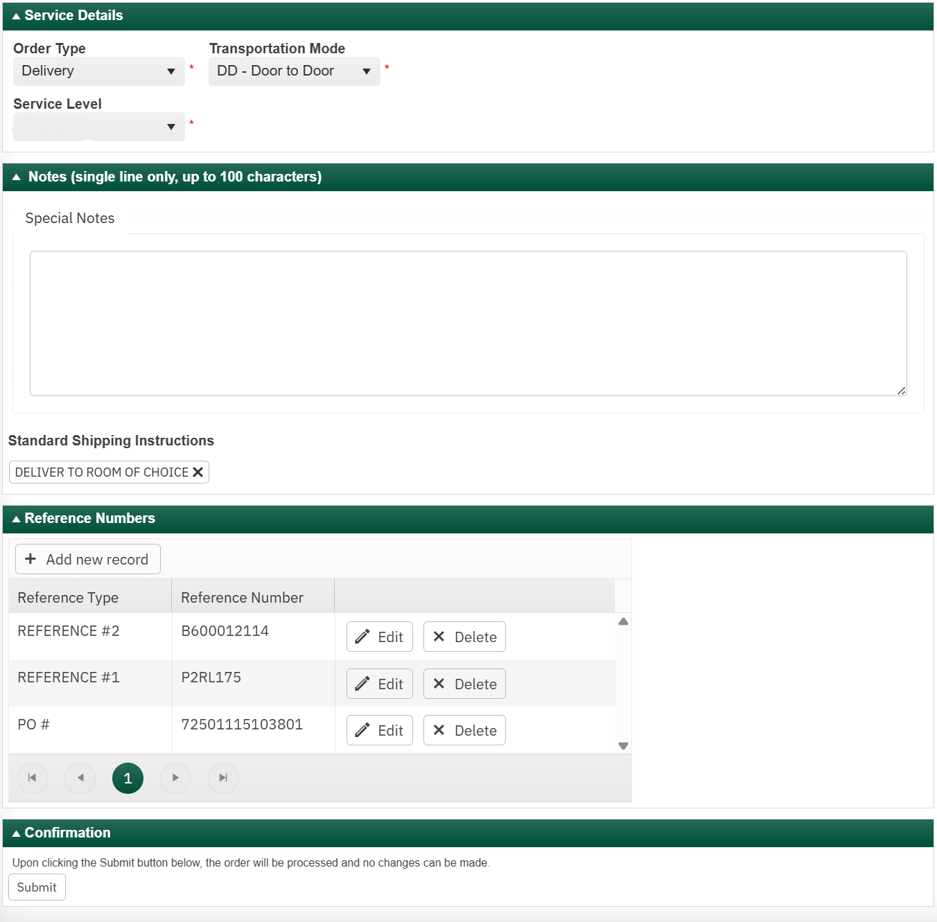
Rug, Artwork, and Lighting Vendors Only:
Service Details:
Order type-Select-“Delivery” from the drop down.
Transportation Mode-Select “DD-Door to Door”.
Service Level:
    Select “Threshold”
Standard Shipping Instructions:
  Store/Ashcomm/Site orders
    Select “Perform Assembly”
Reference Type:
    Under ‘PO #’ field indicate <CustomerPONumber> (All Ashcomm PO Numbers:
      Begin with a 725
      14 digits long
      Under ‘Reference 1’ field indicate <PurchaseOrderNumber> generally starts with a “P”, this is your PO number from Ashley
      Under ‘Reference 2’ field
        Insert Ashley Sku
Threshold

Slide 7
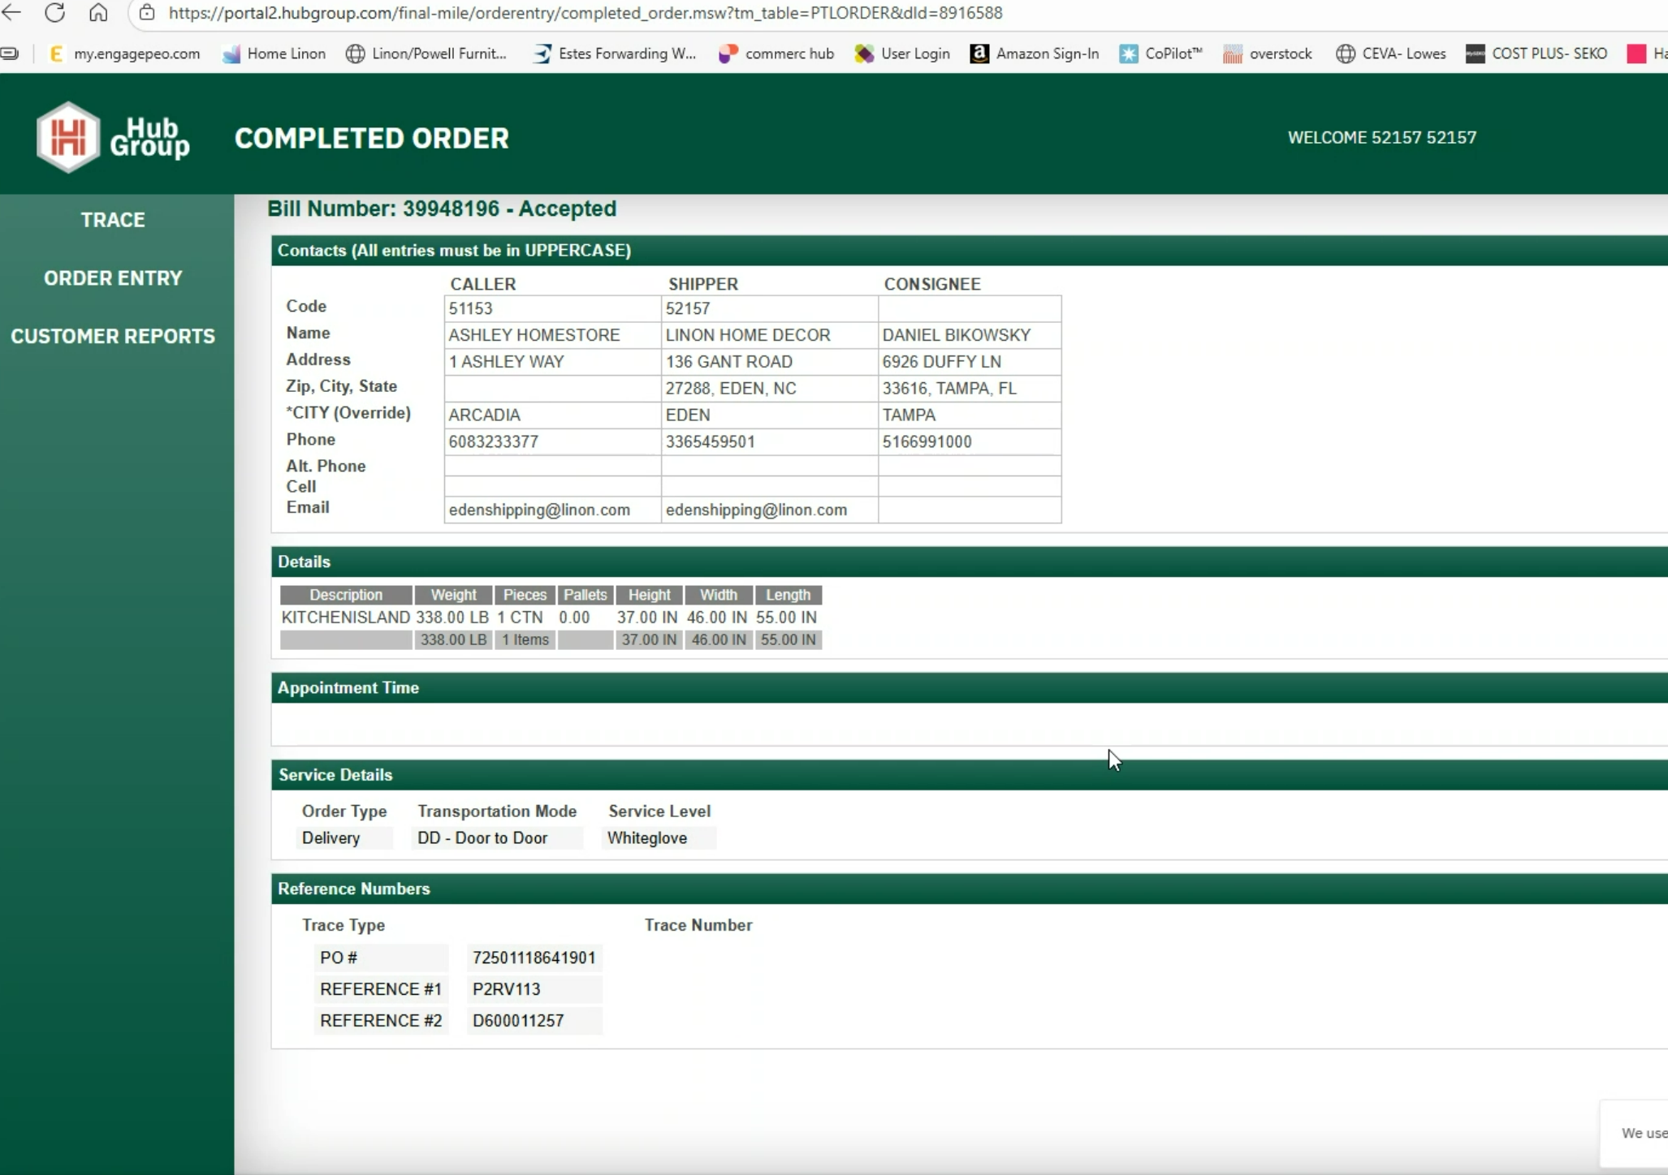
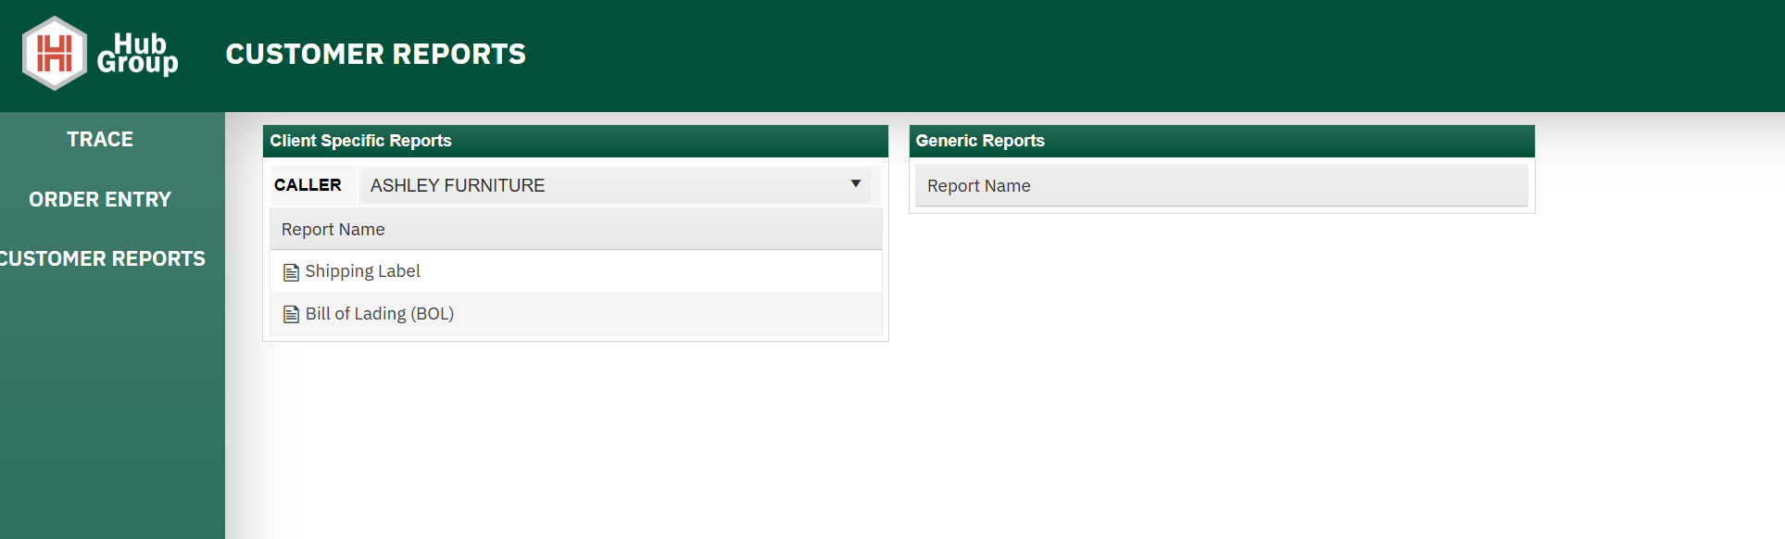
Submitting Shipment:
Click submit
  Page with process and the Hub Group tracking number will be at the top of the page.
    This is the tracking number that needs to be sent back in the ASN/856
    This number is also referred to as the NSD/Bill number and is 8 digits long.
    Note once you see the BOL you will be able to see the carrier assigned to pickup the shipment as well as their tracking number. DO NOT SEND this tracking number in the ASN, sent the Hub Group Tracking number.
BOL and Labels:
  Click on customer reports.
  Reports will be available to print in the portal 20-30 min after the shipment is registered.
  This an ongoing job and timing will depend on when you book your shipment.

Slide 8
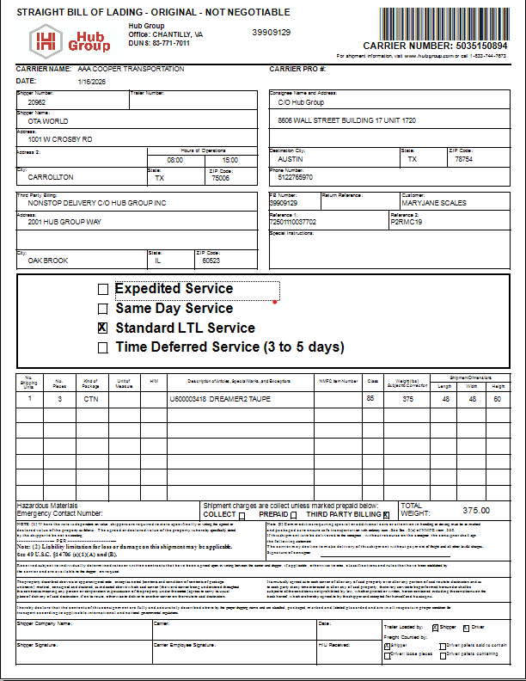
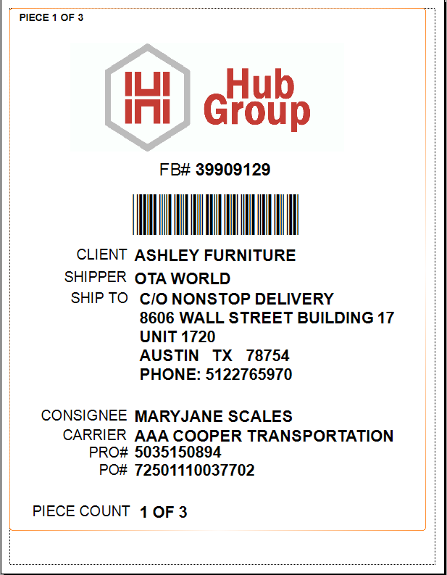
Example Label and BOL Single Sku
  More typical of a Store and Online order.

