Slide 1
PO 105544
Interior Visions Inc.
Olliix Order #20888299
Items received with concealed damages
Received on 10/14/25
Opened on 10/22/25

Slide 2
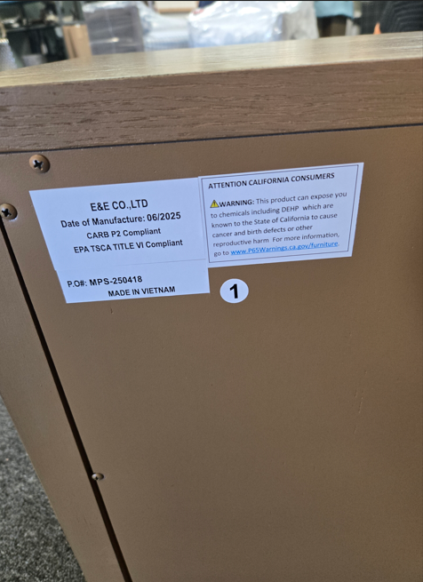
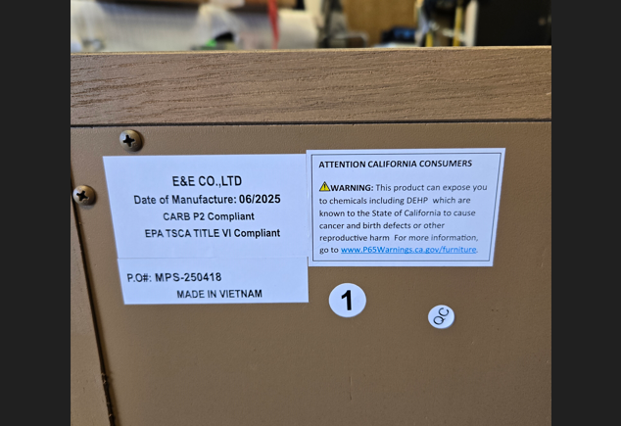

Slide 3
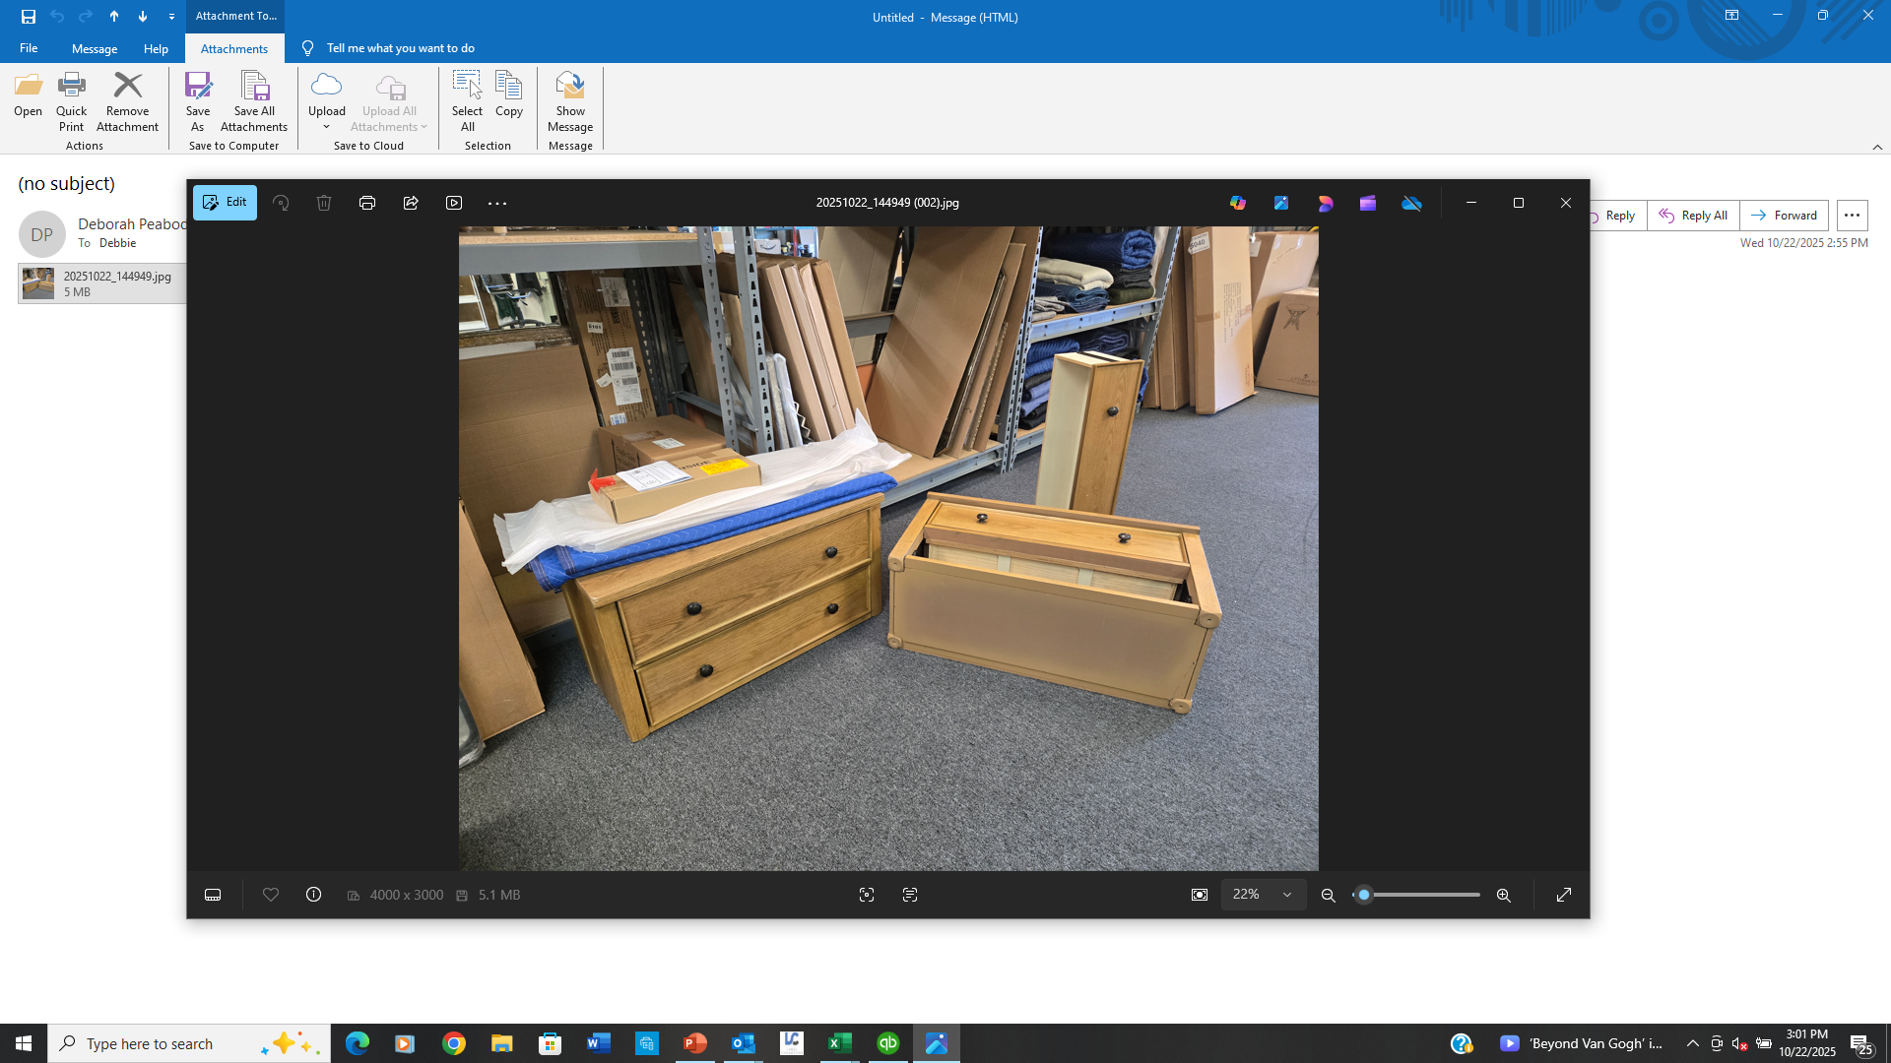
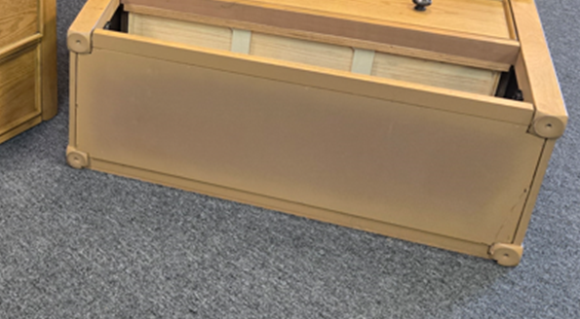

Slide 4
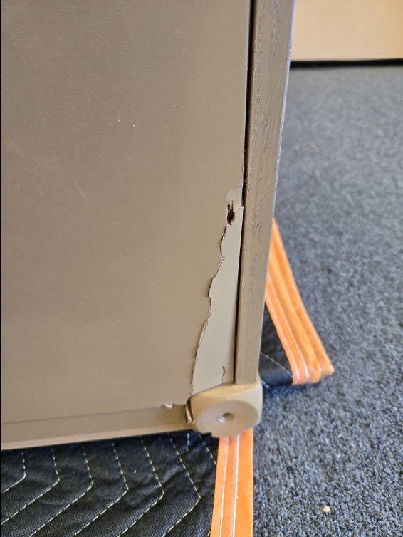
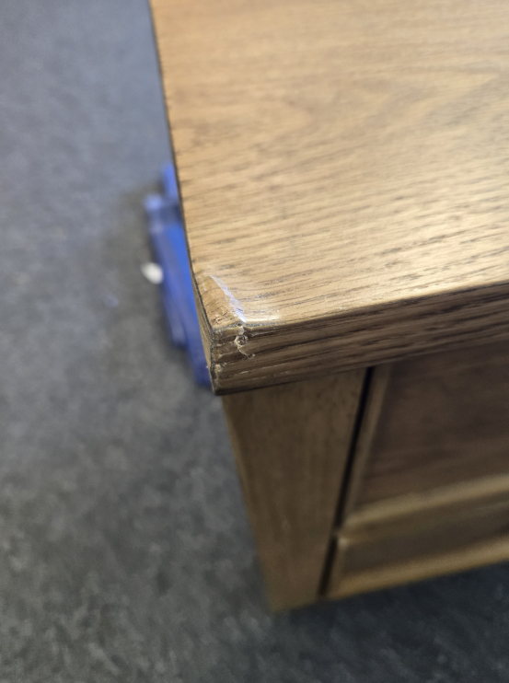


Beckett 2 Drawer Nightstands
#MPS130-0306
Both received with concealed
Damage and need to be replaced.
1 of 2
Front facing, left
Top corner crushed
2 of 2
Busted under
bottom drawer

Slide 5
