Slide 1
PO 105339
INTERIOR VISIONS INC
OLLIIX ORDER #208844750
ITEMS RECEIVED WITH CONCEALED DAMAGES
5/19/2025

Slide 2
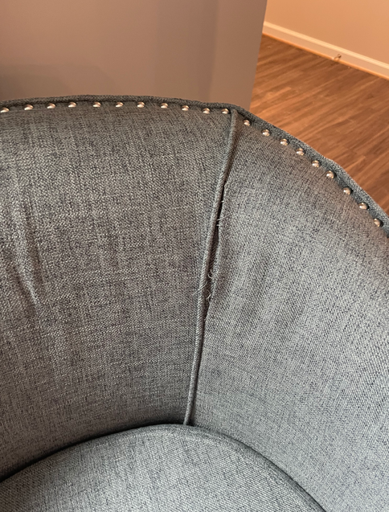
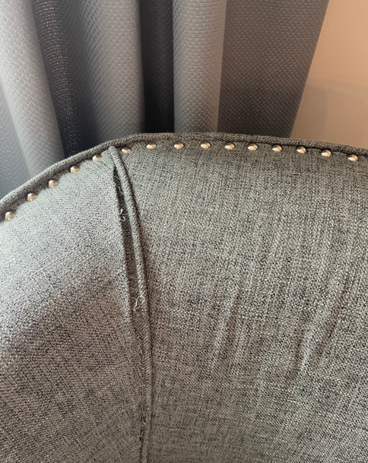
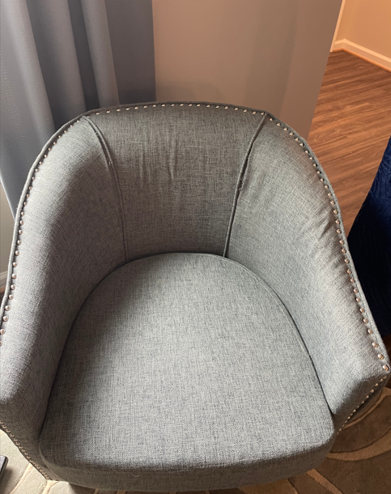
OLLIIX PO 105339 RECEIVED ON 2/26/2025 MODEL K GREAT ROOM
2 ITEM FPF18-0494

