Slide 1
Olliix Policy:
Defective/Damaged Claims
Damage and Defective claims are common customer issues we hear about regularly. In order to be consistent in our handling of these claims, please follow the guidelines set forth in this presentation.
*Important Note: Our furniture items are not commercially rated and use of the items in a commercial setting will void the 1-year Limited Manufacturer Warranty.

Slide 2
DAMAGED IN TRANSIT
Prepaid Shipping (Customer paid us to ship)
  A damaged claim where the item is irreparable, meaning there is no solution to fixing it (like a part replacement, etc.). Customer should be refunded in full or sent a replacement for the item.
    If the replacement item needs to ship LTL, we should refund customer the freight and item costs and inform them to place the item on a future order. We WILL match freight on future order for that item.
  FILE A CLAIM!
    This is mandatory on all damage claims where the carrier is at fault. File a claim with the carrier to ensure we are reimbursed for costs.

Slide 3
DAMAGED IN TRANSIT
CUSTOMER CARRIER (Customer used their own freight service/ground carrier to ship)
  Customer must file a claim with their carrier. We will not reimburse for damaged by carrier items when we were not the shipper of record.
  In the event their carrier denies the claim, we will NOT reimburse. They must resolve all carrier damage claims with their carrier.
    An example is one where the carrier requests certification on ISTA packaging. Even if we do not have ISTA documentation, we still will NOT reimburse. The issue lies between the dealer and their carrier of choice.

Slide 4
Damaged/Defective Claim
Non-Carrier Related
Claim with a “small” defect (i.e. small stain, missing screw, etc.)
  Soft Goods – Offer the customer a 5-10% discount based on the extent of the issue to keep the item as-is.
  Hard Goods – Offer the customer a 5-10% discount based on the extent of the issue to keep the item as-is.
EXAMPLES CAN BE FOUND ON THE NEXT SLIDE(S)

Slide 5
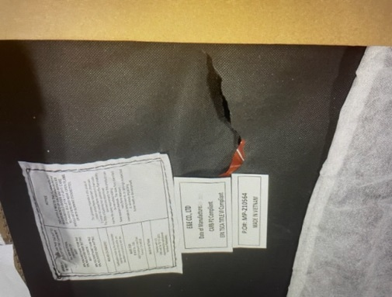
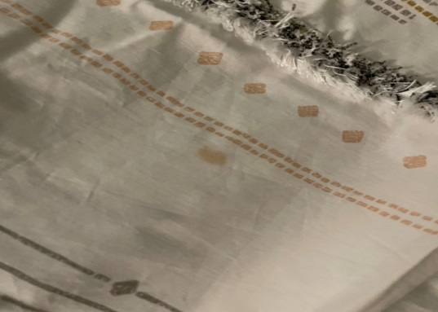
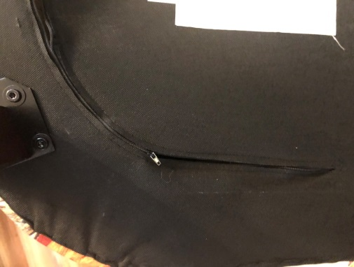
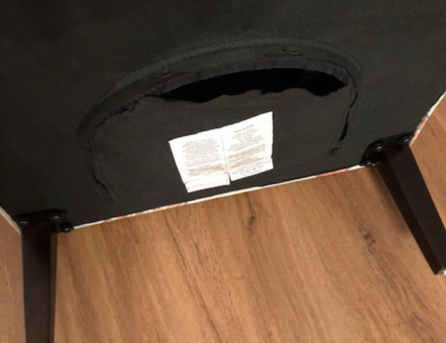
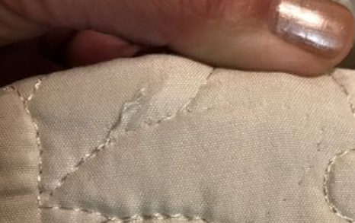
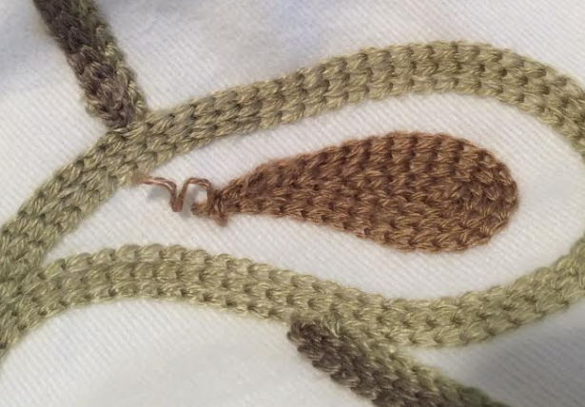
“Small” Defect Examples – 5%
This is the underside of the chair and not visible to anyone
This is a stain that could be washed out
This is the underside of the chair and not visible to anyone
This is the underside of the chair and not visible to anyone
Very small thread pull
Small thread pull

Slide 6
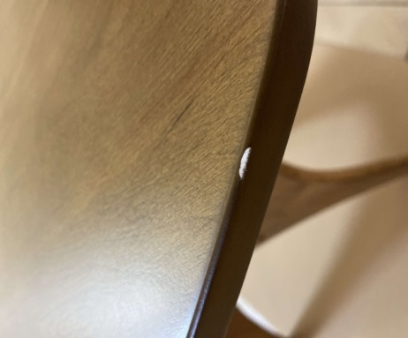
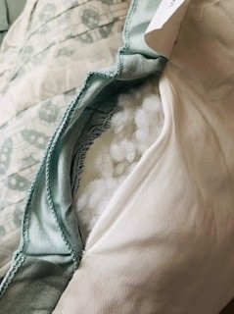
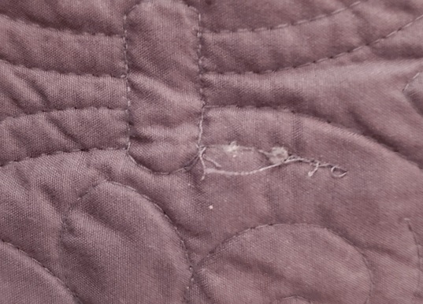
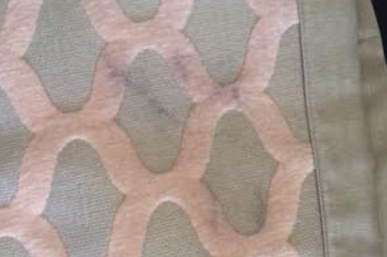
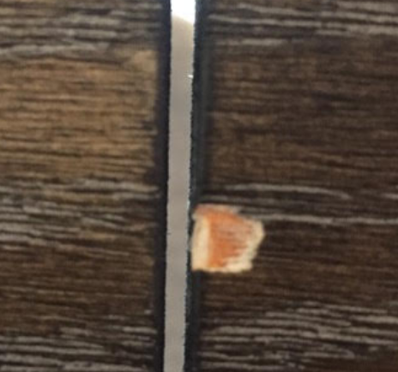
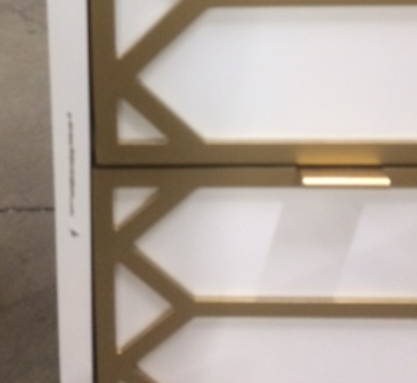
“Small” Defect Examples – 10%
A furniture marker would likely fix this, but added costs and labor make this worth a 10% discount
This could be sewn, but it is additional work the customer has to put in, hence the 10% discount
This could be sewn/cleaned up, but it is additional work the customer has to put in, hence the 10% discount
A furniture marker would likely fix this, but added costs and labor make this worth a 10% discount
On underside
A furniture marker would likely fix this, but added costs and labor makes this worth a 10% discount

Slide 7
Damaged/Defective Claim
Non-Carrier Related
Claim with a “medium defect” (i.e. missing all hardware, scratch in a table, etc.)
  Soft Goods – Offer the customer a 10-15% discount based on the extent of the issue to keep the item as-is.
  Hard Goods – Offer the customer a 10-15% discount based on the extent of the issue to keep the item as-is.
EXAMPLES CAN BE FOUND ON THE NEXT SLIDE(S)

Slide 8
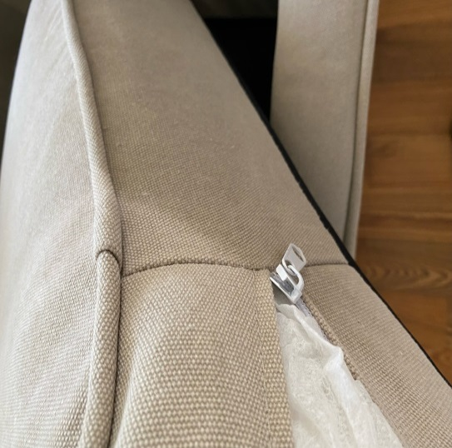
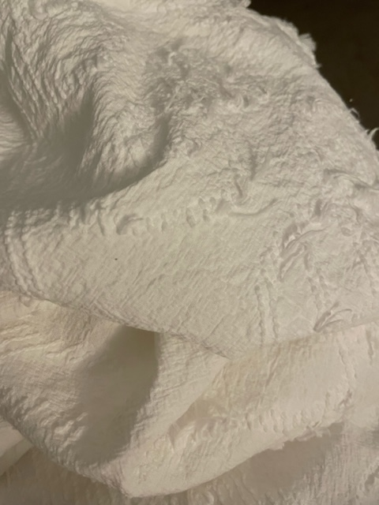
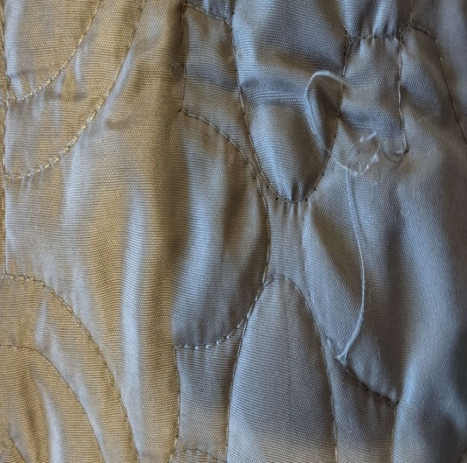
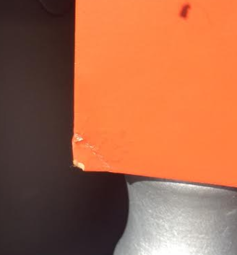
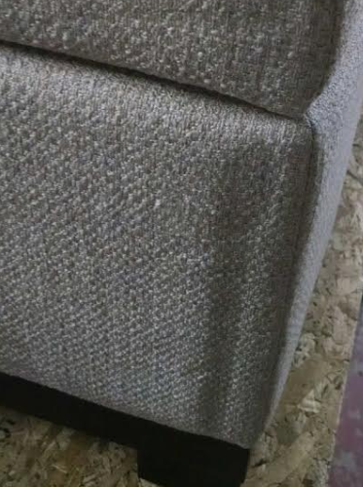
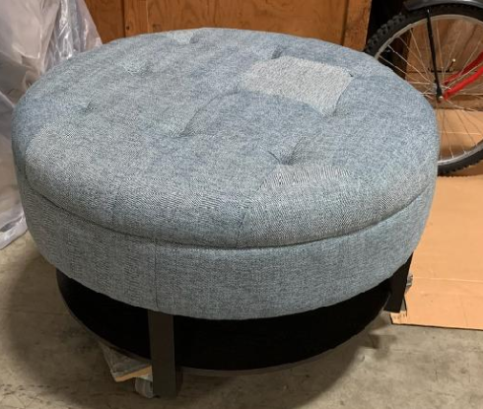
“Medium” Defect Examples – 10%
Zipper needs to be repaired
Very Dirty – Industrial washer/Dryer needed
Many loose threads
A touch up pen and sandpaper should fix this. Due to work involved – 10%
10% Discount to sell as-is
One color square is off. 10% Discount to sell as-is

Slide 9
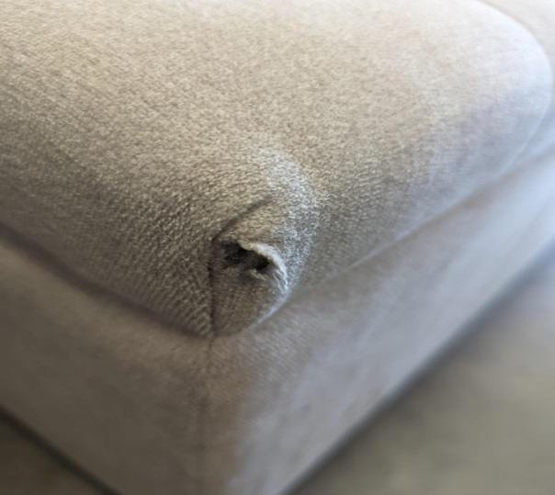
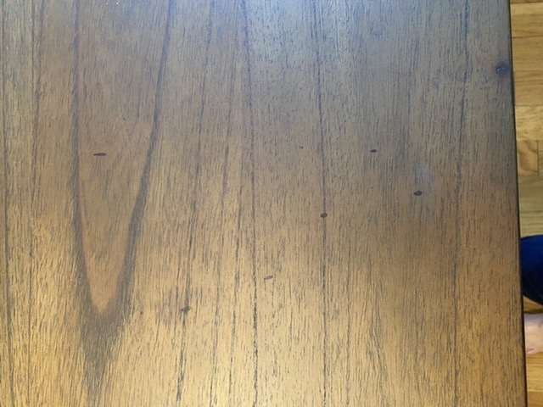
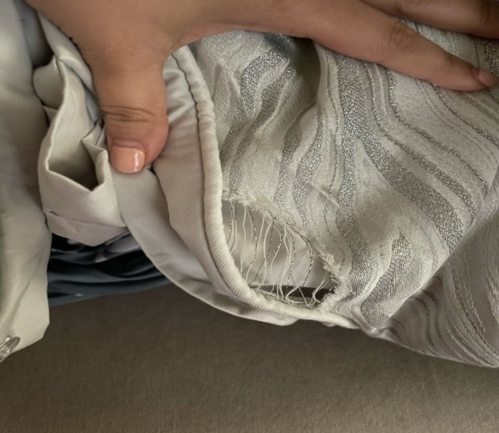
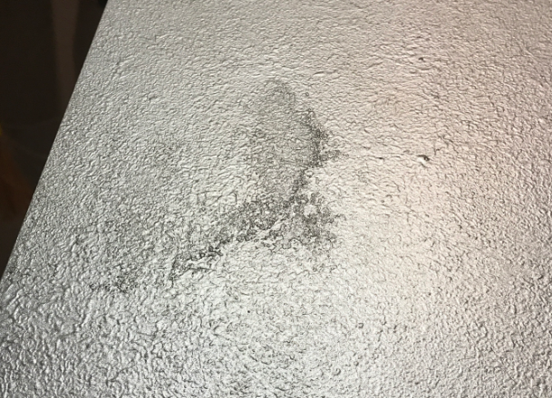
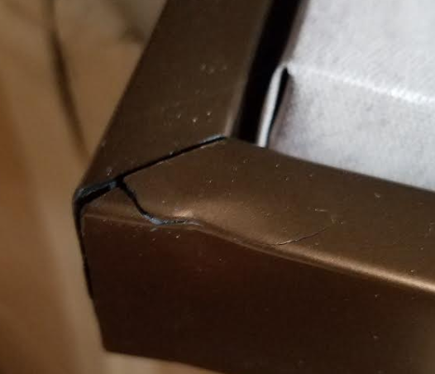
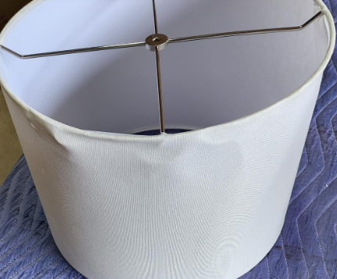
“Medium” Defect Examples – 15%
Damaged arm chair
Multiple blemishes on table
Significant tear in sham
Blemished Dresser Top
Frame is damaged on art. 15% credit so customer can obtain new frame
Lamp Shade is damaged. 15% credit so customer can repair/replace

Slide 10
Damaged/Defective Claim
Non-Carrier Related
Claim with a “major defect” (i.e. dent, major wood damage, etc.)
  Discounts must be approved as follows:
    15-20% - Approved by Lisa
    21-50% - Approved by Heather
    51%+ - Approved by Helen
EXAMPLES CAN BE FOUND ON THE NEXT SLIDE(S)

Slide 11
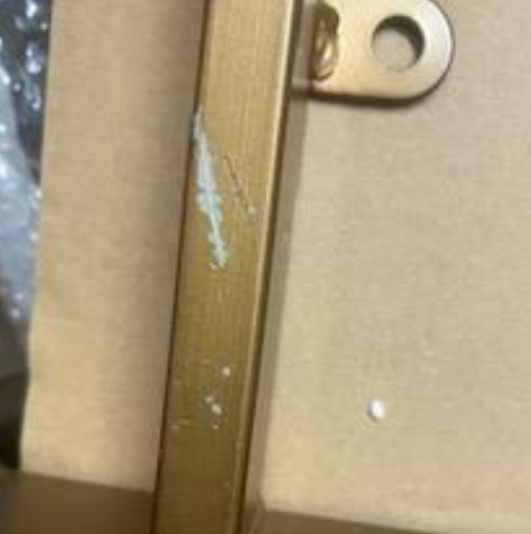

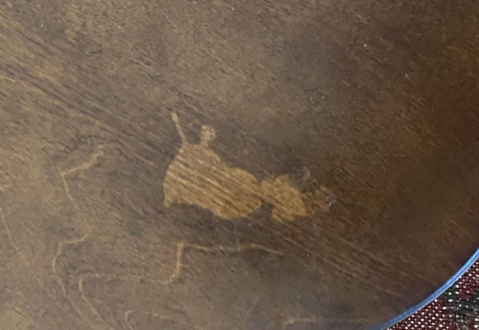
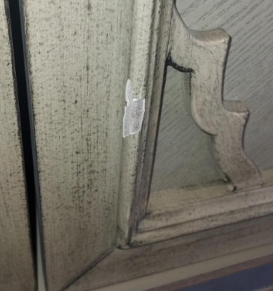
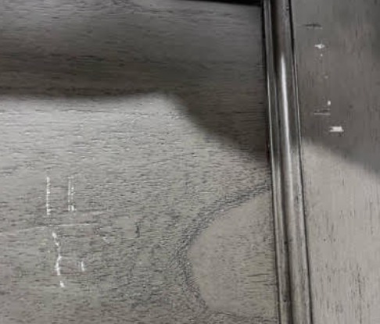
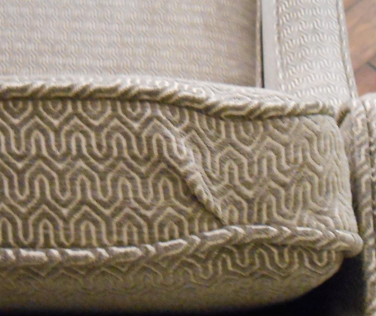
“Major” Defect Examples
20% Discount offered – Customer will have to sand off and repaint
40% Discount offered – this is a major defect and customer would have to do a lot for this to be less noticeable
20% Discount offered – Large shading difference
25% Discount offered – Originally offered 15%, but customer countered at 25% - Worth it to not have to send replacement or issue full refund
25% Discount offered – Lots of scratches the customer will have to fix themselves or sell as-is
20% Discount offered – Allows customer to sell as-is

Slide 12
Damaged/Defective Claim
Non-Carrier Related
Claim with a defect that is irreparable, meaning there is no real solution to fixing the issue other than a refund/replacement (i.e. the glass tabletop is shattered, the lamp is broken, etc).
  Soft Goods – Offer the customer a refund/replacement with proof of damage/defect.
  Hard Goods – Offer the customer a refund/replacement with proof of damage/defect.
When we are issuing a refund in full, the following approvals are necessary:
  CS ok to approve $0-$200
  Melissa ok to approve $201-$500
  Lisa ok to approve $501-$1000
  Heather ok to approve $1001+
EXAMPLES CAN BE FOUND ON THE NEXT SLIDE(S)

Slide 13
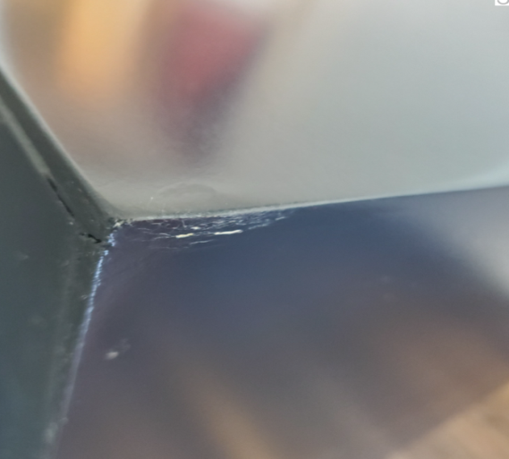
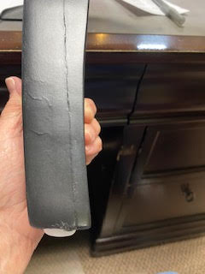
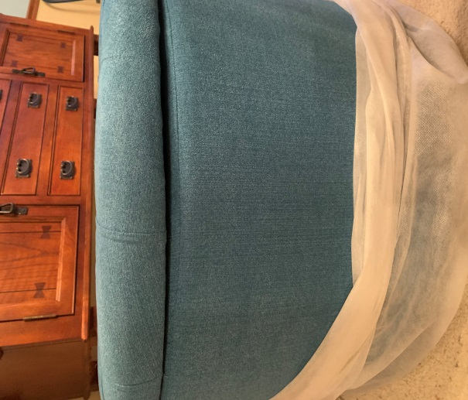
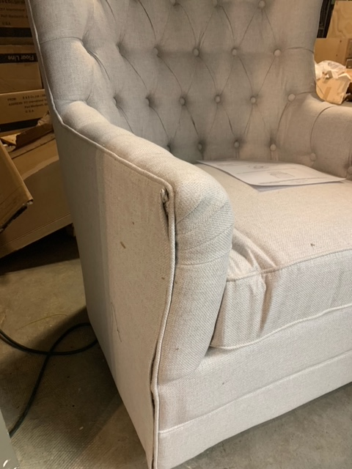
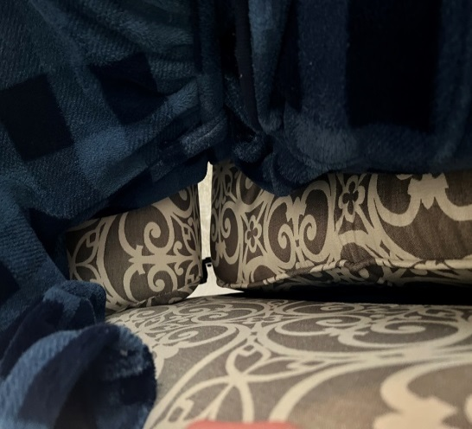
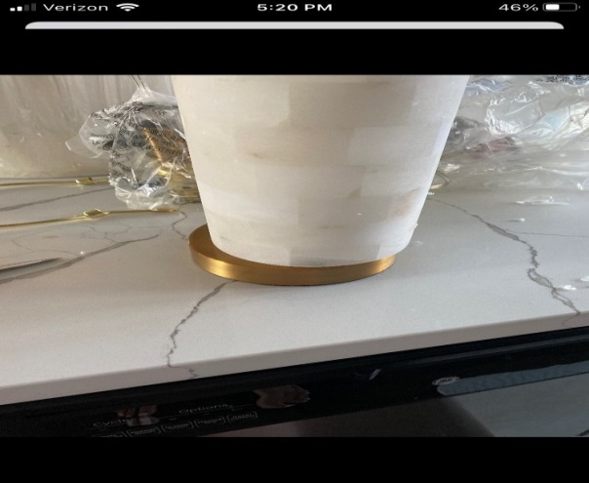
“Irreparable” Defect Examples
Welding appears to have to created clumps. Not able to repair
Leg has a crack through it. Danger to allow customer to continue to use
Ottoman top is not sitting flush to ottoman
Chair is damaged beyond repair
Visible gaps in chair. Unusable
Lamp base is off-center

Slide 14
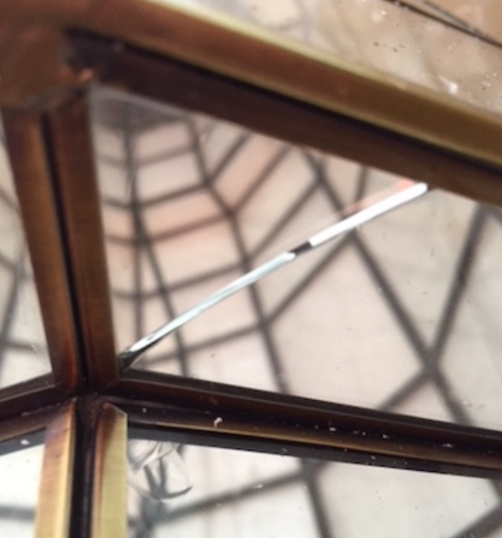
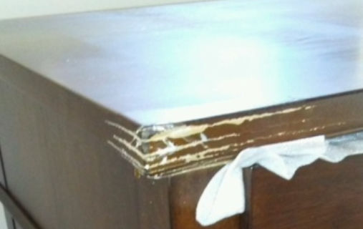
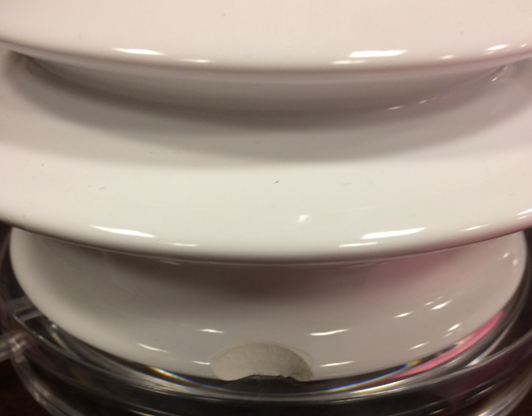
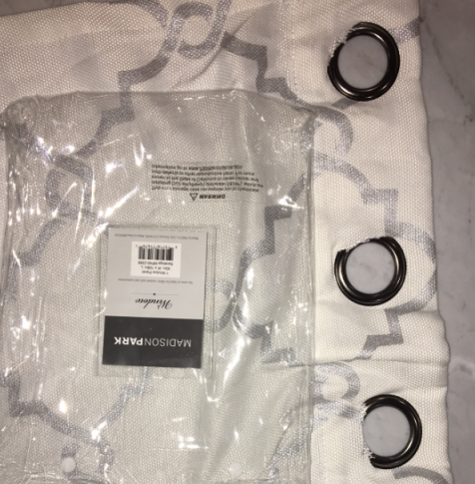
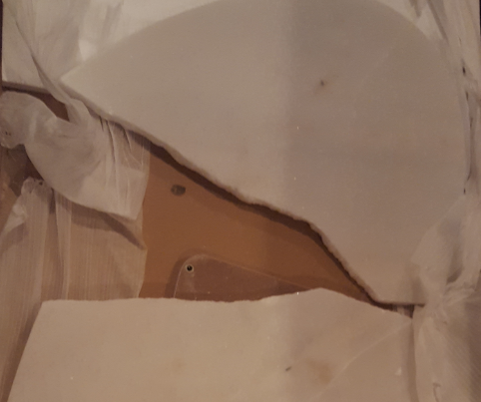
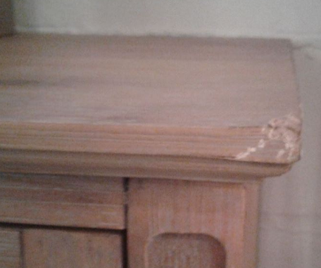
“Irreparable” Defect Examples
Glass is shattered throughout. Cannot be repaired.
Dresser is severely damaged on the top, customer facing part
Large chunk out of base
All holes have ripped material around the loops
Marble Top split in half
Top Shelf of cabinet severely damaged

Slide 15
Reporting Damaged/Missing/Wrong Items
All Damaged/Missing/Wrong items must be reported within 30-days of receipt of the item. This is to ensure we are able to 1. Correct the issue and 2. Be able to investigate with our carrier and file a claim.
  Exceptions to this rule will follow this approval schedule:
    Notified within 30 Days – CS ok to approve
    Notified within 31-90 Days – Lisa to approve
    Notified within 91-180 Days – Heather to approve
    Notified 180+ Days – Helen to approve

